Slide 1
MINOR PROJECT
O.M.G CABLE: GUIDANCE THE SECURITY & COUNTERMEASURES
EDUCATIONAL PURPOSES ONLY
I DO NOT SUPPORT ANY ATTACKS.
MINOR PROJECT STUDENTS:
SYED ABDUL MALIK(20011A0555)
MADHURIKA DAS PIYAL(20011A0550)
M. SAI HARSHITH GOUD(20011A0528)
UNDER THE GUIDENCE OF:
DR. R. SRIDEVI
PROFESSOR OF CSE, JNTUH-UCESTH

Slide 2
AGENDA
INTRODUCTION
OBJECTIVES
PROBLEM STATEMENT
PROPOSED SOLUTION
SOFTWARE AND HARDWARE REQUIRED
PROCEDURE OF MAKING O.M.G CABLE
IMPLEMENTATION
COUNTER MEASURES AGAINST O.M.G CABLE
MERITS AND DEMERITS
CONCLUSION
REFERENCES

Slide 3

INTRODUCTION
The O.MG Cable is an advanced handmade USB cable with an extremely advanced implant hidden inside.
O.MG Cables, which is an abbreviation for Offensive MG Cables, are a unique kind of USB cables that have gained popularity because they are both useful for charging and potentially dangerous to use.
The cable works like a normal USB charging cable in case of mobiles and a socket cable in case of PCs.

Slide 4
PROBLEM STATEMENT
Indeed, this is in the fast-paced world of technology where secure and dependable communication remains a necessity.
The vulnerability of our digital infrastructure is becoming evident as our world continues to become highly interconnected.
In this regard, O.MG Cables is an intriguing topic of research for understanding the vulnerabilities in information security.

Slide 5
PROPOSED SOLUTION
OMG Cable is more capable than an organization that produces cables it is a curator of connectivity experiences. Every cable of these products acts as a link and a bridge, ensuring that it is user-centered and ensures this in every product. OMG cables have evolved to be associated with reliability, speed, and innovativeness in offering various products that meet diverse demands.

Slide 6
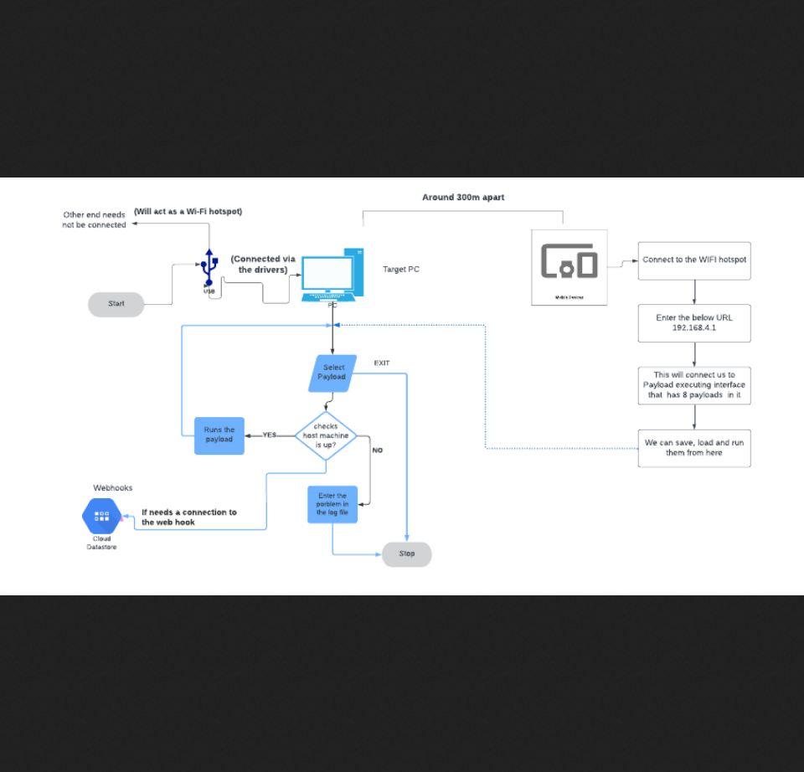
ARCHITECTURE

Slide 7
SOFTWARE AND HARDWARE REQUIRED
Software Requirements
  None (I know it sounds absurd but none!!!)
Hardware Requirements
  Processor: Intel core i3 and above
  Processor speed:1.0GHz or above
  RAM: 2GB RAM or above
  Hard Disk: 64 GB hard disk or above
  Target OS: Windows, Mac, IOS, Android, Linux, Android

Slide 8
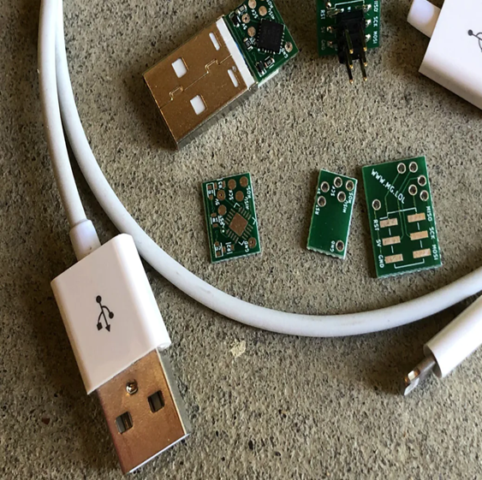
THE MAKING OF OMG CABLE
Initially, the basic components are to be gathered which includes the E-marker chips, cable, type a component, type c component, O.MG Programmer USB A+C, O.MG Cable, O.MG plug and O.MG Adapter.

Slide 9
Next, the cable is initialized with the O.MG Web Flasher, in there plug-in the cable to an electronic socket connected to a power device.
Then by connecting the open port to a USB to UART bridge controller (preferably CP2102N)will make that particular end into a translator between the two interfaces to allow a device to send/receive information on one interface and receive/send the information on the other interface.
After a dummy cable is connected from the same electronic socket to O.MG Programmer USB A+C making sure that the dummy cable is connected to the PC side and the O.MG cable is connected to the O.MG side.
This will make the A type USB side act as a wireless provider, and the other side to be the connector to the device.
These cables can be any type of phone cable, whether it’s Lightning, USB-C, USB-A, micro-USB, it doesn’t matter if it’s Apple or Android, any cable can be used for its practical implementation.

Slide 10
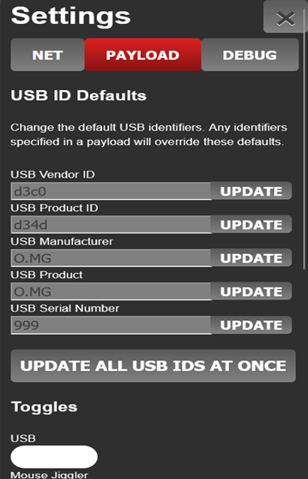
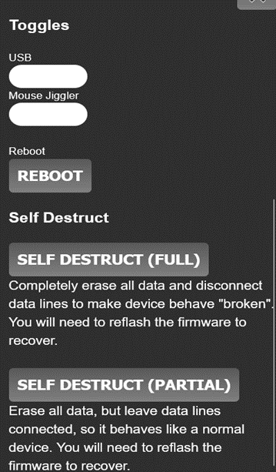
IMPLEMENTATION
CONFIGURATION
When connected to it, their path to the victim’s computer is wireless. Similar to how an attacker would connect it just like a keyboard or a dongle attached to a USB port, they can type commands into a virtual keyboard displayed on their telephone screen, read, copy and download files; In a lab environment, researchers can simulate keyboard inputs to demonstrate how a trusted USB port can be abused.

Slide 11
NEXT STEP
SETTING
After flashing firmware, unplug the O.MG Device from the programmer and plug the active end into a USB port on a USB Host device. (Ex: For * to A device, the active end is the Type A connector. For * to C devices, the active end is the Type C connector).
Then connect your controlling device (ex: your phone, or a laptop) to the O.MG's wireless network (Default SSID: O.MG, PASS: 12345678), wait for your device to get an IP, and then browse to the O.MG's IP address: http://192.168.4.1.

Slide 12
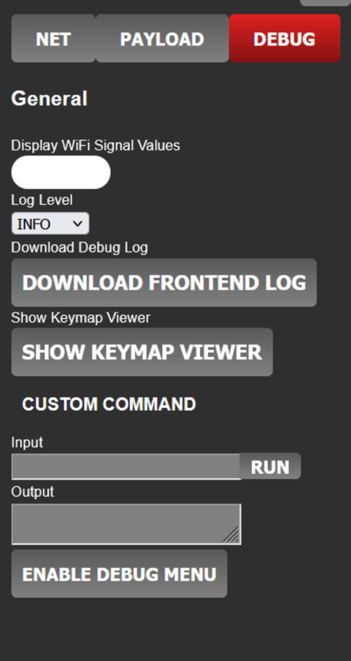
NEXT STEP
DEBUG
The SSID, Password, and toggle between AP Mode & Station Mode (AP vs Wi-Fi Client) can be changed using the settings menu in the Web UI, and during flashing if you use the python flasher
Remote debugging - Most debuggers allows connecting process from a different machine, and then debug it.
This is immensely important in debugging full screen applications or focusing sensitive ones

Slide 13
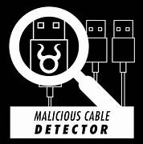
COUNTERMEASURES AGAINST OMG CABLE
MALICIOUS CABLE DETECTOR
The Malicious Cable Detector detects all known malicious USB cables. Additionally, the Detector functions as a data blocker for safe charging.
It is easy to use: plug just the cable into the Detector, then plug the Detector into your computer's USB port. LED activity indicates signs of life!

Slide 14
COUNTERMEASURE CONTD...
Unified Endpoint management (UEM)
UEM solutions have security features that ensure protection of corporate information from insecure device use or other security threats.
UEM features
-USB file transfer control
-Files app USB drive access
-Accessing network drive within Files app.
-Media Management
-Restrict admin users only for the app installation
-Administrators can use iOS feature called "prevention of pairing with non- configuration hosts” to restrict the devices that a given user is allowed to connect to.

Slide 15

IMPACT ON CYBERSECURITY LANDSCAPE:
  Arms Race Dynamics:
  The development of tools like O.MG CABLES may contribute to an arms race in cybersecurity, where new tools are developed in response to perceived threats, potentially escalating the complexity of cyber-attacks.
  It can be used in public places as a form of OSINT for recognition , Recon and likewise.

Slide 16
MERITS AND DEMERITS
MERITS:
Security Awareness
Penetration testing
Research and Development
Red Team Implementation

Slide 17

DEMERITS:
Unauthorized Access
Ethical Considerations
Legitimate Use Confusion
Legal Implication
Security Concerns
Misuse of Educational Intent

Slide 18
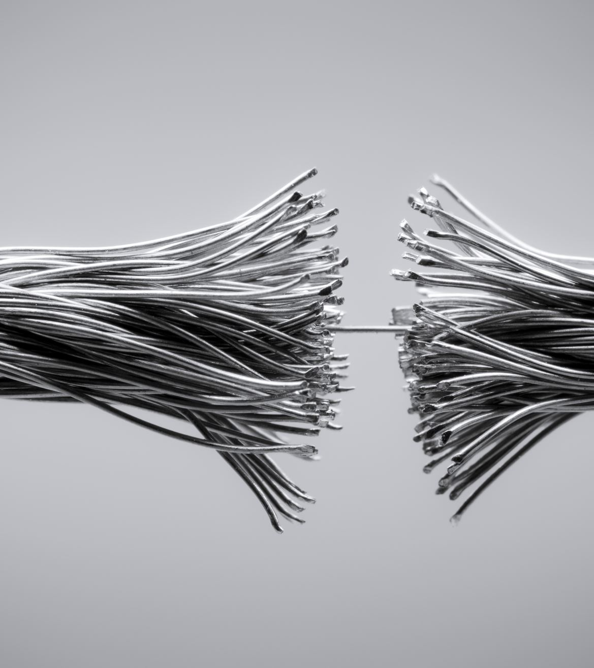
CONCLUSION
In this journey of discovery, it becomes evident that technological advancements bring not only opportunities but also challenges. The responsible development and use of cybersecurity tools are imperative to strike a balance between innovation and protection. The knowledge gained from unveiling the security implications of O.MG CABLES will undoubtedly contribute to the ongoing dialogue on safeguarding our digital environments.

Slide 19

REFERENCES
  A Defcon Blog 2019, that was Pitched by MG(one of the Developers) https://mg.lol/blog/defcon-2019/
  A LinkedIn post by Steven Evans, who is the Wireless, Telecom and IOT business development leaderhttps://www.linkedin.com/in/sde1952/
  Kawaii guy, DC-RIOT domain Provider and Moderator.
  Chengii Liu1, Yufan Tao1, Sawel Liang1, Kai Li 1. Yi Hang Chen1, object detection based on YOLO network in 2019 IEEE 4th information technology and mechatronics engineering conference
  [ITOEC] https//ieee.explorer.ieee.org/org/document/8851911
  Troy , RF Hacker - Physec Engineer - UAVs & UAPs
  Aamir, Consolidated Electronic Wire & Cable
  Ø1phor1³ , O.MG developer and Moderator

Slide 20
THANK YOU
Final Reminder: This project is for educational awareness only.
I do not support any attacks.
Never test on systems you do not own.

