Slide 1

Final Project Report
Cybersecurity Capstone: CYB 6500 CAP1

Slide 2

The Problem: Evolving Cyber Threats
Organizations face sophisticated threats like APTs, ransomware, and nation-state tactics. Traditional security often reacts too late, triggering alerts only post-damage.
Insufficient Insight
Honeypot Detection
Existing honeypots offer limited insight into attacker methodologies.
Many honeypots are easily detected via tools like Shodan, diminishing effectiveness.
Critical Vulnerabilities
Sectors like finance, defense, and healthcare remain susceptible to targeted attacks.

Slide 3






Our Solution: Stealth-Capable Honeypot System
Our project offers a solution with a stealth-capable honeypot system, designed to resist detection through anti-fingerprinting and realistic service emulation.
Anti-Fingerprinting
Techniques to avoid detection by sophisticated attackers.
Realistic Emulation
Mimicking real services to lure and analyze threats.
Attack Path Reconstruction
Visualizing attacker movements and timelines.
Government Module
Exclusive backtracking module for attribution and counter-engagement.

Slide 4





Improvement Opportunities: Smart Honeypot Network
The Smart Honeypot Network enhances cybersecurity by creating an intelligent, deceptive environment for attackers, providing proactive insights.
Capture Attacker Behavior
Undetectable Honeypots
Reconstruct attack paths with visual timelines.
Mimic real services to attract and analyze malicious activities.
Actionable Threat Intelligence
Reports aligned with the MITRE ATT&CK framework.
Stealth-Capable
Resist detection through anti-fingerprinting and realistic emulation.
Analyst Dashboard
Centralize intelligence for effective monitoring and response.

Slide 5

Business Case: Proactive Threat Intelligence
The Smart Honeypot System transforms reactive defenses into proactive threat intelligence platforms, delivering high ROI.
Reduced Remediation Costs
Early detection shortens unresponsiveness, reducing breach remediation costs by an estimated 30–40%.
Improved Incident Response
Reconstruct attack paths and map behaviors to MITRE ATT&CK Framework, refining defensive playbooks.
The government-exclusive backtracking module supports attribution, deterring future attacks and safeguarding critical infrastructure.

Slide 6
Project Scope: Comprehensive Honeypot Network
Setting up a comprehensive honeypot network, from research to advanced analytics and a government-exclusive backtracking module.
01
02
03
Research & Design
Deployment & Optimization
Advanced Analytics
Extensive research into honeypot technologies and network topology design.
Deploying various honeypot services (SSH, SMB, web, databases) with robust logging.
Developing tools to reconstruct attack paths and generate threat intelligence reports.
04
05
Analyst Dashboard
Backtracking Module
Creation of a dashboard for enhanced security operations.
Proposal for a specialized, government-exclusive module for attribution.

Slide 7

Key Deliverables
Tangible outputs showcasing the project's capabilities and future potential.
1
2
Live Honeypot Network
Attack Path Dashboard
Operational network capturing attacker traffic, resisting detection.
Dynamic visualization of attacker actions and timelines.
3
4
Threat Intelligence Reports
ROI Analysis
Actionable reports with MITRE ATT&CK mapping.
Quantifying economic benefits of early threat detection.
5
6
Backtracking Module Outline
Deployment Guide & Report
Structured plan for government-grade attribution capabilities.
Comprehensive documentation of project objectives and methodology.

Slide 8

Project Timeline: Four-Month Development
A systematic approach ensured each phase built upon the previous one, leading to a robust and intelligent honeypot system.
Month 1: Research & Setup
1
Extensive study of honeypot technologies and network topology design. Isolated lab environment setup.
2
Month 2: Deployment & Monitoring
Deployment of honeypot services (web, SSH, SMB, DB) and establishment of logging/monitoring infrastructure.
Month 3: Advanced Analytics
3
Development of attack path visualization tools (e.g., Neo4j) for graphical representation of attacker movements.
4
Month 4: Refinement & Documentation
User-friendly analyst dashboard, optimized detection algorithms, and simulated backtracking workflow.

Slide 9
Project Tracking & Success Metrics
Functional Honeypot
Live traffic capture
100% operational status
Attack Path Dashboard
Distinct paths visualized
Visualization of 3+ paths
ATT&CK Reports
Report generation
Accurate ATT&CK mapping
Analyst Dashboard
Dashboard functionality
Full timeline reconstruction
Backtracking Proposal
Completion & detail
Comprehensive proposal
Project Documentation
Completed project
Delivered within 4 months

Slide 10

Project Outcomes & Lessons Learned
The Smart Honeypot project successfully built and evaluated a sophisticated honeynet environment, enhancing early warning capabilities.
Key Outcomes
Lessons Learned
Deployment of diverse honeypots.
Continuous tuning for anti-fingerprinting techniques.
Effective capture and analysis of attacker behaviors.
Managing large data volumes for logging and retention.
Actionable threat intelligence reports (MITRE ATT&CK aligned).
Complexity of correlating attack sessions.
Critical legal and ethical considerations for backtracking module.
Functional analyst dashboard with timeline visualization.

Slide 11
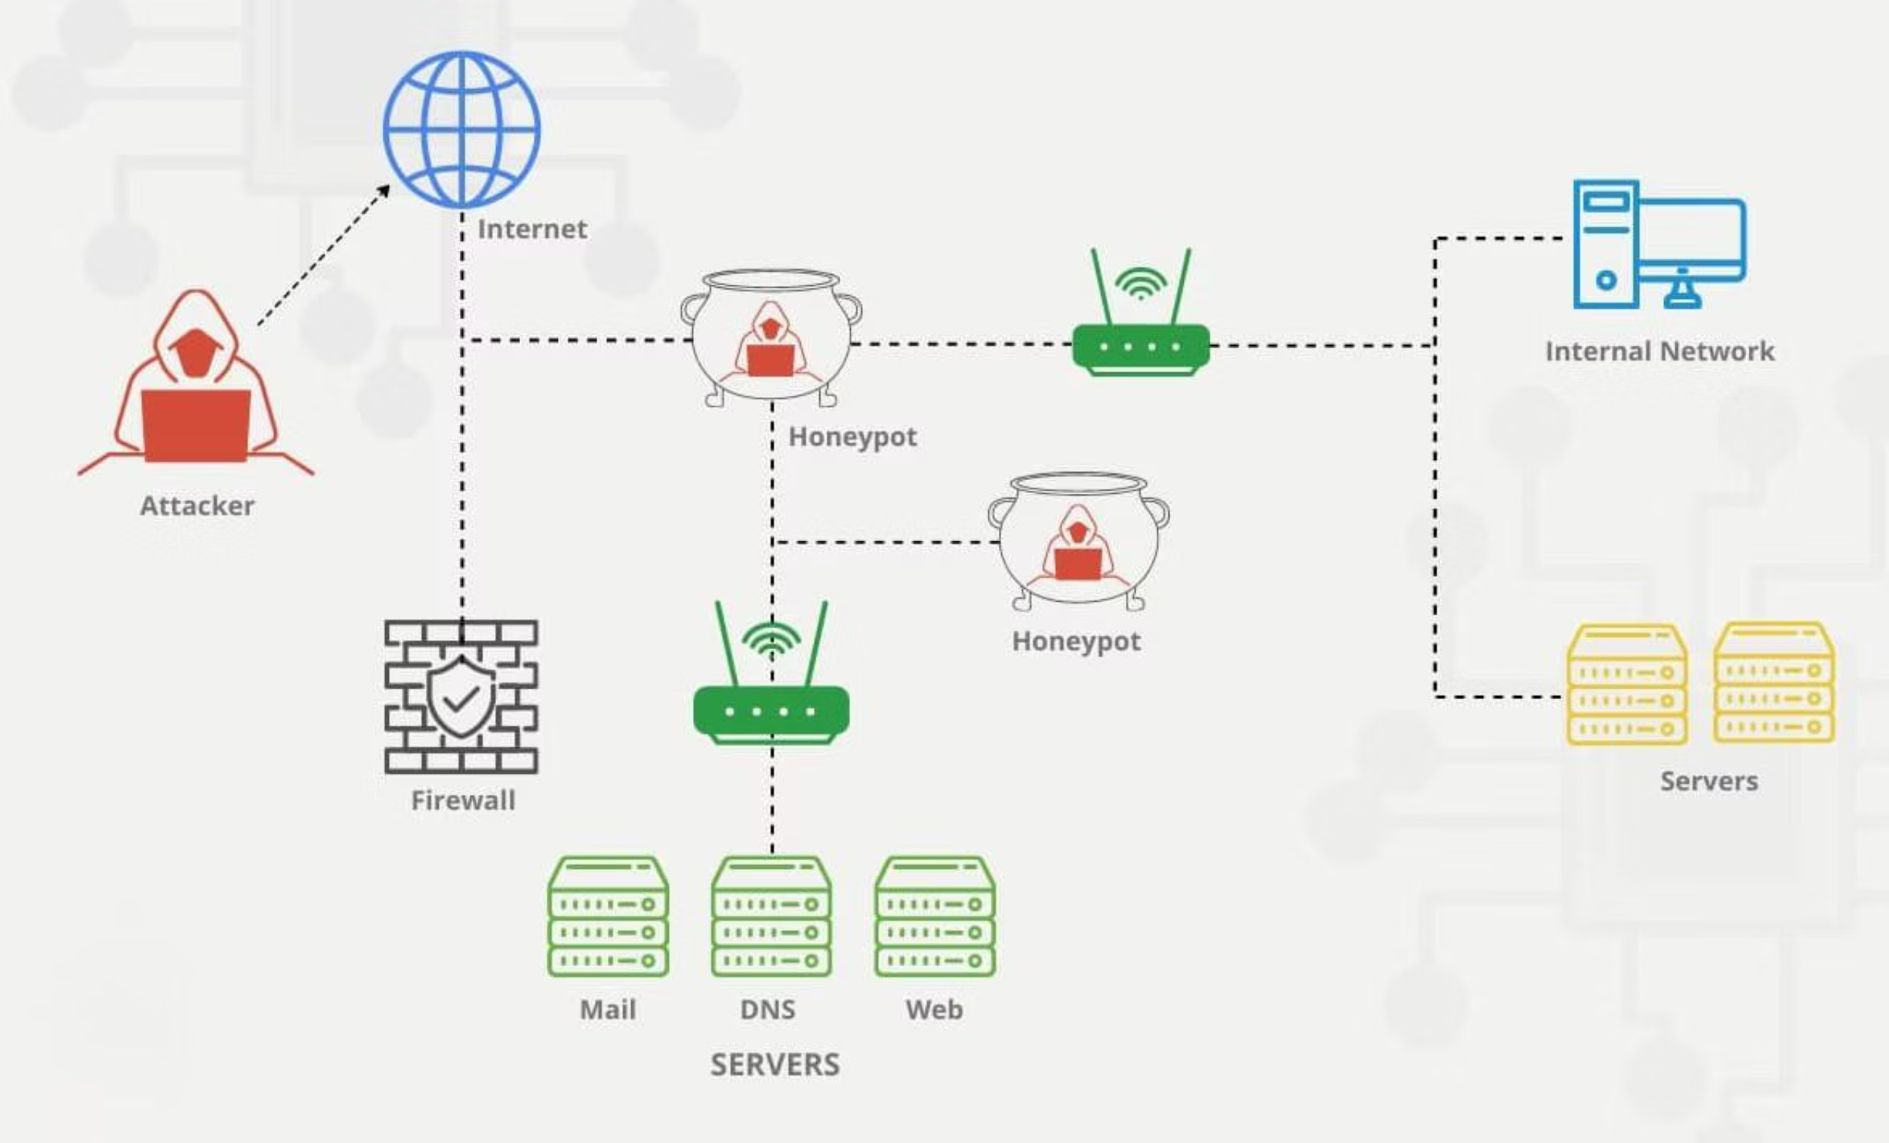
Honeypot Network

