Slide 1
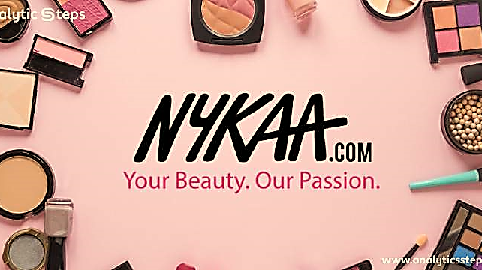









Table of
Contents
31 Dec 2024
Analysis
Presented by: Mr. S. Syed Ibrahim, Batch Code: MBT16
Notes:
https://www.freepik.com/free-ai-image/photorealistic-timber-house-interior-with-wooden-decor-furnishings_152371631.htm

Slide 2
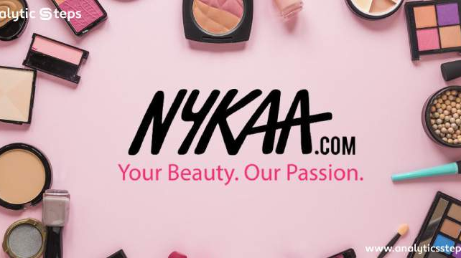




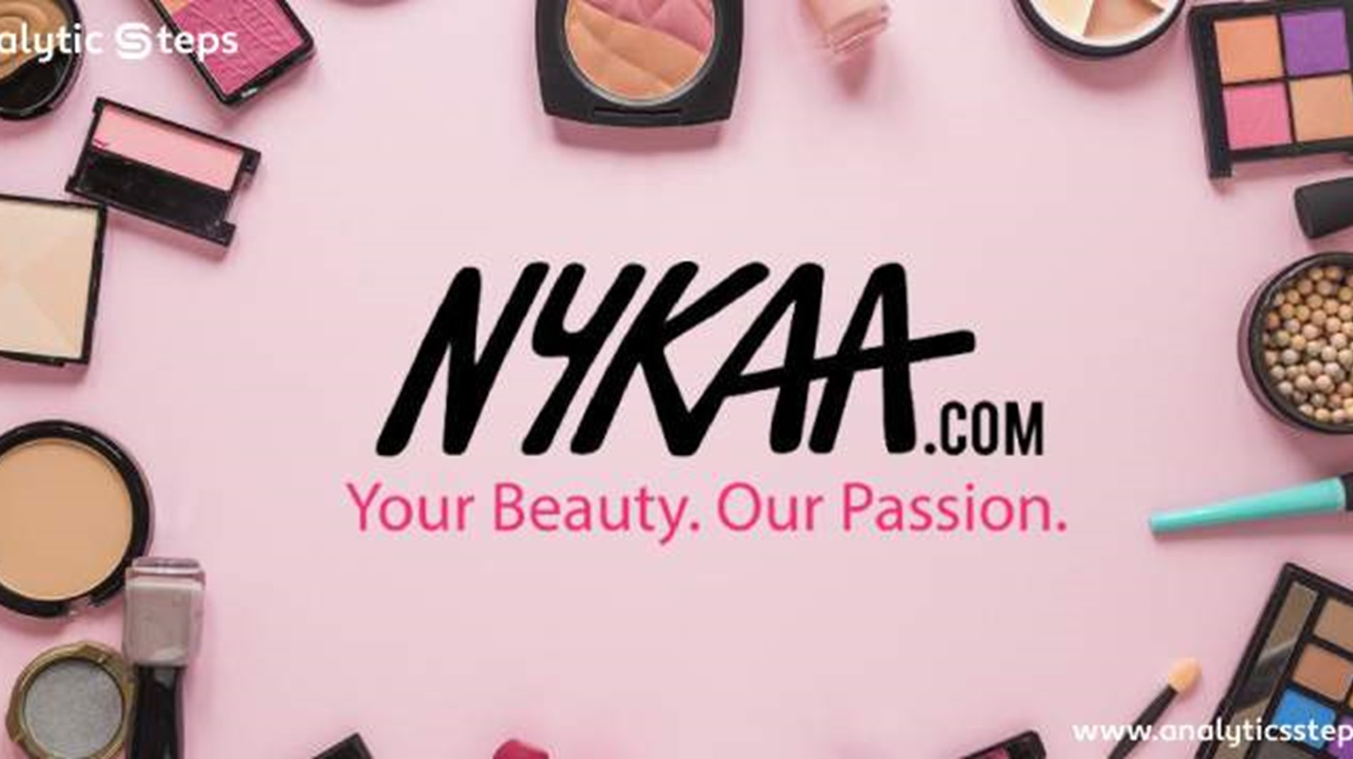

Table of
Contents
31 Dec 2024
Presented by: Mr. S. Syed Ibrahim, Batch Code : MBT16
Notes:
https://www.freepik.com/free-ai-image/photorealistic-timber-house-interior-with-wooden-decor-furnishings_152371631.htm

Slide 3

Thank You

Slide 4
Introduction

Slide 5

Introduction
Nykaa is a prominent Indian e-commerce company specializing in beauty, wellness, and fashion products. Founded in 2012 by Falguni Nayar, a former investment banker, Nykaa has emerged as one of the leading players in the beauty and fashion industry in India. The name "Nykaa" is derived from the Sanskrit word "Nayaka," meaning "heroine," reflecting the brand's vision to empower individuals through beauty and self-expression.

Slide 6
Business
Model

Slide 7
Business
Model
Nykaa operates on an inventory-led business model and a marketplace model, ensuring high-quality and authentic products. It has expanded into an omnichannel strategy, combining online and offline retail experiences:
Online Platform: Nykaa.com and the Nykaa app offer a vast selection of over 2,500 brands and 200,000+ products.
Offline Stores: More than 100 retail stores across India, including Nykaa Luxe and Nykaa On Trend, cater to premium and trending beauty products.

Slide 8
Key
Concept

Slide 9
Key Categories Beauty: Makeup, skincare, haircare, fragrances, and personal care. Wellness: Supplements, health products, and fitness gear. Fashion: Apparel, footwear, and accessories under the Nykaa Fashion division. Private Labels: Nykaa Cosmetics, Nykaa Naturals, and Kay Beauty (collaboration with Bollywood actress Katrina Kaif).
Concept
Key
Financial Success Nykaa went public in November 2021 with an IPO (Initial Public Offering) and became one of India's first profitable unicorns in the beauty and fashion space. Its stock is listed on the National Stock Exchange (NSE) and Bombay Stock Exchange (BSE).
Sustainability Initiatives
Nykaa has made strides toward sustainability, including: Nykaa Naturals: Promoting clean and eco-friendly beauty. Recycling Programs: Initiatives to recycle beauty product packaging.
Challenges and Competitors Despite its success, Nykaa faces challenges like increasing competition from brands like Purplle, Myntra, and Amazon Beauty. Moreover, retaining customer loyalty in the fast-evolving e-commerce market is crucial.
Core Strategies
Digital-First Approach: Nykaa leverages its digital presence with engaging content, including tutorials, reviews, and influencer collaborations.
Customer Engagement: Nykaa’s YouTube channel and blog "Nykaa Network" provide beauty advice and trends, enhancing user experience.
Omnichannel Expansion: A balance between online and offline retail ensures wider customer reach.
Private Labels: Strong focus on in-house brands contributes significantly to revenue.

Slide 10
Competitive
Analysis

Slide 11
Competitive
Analysis
Competitor Identification
Product Range Comparison
Pricing Strategies
&
Sustainability Practices
Omnichannel Presence
&
Customer Reviews and Feedback
Brand Positioning and Marketing
Customer Experience
Technological Innovations
Market Reach

Slide 12
Product Range
Competitors:
Myntra Beauty: Offers a mix of high-end and affordable beauty products with an emphasis on fashion integration.
Purplle: Primarily focuses on budget-friendly beauty and wellness products, targeting Tier 2 and Tier 3 cities.
Amazon/Flipkart Beauty: Extensive product range but lacks curated and premium exclusivity.
Sephora India: Caters to high-end luxury beauty enthusiasts, offering premium international brands.
Nykaa:
Comprehensive range including luxury, mid-tier, and budget categories.
Strong in-house brands (Nykaa Cosmetics, Kay Beauty) with a growing portfolio in skincare, cosmetics, and wellness.
Differentiation:
USP: Private labels that offer affordability and quality.
Opportunity: Launch more region-specific products, such as Ayurvedic or eco-conscious lines for niche markets.

Slide 13
Competitive
Analysis
Competitor Identification
Product Range Comparison
Pricing Strategies
&
Sustainability Practices
Omnichannel Presence
&
Customer Reviews and Feedback
Brand Positioning and Marketing
Customer Experience
Technological Innovations
Market Reach

Slide 14
Online and Offline Integration (Omnichannel)
Competitors:
Myntra and Tata CliQ: Omnichannel presence with features like in-store returns and product availability checks.
Zara and Reliance Trends: Allow checking in-store availability online but have limited beauty product offerings.
Nykaa:
Strong omnichannel strategy with Nykaa Luxe and Nykaa On Trend stores.
Online platform integrates seamlessly with physical store operations.
Differentiation:
USP: Exclusive physical stores dedicated to beauty and wellness, with premium interiors for a luxurious experience.
Opportunity: Enhance the "Check In-Store Availability" feature for real-time updates and introduce in-store exclusive benefits for online buyers.

Slide 15
Competitive
Analysis
Competitor Identification
Product Range Comparison
Pricing Strategies
&
Sustainability Practices
Omnichannel Presence
&
Customer Reviews and Feedback
Brand Positioning and Marketing
Customer Experience
Technological Innovations
Market Reach

Slide 16
Technological Innovation
Competitors:
Sephora: Virtual try-on tools and personalized beauty consultations online.
Amazon: AI-driven personalized recommendations based on browsing and purchase history.
Purplle: Uses AI to provide curated beauty kits for budget-conscious users.
Nykaa:
Personalized recommendations based on AI and analytics.
Active content creation (blogs, tutorials, YouTube) to engage users.
Differentiation:
USP: High engagement through the Nykaa Network community and influencer collaborations.
Opportunity: Introduce AR/VR-powered virtual consultations and gamified experiences to drive deeper customer engagement.

Slide 17
Competitive
Analysis
Competitor Identification
Product Range Comparison
Pricing Strategies
&
Sustainability Practices
Omnichannel Presence
&
Customer Reviews and Feedback
Brand Positioning and Marketing
Customer Experience
Technological Innovations
Market Reach

Slide 18
Customer Engagement and Loyalty
Competitors:
Myntra and Amazon: Large-scale loyalty programs (Myntra Insider, Amazon Prime).
Sephora: Industry-leading loyalty program (Beauty Pass) offering exclusive benefits for repeat customers.
Nykaa:
Nykaa’s reward program provides discounts and early access to sales.
Strong presence on social media with active influencer collaborations.
Differentiation:
USP: Influencer marketing focused on regional and micro-influencers.
Opportunity: Expand loyalty programs with tier-based rewards, subscription boxes, and exclusive early access to product launches.

Slide 19
Competitive
Analysis
Competitor Identification
Product Range Comparison
Pricing Strategies
&
Sustainability Practices
Omnichannel Presence
&
Customer Reviews and Feedback
Brand Positioning and Marketing
Customer Experience
Technological Innovations
Market Reach

Slide 20
Sustainability Initiatives
Competitors:
Sephora: Promotes "Clean at Sephora" for eco-conscious products.
Amazon: Focuses on reducing carbon footprints with initiatives like "Frustration-Free Packaging."
Purplle: Limited visibility on sustainability efforts.
Nykaa:
Promotes Nykaa Naturals and has introduced eco-friendly packaging options.
Differentiation:
USP: Private labels with clean and cruelty-free formulations.
Opportunity: Launch a "Sustainable Beauty" category and expand recycling programs for product packaging

Slide 21
Competitive
Analysis
Competitor Identification
Product Range Comparison
Pricing Strategies
&
Sustainability Practices
Omnichannel Presence
&
Customer Reviews and Feedback
Brand Positioning and Marketing
Customer Experience
Technological Innovations
Market Reach

Slide 22
Market Reach
Competitors:
Amazon/Flipkart: Wide market reach with strong logistics in rural areas.
Purplle: Focused penetration in Tier 2 and Tier 3 cities.
Sephora: Limited to metro cities, catering to high-income groups.
Nykaa:
Dominant in metro cities with growing penetration in smaller towns.
Differentiation:
USP: Balanced focus on premium and budget-friendly categories.
Opportunity: Expand retail stores in Tier 2 and Tier 3 cities with smaller formats and more localized marketing.

Slide 23
Strategic
recommendations

Slide 24
Strategic
recommendations
Enhance Data-Driven Decision-Making :
Customer Insights: Use advanced analytics to segment customers based on preferences, purchasing behavior, and demographics. Develop targeted campaigns and personalized product recommendations.
Sales Analytics: Analyze sales trends to identify high-demand products and optimize inventory management.
Predictive Analytics: Implement AI/ML models to forecast trends, customer needs, and inventory demand during peak seasons or promotions.
Strengthen Omnichannel Presence
Unified Shopping Experience: Develop a seamless shopping experience by integrating online and offline touchpoints. Allow customers to:
Buy online and return in-store.
Check in-store product availability online.
Augmented Reality (AR): Introduce virtual try-on features for makeup, fashion, and accessories on mobile and in-store kiosks

Slide 25
Strategic
recommendations
Expand Private Label Offerings
Affordable Luxury: Introduce mid-tier private label products to target price-sensitive customers in Tier 2 and 3 cities.
Specialized Products: Develop exclusive lines for niche needs like organic skincare, vegan beauty, or gender-neutral cosmetics.
Focus on Sustainability and Ethical Practices
Sustainable Packaging: Shift toward biodegradable or reusable packaging for all private label products.
Green Supply Chain: Partner with eco-friendly suppliers and adopt sustainable logistics practices.
Carbon Neutrality: Highlight corporate responsibility by achieving measurable carbon reduction goals.
Leverage Technology for Personalization
AI-Driven Personalization: Enhance the website and app with AI to provide curated product recommendations and tailored offers.
Chatbots: Deploy AI-powered chatbots for instant customer support and product guidance.
Gamification: Use gamified elements like loyalty rewards, quizzes, and interactive tutorials to keep customers engaged

Slide 26
Strategic
recommendations
Increase Market Penetration in Untapped Regions
Tier 2 and Tier 3 Cities:
Customize pricing and offers for these markets.
Focus on educating customers about beauty and wellness with regional language campaigns.
Physical Store Expansion: Open smaller-format stores to establish brand presence in smaller towns.
Partner with Emerging Brands and Influencers
Exclusive Launches: Collaborate with emerging beauty brands for exclusive product launches.
Influencer Marketing: Partner with micro-influencers to target specific customer groups, as they drive higher engagement than macro-influencers.
Loyalty and Subscription Programs
Loyalty Program Enhancements: Introduce tier-based rewards to retain high-value customers and incentivize frequent purchases.
Subscription Boxes: Launch curated monthly subscription boxes for beauty and wellness, offering samples or full-size products

Slide 27
Strategic
recommendations
Improve Operational Efficiency
Inventory Optimization: Implement demand forecasting models to avoid stockouts and overstocking.
Last-Mile Delivery: Partner with hyper-local delivery services to ensure fast delivery, especially for high-demand urban areas.
Enhance International Presence
Global Expansion: Identify high-potential international markets with large Indian diaspora populations.
Localized Marketing: Customize product offerings and marketing strategies to cater to regional preferences.
Strengthen Cybersecurity and Trust
Data Privacy: Build robust mechanisms to ensure customer data protection and compliance with privacy regulations.
Trust-Building: Highlight Nykaa's commitment to selling authentic, high-quality products.
Innovate Customer Engagement Strategies
Live Shopping Events: Host live beauty tutorials or product launches on the Nykaa app and social media.
Community Building: Create forums where customers can share beauty tips and reviews, enhancing the brand's trust and visibility.

