Slide 1
ASSEMBLY LANGUAGE
BSCS/BSSE

Slide 2
Computing Machines
General purpose: servers, desktops, laptops, PDAs, etc.
Special purpose: cash registers, ATMs, games, Mobile Phones, etc.
Embedded: cars, door locks, printers, digital players, industrial machinery, medical equipment, etc.
Distinguishing Characteristics
Speed
Cost
Ease of use, software support & interface
Scalability

Slide 3
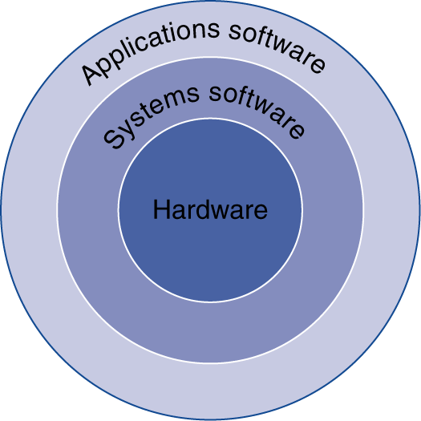
Inside the Computer
Application software
Written in high-level language
System software
Compiler: translates HLL code to machine code
Operating System: service code
Handling input/output
Managing memory and storage
Scheduling tasks & sharing resources
Hardware
Processor, memory, I/O controllers

Slide 4
A Programmer’s View of a Computer
Application Programs
Machine-independent
Machine-Specific
High-Level Languages
High-Level Languages
Low-Level Language
Assembly Language
Machine Language
Micro program Control
Hardware

Slide 5
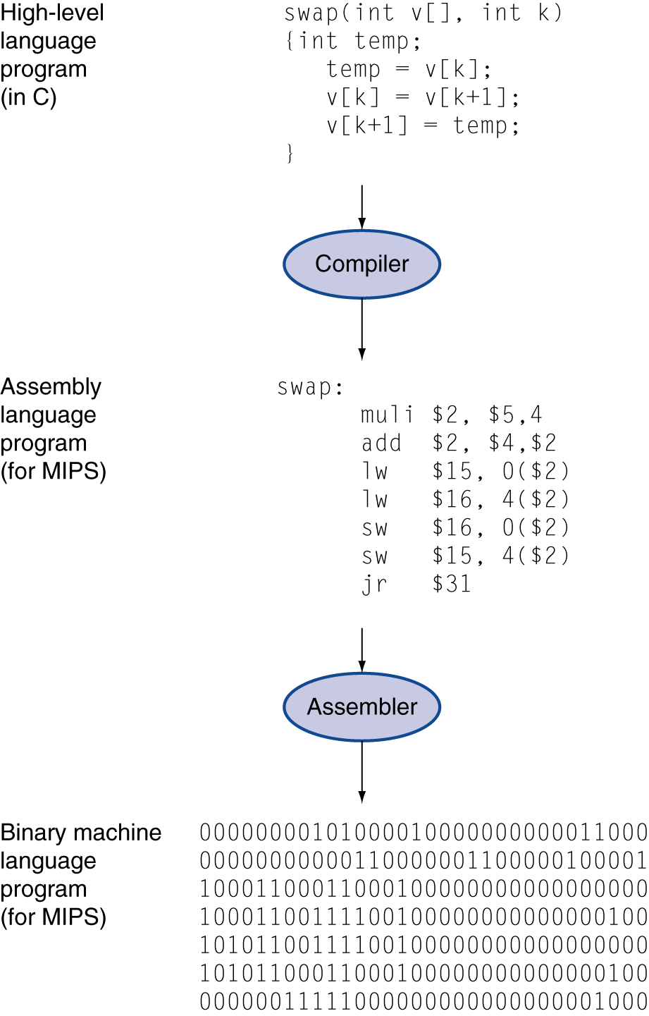
Levels of Program Code
High-level language
Level of abstraction closer to problem domain
Provides productivity and portability
Assembly language
Textual representation of instructions
Hardware representation
Binary digits (bits)
Encoded instructions and data

Slide 6
Detailed Anatomy of a Computer
Processor (CPU)
Control Unit
Common Bus (address, data & control)
Datapath
Arithmetic Logic Unit (ALU)
Registers
Memory
Program Storage
Data Storage
Output Units
Input Units

Slide 7
Anatomy of a Computer: CPU
The brain of a Computer System
Processor (CPU)
Decodes and monitors the execution of instructions.
Controls flow of information in CPU, memory, I/O devices:
System clock (Intel® Core™ I7-720QM Processor (1.6GHz, turbo up to 2.8GHz, 6MB L3 Cache))
Maintains a register called program counter(PC)
Control Unit
Datapath
Arithmetic Logic Unit (ALU)
Registers
ALU: performs all arithmetic computations & logic evaluations.
Registers: storage location in CPU, used to hold data or a memory address during the execution of an instruction..

Slide 8
Anatomy of a Computer: Common Bus
A group of conducting wires that allow signals to travel from one point to another:
Address bus: the location of data in memory or I/O devices
Data bus: carry data in & out from CPU
Control bus: control the operation of the CPU
Common Bus (address, data & control)

Slide 9
A Hierarchy of Languages
Application Programs
Machine-independent
Machine-Specific
High-Level Languages
High-Level Languages
Low-Level Language
Assembly Language
Machine Language
Microprogram Control
Hardware

Slide 10
Assembly and Machine Language
Machine language
Native to a processor: executed directly by hardware
Instructions consist of binary code: 1s and 0s
Assembly language
A programming language that uses symbolic names to represent operations, registers and memory locations.
Slightly higher-level language
Readability of instructions is better than machine language
One-to-one correspondence with machine language instructions
Assemblers translate assembly to machine code
Compilers translate high-level programs to machine code
Either directly, or
Indirectly via an assembler

Slide 11
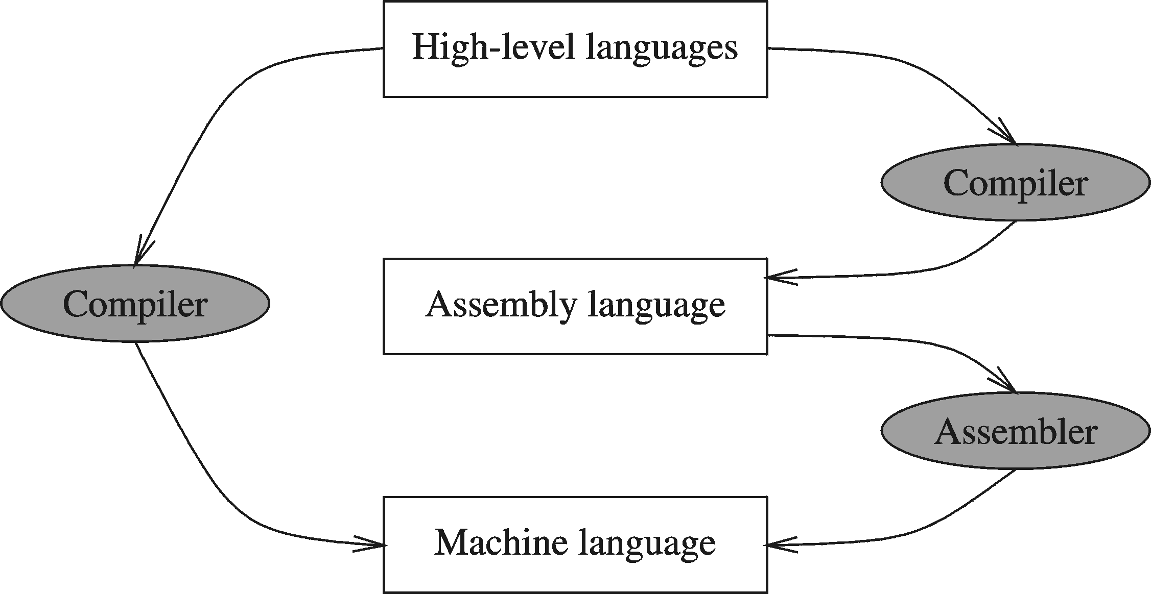
Compiler and Assembler

Slide 12
Instructions and Machine Language
Each command of a program is called an instruction (it instructs the computer what to do).
Computers only deal with binary data; hence the instructions must be in binary format (0s and 1s) .
The set of all instructions (in binary form) makes up the computer's machine language. This is also referred to as the instruction set.

Slide 13
Instruction Fields
Machine language instructions usually are made up of several fields. Each field specifies different information for the computer. The major two fields are:
Opcode field which stands for operation code and it specifies the particular operation that is to be performed.
Each operation has its unique opcode.
Operands fields which specify where to get the source and destination operands for the operation specified by the opcode.
The source/destination of operands can be a constant, the memory or one of the general-purpose registers.

Slide 14
Translating Languages
English: D is assigned the sum of A times B plus 10.
High-Level Language: D = A * B + 10
A statement in a high-level language is translated typically into several machine-level instructions
Intel Assembly Language:
mov eax, A
mul B
add eax, 10
mov D, eax
Intel Machine Language:
A1 00404000
F7 25 00404004
83 C0 0A
A3 00404008

Slide 15
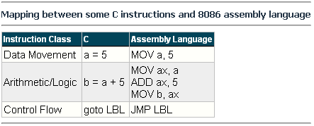
Mapping Between Assembly Language and HLL
Translating HLL programs to machine language programs is not a one-to-one mapping
A HLL instruction (usually called a statement) will be translated to one or more machine language instructions

Slide 16
Advantages of High-Level Languages
Program development is faster
High-level statements: fewer instructions to code
Program maintenance is easier
For the same above reasons
Programs are portable
Contain few machine-dependent details
Can be used with little or no modifications on different machines
Compiler translates to the target machine language
However, Assembly language programs are not portable

Slide 17
What is Assembly Language?
Developed by David John Wheeler
(to interact with machine language easier to perform task).
1. Computer Programming Language
2. Low level Programming Language
It uses Mnemonics/keywords
Closer to Hardware
Time waste in compilation can reduced

Slide 18
Why should we learn Assembly Language?
1. Better/deep understanding of software and hardware interaction??
2. Optimization of processing time
3. Embedded Programming

Slide 19
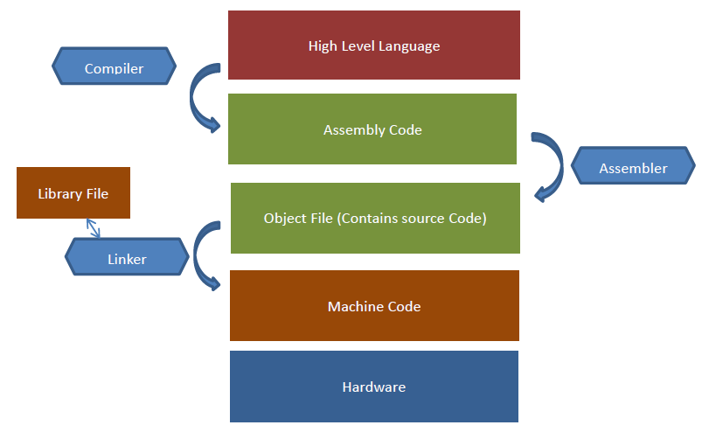

Slide 20
1. High level language program(C,C++, etc.,), Compiler(language translator) is used to convert high level code into Assembly.
2. Assembly code is then converted into object file by Assembler.
3. Then object file convert into machine code. Object file is linked by linker with library file. Every system has different system properties(how is it made, attributes, etc.). This library file present in system and object file link together change into machine code which run the hardware.

Slide 21
Code in C, filename.c (.c extension language format)
Compile in Assembly language, extension changes to filename.asm
Assembler convert it into object file, extension changes into filename.obj
Linker link it with library file extension changes into .exe, hardware run it.

Slide 22
Why Learn Assembly Language?
Accessibility to system hardware
Assembly Language is useful for implementing system software
Also useful for small embedded system applications
Space and Time efficiency
Understanding sources of program inefficiency
Tuning program performance
Writing compact code
Writing assembly programs gives the computer designer the needed deep understanding of the instruction set and how to design one
To be able to write compilers for HLLs, we need to be expert with the machine language. Assembly programming provides this experience

Slide 23
Assembly vs. High-Level Languages
HLL programs are machine independent. They are easy to learn and easy to use.
Assembly language programs are machine specific. It is the language that the processor directly understands.

Slide 24
Tools for Assembly Language: Assembler
Software tools are needed for editing, assembling, linking, and debugging assembly language programs
An assembler is a program that converts source-code programs written in assembly language into object files in machine language
Popular assemblers have emerged over the years for the Intel family of processors. These include …
TASM (Turbo Assembler from Borland)
NASM (Netwide Assembler for both Windows and Linux), and
GNU assembler distributed by the free software foundation
MASM (Macro Assembler from Microsoft)

Slide 25
Tools for Assembly Language: Linker & Libraries
You need a linker program to produce executable files
It combines your program's object file created by the assembler with other object files and link libraries, and produces a single executable program

Slide 26
Assemble and Link Process
A project may consist of multiple source files
Assembler translates each source file separately into an object file
Linker links all object files together with link libraries
Source
File
Assembler
Object
File
Source
File
Assembler
Object
File
Linker
Executable
File
Source
File
Assembler
Object
File
Link
Libraries

Slide 27
Reason
Reason was to combine machine parts to perform specific task (like switches and other components which assemble to perform task), name Assembly

Slide 28
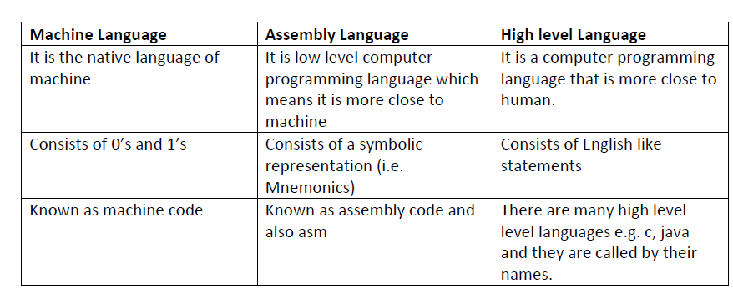

Slide 29
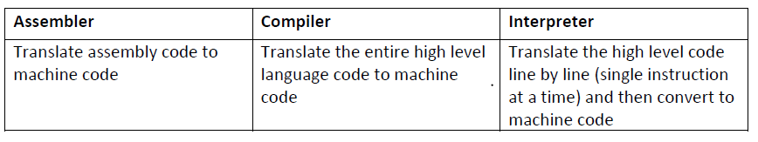

Slide 30
fetch-execute-cycle
CPU executes the instruction with fetch-execute-cycle as;
Fetch
1. Fetch an instruction from memory.
2. Decode the instruction to determine the operation.
3. ·Fetch data from memory if necessary.
Execute
1. Perform the operation on the data.
2. Store the result in memory if needed.

Slide 31
Registers
Records or collection of information
Storage area inside CPU, CPU take info, process and store it.
Fastest area present inside CPU
Helps in Optimization of Processing time (HD file internally run on register and CPU process it)
Understanding of Hardware and Software interaction

Slide 32
Processor operations mostly involve processing data. This data can be stored in memory and accessed from thereon. However, reading data from and storing data into memory slows down the processor, as it involves complicated processes of sending the data request across the control bus and into the memory storage unit and getting the data through the same channel.
To speed up the processor operations, the processor includes some internal memory storage locations, called registers.
The registers store data elements for processing without having to access the memory. A limited number of registers are built into the processor chip.
Registers are a type of computer memory used to quickly accept, store, and transfer data and instructions that are being used immediately by the CPU. The registers used by the CPU are often termed as Processor registers.
A processor register may hold an instruction, a storage address, or any data (such as bit sequence or individual characters).

Slide 33
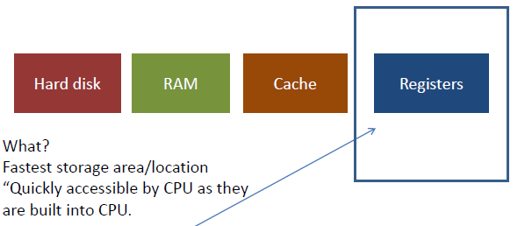
CPU

Slide 34
HD – Main storage- we run files present in HD.
HD file Run – RAM – Cache – Register
Register built in inside CPU, CPU quickly access information from register, program work processing time optimize.
Direct access register , time is saved , info save directly into Register because CPU extract info from here (CPU need space where it keep data to hold or remove).
CPU extract info from register through Assembly language programming.

Slide 35
Registers are the fastest memory locations built into microprocessor. Fast means CPU quickly access it close to CPU.
Chip by Intel 4004 in 1971, launched registered are used first time, by Federico Faggin
Following are the 14 types of registers

