Slide 1
Computer system overview
Notes:
information either analog or digital needs to be converted to either a digital signal or an analog signal for transmission.
In this lecture, digital transmission only…the schemes and techniques that we use to transmit data digitally.
First, we discuss digital-to-digital conversion techniques, methods which convert digital data to digital signals.
Second, we discuss analog-to-digital conversion techniques,

Slide 2
Operating System
A program that controls the execution of application programs
An interface between applications and hardware
Convenience
Efficiency
Ability to evolve
Main objectives of an OS:
Notes:
• Convenience: An OS makes a computer more convenient to use.
• Efficiency: An OS allows the computer system resources to be used in an efficient manner.
• Ability to evolve: An OS should be constructed in such a way as to permit the effective development, testing, and introduction of new system functions without
interfering with service.

Slide 3
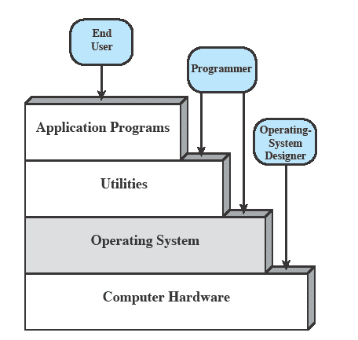
The Operating System as a User/Computer Interface
The end user generally views a computer system in terms of a set of applications and is not concerned with the details of computer hardware.
Application can be expressed in a programming languages and are developed by an application programmers.
If one were to develop an application program as a set of machine instructions that is completely responsible for controlling the computer hardware, and it would be a very complex undertaking.
To ease this chore, a set of system programs is provided. Some of these programs are referred to as utilities, or library programs. These implement frequently used functions that assist in program creation, the management of files, and the control of I/O devices.
A programmer will make use of these facilities in developing an application, and the application, while it is running, will invoke the utilities to perform certain functions.
The most important collection of system programs comprises the OS.
The OS masks the details of the hardware from the programmer and provides the programmer with a convenient interface for using the system. It acts as mediator, making it easier for the programmer and for application programs to access and use those facilities and services.

Slide 4
Operating System services
Operating systems provide an environment for execution of programs and services to programs and users
OS typically provides services in the following areas:
User interface
Program development
Program execution
Access to I/O devices
Controlled access to files
System access
Error detection and response
Communication
Accounting
Notes:
User interface
Almost all operating systems have a user interface (UI). [Command-Line (CLI), Graphics User Interface (GUI)
Program development
application program development tools such as editors and debuggers, to assist the programmer in creating programs, are utility programs not core OS
Program execution
Loading instructions and data into memory, initializing I/O devices and files, preparing other resources, scheduling
Access to I/O devices
Controlled access to files
System access
Error detection and response
hardware errors: a memory error, a device failure or malfunction; software errors: such as division by zero, attempt to access forbidden memory location, and inability of the OS to grant the request of an application. In each case, the OS must provide a response that clears the error condition with the least impact on running applications. The response may range from ending the program that caused the error, to retrying the operation, to simply reporting the error to the application.
Accounting
usage statistics for various resources and monitor performance parameters such as response time. On a multiuser system, the information for billing purpose
Program development: application program development tools such as editors and debuggers, to assist the programmer in creating programs. Typically, these services are in the form of utility programs that, while not strictly part of the core of the OS,
Program execution: A number of steps need to be performed to execute a program.
Instructions and data must be loaded into main memory,
I/O devices and files must be initialized,
and other resources must be prepared.
The OS handles these scheduling duties for the user.
Access to I/O devices: Each I/O device requires its own peculiar set of instructions or control signals for operation.
The OS provides a uniform interface that hides these details so that programmers can access such devices using simple reads and writes.
Controlled access to files: In the case of a system with multiple users, the OS may provide protection mechanisms to control access to the files.
System access: For shared or public systems, the OS controls access to the system as a whole and to specific system resources.
The access function must provide protection of resources and data from unauthorized users and must resolve conflicts for resource contention.
Error detection and response: A variety of errors can occur while a computer system is running.
These include internal and external hardware errors, such as a memory error, or a device failure or malfunction;
and various software errors, such as division by zero, attempt to access forbidden memory location, and inability of the OS to grant the request of an application.
In each case, the OS must provide a response that clears the error condition with the least impact on running applications.
The response may range from ending the program that caused the error, to retrying the operation, to simply reporting the error to the application.
Accounting: A good OS will collect usage statistics for various resources and monitor performance parameters such as response time. On any system, this
information is useful in anticipating the need for future enhancements and in tuning the system to improve performance. On a multiuser system, the information
can be used for billing purposes.

Slide 5
A view of operating system services

Slide 6
Operating System Services
User interface - Almost all operating systems have a user interface (UI).
Varies between Command-Line (CLI), Graphics User Interface (GUI), Batch
Program execution - The system must be able to load a program into memory and to run that program, end execution, either normally or abnormally (indicating error)
I/O operations - A running program may require I/O, which may involve a file or an I/O device
File-system manipulation - The file system is of particular interest. Programs need to read and write files and directories, create and delete them, search them, list file Information, permission management.
Communications – Processes may exchange information, on the same computer or between computers over a network
Communications may be via shared memory or through message passing (packets moved by the OS)
Error detection – OS needs to be constantly aware of possible errors
May occur in the CPU and memory hardware, in I/O devices, in user program
For each type of error, OS should take the appropriate action to ensure correct and consistent computing
Debugging facilities can greatly enhance the user’s and programmer’s abilities to efficiently use the system

Slide 7
Operating System Services (Cont.)
Another set of OS functions exists for ensuring the efficient operation of the system itself via resource sharing
Resource allocation - When multiple users or multiple jobs running concurrently, resources must be allocated to each of them
Many types of resources - CPU cycles, main memory, file storage, I/O devices.
Accounting - To keep track of which users use how much and what kinds of computer resources
Protection and security - The owners of information stored in a multiuser or networked computer system may want to control use of that information, concurrent processes should not interfere with each other
Protection involves ensuring that all access to system resources is controlled
Security of the system from outsiders requires user authentication, extends to defending external I/O devices from invalid access attempts

Slide 8
The Operating System as Resource Manager
A computer is a set of resources for moving, storing, & processing data
The OS is responsible for managing these resources
The OS exercises its control through software i.e. ;
Functions in the same way as ordinary computer software i.e. ;
Program, or suite of programs, executed by the processor
Frequently relinquishes control and must depend on the processor to allow it to regain control

Slide 9
The Operating System as Resource Manager

Slide 10
Ease of Evolution of an Operating System
A major OS will evolve over time for a number of reasons:
Hardware upgrades
New types of hardware
New services
Fixes
Notes:
For example, early versions
of UNIX and the Macintosh OS did not employ a paging mechanism because
they were run on processors without paging hardware
For example, if it is found
to be difficult to maintain good performance for users with existing tools, new
measurement and control tools may be added to the OS.
Any OS has faults. These are discovered over the course of time and
fixes are made. Of course, the fix may introduce new faults.

Slide 11
THE EVOLUTION OF OPERATING SYSTEMS
Stages include:
Serial Processing
Simple Batch Systems
Multiprogrammed Batch Systems
Time Sharing Systems

Slide 12
Serial Processing
Earliest computers, late 1940s to the mid-1950s
No Operating System
The programmer interacted directly with the computer hardware
These computers were run from a console consisting of display lights, toggle switches, some form of input device, and a printer.
Programs in machine code were loaded via the input device (e.g., a card reader).
If an error halted the program, the error condition was indicated by the lights.
If the program proceeded to a normal completion, the output appeared on the printer.
This mode of operation could be termed serial processing, as users have access to the computer in series
Problems
Scheduling:
Most installations used a hardcopy sign-up sheet to reserve computer time. A user might sign up for an hour and finish in 45 minutes; this would result in wasted computer processing time. On the other hand, the user might run into problems, not finish in the allotted time, and be forced to stop before resolving the problem.
Setup time:
A considerable amount of time was spent just on setting up the program to run.
A single program, called a job, could involve loading the compiler plus the high-level language program (source program) into memory, saving the compiled program (object program), and then loading and linking together the object program and common functions. Each of these steps could involve mounting or dismounting tapes or setting up card decks. If an error occurred, the hapless user typically had to go back to the beginning of the setup sequence. Thus, a considerable amount of time was spent just in setting up the program to run

Slide 13
Simple Batch Systems
Early computers were very expensive
important to maximize processor utilization
the wasted time due to scheduling and setup time was unacceptable.
The idea behind the simple batch-processing is the use of a piece of software known as the monitor.
user no longer has direct access to the processor.
the user submits the job on cards to a computer operator, who batches the jobs together sequentially and places the entire batch on an input device, for use by the monitor.
Each program is constructed to branch back to the monitor when it completes processing
monitor automatically begins loading the next program.

Slide 14
Simple Batch PROCESSING Systems
MONITOR POINT OF VIEW
Resident Monitor is software always in memory
Monitor controls the sequence of events
Monitor reads in job and gives control
Job returns control to monitor
PROCESSOR POINT OF VIEW
Processor executes instruction from the memory containing the monitor
Executes the instructions in the user program until it encounters an ending or error condition
“control is passed to a job” means processor is fetching and executing instructions in a user program
“control is returned to the monitor” means that the processor is fetching and executing instructions from the monitor program

Slide 15
Simple Batch PROCESSING ADVANTAGES
The monitor performs a scheduling function. A batch of jobs is queued up, and jobs are executed as rapidly as possible, with no intervening idle time.
The monitor improves job setup time. With each job, instructions are included in a primitive form of job control language (JCL). This is a special type of programming language used to provide instructions to the monitor.
A simple example is that of a user submitting a program written in the programming language FORTRAN plus some data to be used by the program.

Slide 16
Simple Batch PROCESSING Desirable Hardware Features
The monitor, or batch OS, is simply a computer program. It relies on the ability of the processor to fetch instructions from various portions of main memory to alternately seize and relinquish control. Certain other hardware features are also desirable:
Memory protection for monitor
while the user program is executing, it must not alter the memory area containing the monitor
Timer
prevents a job from monopolizing the system
Privileged instructions
can only be executed by the monitor
Interrupts
gives OS more flexibility in controlling user programs

Slide 17
Simple Batch Systems Modes of Operation
Considerations of memory protection and privileged instructions lead to the concept of modes of operation.
User Mode
user program executes in user mode
certain areas of memory are protected from user access
certain instructions may not be executed
Kernel Mode
monitor executes in kernel mode
privileged instructions may be executed
protected areas of memory may be accessed

Slide 18
Simple Batch PROCESSING OVERHEAD
Processor time alternates between execution of user programs and execution of the monitor
Sacrifices:
some main memory is now given over to the monitor
some processor time is consumed by the monitor
Despite overhead, the simple batch system improves utilization of the computer.

Slide 19
Inefficiency of simple Batch processing
Processor is often idle even with automatic job sequencing provided by a simple batch OS. Its because I/O devices are slow compared to processor
In Uniprogramming, the processor spends a certain amount of time executing, until it reaches an I/O instruction; it must then wait until that I/O instruction concludes before proceeding

Slide 20
Multiprogramming Batch Systems
Multiprogramming also known as multitasking
Multiprogramming was designed to keep the processor and I/O devices, including storage devices, simultaneously busy to achieve maximum efficiency.
The key mechanism is this: Memory is expanded to hold the OS (resident monitor) and multiple user programs. When one job needs to wait for I/O, the processor can switch to the other job residing in main memory, which is likely not waiting for I/O.

Slide 21
Multiprogramming example

Slide 22
Multiprogramming example

Slide 23
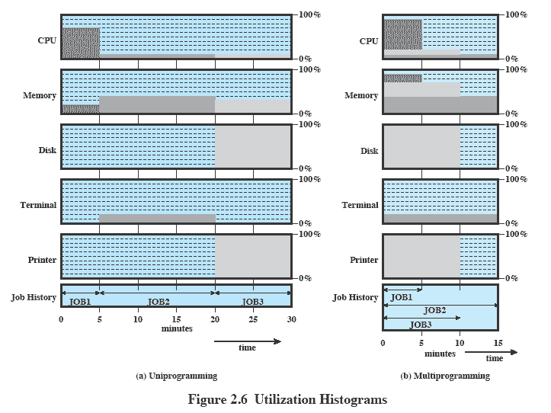
Multiprogramming Utilization Histograms

Slide 24
Time-Sharing Systems
With the use of multiprogramming, batch processing can be quite efficient.
However, for many jobs, it is desirable to provide a mode in which the user interacts directly with the computer.
So, another line of development was general-purpose time sharing.
The key design objective is responsiveness to the individual user and yet, for cost reasons, be able to support many users simultaneously. These goals are compatible because of the relatively slow reaction time of the user. For example, if a typical user needs an average of 2 seconds of processing time per minute, then close to 30 such users should be able to share the same system without noticeable interference.
A time-sharing system can be used to handle multiple interactive jobs
Processor time is shared among multiple users
Multiple users simultaneously access the system through terminals, with the OS interleaving the execution of each user program in a short burst or quantum of computation

Slide 25
real-time transaction processing systems
An other important line of development has been real-time transaction processing systems.
In transaction processing, an interactive mode is essential, a number of users are entering queries or updates against a database. An example is an airline reservation system.
The key difference between the transaction processing system and the time-sharing system is that the former is limited to one or a few applications, whereas users of a time-sharing system can engage in program development, job execution, and the use of various applications. In both cases, system response time is paramount.

Slide 26
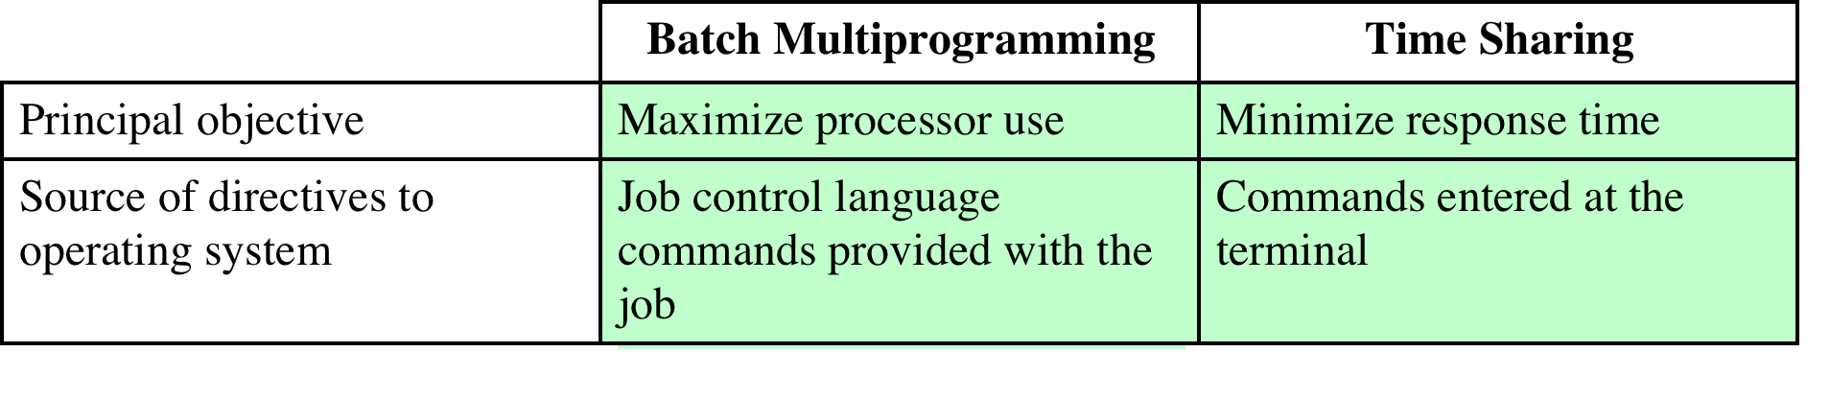
Batch Multiprogramming vs. Time Sharing

Slide 27
Compatible Time-Sharing Systems
CTTS
Compatible Time-Sharing System (CTTS)
One of the first time-sharing operating systems
Developed at MIT by a group known as Project MAC
Ran on a computer with 32,000 36-bit words of main memory, with the resident monitor consuming 5000 of that
To simplify both the monitor and memory management a program was always loaded to start at the location of the 5000th word
TIME SLICING
System clock generates interrupts at a rate of approximately one every 0.2 seconds
At each interrupt OS regained control and could assign processor to another user
At regular time intervals the current user would be preempted and another user loaded in
Old user programs and data were written out to disk
Old user program code and data were restored in main memory when that program was next given a turn

Slide 28
Ctts eXAMPLE
Notes:
Compared to later systems, CTSS is primitive. The system ran on a computer
with 32,000 36-bit words of main memory, with the resident monitor consuming
5000 of that. When control was to be assigned to an interactive user, the user’s program
and data were loaded into the remaining 27,000 words of main memory. A
program was always loaded to start at the location of the 5000th word; this simplified
both the monitor and memory management. A system clock generated interrupts
at a rate of approximately one every 0.2 seconds. At each clock interrupt, the
OS regained control and could assign the processor to another user. This technique
is known as time slicing. Thus, at regular time intervals, the current user would be
preempted and another user loaded in. To preserve the old user program status for
later resumption, the old user programs and data were written out to disk before the
new user programs and data were read in. Subsequently, the old user program code
and data were restored in main memory when that program was next given a turn.
To minimize disk traffic, user memory was only written out when the incoming
program would overwrite it. This principle is illustrated in Figure 2.7. Assume that
there are four interactive users with the following memory requirements, in words:
􀀁 􀁲􀀁 JOB1: 15,000
􀀁 􀁲􀀁 JOB2: 20,000
􀀁 􀁲􀀁 JOB3: 5000
􀀁 􀁲􀀁 JOB4: 10,000
Initially, the monitor loads JOB1 and transfers control to it (a). Later, the
monitor decides to transfer control to JOB2. Because JOB2 requires more memory
than JOB1, JOB1 must be written out first, and then JOB2 can be loaded (b). Next,
JOB3 is loaded in to be run. However, because JOB3 is smaller than JOB2, a portion
of JOB2 can remain in memory, reducing disk write time (c). Later, the monitor
decides to transfer control back to JOB1. An additional portion of JOB2 must
be written out when JOB1 is loaded back into memory (d). When JOB4 is loaded,
part of JOB1 and the portion of JOB2 remaining in memory are retained (e). At
this point, if either JOB1 or JOB2 is activated, only a partial load will be required.
In this example, it is JOB2 that runs next. This requires that JOB4 and the remaining
resident portion of JOB1 be written out and that the missing portion of JOB2
be read in (f).

Slide 29
MAJOR ACHIEVEMENTS
There have been four major theoretical advances in the development of operating systems:
Processes
Memory management
Information protection and security
Scheduling and resource management
Taken together, these four areas span many of the key design and implementation issues of modern operating systems.

Slide 30
The Process
Central to the design of operating systems is the concept of process.
It is more general term than job. Some of the definitions have been given for the term process are:
A program in execution
An instance of a program running on a computer
The entity that can be assigned to and executed on a processor
A unit of activity characterized by a single sequential thread of execution, a current state, and an associated set of system resources
The concept of process should become clearer as we proceed.

Slide 31
concept of process
The concept of the process provides the foundation. We can think of a process as consisting of three components:
An executable program
The associated data needed by the program (variables, work space, buffers, etc.)
The execution context of the program
The last element, execution context, or process state, is essential, it is the internal data by which the OS is able to supervise and control the process. This internal information is separated from the process, because the OS has information not permitted to the process.
The context includes all of the information that the OS needs to manage the process and that the processor needs to execute the process properly. The context includes the contents of the various processor registers, such as the program counter and data registers. It also includes information of use to the OS, such as the priority of the process and whether the process is waiting for the completion of a particular I/O event, process state.

Slide 32
Typical process implementation
Example shows how two processes A and B may be managed.
A block of memory is allocated to each process that contains the program, data, and context information.
Each process is recorded in a process list built and maintained by the OS.
The process list contains one entry for each process, which includes a pointer to the location of the block of memory that contains the process.
The entry may also include part or all of the execution context of the process. The remainder of the execution context is stored elsewhere, perhaps with the process itself (as indicated in Figure) or frequently in a separate region of memory.

Slide 33
Typical process implementation
The process index register contains the index into the process list of the process currently controlling the processor.
The program counter points to the next instruction in that process to be executed.
The base and limit registers define the memory occupied by the process as starting address and the size.
The program counter and all data references are interpreted relative to the base register and must not exceed the value in the limit register. This prevents interprocess interference.
Process index register indicates that process B is executing.
Process A was previously executing but has been temporarily interrupted. The contents of all the registers at the moment of A’s interruption were recorded in its execution context. Later, the OS can perform a process switch and resume execution of process A.

Slide 34
Typical process implementation
Thus, the process is realized as a data structure. This structure allows the development of powerful techniques for ensuring coordination and cooperation among processes.
New features can be designed and incorporated into the OS (e.g., priority) by expanding the context to include any new information needed to support the feature.

Slide 35
Key Elements of an Operating System for multiprogramming

