Slide 1
Threads

Slide 2
Threads: Motivation
The basic idea – the motivation is that the several components in any complex system will perform particular subfunctions that contribute to the overall function.
Notes:
This chapter examines some more advanced concepts related to process management, which are found in a number of contemporary operating systems. We show that the concept of process is more complex and subtle than presented so far and in fact embodies two separate and potentially independent concepts: one relating to resource ownership and another relating to execution. This distinction has led to the development, in many operating systems, of a construct known as the thread .

Slide 3
Threads: Motivation
A word processor may have a thread for displaying graphics, another thread for responding to keystrokes from the user, and a third thread for performing spelling and grammar checking in the background.
A single application may be required to perform several similar tasks.
For example, a web server accepts client requests for web pages, images, sound, and so forth.
Earlier solution was to create a separate process to service each request.
Process creation is time consuming and resource intensive
New solution is to have the server run as a single process that accepts requests. When the server receives a request, it creates a separate thread to service that request.

Slide 4
Threads: Motivation

Slide 5
Processes and Threads
Traditional processes have two characteristics:
Resource Ownership
Scheduling/Execution
Process includes a virtual address space to hold the process image
the OS provides protection to prevent unwanted interference between processes with respect to resources
Follows an execution path that may be interleaved with other processes
a process has an execution state (Running, Ready, etc.) and a dispatching priority and is scheduled and dispatched by the OS
Traditional processes are sequential; i.e. only one execution path

Slide 6
Processes and Threads
Multithreading - The ability of an OS to support multiple, concurrent paths of execution within a single process
The unit of resource ownership is referred to as a process or task
The unit of dispatching is referred to as a thread or lightweight process
Notes:
To distinguish the two characteristics, the unit of dispatching is usually referred to as a thread or lightweight process , while the unit of resource ownership is usually referred to as a process or task .
Multithreading refers to the ability of an OS to support multiple, concurrent paths of execution within a single process.

Slide 7
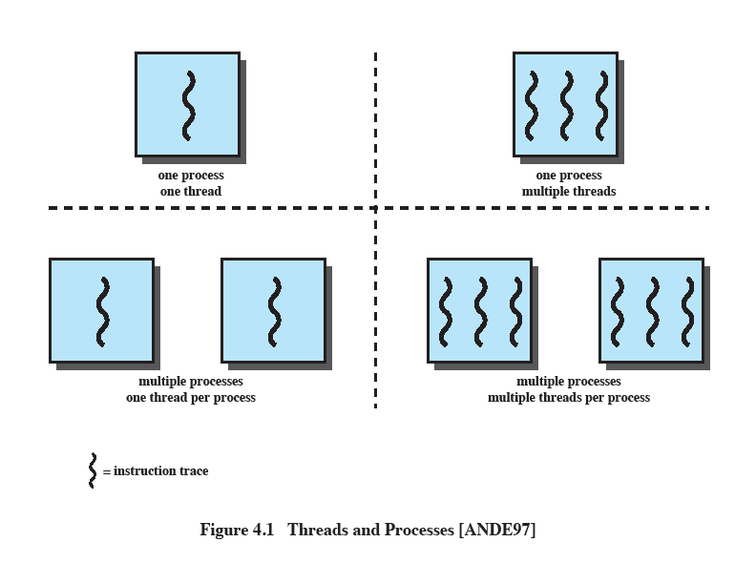
Single Threaded Approaches
A single execution path per process, in which the concept of a thread is not recognized, is referred to as a single-threaded approach
MS-DOS, some versions of UNIX supported only this type of process.
Notes:
The traditional approach of a single thread of execution per process, in which the concept of a thread is not recognized, is referred to as a single-threaded approach. The two arrangements shown in the left half of Figure 4.1 are single-threaded approaches. MS-DOS is an example of an OS that supports a single user process and a single thread.

Slide 8
Multithreaded Approaches
The right half of Figure depicts multithreaded approaches
A Java run-time environment is a system of one process with multiple threads; Windows, some UNIXes, support multiple multithreaded processes.
Notes:
The right half of Figure 4.1 depicts multithreaded approaches. A Java run-time environment is an example of a system of one process with multiple threads. Of interest in this section is the use of multiple processes, each of which supports multiple threads. This approach is taken in Windows, Solaris, and many modern versions of UNIX, among others. In this section we give a general description of multithreading; the details of the Windows, Solaris, and Linux approaches are discussed later in this chapter.

Slide 9
Threads vs Process
A thread is a basic unit of CPU utilization;
it comprises a thread ID, a program counter (PC), a register set, and a stack.
It shares code section, data section, open files and other operating-system resources, such as signals of the process with other threads belonging to the same process.

Slide 10
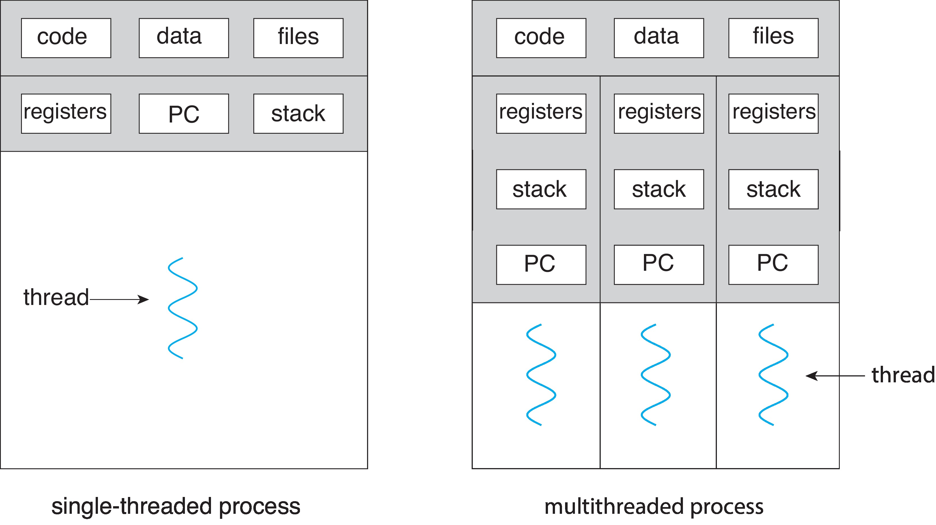
Single and Multithreaded Processes

Slide 11
Processes
In a multithreaded environment the process is the unit that owns resources and the unit of protection.
i.e., the OS provides protection at the process level
Processes have
A virtual address space that holds the process image
Protected access to
processors
other processes
files
I/O resources
Notes:
In a multithreaded environment, a process is defined as the unit of resource allocation and a unit of protection. The following are associated with processes:
• A virtual address space that holds the process image
• Protected access to processors, other processes (for interprocess communication), files, and I/O resources (devices and channels)

Slide 12
One or More Threads in a Process
Each thread has:
an execution state (Running, Ready, etc.)
saved thread context when not running (TCB)
an execution stack
some per-thread static storage for local variables
access to the shared memory and resources of its process (all threads of a process share this)
Notes:
Within a process, there may be one or more threads, each with the following:
• A thread execution state (Running, Ready, etc.)
• A saved thread context when not running; one way to view a thread is as an independent program counter operating within a process
• An execution stack
• Some per-thread static storage for local variables
• Access to the memory and resources of its process, shared with all other threads in that process

Slide 13
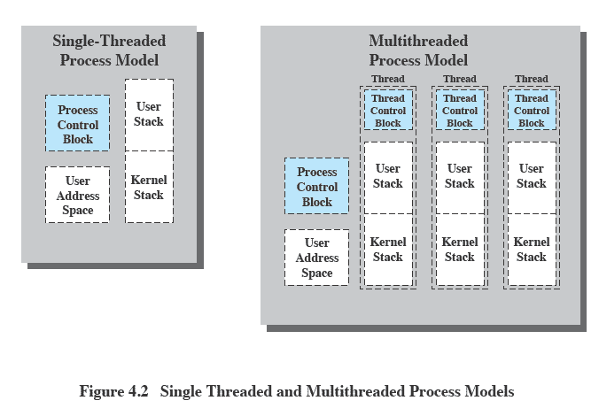
Threads vs. Processes
Notes:
Figure 4.2 illustrates the distinction between threads and processes from the point of view of process management.
In a single-threaded process model (i.e., there is no distinct concept of thread), the representation of a process includes its process control block and user address space, as well as user and kernel stacks to manage the call/return behavior of the execution of the process. While the process is running, it controls the processor registers. The contents of these registers are saved when the process is not running. In a multithreaded environment, there is still a single process control block and user address space associated with the process, but now there are separate stacks for each thread, as well as a separate control block for each thread containing register values, priority, and other thread-related state information.

Slide 14
Benefits of Multithreading
Responsiveness – may allow continued execution if part of process is blocked, especially important for user interfaces
Resource Sharing – threads share resources of process, easier than shared memory or message passing
Economy – cheaper than process creation, thread switching lower overhead than context switching
Scalability – process can take advantage of multicore architectures

Slide 15
Benefits of Threads
The key benefits of threads derive from the performance implications:
Takes less time to create a new thread than a process
Less time to terminate a thread than a process
Switching between two threads takes less time than switching between processes
Threads enhance efficiency in communication between programs
Notes:
Thus, all of the threads of a process share the state and resources of that process.
They reside in the same address space and have access to the same data.
When one thread alters an item of data in memory, other threads see the results if and when they access that item.
If one thread opens a file with read privileges, other threads in the same process can also read from that file.
The key benefits of threads derive from the performance implications:
1. It takes far less time to create a new thread in an existing process than to
create a brand-new process. Studies done by the Mach developers show that
thread creation is ten times faster than process creation in UNIX [TEVA87].
2. It takes less time to terminate a thread than a process.
3. It takes less time to switch between two threads within the same process than to switch between processes.
4. Threads enhance efficiency in communication between different executing programs. In most operating systems, communication between independent processes requires the intervention of the kernel to provide protection and the mechanisms needed for communication. However, because threads within the same process share memory and files, they can communicate with each other without invoking the kernel.
Thus, if there is an application or function that should be implemented as a set of related units of execution, it is far more efficient to do so as a collection of threads rather than a collection of separate processes.

Slide 16
Thread Use in a Single-User System
Foreground and background work For example, in a spreadsheet program: one thread could display menus and read user input, while another thread executes user commands and updates the spreadsheet. This arrangement often increases the perceived speed of the application by allowing the program to prompt for the next command before the previous command is complete.
Asynchronous processing Asynchronous elements in the program can be implemented as threads. For example, as a protection against power failure, one can design a word processor to write its random access memory (RAM) buffer to disk once every minute. A thread can be created whose sole job is periodic backup and that schedules itself directly with the OS; there is no need for fancy code in the main program to provide for time checks or to coordinate input and output.
Speed of execution A multithreaded process can compute one batch of data while reading the next batch from a device. On a multiprocessor system, multiple threads from the same process may be able to execute simultaneously. Thus, even though one thread may be blocked for an I/O operation to read in a batch of data, another thread may be executing.
Modular program structure Programs that involve a variety of activities or a variety of sources and destinations of input and output may be easier to design and implement using threads.
Notes:
[LETW88] gives four examples of the uses of threads in a single-user multiprocessing system:
• Foreground and background work: For example, in a spreadsheet program,
one thread could display menus and read user input, while another thread executes user commands and updates the spreadsheet. This arrangement often increases the perceived speed of the application by allowing the program to prompt for the next command before the previous command is complete.
• Asynchronous processing:
Asynchronous elements in the program can be implemented as threads.
For example, as a protection against power failure, one can design a word processor to write its random access memory (RAM) buffer to disk once every minute. A thread can be created whose sole job is periodic backup and that schedules itself directly with the OS; there is no need for fancy code in the main program to provide for time checks or to coordinate input and output.
• Speed of execution:
A multithreaded process can compute one batch of data while reading the next batch from a device.
On a multiprocessor system, multiple threads from the same process may be able to execute simultaneously. Thus, even though one thread may be blocked for an I/O operation to read in a batch of data, another thread may be executing.
• Modular program structure:
Programs that involve a variety of activities or a variety of sources and destinations of input and output may be easier to design and implement using threads.

Slide 17
Threads
In an OS that supports threads, scheduling and dispatching is done on a thread basis
Most of the state information dealing with execution is maintained in thread-level data structures
suspending a process involves suspending all threads of the process
termination of a process terminates all threads within the process
Notes:
In an OS that supports threads, scheduling and dispatching is done on a thread basis; hence, most of the state information dealing with execution is maintained in thread-level data structures. There are, however, several actions that affect all of the threads in a process and that the OS must manage at the process level. For example, suspension involves swapping the address space of one process out of main memory to make room for the address space of another process. Because all threads in a process share the same address space, all threads are suspended at the same time. Similarly, termination of a process terminates all threads within that process.

Slide 18
Thread Execution States
Thread operations associated with a change in thread state are:
Spawn (create)
Block
Unblock
Finish
The key states for
a thread are:
Running
Ready
Blocked
Notes:
THREAD STATES
As with processes, the key states for a thread are Running, Ready, and Blocked.
Generally, it does not make sense to associate suspend states with threads because such states are process-level concepts.
In particular, if a process is swapped out, all of its threads are necessarily swapped out because they all share the address space of the process.
There are four basic thread operations associated with a change in thread state [ANDE04]:
• Spawn: Typically, when a new process is spawned, a thread for that process is also spawned. Subsequently, a thread within a process may spawn another thread within the same process, providing an instruction pointer and arguments for the new thread. The new thread is provided with its own register context and stack space and placed on the ready queue.
• Block: When a thread needs to wait for an event, it will block (saving its user registers, program counter, and stack pointers). The processor may now turn to the execution of another ready thread in the same or a different process.
• Unblock: When the event for which a thread is blocked occurs, the thread is moved to the Ready queue.
• Finish: When a thread completes, its register context and stacks are deallocated.

Slide 19
Thread Execution
A key issue with threads is whether or not they can be scheduled independently of the process to which they belong.
Or, is it possible to block one thread in a process without blocking the entire process?
If not, then much of the flexibility of threads is lost.
Notes:
THREAD STATES
As with processes, the key states for a thread are Running, Ready, and Blocked. Generally, it does not make sense to associate suspend states with threads because such states are process-level concepts. In particular, if a process is swapped out, all of its threads are necessarily swapped out because they all share the address space of the process. There are four basic thread operations associated with a change in thread state [ANDE04]:
• Spawn: Typically, when a new process is spawned, a thread for that process is also spawned. Subsequently, a thread within a process may spawn another thread within the same process, providing an instruction pointer and arguments for the new thread. The new thread is provided with its own register context and stack space and placed on the ready queue.
• Block: When a thread needs to wait for an event, it will block (saving its user registers, program counter, and stack pointers). The processor may now turn to the execution of another ready thread in the same or a different process.
• Unblock: When the event for which a thread is blocked occurs, the thread is moved to the Ready queue.
• Finish: When a thread completes, its register context and stacks are deallocated.

Slide 20
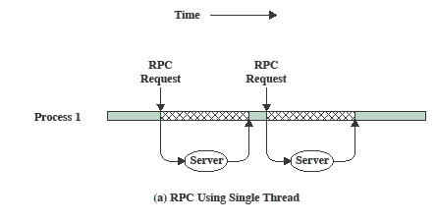
RPC (Remote Process Call) Using Single Thread
Notes:
A significant issue is whether the blocking of a thread results in the blocking of the entire process. In other words, if one thread in a process is blocked, does this prevent the running of any other thread in the same process even if that other thread is in a ready state? Clearly, some of the flexibility and power of threads is lost if the one blocked thread blocks an entire process.
We return to this issue subsequently in our discussion of user-level versus kernel-level threads,
but for now let us consider the performance benefits of threads that do not block an entire process.
Figure shows a program that performs two remote procedure calls (RPCs) 2 to two different hosts to obtain a combined result.
In a single-threaded program, the results are obtained in sequence, so the program has to wait for a response from each server in turn.
Rewriting the program to use a separate thread for each RPC results in a substantial speedup. Note that if this program operates on a uniprocessor, the requests must be generated sequentially and the results processed in sequence; however, the program waits concurrently for the two replies.

Slide 21
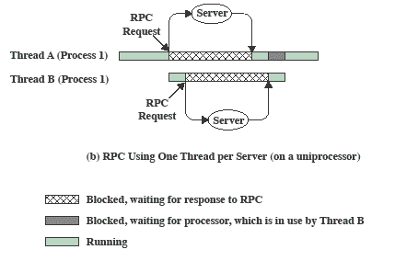
RPC Using One Thread per Server
Notes:
Rewriting the program to use a separate thread for each RPC results in a substantial speedup.
Note that if this program operates on a uniprocessor, the requests must be generated sequentially and the results processed in sequence;
however, the program waits concurrently for the two replies.

Slide 22
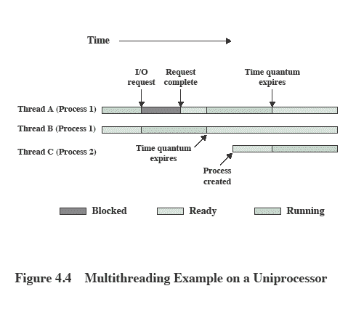
Multithreading on a Uniprocessor
Notes:
On a uniprocessor, multiprogramming enables the interleaving of multiple threads within multiple processes. In the example of Figure 4.4 , three threads in two processes are interleaved on the processor. Execution passes from one thread to another either when the currently running thread is blocked or when its time slice is exhausted.

Slide 23
Multiple Cores & Multithreading

Slide 24
Multiple Cores & Multithreading
The use of multicore system to support a single application with multiple threads improves performance.
i.e. multicore chips and multithreading combined have the potential to improve performance of processor intensive applications that have large amounts of parallelism
Gaming, simulations, etc. are examples
Notes:
The potential performance benefits of a multicore organization depend on the ability to effectively exploit the parallel resources available to the application. Let us focus first on a single application running on a multicore system. Amdahl’s law (see Appendix E ) states that:
Speedup = time to execute program on a single processor time to execute program on N parallel processors
= 1 (1 - f ) + f N
The law assumes a program in which a fraction (1 - f) of the execution time involves code that is inherently serial and a fraction f that involves code that is infinitely
parallelizable with no scheduling overhead. This law appears to make the prospect of a multicore organization attractive. But as Figure 4.7a shows, even a small amount of serial code has a noticeable impact. If only 10% of the code is inherently serial ( f = 0.9) , running the program on a multicore system with eight processors yields a performance gain of only a factor of 4.7. In addition, software typically incurs overhead as a result of communication and distribution of work to multiple processors and cache coherence overhead. This
results in a curve where performance peaks and then begins to degrade because of the increased burden of the overhead of using multiple processors. Figure 4.7b ,
from [MCDO07], is a representative example.
However, software engineers have been addressing this problem and there are numerous applications in which it is possible to effectively exploit a multicore system. [MCDO07] reports on a set of database applications, in which great attention

Slide 25

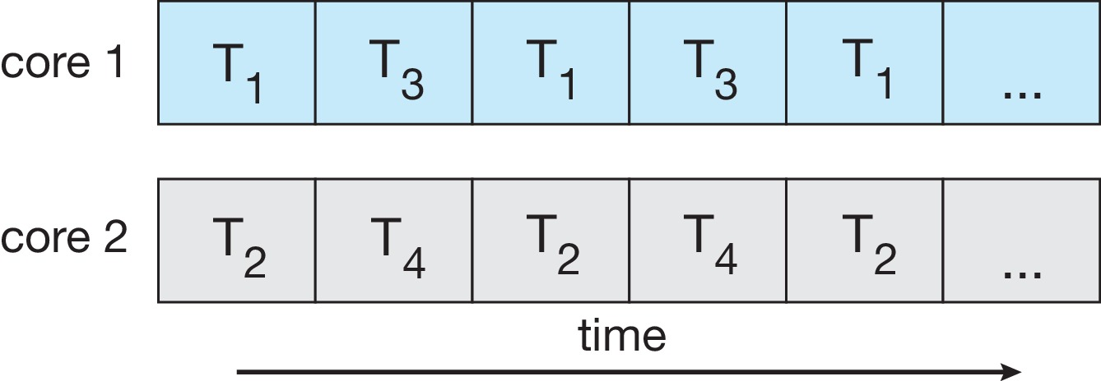
Concurrency vs. Parallelism
Concurrent execution on single-core system:
Parallelism on a multi-core system:

Slide 26
Programming Challenges
To make better use of the multiple computing cores Multi-core Systems bring new challenges for both operating system designers and application programmers.
Designers of operating systems must write scheduling algorithms that use multiple processing cores to allow the parallel execution.
For application programmers, the challenge is to design new programs that are multithreaded.

Slide 27
Challenges in programming for multicore systems
Identifying tasks
This involves examining applications to find areas that can be divided into separate, concurrent tasks.
Ideally, tasks are independent of one another and thus can run in parallel on individual cores.
Balance
programmers must also ensure that the tasks perform equal work of equal value.
If a certain task does not contribute as much value to the overall process as other tasks. Using a separate execution core to run that task may not be worth the cost.
Data splitting
The data accessed and manipulated by the tasks must be divided to run on separate cores.
Data dependency
The data accessed by the tasks must be examined for dependencies between two or more tasks.
When one task depends on data from another, programmers must ensure that the execution of the tasks is synchronized to accommodate the data dependency
Testing and debugging
Testing and debugging such concurrent programs is inherently more difficult than testing and debugging single-threaded applications.

Slide 28
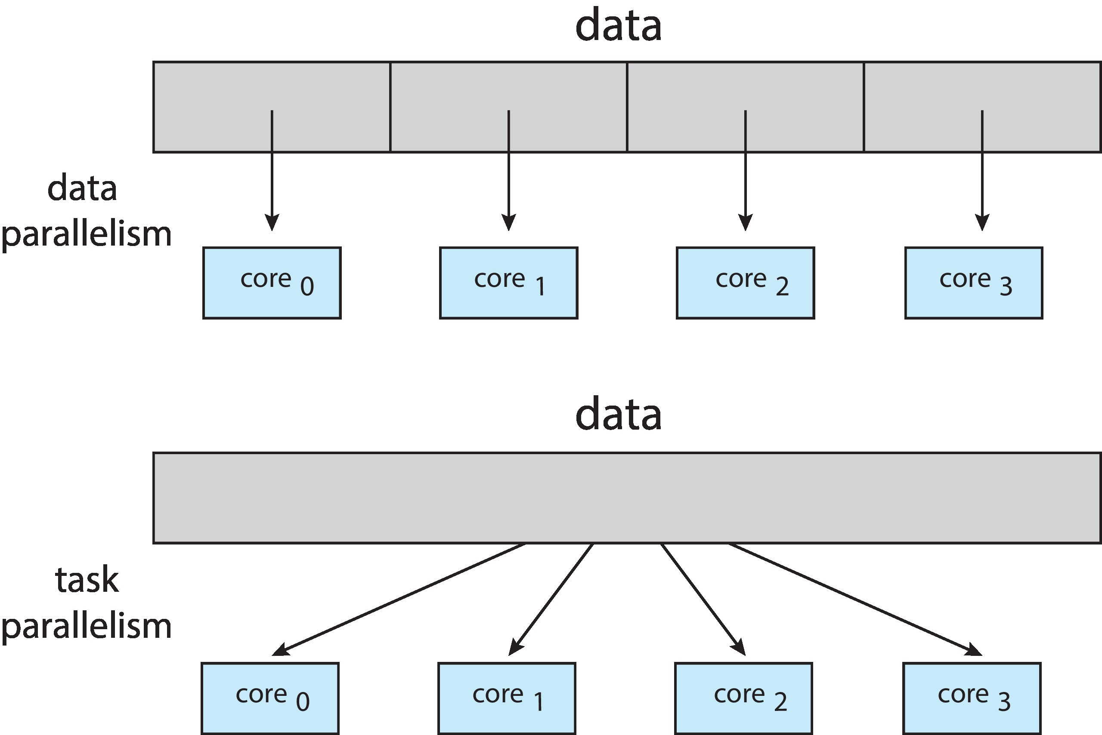
Types of parallelism
Data parallelism – distributes subsets of the same data across multiple cores, same operation on each
Task parallelism – distributing threads across cores, each thread performing unique operation

Slide 29
Thread Synchronization
It is necessary to synchronize the activities of the various threads
all threads of a process share the same address space and other resources
any alteration of a resource by one thread affects the other threads in the same process
Notes:
THREAD SYNCHRONIZATION
All of the threads of a process share the same address space and other resources, such as open files. Any alteration of a resource by one thread affects the environment of the other threads in the same process. It is therefore necessary to synchronize the activities of the various threads so that they do not interfere with each other or corrupt data structures. For example, if two threads each try to add an element to a doubly linked list at the same time, one element may be lost or the list may end up malformed. The issues raised and the techniques used in the synchronization of threads are, in general, the same as for the synchronization of processes. These issues and techniques are the subject of Chapters 5 and 6 .

Slide 30
Performance of Software on Multicore
Performance doesn’t necessarily scale linearly with the number of cores …
The potential performance benefits of a multicore organization depend on the ability to effectively exploit the parallel resources available to the application.
Let us focus first on a single application running on a multicore system.
Notes:
The potential performance benefits of a multicore organization depend on the ability to effectively exploit the parallel resources available to the application. Let us focus first on a single application running on a multicore system. Amdahl’s law (see Appendix E ) states that:
Speedup = time to execute program on a single processor time to execute program on N parallel processors
= 1 (1 - f ) + f N
The law assumes a program in which a fraction (1 - f) of the execution time involves code that is inherently serial and a fraction f that involves code that is infinitely
parallelizable with no scheduling overhead. This law appears to make the prospect of a multicore organization attractive. But as Figure 4.7a shows, even a small amount of serial code has a noticeable impact. If only 10% of the code is inherently serial ( f = 0.9) , running the program on a multicore system with eight processors yields a performance gain of only a factor of 4.7. In addition, software typically incurs overhead as a result of communication and distribution of work to multiple processors and cache coherence overhead. This
results in a curve where performance peaks and then begins to degrade because of the increased burden of the overhead of using multiple processors. Figure 4.7b ,
from [MCDO07], is a representative example.
However, software engineers have been addressing this problem and there are numerous applications in which it is possible to effectively exploit a multicore system. [MCDO07] reports on a set of database applications, in which great attention

Slide 31
Performance of Software on Multicore
Amdahl’s law states that:
time to execute program on a single processor
Speedup =
time to execute program on N parallel processors
= 1 / [ (1 - f ) + (f/N)]
The law assumes a program in which a fraction (1 - f) of the execution time involves code that is inherently serial and a fraction f that involves code that is infinitely parallelizable with no scheduling overhead.

Slide 32
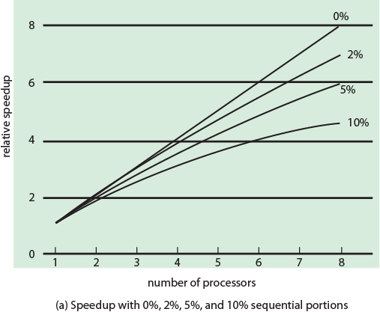
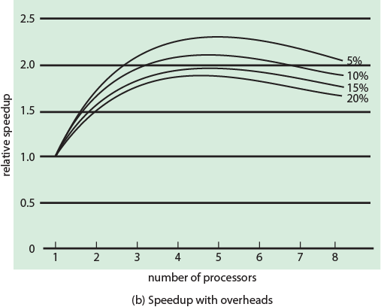
Performance Effect of Multiple Cores
Figure 4.7 (a)
Figure 4.7 (b)
Notes:
As Figure 4.7a shows, even a small amount of serial code has a noticeable impact. If only 10% of the code is inherently serial ( f = 0.9) , running the program on a multicore system with eight processors yields a performance gain of only a factor of 4.7.
In addition, software typically incurs overhead as a result of communication and distribution of work to multiple processors and cache coherence overhead.
This results in a curve where performance peaks and then begins to degrade because of the increased burden of the overhead of using multiple processors. Figure 4.7b ,
from [MCDO07], is a representative example.
However, software engineers have been addressing this problem and there are numerous applications in which it is possible to effectively exploit a multicore system. [MCDO07] reports on a set of database applications, in which great attention

Slide 33
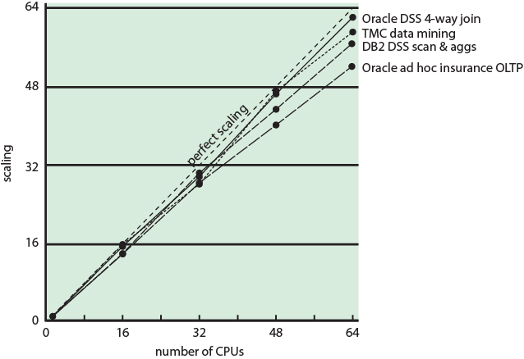
Database Workloads on Multiple-Processor Hardware
Figure 4.8 Scaling of Database Workloads on Multiple Processor Hardware
Notes:
However, software engineers have been addressing this problem and there are numerous applications in which it is possible to effectively exploit a multicore system. [MCDO07] reports on a set of database applications, in which great attention was paid to reducing the serial fraction within hardware architectures, operating systems, middleware, and the database application software. Figure 4.8 shows the result. As this example shows, database management systems and database applications are one area in which multicore systems can be used effectively. Many kinds of servers can also effectively use the parallel multicore organization, because servers typically handle numerous relatively independent transactions in parallel.

Slide 34
Applications That Benefit from multicores
Multithreaded native applications
characterized by having a small number of highly threaded processes
Multiprocess applications
characterized by the presence of many single-threaded processes
Java applications
Multi-instance applications
multiple instances of the application in parallel
Notes:
In addition to general-purpose server software, a number of classes of applications benefit directly from the ability to scale throughput with the number of cores. [MCDO06] lists the following examples:
• Multithreaded native applications:
Multithreaded applications are characterized by having a small number of highly threaded processes. Examples of threaded applications include Lotus Domino or Siebel CRM (Customer Relationship Manager).
• Multiprocess applications:
Multiprocess applications are characterized by the presence of many single-threaded processes. Examples of multiprocess applications include the Oracle database, SAP, and PeopleSoft.
• Java applications:
Java applications embrace threading in a fundamental way. Not only does the Java language greatly facilitate multithreaded applications, but the Java Virtual Machine is a multithreaded process that provides scheduling and memory management for Java applications. Java applications that can benefit directly from multicore resources include application servers such
as Sun’s Java Application Server, BEA’s Weblogic, IBM’s Websphere, and the open-source Tomcat application server. All applications that use a Java 2 Platform, Enterprise Edition (J2EE platform) application server can immediately benefit from multicore technology.
Multiinstance applications:
Even if an individual application does not scale to take advantage of a large number of threads, it is still possible to gain from multicore architecture by running multiple instances of the application in parallel. If multiple application instances require some degree of isolation, virtualization technology (for the hardware of the operating system) can be used to provide each of them with its own separate and secure environment.

Slide 37
Types of Threads

Slide 38
Types of Threads
Support for threads may be provided either at the user level, for user threads, or by the kernel, for kernel threads.
User threads are supported above the kernel and are managed without kernel support, whereas kernel threads are supported and managed directly by the operating system.
Virtually all contemporary operating systems—including Windows, Linux, and macOS— support kernel threads.

Slide 39
Types of Threads
User-Level and Kernel-Level Threads
There are two broad categories of thread implementation: user-level threads (ULTs) and kernel-level threads (KLTs).
The latter are also referred to in the literature as kernel-supported threads or lightweight processes.
NOTE: we are talking about threads for user processes. Both ULT & KLT execute in user mode. An OS may also have threads but that is not what we are discussing here.

Slide 40
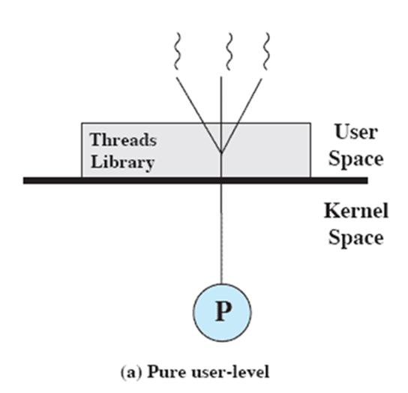
User-Level Threads (ULTs)
In a pure ULT facility, all of the work of thread management is done by the application and
the kernel is not aware of the existence of threads.
Any application can be programmed to be multithreaded by using a threads library,
Threads Library is a package of routines for ULT management, that contains code for creating and destroying threads, for passing messages and data between threads, for scheduling thread execution, and for saving and restoring thread contexts.

Slide 41
User-Level Threads (ULTs)
By default, an application begins with a single thread and begins running in that thread.
This application and its thread are allocated to a single process managed by the kernel.
At any time that the application is running (the process is in the Running state), the application may spawn a new thread to run within the same process.
Spawning is done by invoking the spawn utility in the threads library.
Control is passed to that utility by a procedure call. The threads library creates a data structure for the new thread and then passes control to one of the threads within this process that is in the Ready state, using some scheduling algorithm.
When control is passed to the library, the context of the current thread is saved, and when control is passed from the library to a thread, the context of that thread is restored.
The context essentially consists of the contents of user registers, the program counter, and stack pointers.

Slide 42
User-Level Threads (ULTs)
All of the activity described so far takes place in user space and within a single process.
The kernel is unaware of this activity.
The kernel continues to schedule the process as a unit and assigns a single execution state (Ready, Running, Blocked, etc.) to that process.

Slide 43
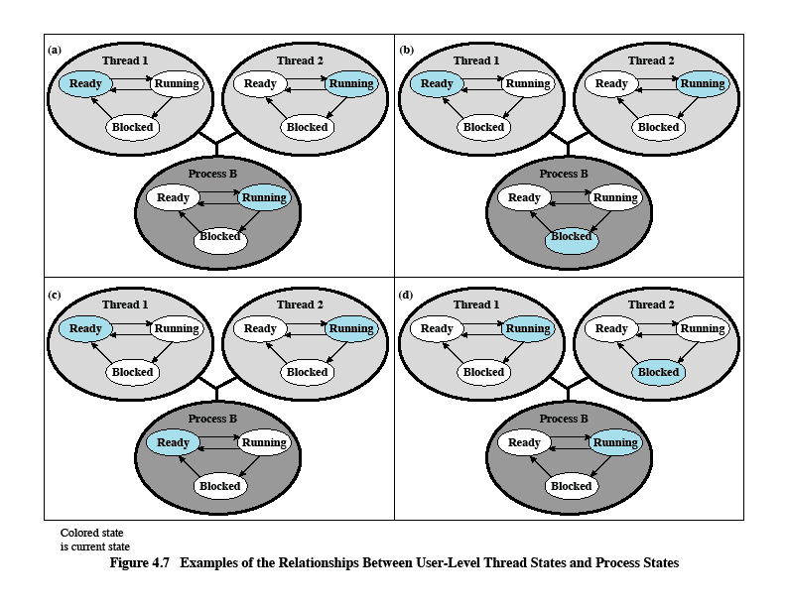
Relationships Between ULT States and Process States
This example will clarify the relationship between thread scheduling and process scheduling
Possible transitions from 4.6a:
4.6a→4.6b
4.6a→4.6c
4.6a→4.6d
Notes:
Suppose that process B is executing in its thread 2; the states of the process and two ULTs that are part of the process are shown in Figure 4.6a . Each of the following is a possible occurrence:
1. The application executing in thread 2 makes a system call that blocks B. For
example, an I/O call is made. This causes control to transfer to the kernel. The kernel invokes the I/O action, places process B in the Blocked state, and switches to another process. Meanwhile, according to the data structure maintained by the threads library, thread 2 of process B is still in the Running state. It is important to note that thread 2 is not actually running in the sense of being executed on a processor; but it is perceived as being in the Running state by the threads library. The corresponding state diagrams are shown in Figure 4.6b .
2. A clock interrupt passes control to the kernel and the kernel determines that the currently running process (B) has exhausted its time slice.
The kernel places process B in the Ready state and switches to another process. Meanwhile, according to the data structure maintained by the threads library, thread 2 of process B is still in the Running state. The corresponding state diagrams are shown in Figure 4.6c .
3. Thread 2 has reached a point where it needs some action performed by thread 1 of process B.
Thread 2 enters a Blocked state and thread 1 transitions from Ready to Running. The process itself remains in the Running state. The corresponding state diagrams are shown in Figure 4.6d .
In cases 1 and 2 ( Figures 4.6b and 4.6c ), when the kernel switches control back to process B, execution resumes in thread 2. Also note that a process can be interrupted, either by exhausting its time slice or by being preempted by a higher priority process, while it is executing code in the threads library. Thus, a process may be in the midst of a thread switch from one thread to another when interrupted. When that process is resumed, execution continues within the threads library, which completes the thread switch and transfers control to another thread within that process.

Slide 44
Advantages of ULTs over KLTs
1. Thread switching does not require kernel mode privileges
because all of the thread management data structures are within the user address space of a single process.
This saves the overhead of two mode switches (user to kernel; kernel back to user).
2. Scheduling can be application specific.
One application may benefit most from a simple round-robin scheduling algorithm, while another might benefit from a priority-based scheduling algorithm.
The scheduling algorithm can be tailored to the application without disturbing the underlying OS scheduler.
3. ULTs can run on any OS.
No changes are required to the underlying kernel to support ULTs.
The threads library is a set of application-level functions shared by all applications.

Slide 45
Disadvantages of ULTs
when a ULT executes a system call, not only is that thread blocked, but all of the threads within the process are blocked
In a pure ULT strategy, a multithreaded application cannot take advantage of multiprocessing
Notes:
There are two disadvantages of ULTs compared to KLTs:
1. In a typical OS, many system calls are blocking. As a result, when a ULT
executes a system call, not only is that thread blocked, but also all of the threads within the process are blocked.
2. In a pure ULT strategy, a multithreaded application cannot take advantage
of multiprocessing. A kernel assigns one process to only one processor at a time. Therefore, only a single thread within a process can execute at a time. In effect, we have application-level multiprogramming within a single process. While this multiprogramming can result in a significant speedup of the application, there are applications that would benefit from the ability to execute portions of code simultaneously.

Slide 46
Overcoming ULT Disadvantages
There are ways to work around these two problems.
For example, both problems can be overcome by writing an application as multiple processes rather than multiple threads.
But this approach eliminates the main advantage of threads: Each switch becomes a process switch rather than a thread switch, resulting in much greater overhead.
Another way to overcome the problem of blocking threads is to use a technique referred to as jacketing .
The purpose of jacketing is to convert a blocking system call into a non-blocking system call.
Instead of directly calling a system I/O routine, a thread calls an application-level I/O jacket routine.
Within this jacket routine is code that checks to determine if the I/O device is busy. If it is, the thread enters the Blocked state and passes control (through the threads library) to another thread.
When this thread later is given control again, the jacket routine checks the I/O device again.

Slide 47
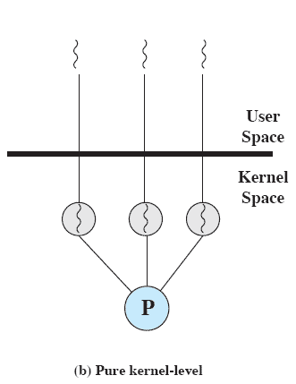
Kernel-Level Threads (KLTs)
Thread management is done by the kernel
no thread management is done by the application
Windows is an example of this approach
The kernel maintains context information for the process as a whole and for individual threads within the process.
Notes:
KERNEL-LEVEL THREADS
In a pure KLT facility, all of the work of thread management is done by the kernel. There is no thread management code in the application level, simply an application programming interface (API) to the kernel thread facility. Windows is an example of this approach. Figure 4.5b depicts the pure KLT approach. The kernel maintains context
information for the process as a whole and for individual threads within the process.

Slide 48
Advantages of KLTs
Scheduling by the kernel is done on a thread basis.
This approach overcomes the two principal drawbacks of the ULT approach.
The kernel can simultaneously schedule multiple threads from the same process on multiple processors
If one thread in a process is blocked, the kernel can schedule another thread of the same process
Notes:
Scheduling by the kernel is done on a thread basis. This approach overcomes the two principal drawbacks of the ULT approach. First, the kernel can simultaneously schedule multiple threads from the same process on multiple processors. Second, if one thread in a process is blocked, the kernel can schedule another thread of the same process. Another advantage of the KLT approach is that kernel routines themselves can be multithreaded.

Slide 49
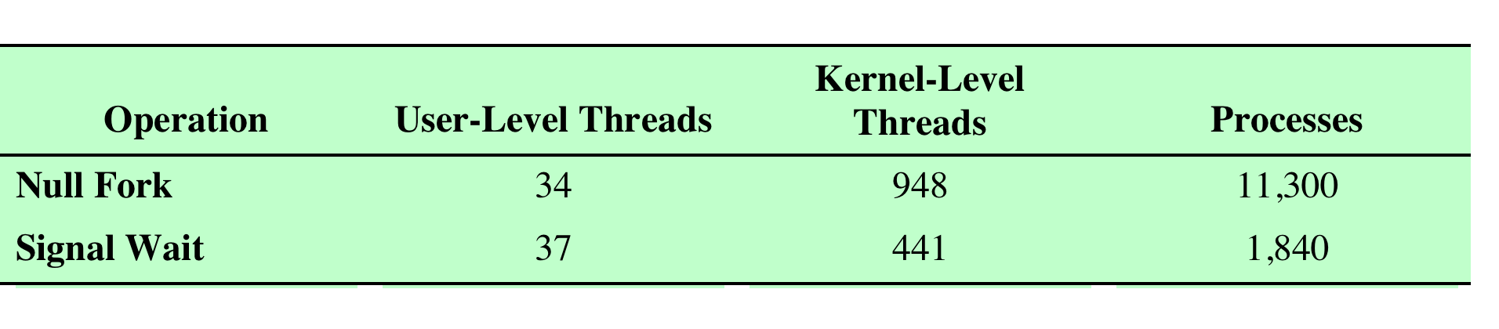

Disadvantage of KLTs
The principal disadvantage of the KLT approach compared to the ULT approach is that the transfer of control from one thread to another within the same process requires a mode switch to the kernel.
Notes:
Table 4.1 shows the results of measurements taken on a uniprocessor VAX computer running a UNIX-like OS. The two benchmarks are as follows:
Null Fork, the time to create, schedule, execute, and complete a process/thread that invokes the null procedure (i.e., the overhead of forking a process/thread);
Signal-Wait, the time for a process/thread to signal a waiting process/thread and then wait on a condition (i.e., the overhead of synchronizing two processes/threads together).
We see that there is an order of magnitude or more of difference between ULTs and KLTs and similarly between KLTs and processes.

Slide 50
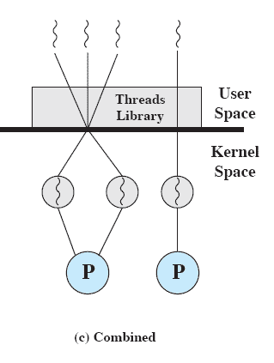
Combined Approaches
Some operating systems provide a combined ULT/ KLT facility. Solaris is a good example.
In a combined system, thread creation is done completely in user space, as is the bulk of the scheduling and synchronization of threads within an application.
The multiple ULTs from a single application are mapped onto some (smaller or equal) number of KLTs.
The programmer of the application may adjust the number of KLTs for a particular application and processor to achieve the best overall results.
In a combined approach, multiple threads within the same application can run in parallel on multiple processors, and a blocking system call need not block the entire process.
Notes:
COMBINED APPROACHES
Some operating systems provide a combined ULT/ KLT facility ( Figure 4.5c ). In a combined system, thread creation is done completely in user space, as is the bulk of the scheduling and synchronization of threads within an application. The multiple ULTs from a single application are mapped onto some (smaller or equal) number of KLTs. The programmer may
adjust the number of KLTs for a particular application and processor to achieve the best overall results. In a combined approach, multiple threads within the same application can run in parallel on multiple processors, and a blocking system call need not block the entire process. If properly designed, this approach should combine the advantages of the pure ULT and KLT approaches while minimizing the disadvantages. Solaris is a good example of an OS using this combined approach. The current Solaris version limits the ULT/KLT relationship to be one-to-one.

Slide 51
Relationship between user threads and kernel threads

Slide 52
Many-to-One Model
It maps many user-level threads to one kernel thread.
Thread management is done by the thread library in user space, so it is efficient.
However, the entire process will block if a thread makes a blocking system call.
Also, because only one thread can access the kernel at a time, multiple threads are unable to run in parallel on multicore systems.

Slide 53
One-to-One Model
It maps each user thread to a kernel thread.
It provides more concurrency than the many-to-one model by allowing another thread to run when a thread makes a blocking system call.
It also allows multiple threads to run in parallel on multiprocessors.
The only drawback to this model is that creating a user thread requires creating the corresponding kernel thread, and a large number of kernel threads may burden the performance of a system.
Linux, along with the family of Windows operating systems, implement the one-to-one model.

Slide 54
Many-to-Many Model
The many-to-many model multiplexes many user-level threads to a smaller or equal number of kernel threads.
The number of kernel threads may be specific to either a particular application or a particular machine (an application may be allocated more kernel threads on a system with eight processing cores than a system with four cores).
many-to-many model appears to be the most flexible of the models discussed, in practice it is difficult to implement.
Most operating systems now use the one-to-one model.

Slide 55
Thread Libraries
A thread library provides the programmer with an API for creating and managing threads.
There are two primary ways of implementing a thread library.
The first approach is to provide a library entirely in user space with no kernel support.
All code and data structures for the library exist in user space.
invoking a function in the library results in a local function call in user space and not a system call.
The second approach is to implement a kernel-level library supported directly by the operating system.
Code and data structures for the library exist in kernel space.
Invoking a function in the API for the library typically results in a system call to the kernel.

Slide 56
Thread Libraries
Three main thread libraries are in use today:
POSIX Pthreads
used in UNIX, Linux, and macOS systems
Windows
Java
For POSIX and Windows threading, any data declared globally—that is, declared outside of any function—are shared among all threads belonging to the same process.

