Slide 1

FEA Lab Project
By: Syed Muhammad Haider Hameed (ME-1876)

Slide 2
Project Overview
Finite Element Analysis conducted using ANSYS
Two major analyses: Static Structural & Transient Structural
Geometry based on roll number rule: Pentagon shape
Custom material created using roll number digits

Slide 3
Static Structural – Workflow
Created material: Young’s Modulus = 76000 MPa, Poisson Ratio = 0.28
Geometry: Pentagon sketch extruded to 1 m
Mesh generated after assigning material
Fixed support applied to one face
Remote force applied at 1/3rd length (5.635 m)

Slide 4
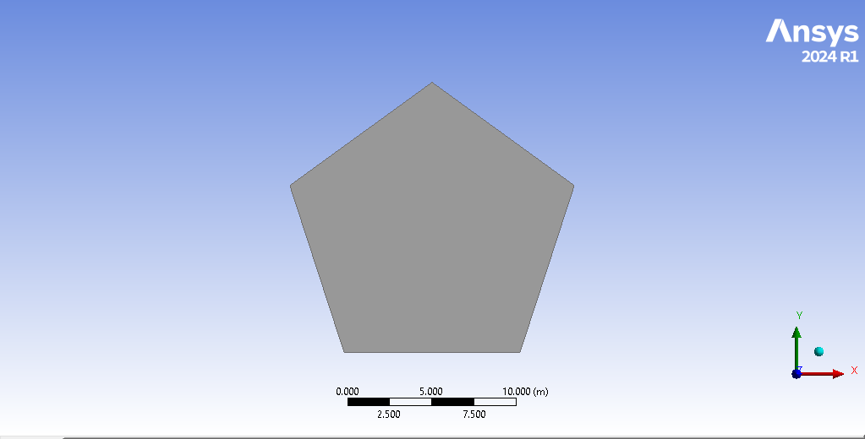
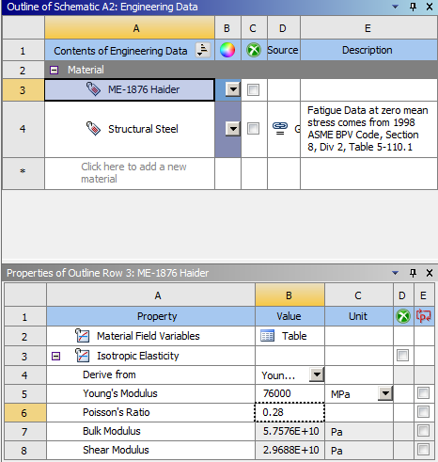
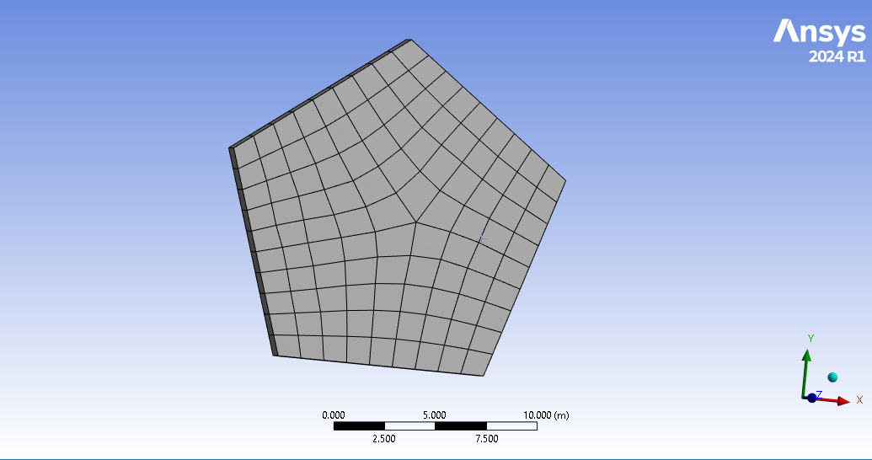
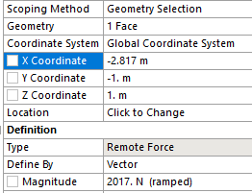

Slide 5
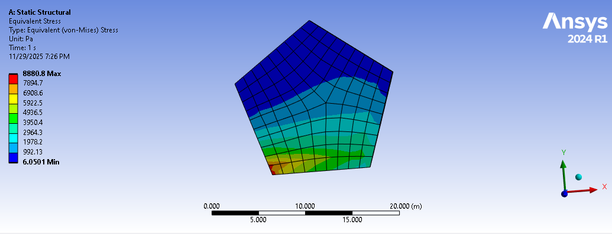
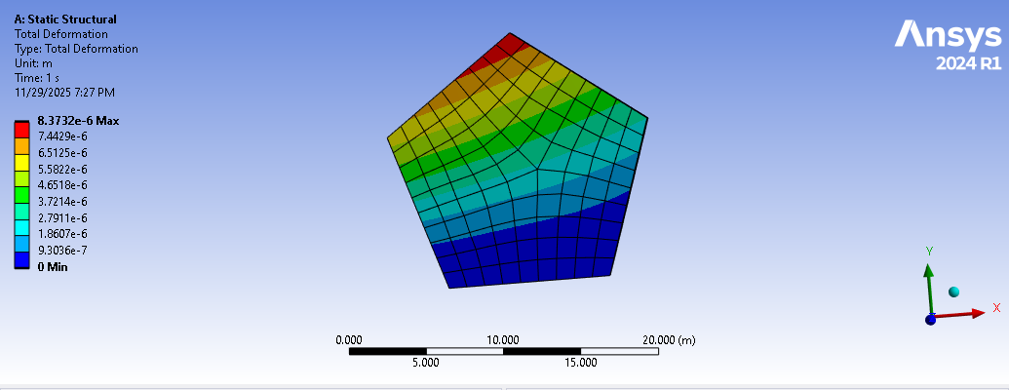
Static Structural – Results
Total deformation observed
Equivalent Von-Mises stress calculated

Slide 6

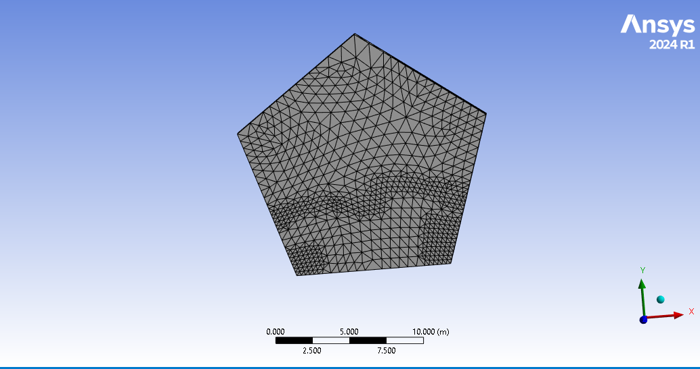
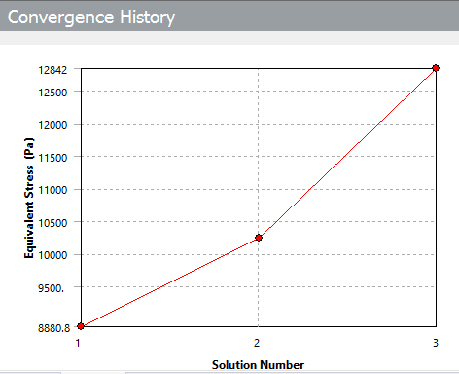

Slide 7

Transient Structural – Workflow
Same geometry and material setup
Body sizing: 1 m mesh
Time settings: 1 s duration, 0.25 s step
Fixed support on one face
Forces applied on four faces

Slide 8
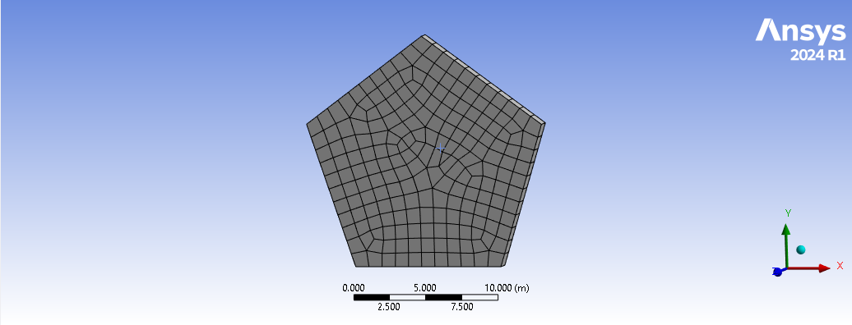
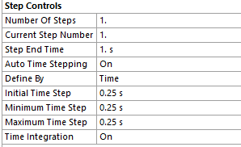
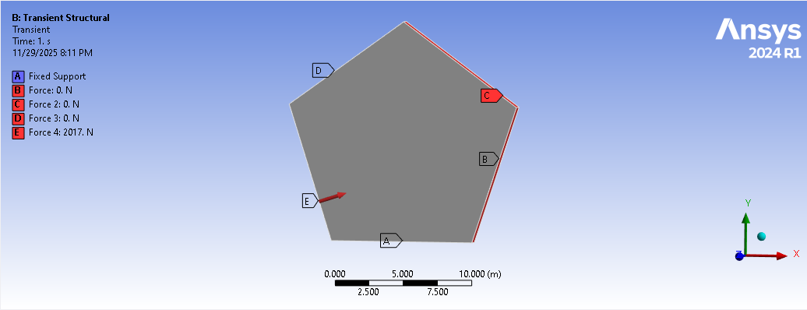

Slide 9
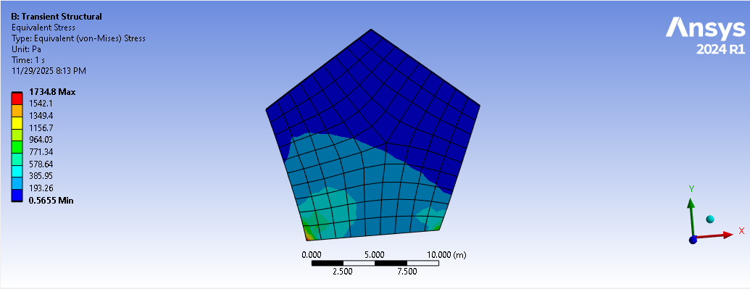
Transient Structural – Results
Equivalent Von-Mises stress evaluated
Time-dependent effects analyzed

Slide 10
Conclusion
Successfully applied FEA concepts using ANSYS
Demonstrated understanding of material creation, meshing, load application, and result interpretation.
Both static and dynamic behavior of structure analyzed

