Slide 1
Historical Perspective of Data Models
Spring 2023: Database Systems

Slide 2
Historical Perspective on Data Models
Network Data Model
Hierarchical Data Model
Relational Data Model
Object Oriented Data Model
Object Relational Data Model

Slide 3
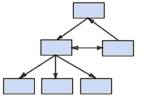
Historical Perspective
Early 1960s:
First general purpose DBMS, called Integrated Data Store.
Based on network data model (representation framework)
The network model or database organization retains the organization of information on branches and nodes, but does not require a tree of structure.
Designed by Charles Bachman at GE.
1973: Received 1st ACM Turing Award.
Q: What is network data model?

Slide 4
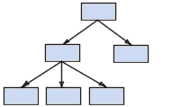
Historical Perspective
Late 1960s:
IBM’s IMS(Information Management Systems) DBMS
Based on hierarchical data model
The hierarchical model has the characteristic that each item has a single predecessor and a variable number of subordinate data items.
SABRE (Airline reservation system) was developed both by American Airlines & IBM.
Q: What is hierarchical data model?

Slide 5
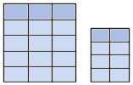
Historical Perspective
1970s:
Edgar Codd at IBM (San Jose Laboratory) proposed new representation framework
Based on relational data model
The data is stored in two-dimensional tables (rows and columns)
Relational model led to rapid development of various DBMSs.
1981: Received ACM Turing Award.
Q: What is hierarchical data model?

Slide 6
Historical Perspective
In 1980s:
Relational model remained as a dominant force in industry.
-SQL was developed as part of IBM’s System R Project, and was later standardized as standard query language.
Current SQL Standard is: SQL:2011 (7th Revision)
Previous: SQL:2008, 2003, SQL:1999 etc

Slide 7
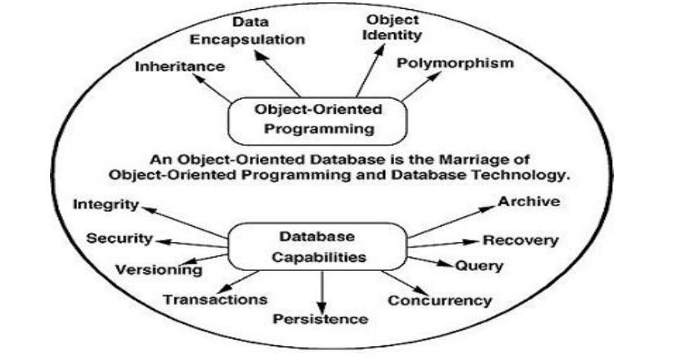
OODBMS
In Mid 1980s: Based on Object Oriented Data Model
Data is represented in the form of objects.

Slide 8
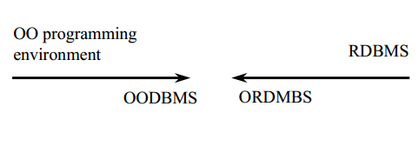
Object Relational DBMS
In Early 1990s:
Traditional Relational database extended to include object oriented concepts.

Slide 9
References: Books
A. Database System Concepts
by Silberschatz, H. F. Korth & S. Sudarshan
McGraw Hill, 6th edition, 2010.
B. Fundamentals of Database Systems
by R. Elmasri & S. B. Navathe.
Addison Wesley, 6th edition, 2011
C. Database Management Systems
Raghu Ramakrishnan
McGraw Hill, 3rd Edition, 2003

Slide 10
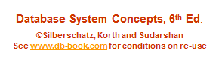
Module 1: Introduction
Lecture 2

Slide 11
Outline
The Need for Databases
Data Models
Relational Databases
Database Design
Storage Manager
Query Processing
Transaction Manager

Slide 12
Database Management System (DBMS)
DBMS contains information about a particular enterprise
Collection of interrelated data
Set of programs to access the data
An environment that is both convenient and efficient to use
Database Applications:
Banking: transactions
Airlines: reservations, schedules
Universities: registration, grades
Sales: customers, products, purchases
Online retailers: order tracking, customized recommendations
Manufacturing: production, inventory, orders, supply chain
Human resources: employee records, salaries, tax deductions
Databases can be very large.
Databases touch all aspects of our lives
Notes:
12

Slide 13
University Enterprise Example
One way of Storing Information is to use Files (or File Systems).
Application Programs are written to manipulate the information stores in files. Such programs may include:
Adding new students, instructors, and courses
Registering students for courses, and generate class rosters
Assigning grades to students, compute grade point averages (GPA) and generate transcripts
In the early days, database applications were built directly on top of file systems.
New application programs are written as and when the need arises.
Notes:
13
-Updated

Slide 14
Drawbacks of using file systems to store data
It is very difficult to manage data in files. The reasons could be obvious when we understand the drawbacks of the Files:
Data redundancy and inconsistency
Multiple file formats, duplication of information in different files
For example: Student with a double major (Music and Mathematics) will store information regarding telephone and address in two different files hence causing duplication leading to higher storage and access cost.
Difficulty in accessing data
Need to write a new program to carry out each new task
Very inefficient and inconvenient task.
Notes:
14
Updated…

Slide 15
Drawbacks of using file systems to store data
Data isolation
Data can be scattered across multiple files and different file formats.
Becomes very difficult to retrieve data.
Integrity problems
Integrity constraints (e.g., account balance > 0) become “buried” in program code rather than being stated explicitly
Hard to add new constraints or change existing ones
Notes:
15
Updated…

Slide 16
Drawbacks of using file systems to store data (Cont.)
Atomicity of updates
Failures may leave database in an inconsistent state with partial updates carried out.
Example: Transfer of funds from one account to another should either complete or not happen at all (atomicity).
Concurrent access by multiple users
Concurrent access needed for performance
Uncontrolled concurrent accesses can lead to inconsistencies
Example: Two people reading a balance (say 100) and updating it by withdrawing money (say 50 each) at the same time.
Notes:
16
updated

Slide 17
Drawbacks of using file systems to store data (Cont.)
Security problems
Hard to provide user access to some, but not all, data
Database systems offer solutions to all the above problems
Notes:
17
updated

Slide 18
Levels of Abstraction
DBMS provides users with abstract view of data.
Abstraction: Hiding details of how data is stored and maintained.
1. Physical level: describes how a record (e.g., instructor) is stored.
Data in form of records is stored in files and is also indexed.
Addresses “how” part.
2. Logical level: describes data stored in database, and the relationships among the data.
Defines logical structure of data.
Addresses “what” part.
type instructor = record
ID : string; name : string; dept_name : string; salary : integer;
end;
Notes:
18
-Updated slides in PC.
-Partially updated here.

Slide 19
Levels of Abstraction
3. View level: application programs hide details of data types. Views can also hide information (such as an employee’s salary) for security purposes.
Views describe how users see the data.
Notes:
19
-Updated slides in PC.
-Partially updated here.

Slide 20
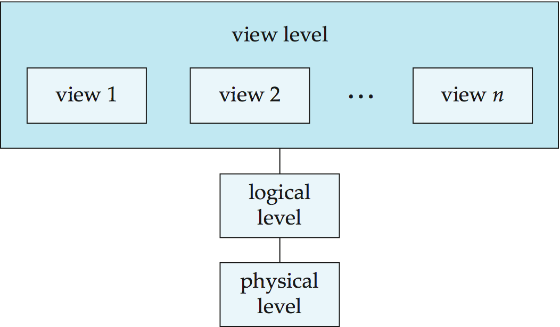
Levels of Abstraction in a DBMS
Notes:
20

Slide 21
Levels of Abstraction in a DBMS
← Multiple
← Single
← Single
Notes:
21

Slide 22
Levels of Abstraction in a DBMS
3. External Schema
describes views of data
← Multiple
2. Conceptual Schema
describes data stored in terms of data model.
1. Physical Schema
Provides storage details
Single
Single
Notes:
22

Slide 23
Levels of Abstraction in a DBMS
3. External Schema
describes views of data
← Multiple
2. Conceptual Schema
describes data stored in terms of data model.
1. Physical Schema
Provides storage details
Single
-Build relations
-Conceptual DB Design
Single
-Unsorted files of records, Indexes
-Physical DB Design
Notes:
23

Slide 24
Levels of Abstraction
Information about all three schemas is stored in System Catalog.
DDL (Data Definition Language) describes the external and conceptual schemas.
Notes:
24
-Updated slides in PC.
-Partially updated here.

Slide 25
Instances and Schemas
Similar to types and variables in programming languages
Schema – the overall design of the database. (analogous to variable declaration).
Logical Schema – the overall logical structure of the database
Example: The database consists of information about a set of customers and accounts in a bank and the relationship between them
Analogous to type information of a variable in a program
Physical schema– the overall physical structure of the database.
Instance – the actual content of the database at a particular point in time
Analogous to the value of a variable
Physical Data Independence – the ability to modify the physical schema without changing the logical schema
Applications depend on the logical schema
In general, the interfaces between the various levels and components should be well defined so that changes in some parts do not seriously influence others.
Notes:
25
-updated in office pc.
-updates in laptop.

Slide 26
Data Models
A collection of tools for describing
Data
Data relationships
Data semantics
Data constraints
Four Classifications of Data Models:
Relational model
Entity-Relationship data model (mainly for database design)
Object-based data models (Object-oriented and Object-relational)
Semistructured data model (XML)
Other older models:
Network model
Hierarchical model
Notes:
26
-updated in laptop.

Slide 27
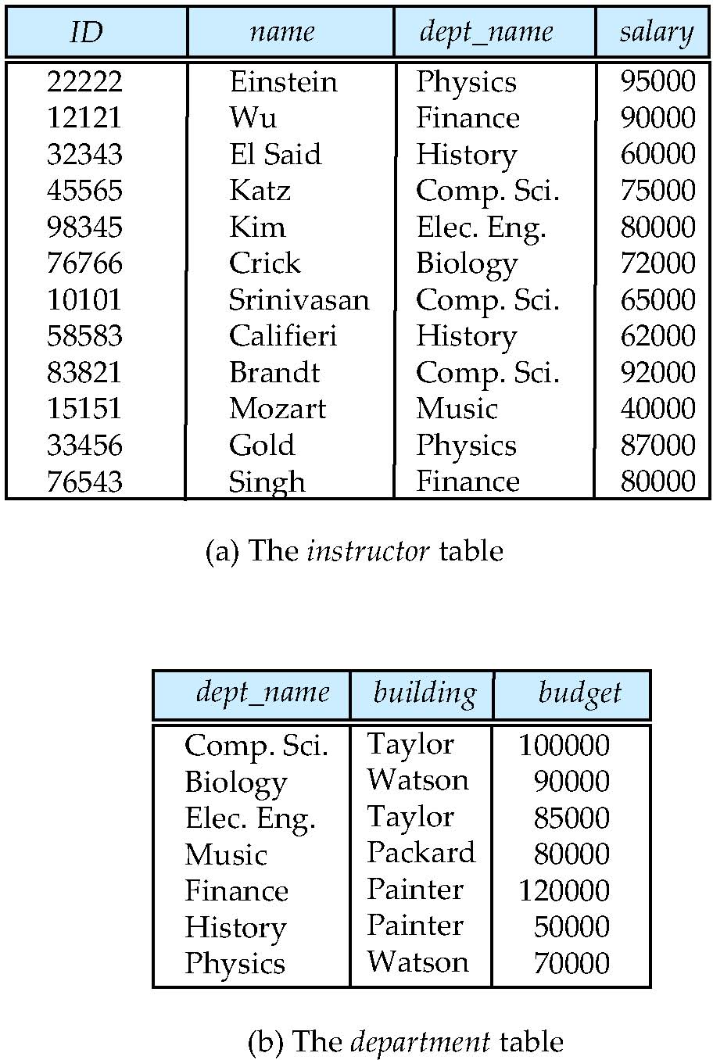
Relational Model
All the data is stored in various tables.
Example of tabular data in the relational model
Tables are called relations.
Columns
Rows
Notes:
27
-Updated in Laptop.

Slide 28
A Sample Relational Database
Notes:
28

Slide 29
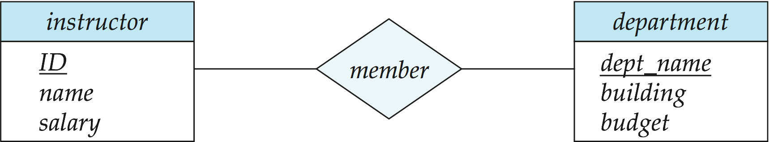
The Entity-Relationship Model
Models an enterprise as a collection of entities and relationships
Entity: a “thing” or “object” in the enterprise that is distinguishable from other objects
Described by a set of attributes
Relationship: an association among several entities
Represented diagrammatically by an entity-relationship diagram:
Notes:
29

Slide 30
Object-Based Data Models
Object Oriented Data Model:
A model extending the E-R model with object oriented constructs of encapsulation, methods and object identity.
Object Relational Data Models
Combines the features of object-oriented data model and relational data model. (Chapter 22).
Notes:
30

Slide 31
XML: Extensible Markup Language
Defined by the WWW Consortium (W3C)
Originally intended as a document markup language not a database language
The ability to specify new tags, and to create nested tag structures made XML a great way to exchange data, not just documents
XML has become the basis for all new generation data interchange formats.
A wide variety of tools is available for parsing, browsing and querying XML documents/data
Notes:
31

Slide 32
Data Definition Language (DDL)
Specification notation for defining the database schema
Example: create table instructor ( ID char(5), name varchar(20), dept_name varchar(20), salary numeric(8,2))
DDL compiler generates a set of table templates stored in a data dictionary
Data dictionary contains metadata (i.e., data about data)
Database schema
Integrity constraints
Primary key (ID uniquely identifies instructors)
Authorization
Who can access what
Notes:
32

Slide 33
Data Manipulation Language (DML)
Language for accessing and manipulating the data organized by the appropriate data model
DML also known as query language
Notes:
33
-updated.

Slide 34
SQL
Structured Query Language.
Query Language for inquiring into data and metadata from within DBMS.
The most widely used commercial language
DDL and DML are part of SQL
Notes:
34

Slide 35
Database Design
The process of designing the general structure of the database:
Logical Design – Deciding on the database schema. Database design requires that we find a “good” collection of relation schemas.
Business decision – What attributes should we record in the database?
Computer Science decision – What relation schemas should we have and how should the attributes be distributed among the various relation schemas?
Physical Design – Deciding on the physical layout of the database
Notes:
35

Slide 36
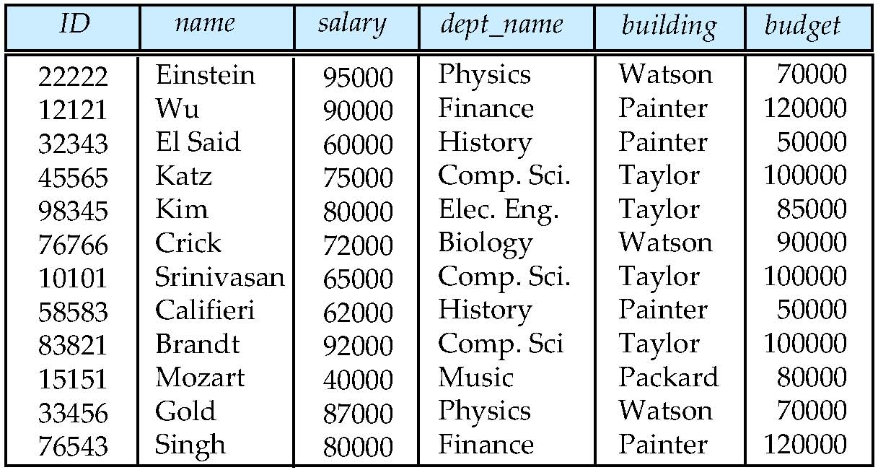
Database Design (Cont.)
Is there any problem with this relation?
Repetition of Information (Department)
Problems: wastes space, lead to inconsistencies, update costs are high.
Inability to Represent Information ( A new department )
Solution is to introducing null values in columns
Notes:
36

Slide 37
Design Approaches
Need to come up with a methodology to ensure that each of the relations in the database is “good”
Two ways of doing so:
Entity Relationship Model (Chapter 7)
Models an enterprise as a collection of entities and relationships
Represented diagrammatically by an entity-relationship diagram:
Normalization Theory (Chapter 8)
Formalize what designs are bad, and test for them
Notes:
37
Last Slide

Slide 38
References: Books
Database System Concepts
by Silberschatz, H. F. Korth & S. Sudarshan
McGraw Hill, 6th edition, 2010.
B. Fundamentals of Database Systems
by R. Elmasri & S. B. Navathe.
Addison Wesley, 6th edition, 2011
C. Database Management Systems
Raghu Ramakrishnan
McGraw Hill, 3rd Edition, 2003

