Slide 1
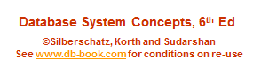
Module 3: Introduction to SQL
(Chapter 3)
Lecture No. 7 & 8

Slide 2
Set Operations
Find courses that ran in Fall 2009 or in Spring 2010
(select course_id from section where sem = ‘Fall’ and year = 2009)
union
(select course_id from section where sem = ‘Spring’ and year = 2010)
Find courses that ran in Fall 2009 and in Spring 2010
(select course_id from section where sem = ‘Fall’ and year = 2009)
intersect
(select course_id from section where sem = ‘Spring’ and year = 2010)
Find courses that ran in Fall 2009 but not in Spring 2010
(select course_id from section where sem = ‘Fall’ and year = 2009)
except
(select course_id from section where sem = ‘Spring’ and year = 2010)

Slide 3
Set Operations (Cont.)
Find the salaries of all instructors that are less than the largest salary.
  select distinct T.salary
  from instructor as T, instructor as S
  where T.salary < S.salary
Find all the salaries of all instructors
  select distinct salary
  from instructor
Find the largest salary of all instructors.
  (select “second query” )
  except
  (select “first query”)
Notes:
9

Slide 4
Null Values
It is possible for tuples to have a null value, denoted by null, for some of their attributes
null signifies an unknown value or that a value does not exist.
The result of any arithmetic expression involving null is null
  Example: 5 + null returns null
The predicate is null can be used to check for null values.
  Example: Find all instructors whose salary is null.
select name
from instructor
where salary is null

Slide 5
Null Values and Three Valued Logic
Three values – true, false, unknown
Any comparison with null returns unknown
  Example: 5 < null or null <> null or null = null
Three-valued logic using the value unknown:
  OR: (unknown or true) = true,
  (unknown or false) = unknown
  (unknown or unknown) = unknown
  AND: (true and unknown) = unknown,
  (false and unknown) = false,
  (unknown and unknown) = unknown
  NOT: (not unknown) = unknown
  “P is unknown” evaluates to true if predicate P evaluates to unknown
Result of where clause predicate is treated as false if it evaluates to unknown

Slide 6
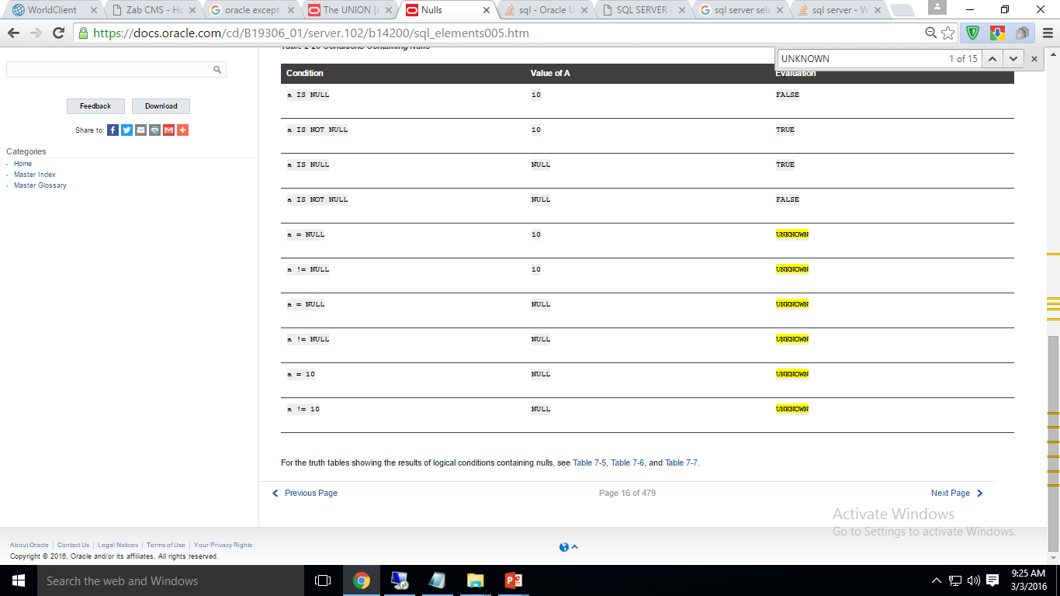

Slide 8
Aggregate Functions
These functions operate on the multiset of values of a column of a relation, and return a value
avg: average value
min: minimum value
max: maximum value
sum: sum of values
count: number of values

Slide 9
Aggregate Functions (Cont.)
Find the average salary of instructors in the Computer Science department
  select avg (salary)
  from instructor
  where dept_name= ’Comp. Sci.’;
Find the total number of instructors who teach a course in the Spring 2010 semester
  select count (distinct ID)
  from teaches
  where semester = ’Spring’ and year = 2010;
Find the number of tuples in the course relation
  select count (*)
  from course;

Slide 10


Aggregate Functions – Group By
Find the average salary of instructors in each department
  select dept_name, avg (salary) as avg_salary
  from instructor
  group by dept_name;
avg_salary

Slide 11
Aggregation (Cont.)
Attributes in select clause outside of aggregate functions must appear in group by list
  /* erroneous query */
  select dept_name, ID, avg (salary)
  from instructor
  group by dept_name;

Slide 12
Aggregate Functions – Having Clause
Find the names and average salaries of all departments whose average salary is greater than 42000
select dept_name, avg (salary)
from instructor
group by dept_name
having avg (salary) > 42000;
Note: predicates in the having clause are applied after the
formation of groups whereas predicates in the where
clause are applied before forming groups

Slide 13
Null Values and Aggregates
Total all salaries
select sum (salary )
from instructor
  Above statement ignores null amounts
  Result is null if there is no non-null amount
All aggregate operations except count(*) ignore tuples with null values on the aggregated attributes
What if collection has only null values?
  count returns 0
  all other aggregates return null

Slide 14
Nested Subqueries
SQL provides a mechanism for the nesting of subqueries. A subquery is a select-from-where expression that is nested within another query.
The nesting can be done in the following SQL query
select A₁, A₂, ..., A_{n}
from r₁, r₂, ..., r_{m}
where P
as follows:
  A_{i} can be replaced by a subquery that generates a single value.
  r_{i} can be replaced by any valid subquery
  P can be replaced with an expression of the form:
  B <operation> (subquery)
  Where B is an attribute and <operation> to be defined later.
  Sub-query can also be written in having clause.

Slide 15
Subqueries in the Where Clause

Slide 16
Subqueries in the Where Clause
A common use of subqueries is to perform tests:
  For set membership
  For set comparisons
  For set cardinality.

Slide 17
Set Membership
Find courses offered in Fall 2009 and in Spring 2010
select distinct course_id
from section
where semester = ’Fall’ and year= 2009 and
course_id in (select course_id
from section
where semester = ’Spring’ and year= 2010);
Find courses offered in Fall 2009 but not in Spring 2010
select distinct course_id
from section
where semester = ’Fall’ and year= 2009 and
course_id not in (select course_id
from section
where semester = ’Spring’ and year= 2010);

Slide 18
Set Membership (Cont.)
Find the total number of (distinct) students who have taken course sections taught by the instructor with ID 10101
select count (distinct ID)
from takes
where (course_id, sec_id, semester, year) in
(select course_id, sec_id, semester, year
from teaches
where teaches.ID= 10101);
Note: Above query can be written in a much simpler manner.
The formulation above is simply to illustrate SQL features.

Slide 19
Set Comparison – “some” Clause
Find names of instructors with salary greater than that of some (at least one) instructor in the Biology department.
select distinct T.name
from instructor as T, instructor as S
where T.salary > S.salary and S.dept name = ’Biology’;
Same query using > some clause
select name
from instructor
where salary > some (select salary
from instructor
where dept name = ’Biology’);

Slide 20
Definition of “some” Clause
F <comp> some r ⇔ ∃ t ∈ r such that (F <comp> t )
Where <comp> can be: <, ≤, >, =, ≠
0
(5 < some
5
) = true
(read: 5 < some tuple in the relation)
6
0
(5 < some
5
) = false
0
(5 = some
) = true
5
0
(5 ≠ some
5
) = true (since 0 ≠ 5)
(= some) ≡ in
However, (≠ some) ≡ not in

Slide 21
Set Comparison – “all” Clause
Find the names of all instructors whose salary is greater than the salary of all instructors in the Biology department.
select name
from instructor
where salary > all (select salary
from instructor
where dept name = ’Biology’);

Slide 22
Definition of “all” Clause
F <comp> all r ⇔ ∀ t ∈ r (F <comp> t)
0
(5 < all
5
) = false
6
6
(5 < all
) = true
10
4
(5 = all
) = false
5
4
(5 ≠ all
) = true (since 5 ≠ 4 and 5 ≠ 6)
6
(≠ all) ≡ not in
However, (= all) ≡ in

Slide 23
Test for Empty Relations
The exists construct returns the value true if the argument subquery is nonempty.
exists r ⇔ r ≠ Ø
not exists r ⇔ r = Ø

Slide 24
Use of “exists” Clause
Yet another way of specifying the query “Find all courses taught in both the Fall 2009 semester and in the Spring 2010 semester”
select course_id
from section as S
where semester = ’Fall’ and year = 2009 and
exists (select *
from section as T
where semester = ’Spring’ and year= 2010
and S.course_id = T.course_id);
Correlation name – variable S in the outer query
Correlated subquery – the inner query : Executes once for each row processed by the outer/parent query.

Slide 25
Use of “not exists” Clause
Find all students who have taken all courses offered in the Biology department.
select distinct S.ID, S.name
from student as S
where not exists ( (select course_id
from course
where dept_name = ’Biology’)
except
(select T.course_id
from takes as T
where S.ID = T.ID));
First nested query lists all courses offered in Biology
Second nested query lists all courses a particular student took
Note that X – Y = Ø ⇔ X ⊆ Y
Note: Cannot write this query using = all and its variants

Slide 26
Test for Absence of Duplicate Tuples
The unique construct tests whether a subquery has any duplicate tuples in its result.
The unique construct evaluates to “true” if a given subquery contains no duplicates .
Find all courses that were offered at most once in 2009
  select T.course_id
  from course as T
  where unique (select R.course_id
  from section as R
  where T.course_id= R.course_id
  and R.year = 2009);

Slide 27
Subqueries in the Form Clause

Slide 28
Subqueries in the From Clause
SQL allows a subquery expression to be used in the from clause
Find the average instructors’ salaries of those departments where the average salary is greater than $42,000.”
  select dept_name, avg_salary
  from (select dept_name, avg (salary) as avg_salary
  from instructor
  group by dept_name)
  where avg_salary > 42000;
Note that we do not need to use the having clause
Another way to write above query
  select dept_name, avg_salary
  from (select dept_name, avg (salary)
  from instructor
  group by dept_name) as dept_avg (dept_name, avg_salary)
  where avg_salary > 42000;

Slide 29
With Clause
The with clause provides a way of defining a temporary relation whose definition is available only to the query in which the with clause occurs.
Find all departments with the maximum budget
with max_budget (value) as
(select max(budget)
from department)
select department.name
from department, max_budget
where department.budget = max_budget.value;

Slide 30
Complex Queries using With Clause
Find all departments where the total salary is greater than the average of the total salary at all departments
with dept _total (dept_name, value) as
(select dept_name, sum(salary)
from instructor
group by dept_name),
dept_total_avg(value) as
(select avg(value)
from dept_total)
select dept_name
from dept_total, dept_total_avg
where dept_total.value > dept_total_avg.value;

Slide 31
Subqueries in the Select Clause

Slide 32
Scalar Subquery
Scalar subquery is one which is used where a single value is expected
List all departments along with the number of instructors in each department
select dept_name,
(select count(*)
from instructor
where department.dept_name = instructor.dept_name)
as num_instructors
from department;
Runtime error if subquery returns more than one result tuple

Slide 33
Modification of the Database
Deletion of tuples from a given relation.
Insertion of new tuples into a given relation
Updating of values in some tuples in a given relation

Slide 34
Deletion
Delete all instructors
delete from instructor
Delete all instructors from the Finance department
delete from instructor
where dept_name= ’Finance’;
Delete all tuples in the instructor relation for those instructors associated with a department located in the Watson building.
delete from instructor
where dept name in (select dept name
from department
where building = ’Watson’);

Slide 35
Deletion (Cont.)
Delete all instructors whose salary is less than the average salary of instructors
delete from instructor
where salary < (select avg (salary)
from instructor);
  Problem: as we delete tuples from deposit, the average salary changes
  Solution used in SQL:
  1. First, compute avg (salary) and find all tuples to delete
  2. Next, delete all tuples found above (without
  recomputing avg or retesting the tuples)

Slide 36
Insertion
Add a new tuple to course
insert into course
values (’CS-437’, ’Database Systems’, ’Comp. Sci.’, 4);
or equivalently
insert into course (course_id, title, dept_name, credits)
values (’CS-437’, ’Database Systems’, ’Comp. Sci.’, 4);
Add a new tuple to student with tot_creds set to null
insert into student
values (’3003’, ’Green’, ’Finance’, null);

Slide 37
Insertion (Cont.)
Add all instructors to the student relation with tot_creds set to 0
insert into student
select ID, name, dept_name, 0
from instructor
The select from where statement is evaluated fully before any of its results are inserted into the relation.
Otherwise queries like
insert into table1 select * from table1
would cause problem

Slide 38
Updates
Increase salaries of instructors whose salary is over $100,000 by 3%, and all others by a 5%
  Write two update statements:
  update instructor
  set salary = salary * 1.03
  where salary > 100000;
  update instructor
  set salary = salary * 1.05
  where salary <= 100000;
  The order is important
  Can be done better using the case statement (next slide)

Slide 39
Case Statement for Conditional Updates
Same query as before but with case statement
update instructor
set salary = case
when salary <= 100000 then salary * 1.05
else salary * 1.03
end

Slide 40
Updates with Scalar Subqueries
Recompute and update tot_creds value for all students
update student S
set tot_cred = (select sum(credits)
from takes, course
where takes.course_id = course.course_id and
S.ID= takes.ID.and takes.grade <> ’F’ and
takes.grade is not null);
Sets tot_creds to null for students who have not taken any course
Instead of sum(credits), use:
case
when sum(credits) is not null then sum(credits)
else 0
end

Slide 41
Derived Relations with “lateral”
Find the maximum across all departments of the total salary at each department
Can use the lateral clause
  select name, salary, avg_salary
  from instructor I1, lateral (select avg(salary) as avg_salary
  from instructor I2
  where I2.dept_name= I1.dept_name);
Note: lateral is part of the SQL standard, but is not supported on many database systems; some databases such as SQL Server offer alternative syntax

