Slide 1
Sudoku Puzzle Solver using
Backtracking Algorithm
Min H. Kao Department of Electrical Engineering and Computer Science
Python Assignment from CS-140 Lecture notes
University of Tennessee, (Knoxville) US
University of Karachi (Mathematics Department)
Course Software Engineering (663) MSc Mathematics
Engineer Syed Umaid Ahmed
BE (EE), ME (Mechatronics)
NED University of Engineering & Technology

Slide 2
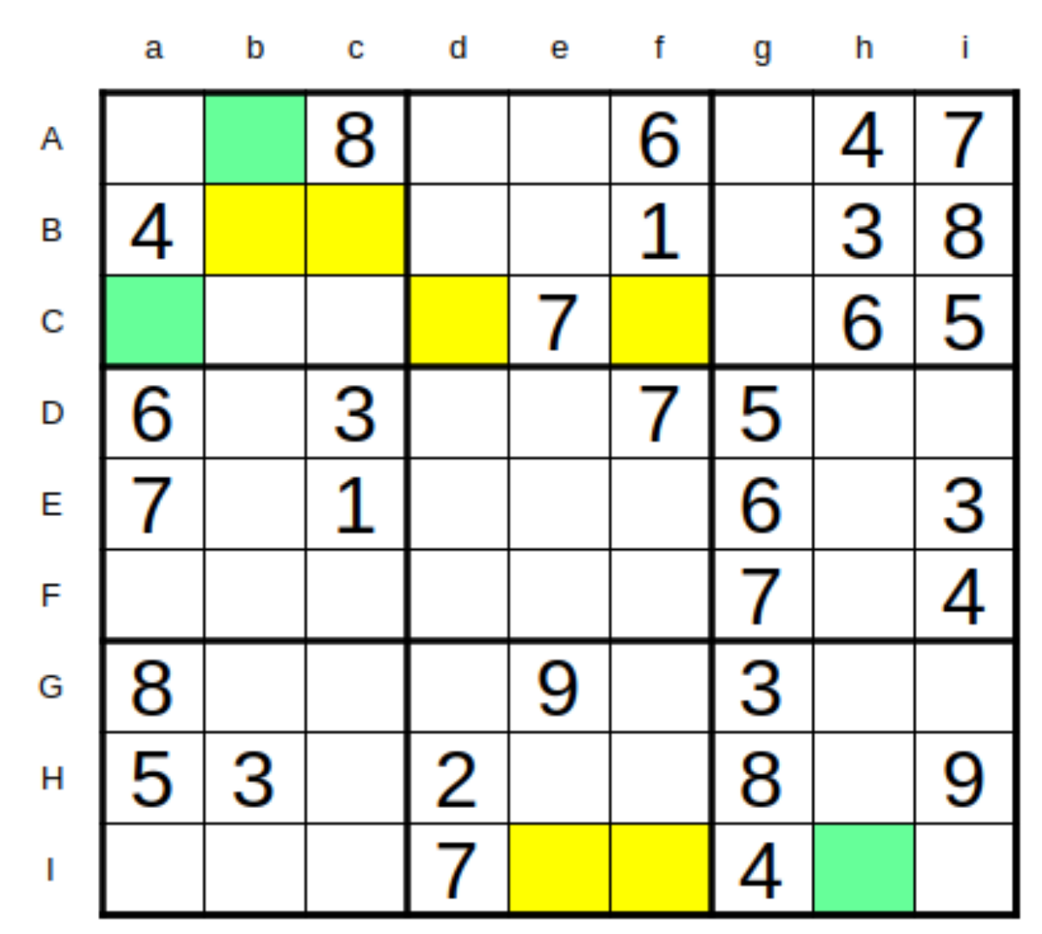
What is Sudoku ?
Sudoku requires no calculation or arithmetic skills.
It is essentially a game of placing numbers in squares.
It uses very simple rules of logic and deduction.
It can be played by children and adults and the rules are simple to learn.
Objective of game is to fill all the blank squares in a game with the correct numbers.

Slide 3
Simple Rules of Sudoku Solving
There are three very simple constraints to follow:
Every row of 9 numbers must include all digits 1 through 9 in any order
Every column of 9 numbers must include all digits 1 through 9 in any order
Every 3 by 3 subsection of the 9 by 9 square must include all digits 1 through 9

Slide 4
Online Material of Sudoku Puzzle
Here are a few Sudoku Websites that you can practice some more:
• https://www.thesudoku.com/
• www.sudokufun.com
• www.dailymail.co.uk/coffeebreak/puzzles/sudoku.html

Slide 5
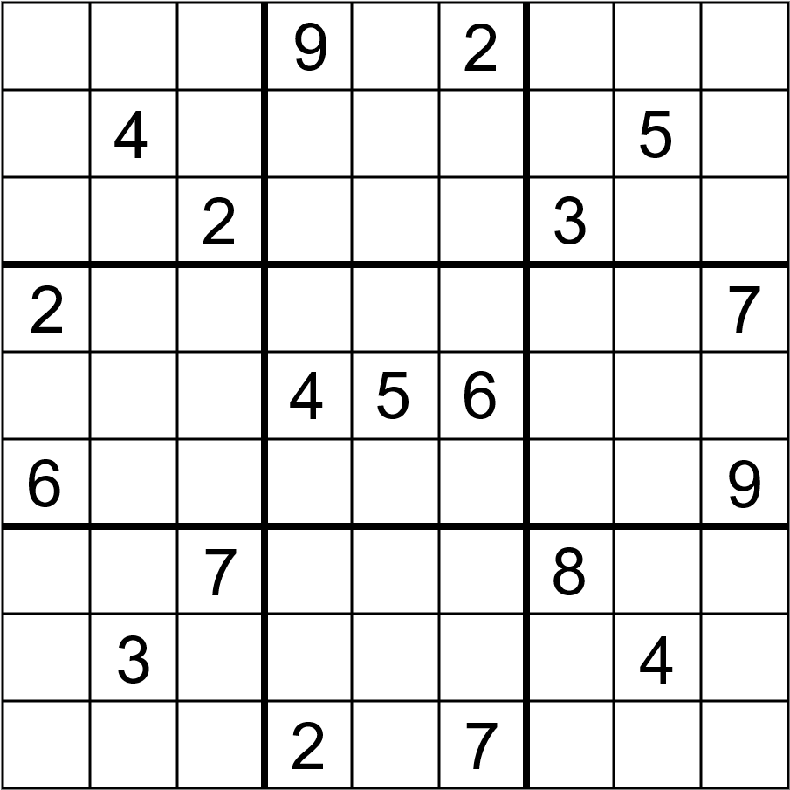


Manual Solution of Sudoku Puzzle
First of all, we will solve sudoku puzzle manually using backtracking algorithm.
Let’s start with the worksheet provided to individual students

Slide 6
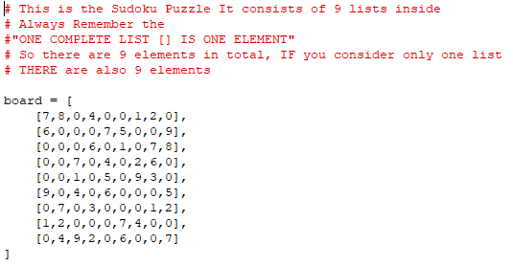
Python Solution of Sudoku Puzzle (Step # 1)
The first step is to put the manual sudoku in Python lists, For empty spaces write zero

Slide 7
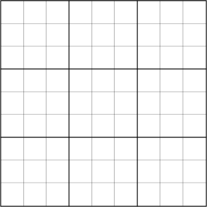
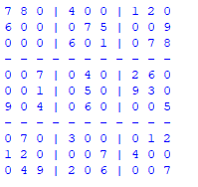
Python Solution of Sudoku Puzzle (Step # 2a)
The second step is to make function for printing board “like this below” with lines
seperating each BOX, ROW and COLUMNS

Slide 8
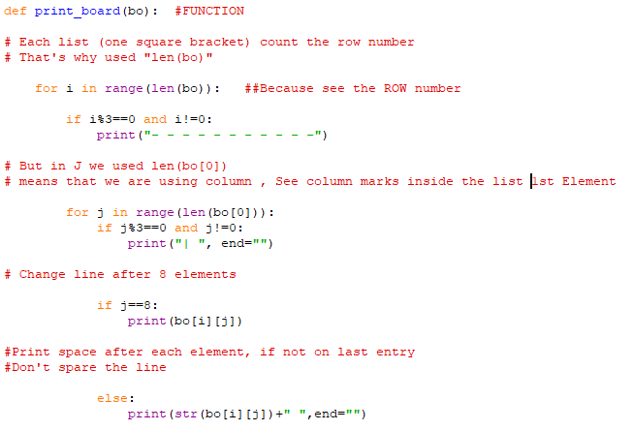
Python Solution of Sudoku Puzzle (Step # 2b)

Slide 9
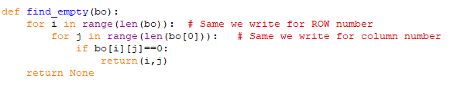
Python Solution of Sudoku Puzzle (Step # 3)
The third step is to make function for finding positions of empty values in
ROW and COLUMNS
(3,0)
Tuple
These all will be later passed to a function
Having a parameter names “pos”
(5,6)
Tuple
(7,2)
Tuple

Slide 10
find_EMPTY Function
*All Locations of Empty Boxes
(0 , 2) (0 , 4) (0 , 5) (0 , 8)
(1 , 1) (1 , 2) (1 , 3) (1 , 6) (1 , 7)
(2 , 0) (2 , 1) (2 , 2) (2 , 4) (2 , 6)
(3 , 0) (3 , 1) (3 , 3) (3 , 5) (3 , 8)
(4 , 0) (4 , 1) (4 , 3) (4 , 5) (4 , 8)
(5 , 1) (5 , 3) (5 , 5) (5 , 6) (5 , 7)
(6 , 0) (6 , 2) (6 , 4) (6 , 5) (6 , 6)
(7 , 2) (7 , 3) (7 , 4) (7 , 7) (7 , 8)
(8 , 0) (8 , 4) (8 , 6) (8 , 7)

Slide 11
Python Solution of Sudoku Puzzle (Step # 4a)
The fourth (a) step is to make function “valid” with 3 arguments for checking valid entries
Before starting the work, first learn what are these “THREE” arguments
This is nothing but only the
“Print Board Function”
passed
This is tuple returned
from
“find_empty”
function
This is simple numbers list
“Passed from 1 to 9”
in next step

Slide 12
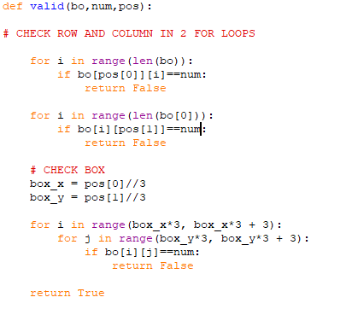

Python Solution of Sudoku Puzzle (Step # 4b)
The fourth (b) step is to checking entries by row and column (One by One)
Also, we are making sure that it is not the same checked before !

Slide 13
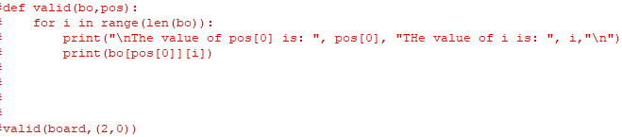
Go for some Animation for Understanding (ROW)
When pos is (0,2)
Check Program Output First !
When pos is (1,1)

Slide 14
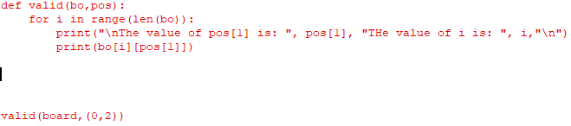
Go for some Animation for Understanding COLUMN
When pos is (0,2)
Check Program Output First !
When pos is (0,4)

Slide 15


Python Solution of Sudoku Puzzle (Step # 4c)
The fourth (c) step is to move technically find the “box number and box term”
Using the “FLOOR DIVISION (//) and MULTIPLICATION TECHNIQUE”
Box No (0,0)
Box No(0,2)
Box No (2,1)

Slide 16
(0 , 2) (0 , 4) (0 , 5) (0 , 8)
(1 , 1) (1 , 2) (1 , 3) (1 , 6) (1 , 7)
(2 , 0) (2 , 1) (2 , 2) (2 , 4) (2 , 6)
(3 , 0) (3 , 1) (3 , 3) (3 , 5) (3 , 8)
(4 , 0) (4 , 1) (4 , 3) (4 , 5) (4 , 8)
(5 , 1) (5 , 3) (5 , 5) (5 , 6) (5 , 7)
(6 , 0) (6 , 2) (6 , 4) (6 , 5) (6 , 6)
(7 , 2) (7 , 3) (7 , 4) (7 , 7) (7 , 8)
(8 , 0) (8 , 4) (8 , 6) (8 , 7)
Pos[0] is the “x” element
Pos[1] is the “y” element
box_x = pos[0] // 3
0 // 3 = 0
1 // 3 = 0
2 // 3 = 0
3 // 3 = 1
4 // 3 = 1
5 // 3 = 1
6 // 3 = 2
7 // 3 = 2
8 // 3 = 2
box_y = pos[1] // 3
2 // 3 = 0
4 // 3 = 1
5 // 3 = 1
8 // 3 = 2
1 // 3 = 0
3 // 3 = 1
6 // 3 = 2
7 // 3 = 2
0 // 3 = 0
Box No (0,0)
Box No (1,2)
Box No (2,0)

Slide 17
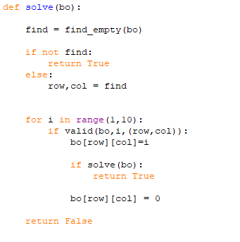
Python Solution of Sudoku Puzzle (Step # 5)
The final step is to just use the solve function managing all the backtracking
Tasks with the recursive function

