Slide 1
Web Platform for food Donation and Assistance using IR Algorithm
TEAM MEMBERS
Suryaa KS (210701273)
Syed Javith R (210701278)
Jagathratchahan V(210701701)

Slide 2

PROBLEM STATEMENT
How might we innovate to address urban excess food waste, hunger-related deaths, and create a logistic network with innovative technology and cost-effective storage solutions? This is to efficiently transfer surplus food from cities to areas in deficit

Slide 3
Abstract
It is a web application that allows users to easily participate in food sharing activities. The platforms ensures a safe experience by integrating user authentication. Users can suggests whether to submit a food request or donate excess food based on their choices. The real-time notification system, which alerts users within a given radius who have raised food demands which is a crucial component of this platform. The Recommendation system Algorithm ensures that the frequently active users are getting immediate notification in need of their contribution .The method works effectively to connect these requests with nearby surplus food donations that are available. The app easily connects with a volunteer to improve the delivery process, simplifying and guaranteeing that food is sent on time. The Objective is to provide a user-friendly and responsive interface that promotes community involvement in the fight against food scarcity. The project's objective is of a community where extra food is freely distributed to those in need, encouraging a helpful and long-lasting solution to the problems associated with food scarcity.

Slide 4
Existing System
It's possible that there isn't a centralized mechanism in place right now that is intended to effectively distribute extra food to people in need. Nonetheless, there are numerous global organizations and programs that use comparable strategies to combat food insecurity. Food banks, community kitchens, and nonprofit groups that gather extra food from donors and give it to people in need are a few examples of these. Although these efforts are worthwhile, it's possible that they don't have the advanced technology and efficient procedures that the initiative suggests. Implementing user-friendly elements into current systems could greatly improve the efficiency and reach of initiatives to distribute excess food.

Slide 5
Proposed System
The proposed system aims to efficiently distribute surplus food to those in need through a user-friendly platform with three categories: users, volunteers, and food distributors. Users can raise food requests, while distributors can post surplus food details. Volunteers view requests and deliver food, receiving a secret code upon acceptance. Users use the code to confirm delivery. If a volunteer fails, actions are taken with the code. This comprehensive system promotes community engagement, and ensures transparency in surplus food distribution, addressing food deficiency effectively. Additionally, the platform incorporates secure authentication for user login, ensuring a safe and reliable experience. The system's recommendation algorithm dynamically adjusts to user behavior and contribution patterns, maximizing efficiency.

Slide 6
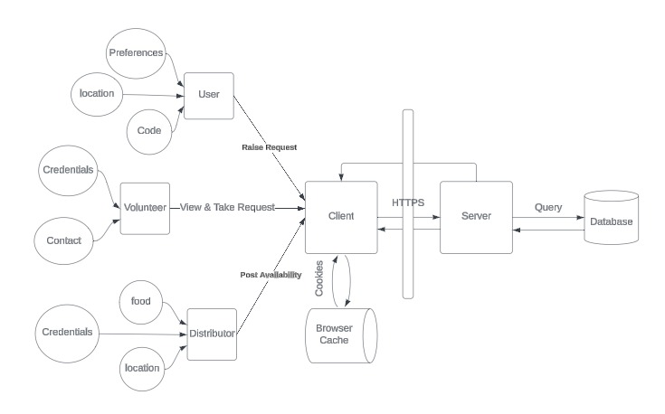
System Architecture

Slide 7
Modules
User Authentication module: Gmail is used to implement user authentication, ensuring a secure login experience. This integration ensures that user credentials are handled securely without storing passwords on the platform. Role-based authorization is implemented to restrict access to specific features based on the user’s role (user, volunteer, or food distributor). This setup ensures that each user type can only access functionalities relevant to their role, enhancing both security and usability.
Food Sharing : Users can enter detailed information about the food items they want to contribute, including type, quantity, expiration date, and packing facility. Similarly, users in need can specify the type of food they are requesting .The interface is designed to be user-friendly, ensuring that both contributions and requests can be made quickly and easily, promoting active participation from all users.

Slide 8
Modules
Raise food requests: Users who are in need of food can raise requests through a straightforward process. They can detail their specific needs, such as the type of food required, quantity, and preferred delivery time. Once a request is made, it is listed in the system for volunteers to view. Users receive notifications when a volunteer accepts their request, providing them with real-time updates. This module ensures that the process of requesting food is accessible and efficient, facilitating timely assistance to those in need.
Secret Code generation: The system generates a unique secret code which is sent to the user in need of food. This code serves as a verification mechanism; the user provides the code to the volunteer upon receiving the food, which the volunteer then enters into the system to confirm delivery. If a volunteer fails to deliver the food, the code helps in tracking and managing the issue. This feature ensures accountability and provides a reliable way to confirm successful food deliveries.

Slide 9
Modules
Recommendation module:
The recommendation system employs an algorithm designed to enhance user engagement and resource allocation. It tracks user activity and preferences to notify regular contributors about relevant food requests and contributions first. This ensures that the most active and reliable users are prioritized, optimizing the chances of successful food distribution. The algorithm considers factors such as past contribution history, location, and the type of food usually contributed or requested, creating a personalized and efficient notification system.

Slide 10
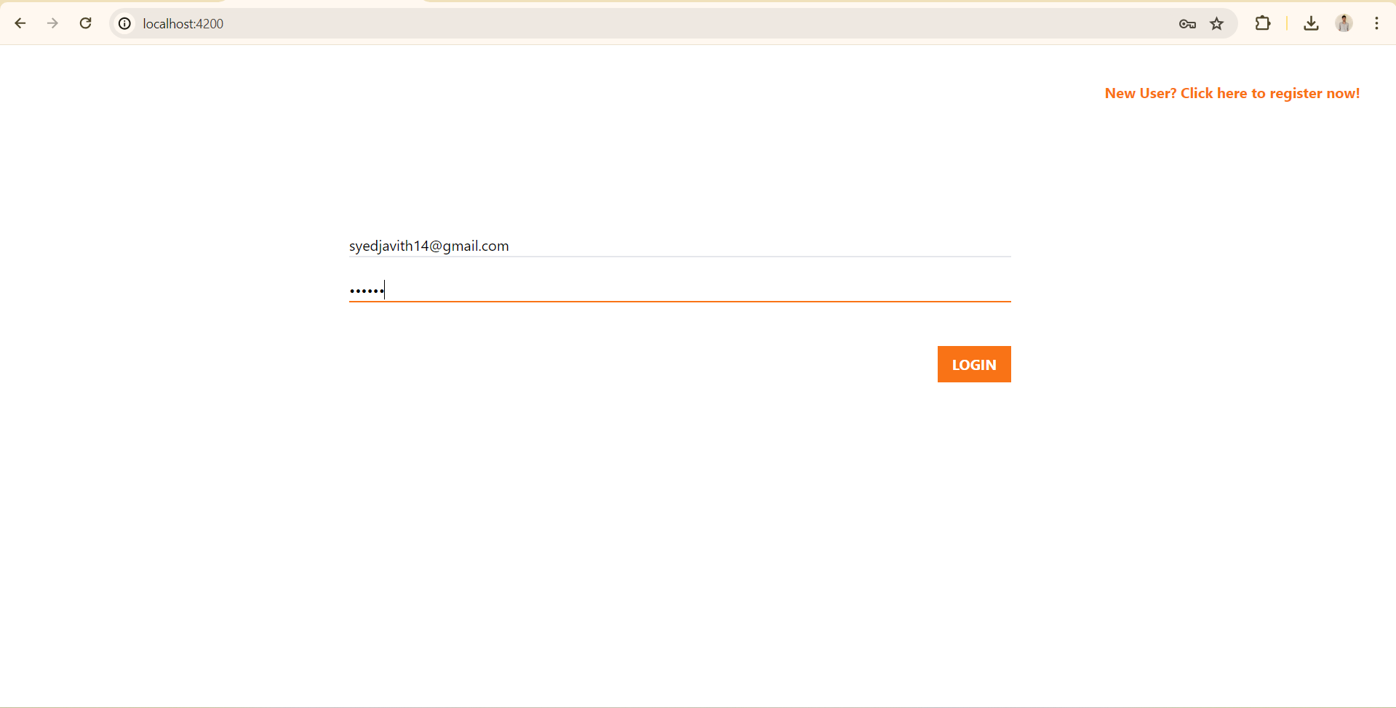
Result & Discussion
The result of the project is a functional web application that enables users to efficiently share surplus food and request assistance, thereby contributing to the alleviation of food scarcity within communities.
The platform simplifies the process of redistributing food resources. With a focus on user-friendliness and community engagement, this solution aims to foster direct connections between donors and recipients, enhancing the effectiveness of food redistribution efforts.
Login page

Slide 11
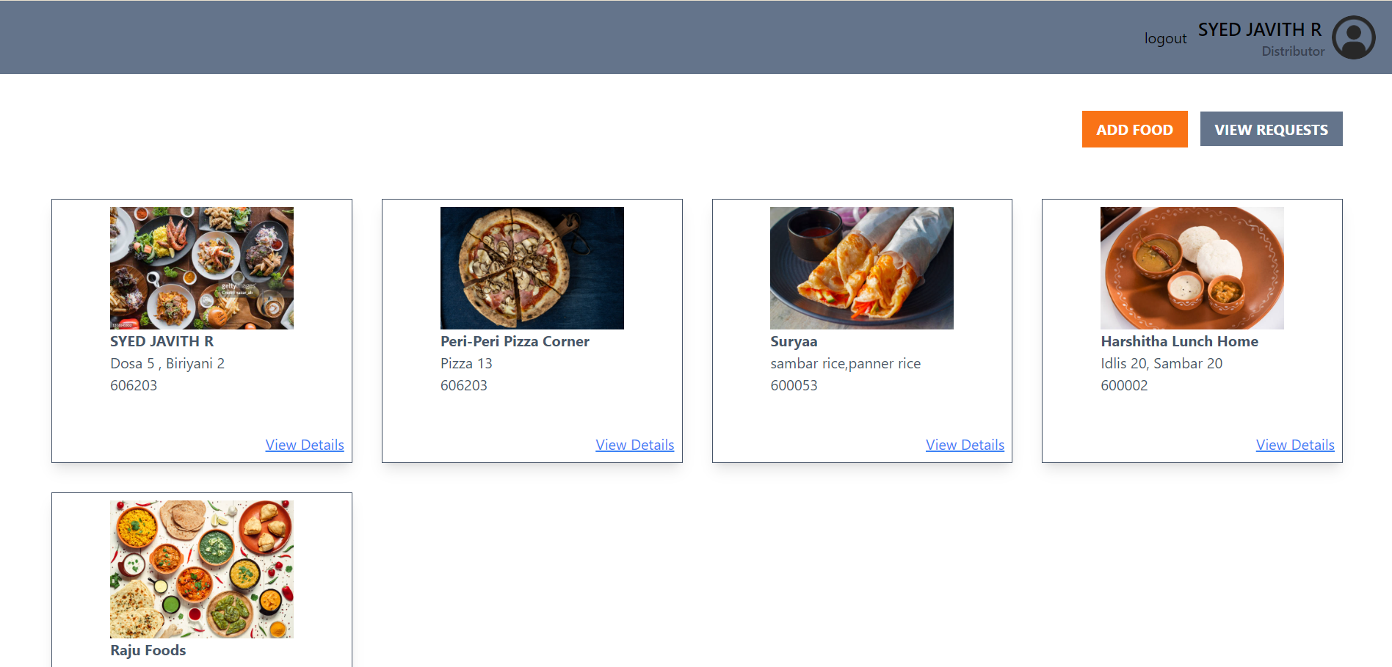
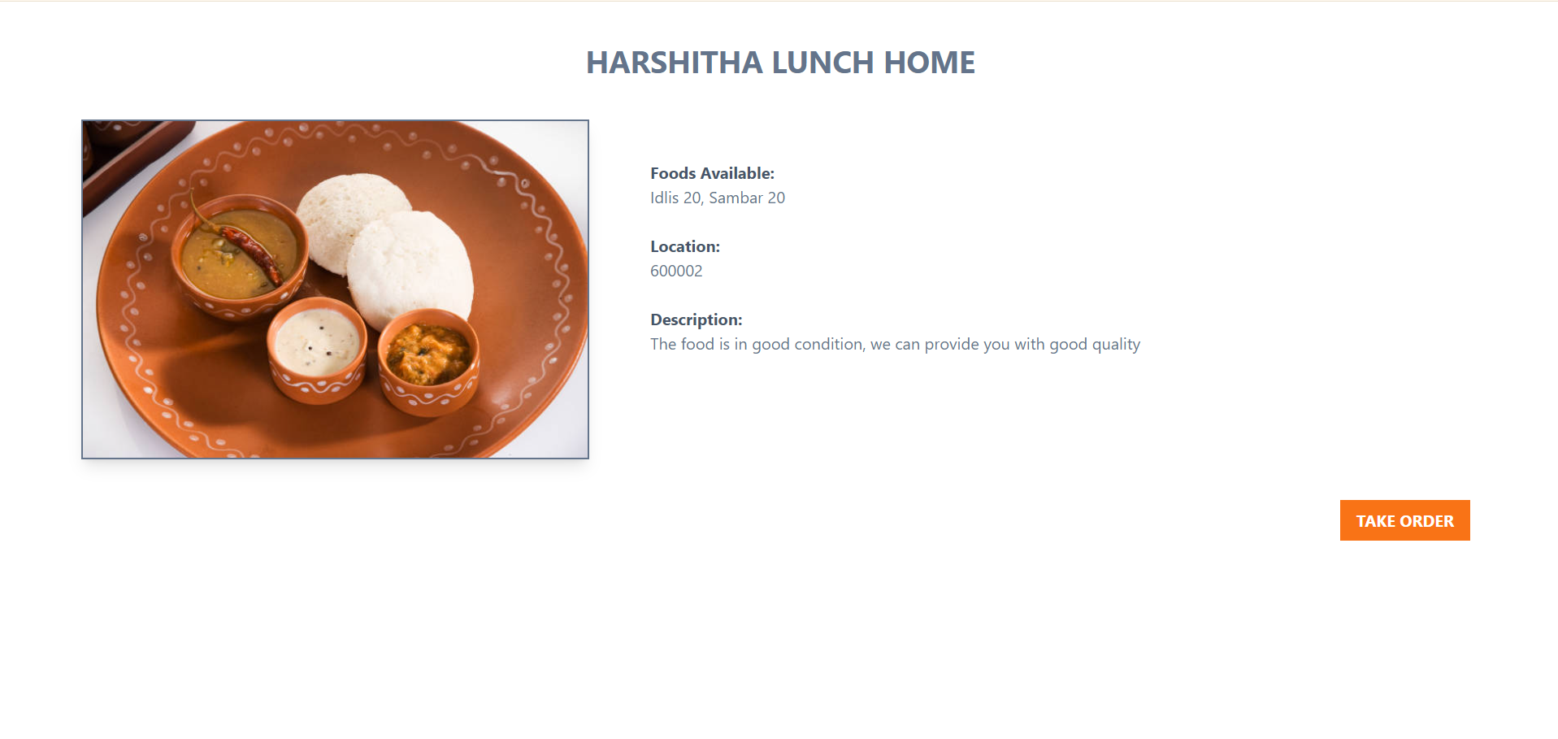
Result
Detailed info
Food Display page

Slide 12
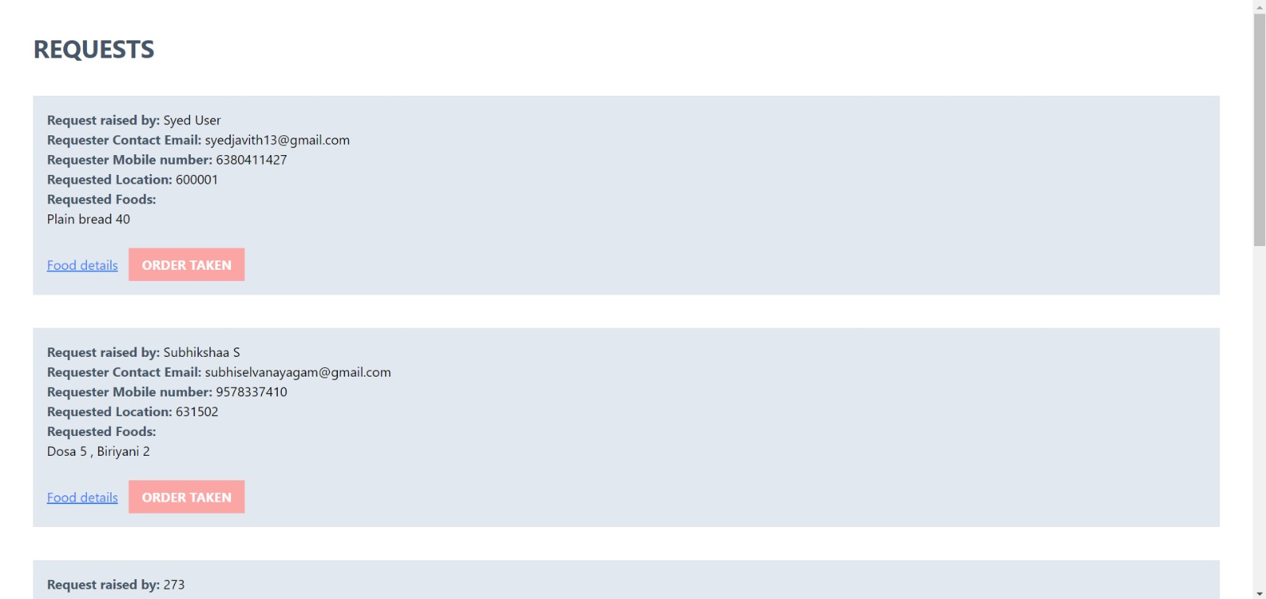
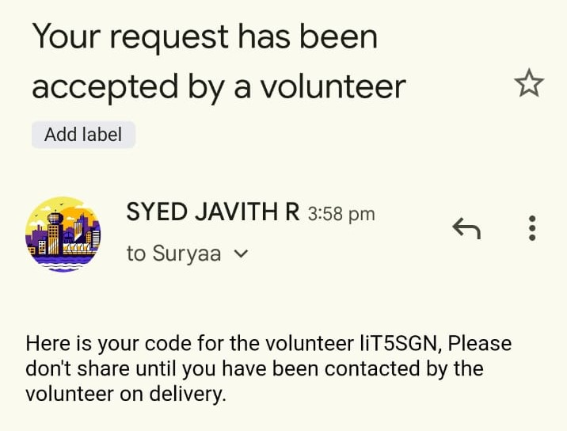
Result
Secret code
Request page

Slide 13
Conclusion and Future Enhancement
Thus the proposed project emerges as a beacon of hope, embodying the essence of community solidarity and innovation. It symbolizes a collective effort to combat hunger by facilitating the seamless exchange of surplus food with those in need. Through its intuitive interface and real-time matching system, it bridges the gap between donors and recipients, transcending geographical boundaries and fostering a culture of mutual support. By streamlining logistics and emphasizing prompt delivery, it not only addresses immediate hunger but also cultivates a sense of empathy and interconnectedness within communities.
One potential future enhancement for the proposed project could involve the implementation of advanced data analytics and machine learning algorithms. By analyzing donation patterns, recipient demographics, and geographical trends, the platform could gain insights to optimize its matching process and anticipate future needs more effectively. Additionally, incorporating user feedback mechanisms could further refine the user experience and ensure that the platform continues to meet the evolving needs of its community

