Slide 1
THE
AI & Machine Learning Tree
Math | Classical ML | Deep Learning | Applied AI | MLOps | Responsible AI
Developed by Syed Muhammad Tayyab
6
28
121
39
branches
fields
tools
links
github.com/Syed-Muhammad-Tayyab

Slide 2
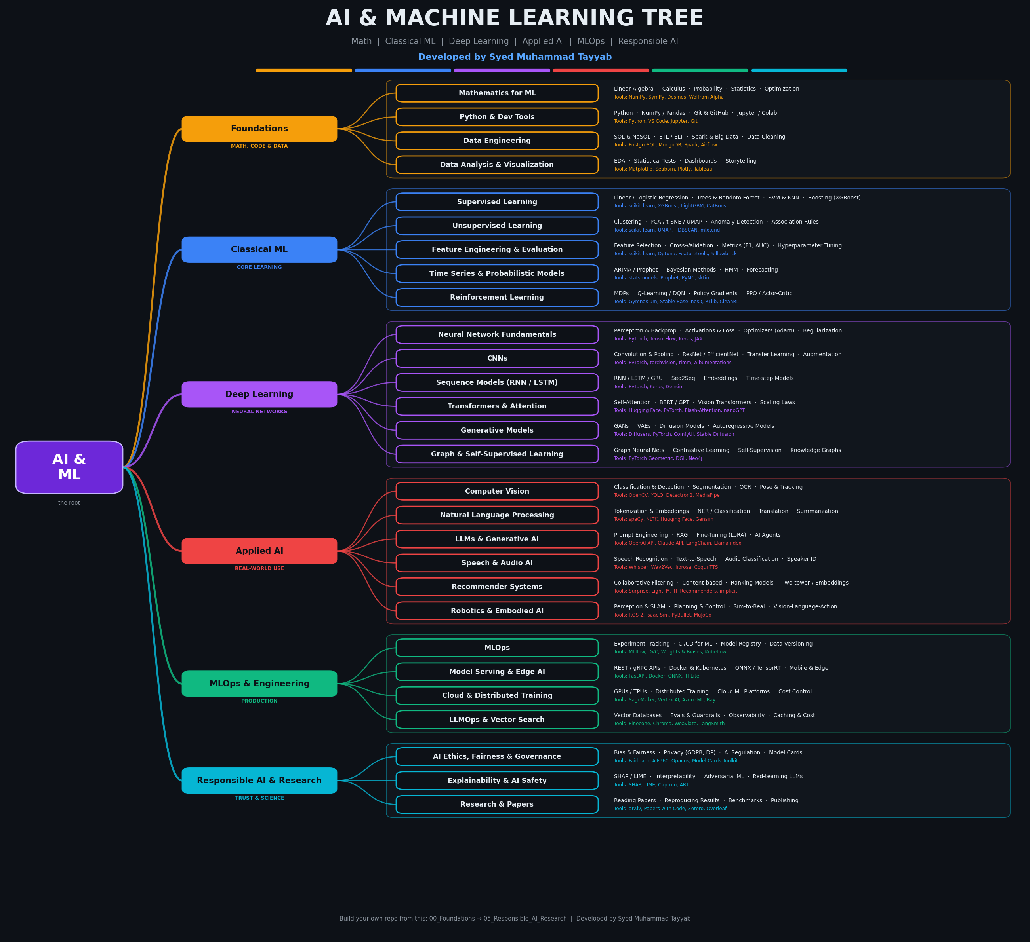
The Full Tree
Root
AI & Machine Learning
Branches
6 learning areas
Fields
28 specialties
Leaves
sub-fields + tools
Full-size PNG included for GitHub and posters.

Slide 3
Six Branches, One Goal
MATH, CODE & DATA
Foundations
Math, code and data: the base of every model
4 fields
CORE LEARNING
Classical ML
Learn patterns from data without deep nets
5 fields
NEURAL NETWORKS
Deep Learning
Layers, attention and generative models
6 fields
REAL-WORLD USE
Applied AI
Vision, language, speech, recommenders and robots
6 fields
PRODUCTION
MLOps & Engineering
Ship, scale and monitor models
4 fields
TRUST & SCIENCE
Responsible AI & Research
Ethics, safety, explainability and papers
3 fields

Slide 4
Foundations: Math, Code & Data
Mathematics for ML
Linear Algebra · Calculus · Probability · Statistics · Optimization
Tools: NumPy, SymPy, Desmos, Wolfram Alpha
Certs: Khan Academy, MIT 18.06, 3Blue1Brown
Python & Dev Tools
Python · NumPy / Pandas · Git & GitHub · Jupyter / Colab
Tools: Python, VS Code, Jupyter, Git, Conda
Certs: CS50P, Python for Everybody
Data Engineering
SQL & NoSQL · ETL / ELT · Spark & Big Data · Data Cleaning
Tools: PostgreSQL, MongoDB, Spark, Airflow, dbt
Certs: Google Data Analytics, Databricks Associate
Data Analysis & Visualization
EDA · Statistical Tests · Dashboards · Storytelling
Tools: Matplotlib, Seaborn, Plotly, Tableau, Power BI
Certs: IBM Data Analyst, Kaggle Data Viz

Slide 5
Classical Machine Learning
Supervised Learning
Linear / Logistic Regression · Trees & Random Forest · SVM & KNN · Boosting (XGBoost)
Tools: scikit-learn, XGBoost, LightGBM, CatBoost
Certs: Andrew Ng ML Specialization, Kaggle Intro to ML
Unsupervised Learning
Clustering · PCA / t-SNE / UMAP · Anomaly Detection · Association Rules
Tools: scikit-learn, UMAP, HDBSCAN, mlxtend
Certs: Unsupervised Learning (Coursera)
Feature Engineering & Evaluation
Feature Selection · Cross-Validation · Metrics (F1, AUC) · Hyperparameter Tuning
Tools: scikit-learn, Optuna, Featuretools, Yellowbrick
Certs: Kaggle Feature Engineering
Time Series & Probabilistic Models
ARIMA / Prophet · Bayesian Methods · HMM · Forecasting
Tools: statsmodels, Prophet, PyMC, sktime
Certs: Kaggle Time Series
Reinforcement Learning
MDPs · Q-Learning / DQN · Policy Gradients · PPO / Actor-Critic
Tools: Gymnasium, Stable-Baselines3, RLlib, CleanRL
Certs: David Silver RL, HF Deep RL Course

Slide 6
Deep Learning
Neural Network Fundamentals
Perceptron & Backprop · Activations & Loss · Optimizers (Adam) · Regularization
Tools: PyTorch, TensorFlow, Keras, JAX
Certs: Deep Learning Specialization, fast.ai Part 1
CNNs
Convolution & Pooling · ResNet / EfficientNet · Transfer Learning · Augmentation
Tools: PyTorch, torchvision, timm, Albumentations
Certs: CS231n
Sequence Models (RNN / LSTM)
RNN / LSTM / GRU · Seq2Seq · Embeddings · Time-step Models
Tools: PyTorch, Keras, Gensim
Certs: Sequence Models (Coursera)
Transformers & Attention
Self-Attention · BERT / GPT · Vision Transformers · Scaling Laws
Tools: Hugging Face, PyTorch, Flash-Attention, nanoGPT
Certs: Karpathy: Zero to Hero, CS224N
Generative Models
GANs · VAEs · Diffusion Models · Autoregressive Models
Tools: Diffusers, PyTorch, ComfyUI, Stable Diffusion
Certs: HF Diffusion Course
Graph & Self-Supervised Learning
Graph Neural Nets · Contrastive Learning · Self-Supervision · Knowledge Graphs
Tools: PyTorch Geometric, DGL, Neo4j
Certs: CS224W

Slide 7
Applied AI
Computer Vision
Classification & Detection · Segmentation · OCR · Pose & Tracking
Tools: OpenCV, YOLO, Detectron2, MediaPipe
Certs: CS231n, OpenCV University
Natural Language Processing
Tokenization & Embeddings · NER / Classification · Translation · Summarization
Tools: spaCy, NLTK, Hugging Face, Gensim
Certs: CS224N, HF NLP Course
LLMs & Generative AI
Prompt Engineering · RAG · Fine-Tuning (LoRA) · AI Agents
Tools: OpenAI API, Claude API, LangChain, LlamaIndex
Certs: DeepLearning.AI GenAI, HF LLM Course
Speech & Audio AI
Speech Recognition · Text-to-Speech · Audio Classification · Speaker ID
Tools: Whisper, Wav2Vec, librosa, Coqui TTS
Certs: HF Audio Course
Recommender Systems
Collaborative Filtering · Content-based · Ranking Models · Two-tower / Embeddings
Tools: Surprise, LightFM, TF Recommenders, implicit
Certs: Recsys Specialization (UMN)
Robotics & Embodied AI
Perception & SLAM · Planning & Control · Sim-to-Real · Vision-Language-Action
Tools: ROS 2, Isaac Sim, PyBullet, MuJoCo
Certs: Modern Robotics (Coursera)

Slide 8
MLOps, Engineering & Responsible AI
MLOPS & ENGINEERING
MLOps
Experiment Tracking · CI/CD for ML · Model Registry · Data Versioning
Tools: MLflow, DVC, Weights & Biases, Kubeflow
Certs: MLOps Zoomcamp, Google Prof. ML Engineer
MLOPS & ENGINEERING
Model Serving & Edge AI
REST / gRPC APIs · Docker & Kubernetes · ONNX / TensorRT · Mobile & Edge
Tools: FastAPI, Docker, ONNX, TFLite
Certs: AWS ML Specialty
MLOPS & ENGINEERING
Cloud & Distributed Training
GPUs / TPUs · Distributed Training · Cloud ML Platforms · Cost Control
Tools: SageMaker, Vertex AI, Azure ML, Ray
Certs: Azure DP-100, AWS ML Specialty
MLOPS & ENGINEERING
LLMOps & Vector Search
Vector Databases · Evals & Guardrails · Observability · Caching & Cost
Tools: Pinecone, Chroma, Weaviate, LangSmith
Certs: DeepLearning.AI LLMOps
RESPONSIBLE AI & RESEARCH
AI Ethics, Fairness & Governance
Bias & Fairness · Privacy (GDPR, DP) · AI Regulation · Model Cards
Tools: Fairlearn, AIF360, Opacus, Model Cards Toolkit
Certs: Elements of AI, AI Ethics (Coursera)
RESPONSIBLE AI & RESEARCH
Explainability & AI Safety
SHAP / LIME · Interpretability · Adversarial ML · Red-teaming LLMs
Tools: SHAP, LIME, Captum, ART
Certs: AI Safety Fundamentals
RESPONSIBLE AI & RESEARCH
Research & Papers
Reading Papers · Reproducing Results · Benchmarks · Publishing
Tools: arXiv, Papers with Code, Zotero, Overleaf
Certs: Research Methods

Slide 9
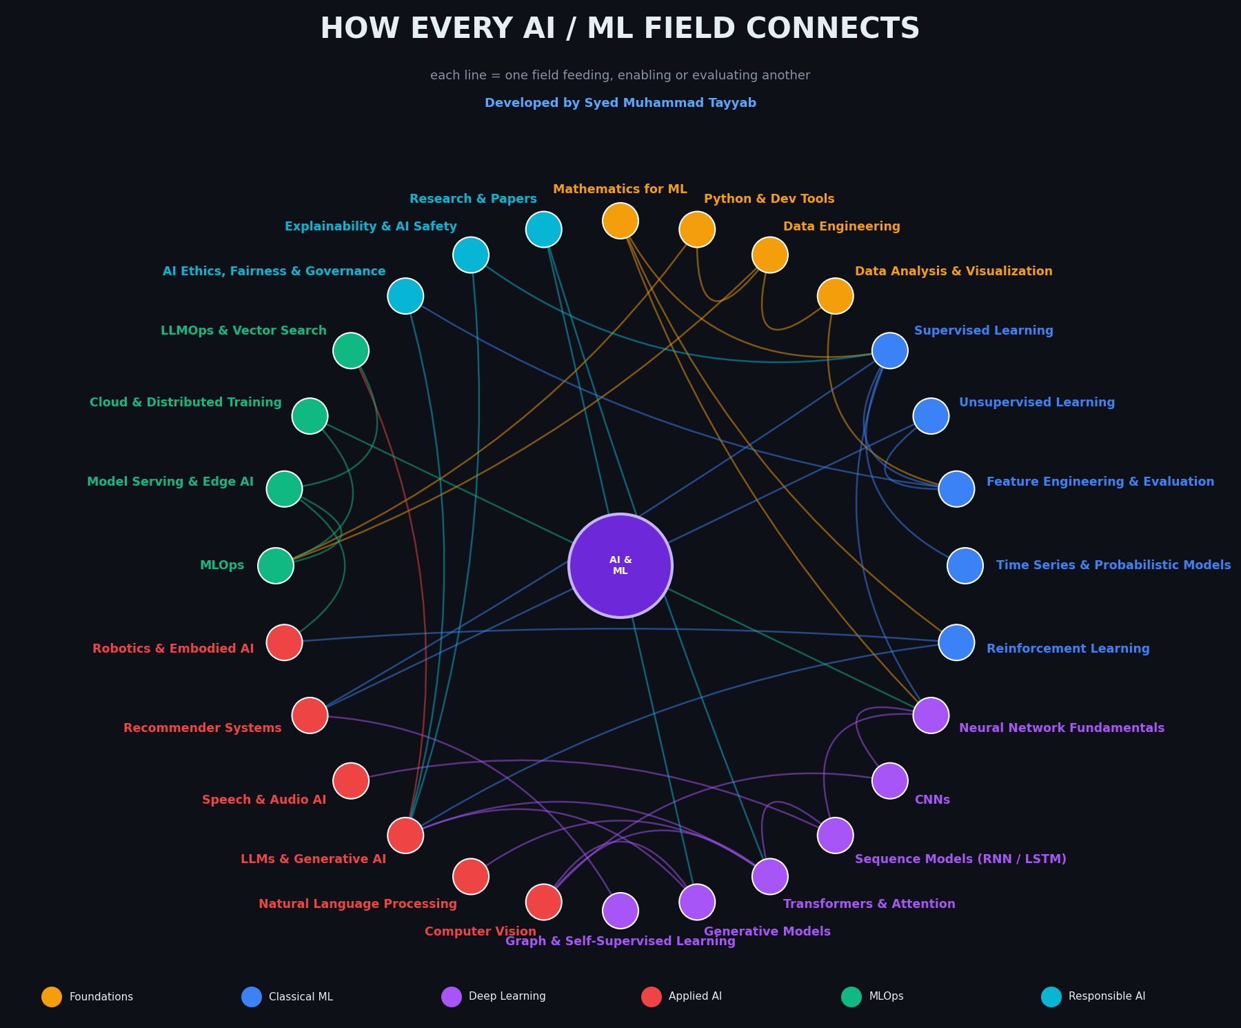
How Every Field Connects
Math -> Supervised & Deep Learning
statistics & calculus power every model
Data -> EDA -> Features -> Models
better data, better results
Sequence -> Transformer -> LLM
attention changed everything
Transformers -> Vision & NLP
one architecture, many domains
MLOps -> Serving -> Edge
models that reach users
Ethics & XAI -> LLMs & Models
trust, safety and explainability

Slide 10
The ML Lifecycle
Stage | What happens | Tools & good practice
1. Problem Framing | Define goal, metric and constraints | Stakeholder interviews, baselines, success metrics
2. Data Collection | Gather and label data | APIs, scraping, labeling tools, DVC
3. Data Prep & EDA | Clean, explore, split | Pandas, SQL, Great Expectations, leakage checks
4. Feature Engineering | Create and select features | scikit-learn pipelines, feature stores
5. Model Training | Train and tune | PyTorch, XGBoost, Optuna, Weights & Biases
6. Evaluation | Validate, compare, test fairness | Cross-validation, error analysis, SHAP
7. Deployment | Ship as API, batch or edge | Docker, FastAPI, ONNX, Kubernetes
8. Monitoring | Watch drift, quality and cost | Evidently, Prometheus, retraining triggers

Slide 11
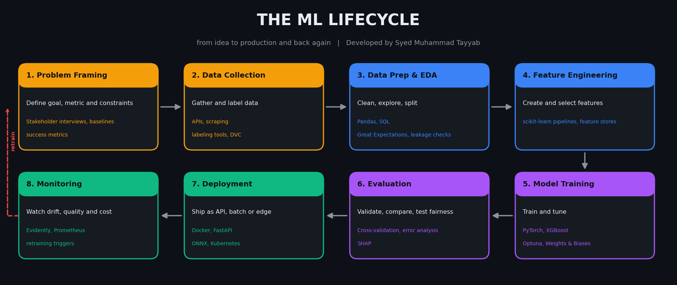
Lifecycle Pipeline

Slide 12
Folder Structure for Your Study Repo
Cybersecurity/
├── 00_Foundations/ [Math, Code & Data]
│ ├── Mathematics/
│ ├── Python_Dev_Tools/
│ ├── Data_Engineering/
│ └── Data_Analysis_Viz/
├── 01_Classical_ML/ [Core Learning]
│ ├── Supervised_Learning/
│ ├── Unsupervised_Learning/
│ ├── Feature_Eng_Evaluation/
│ ├── Time_Series_Probabilistic/
│ └── Reinforcement_Learning/
├── 02_Deep_Learning/ [Neural Networks]
│ ├── Neural_Net_Fundamentals/
│ ├── CNNs/
│ ├── Sequence_Models/
│ ├── Transformers_Attention/
│ ├── Generative_Models/
│ └── Graph_SelfSupervised/
├── 03_Applied_AI/ [Real-World Use]
│ ├── Computer_Vision/
│ ├── NLP/
│ ├── LLMs_GenAI/
│ ├── Speech_Audio/
│ ├── Recommender_Systems/
│ └── Robotics_Embodied/
├── 04_MLOps_Engineering/ [Production]
│ ├── MLOps/
│ ├── Serving_Edge/
│ ├── Cloud_Distributed/
│ └── LLMOps_Vector_Search/
├── 05_Responsible_AI_Research/ [Trust & Science]
│ ├── Ethics_Fairness_Governance/
│ ├── Explainability_Safety/
│ └── Research_Papers/
├── 06_Projects/
├── 07_Kaggle_Competitions/
├── 08_Papers_Notes/
└── 09_Resources/

Slide 13
Learning & Certification Roadmap
Beginner
Andrew Ng ML Specialization, Kaggle Learn, fast.ai, CS50 AI
Data Scientist
IBM Data Science, Google Data Analytics, Kaggle Comps, Azure DP-100
ML Engineer
AWS ML Specialty, Google Prof. ML Engineer, MLOps Zoomcamp
Research / GenAI
Deep Learning Spec., Hugging Face Course, CS224N, CS231n
1
2
3
4
5
Foundations
Math, Python, SQL, data
Classical ML
Models, features, metrics
Deep Learning
PyTorch, CNNs, Transformers
Specialize
NLP, vision, LLMs, RL
Ship & Share
MLOps, projects, papers

Slide 14
Learn it. Build it. Ship it responsibly.
Educational reference. Respect data privacy, licenses and people.
Developed by Syed Muhammad Tayyab | github.com/Syed-Muhammad-Tayyab

