Slide 1
THE
Quantum Computing & PQC
Quantum Core | Hardware | Post-Quantum Cryptography | Software | Policy
Developed by Syed Muhammad Tayyab
6
29
113
40
branches
fields
tools
links
github.com/Syed-Muhammad-Tayyab

Slide 2
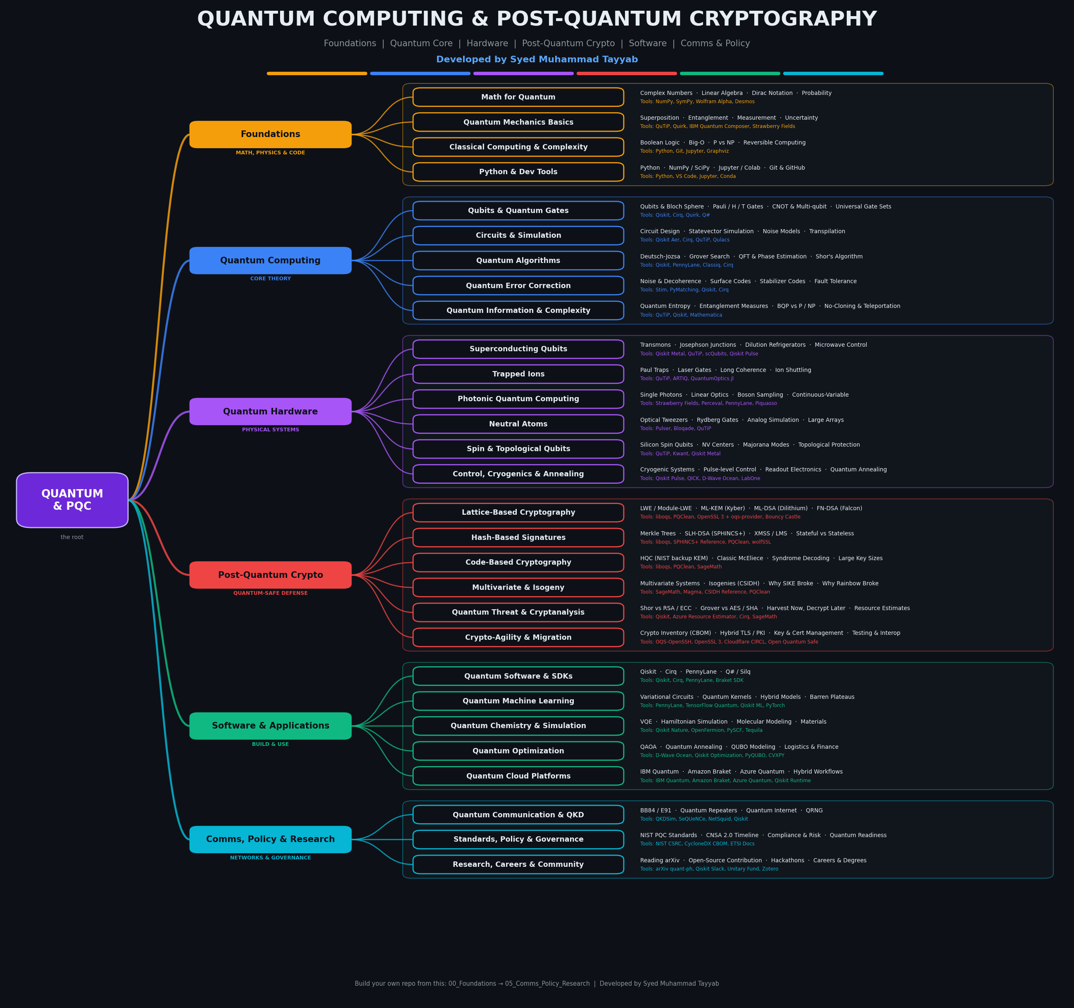
The Full Tree
Root
Quantum + PQC
Branches
6 learning areas
Fields
29 specialties
Leaves
sub-fields + tools
Full-size PNG included for GitHub and posters.

Slide 3
Six Branches, One Quantum Future
MATH, PHYSICS & CODE
Foundations
Math, quantum mechanics and code: the base of everything
4 fields
CORE THEORY
Quantum Computing
Qubits, gates, circuits, algorithms and error correction
5 fields
PHYSICAL SYSTEMS
Quantum Hardware
The machines that actually hold and control qubits
6 fields
QUANTUM-SAFE DEFENSE
Post-Quantum Crypto
Cryptography that survives quantum attacks
6 fields
BUILD & USE
Software & Applications
SDKs, algorithms in practice and cloud access
5 fields
NETWORKS & GOVERNANCE
Comms, Policy & Research
Quantum networks, standards, roadmaps and careers
3 fields

Slide 4
Foundations: Math, Physics & Code
Math for Quantum
Complex Numbers · Linear Algebra · Dirac Notation · Probability
Tools: NumPy, SymPy, Wolfram Alpha, Desmos
Certs: 3Blue1Brown Linear Algebra, MIT 18.06, Khan Academy
Quantum Mechanics Basics
Superposition · Entanglement · Measurement · Uncertainty
Tools: QuTiP, Quirk, IBM Quantum Composer, Strawberry Fields
Certs: Quantum Country, MIT 8.04, Feynman Lectures
Classical Computing & Complexity
Boolean Logic · Big-O · P vs NP · Reversible Computing
Tools: Python, Git, Jupyter, Graphviz
Certs: CS50, Nand2Tetris, MIT 6.006
Python & Dev Tools
Python · NumPy / SciPy · Jupyter / Colab · Git & GitHub
Tools: Python, VS Code, Jupyter, Conda, Git
Certs: CS50P, Python for Everybody

Slide 5
Quantum Computing Core
Qubits & Quantum Gates
Qubits & Bloch Sphere · Pauli / H / T Gates · CNOT & Multi-qubit · Universal Gate Sets
Tools: Qiskit, Cirq, Quirk, Q#
Certs: IBM Quantum Learning, Qiskit Textbook
Circuits & Simulation
Circuit Design · Statevector Simulation · Noise Models · Transpilation
Tools: Qiskit Aer, Cirq, QuTiP, Qulacs
Certs: Qiskit Developer Certification
Quantum Algorithms
Deutsch-Jozsa · Grover Search · QFT & Phase Estimation · Shor's Algorithm
Tools: Qiskit, PennyLane, Classiq, Cirq
Certs: Nielsen & Chuang, Qiskit Global Summer School
Quantum Error Correction
Noise & Decoherence · Surface Codes · Stabilizer Codes · Fault Tolerance
Tools: Stim, PyMatching, Qiskit, Cirq
Certs: Preskill Lecture Notes, Error Correction Zoo
Quantum Information & Complexity
Quantum Entropy · Entanglement Measures · BQP vs P / NP · No-Cloning & Teleportation
Tools: QuTiP, Qiskit, Mathematica
Certs: Watrous: Theory of Quantum Information, Aaronson Lectures

Slide 6
Quantum Hardware
Superconducting Qubits
Transmons · Josephson Junctions · Dilution Refrigerators · Microwave Control
Tools: Qiskit Metal, QuTiP, scQubits, Qiskit Pulse
Certs: Circuit QED Lectures
Trapped Ions
Paul Traps · Laser Gates · Long Coherence · Ion Shuttling
Tools: QuTiP, ARTIQ, QuantumOptics.jl
Certs: Quantinuum Resources, IonQ Docs
Photonic Quantum Computing
Single Photons · Linear Optics · Boson Sampling · Continuous-Variable
Tools: Strawberry Fields, Perceval, PennyLane, Piquasso
Certs: Xanadu Codebook, Quandela Docs
Neutral Atoms
Optical Tweezers · Rydberg Gates · Analog Simulation · Large Arrays
Tools: Pulser, Bloqade, QuTiP
Certs: QuEra Docs, Pasqal Docs
Spin & Topological Qubits
Silicon Spin Qubits · NV Centers · Majorana Modes · Topological Protection
Tools: QuTiP, Kwant, Qiskit Metal
Certs: Microsoft Quantum Docs, Spin Qubit Reviews
Control, Cryogenics & Annealing
Cryogenic Systems · Pulse-level Control · Readout Electronics · Quantum Annealing
Tools: Qiskit Pulse, QICK, D-Wave Ocean, LabOne
Certs: D-Wave Learning, Qiskit Pulse Docs

Slide 7
Post-Quantum Cryptography
Lattice-Based Cryptography
LWE / Module-LWE · ML-KEM (Kyber) · ML-DSA (Dilithium) · FN-DSA (Falcon)
Tools: liboqs, PQClean, OpenSSL 3 + oqs-provider, Bouncy Castle
Certs: NIST FIPS 203 / 204, Regev LWE Paper
Hash-Based Signatures
Merkle Trees · SLH-DSA (SPHINCS+) · XMSS / LMS · Stateful vs Stateless
Tools: liboqs, SPHINCS+ Reference, PQClean, wolfSSL
Certs: NIST FIPS 205, NIST SP 800-208
Code-Based Cryptography
HQC (NIST backup KEM) · Classic McEliece · Syndrome Decoding · Large Key Sizes
Tools: liboqs, PQClean, SageMath
Certs: NIST IR 8545, McEliece Papers
Multivariate & Isogeny
Multivariate Systems · Isogenies (CSIDH) · Why SIKE Broke · Why Rainbow Broke
Tools: SageMath, Magma, CSIDH Reference, PQClean
Certs: NIST Round Reports
Quantum Threat & Cryptanalysis
Shor vs RSA / ECC · Grover vs AES / SHA · Harvest Now, Decrypt Later · Resource Estimates
Tools: Qiskit, Azure Resource Estimator, Cirq, SageMath
Certs: Gidney & Ekera Paper, Mosca's Theorem
Crypto-Agility & Migration
Crypto Inventory (CBOM) · Hybrid TLS / PKI · Key & Cert Management · Testing & Interop
Tools: OQS-OpenSSH, OpenSSL 3, Cloudflare CIRCL, Open Quantum Safe
Certs: NIST NCCoE Migration, PQCA Resources

Slide 8
Software, Applications & Policy
SOFTWARE & APPLICATIONS
Quantum Software & SDKs
Qiskit · Cirq · PennyLane · Q# / Silq
Tools: Qiskit, Cirq, PennyLane, Braket SDK
Certs: Qiskit Developer Certification, Unitary Fund Tutorials
SOFTWARE & APPLICATIONS
Quantum Machine Learning
Variational Circuits · Quantum Kernels · Hybrid Models · Barren Plateaus
Tools: PennyLane, TensorFlow Quantum, Qiskit ML, PyTorch
Certs: PennyLane Codebook, Xanadu QML Course
SOFTWARE & APPLICATIONS
Quantum Chemistry & Simulation
VQE · Hamiltonian Simulation · Molecular Modeling · Materials
Tools: Qiskit Nature, OpenFermion, PySCF, Tequila
Certs: Qiskit Nature Docs, OpenFermion Tutorials
SOFTWARE & APPLICATIONS
Quantum Optimization
QAOA · Quantum Annealing · QUBO Modeling · Logistics & Finance
Tools: D-Wave Ocean, Qiskit Optimization, PyQUBO, CVXPY
Certs: D-Wave Learning, Qiskit Optimization Docs
SOFTWARE & APPLICATIONS
Quantum Cloud Platforms
IBM Quantum · Amazon Braket · Azure Quantum · Hybrid Workflows
Tools: IBM Quantum, Amazon Braket, Azure Quantum, Qiskit Runtime
Certs: IBM Quantum Learning, AWS Braket Workshops
COMMS, POLICY & RESEARCH
Quantum Communication & QKD
BB84 / E91 · Quantum Repeaters · Quantum Internet · QRNG
Tools: QKDSim, SeQUeNCe, NetSquid, Qiskit
Certs: Quantum Internet Alliance, ETSI QKD Standards
COMMS, POLICY & RESEARCH
Standards, Policy & Governance
NIST PQC Standards · CNSA 2.0 Timeline · Compliance & Risk · Quantum Readiness
Tools: NIST CSRC, CycloneDX CBOM, ETSI Docs
Certs: CISSP, ISO 27001, PQCC Roadmap
COMMS, POLICY & RESEARCH
Research, Careers & Community
Reading arXiv · Open-Source Contribution · Hackathons · Careers & Degrees
Tools: arXiv quant-ph, Qiskit Slack, Unitary Fund, Zotero
Certs: Qiskit Advocate, Quantum Open Source Foundation

Slide 9
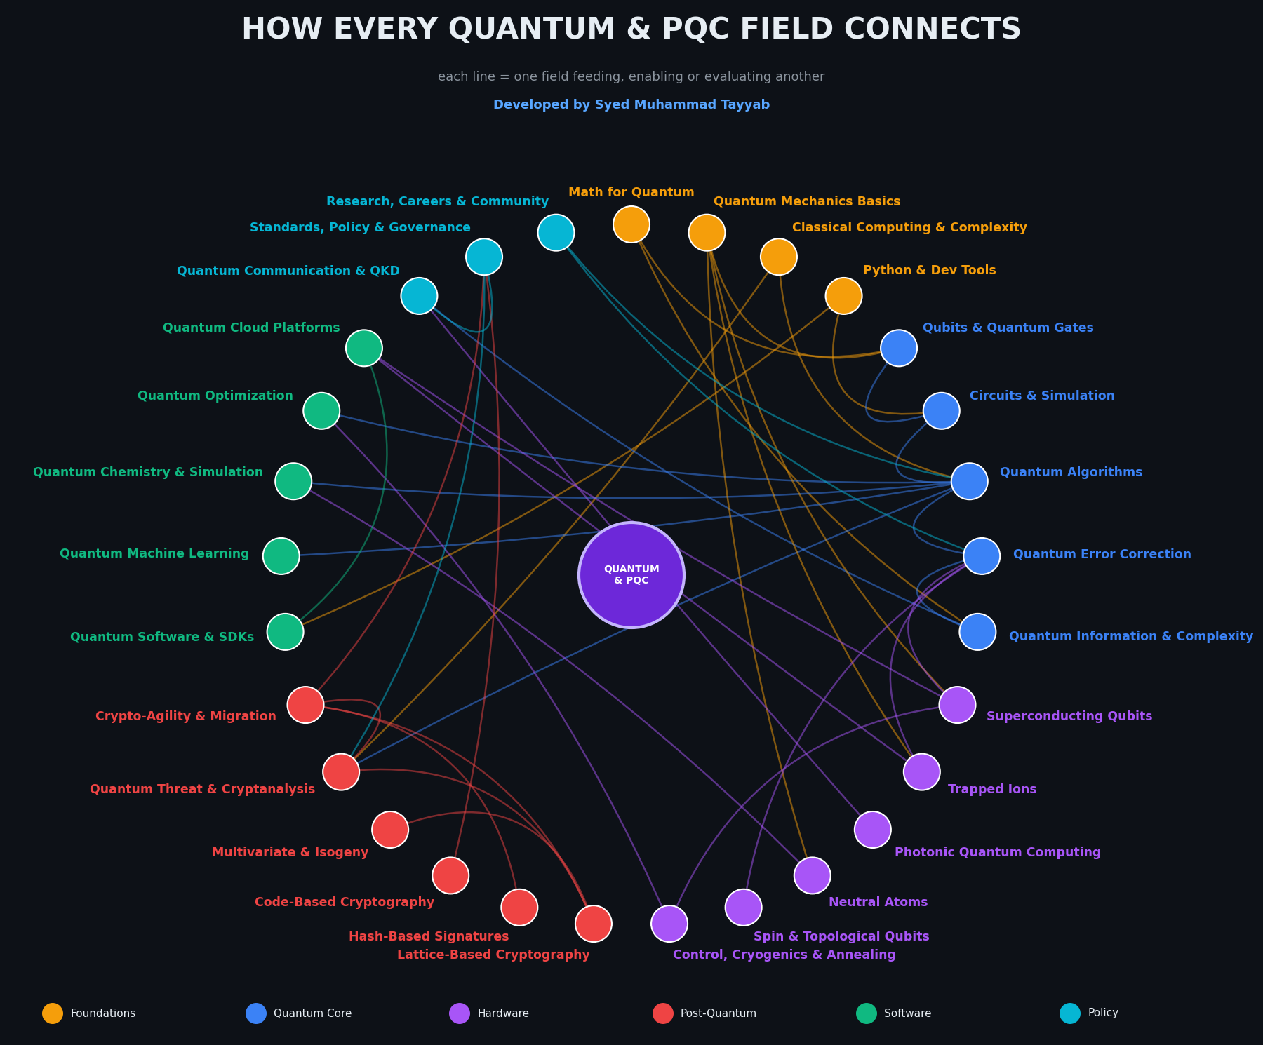
How Every Field Connects
Math & Physics -> Qubits
linear algebra describes quantum states
Circuits -> Algorithms
Shor and Grover define the threat
Shor vs RSA / ECC
why we need post-quantum crypto
Lattice & Hash PQC -> Migration
ML-KEM, ML-DSA, SLH-DSA in real systems
Hardware -> Error Correction
fault tolerance enables big algorithms
Policy -> Threat -> Planning
timelines drive crypto-agility

Slide 10
The Quantum-Safe Migration Journey
Step | What happens | Tools & good practice
1. Inventory | Find every use of cryptography | CBOM, scanners, code search
2. Assess Risk | Rank by data lifetime and exposure | Mosca's theorem, HNDL review, threat models
3. Plan | Pick algorithms and timelines | NIST FIPS 203/204/205, CNSA 2.0 dates
4. Prototype | Test PQC in a lab | liboqs, OQS-OpenSSL, test vectors
5. Hybrid Deploy | Combine classical + PQC | Hybrid TLS, dual-signed certs, X25519+ML-KEM
6. Migrate | Roll out to systems and PKI | Crypto-agile libraries, HSM updates, CI checks
7. Validate | Test speed, interop and safety | Benchmarks, fuzzing, side-channel review
8. Monitor | Track standards and new attacks | NIST updates, cryptanalysis news, re-audits

Slide 11
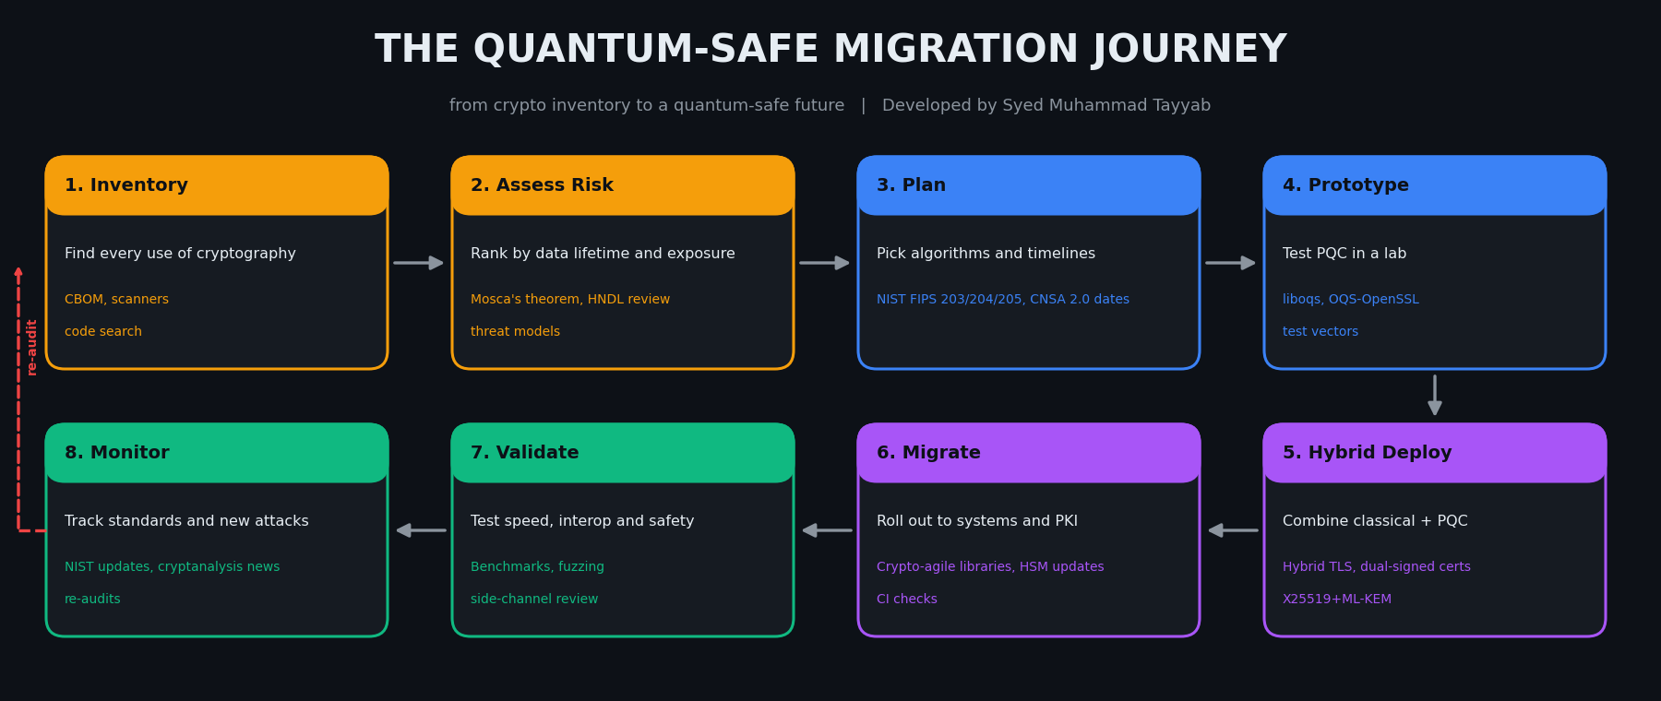
Migration Pipeline

Slide 12
Folder Structure for Your Study Repo
Quantum-PQC-Guide/
├── 00_Foundations/ [Math, Physics & Code]
│ ├── Math_For_Quantum/
│ ├── Quantum_Mechanics_Basics/
│ ├── Classical_Computing_Complexity/
│ └── Python_Dev_Tools/
├── 01_Quantum_Computing/ [Core Theory]
│ ├── Qubits_Gates/
│ ├── Circuits_Simulation/
│ ├── Quantum_Algorithms/
│ ├── Quantum_Error_Correction/
│ └── Quantum_Information_Complexity/
├── 02_Quantum_Hardware/ [Physical Systems]
│ ├── Superconducting_Qubits/
│ ├── Trapped_Ions/
│ ├── Photonic_Quantum/
│ ├── Neutral_Atoms/
│ ├── Spin_Topological_Qubits/
│ └── Control_Cryo_Annealing/
├── 03_Post_Quantum_Crypto/ [Quantum-Safe Defense]
│ ├── Lattice_Based/
│ ├── Hash_Based_Signatures/
│ ├── Code_Based/
│ ├── Multivariate_Isogeny/
│ ├── Quantum_Threat_Cryptanalysis/
│ └── Crypto_Agility_Migration/
├── 04_Software_Applications/ [Build & Use]
│ ├── Quantum_SDKs/
│ ├── Quantum_ML/
│ ├── Quantum_Chemistry/
│ ├── Quantum_Optimization/
│ └── Quantum_Cloud/
├── 05_Comms_Policy_Research/ [Networks & Governance]
│ ├── Quantum_Communication_QKD/
│ ├── Standards_Policy_Governance/
│ └── Research_Careers_Community/
├── 06_Projects/
├── 07_Labs_Notebooks/
├── 08_Papers_Notes/
└── 09_Resources/

Slide 13
Learning & Certification Roadmap
Beginner
IBM Quantum Learning, Qiskit Textbook, Quantum Country, edX QM
Quantum Developer
Qiskit Developer Cert, PennyLane Codebook, Cirq, Azure Quantum
PQC & Security
NIST PQC, Open Quantum Safe, ETSI Docs, CISSP/CISM + PQC reading
Research
MIT Quantum Courses, Nielsen & Chuang, Preskill Notes, arXiv
1
2
3
4
5
Foundations
Linear algebra, QM, Python
Quantum Core
Qubits, circuits, algorithms
Pick a Path
Developer, hardware or PQC
Build
Qiskit labs, liboqs demos
Ship & Share
Projects, write-ups, plans

Slide 14
Learn it. Build it. Secure the quantum future.
Educational reference. Follow official NIST guidance before real-world deployment.
Developed by Syed Muhammad Tayyab | github.com/Syed-Muhammad-Tayyab

