Slide 1
THE
Cyber Security Tree
Red Team | Blue Team | Purple Team | every field, tool and link
6
25
101
36
branches
fields
tools
links
github.com/Syed-Muhammad-Tayyab

Slide 2
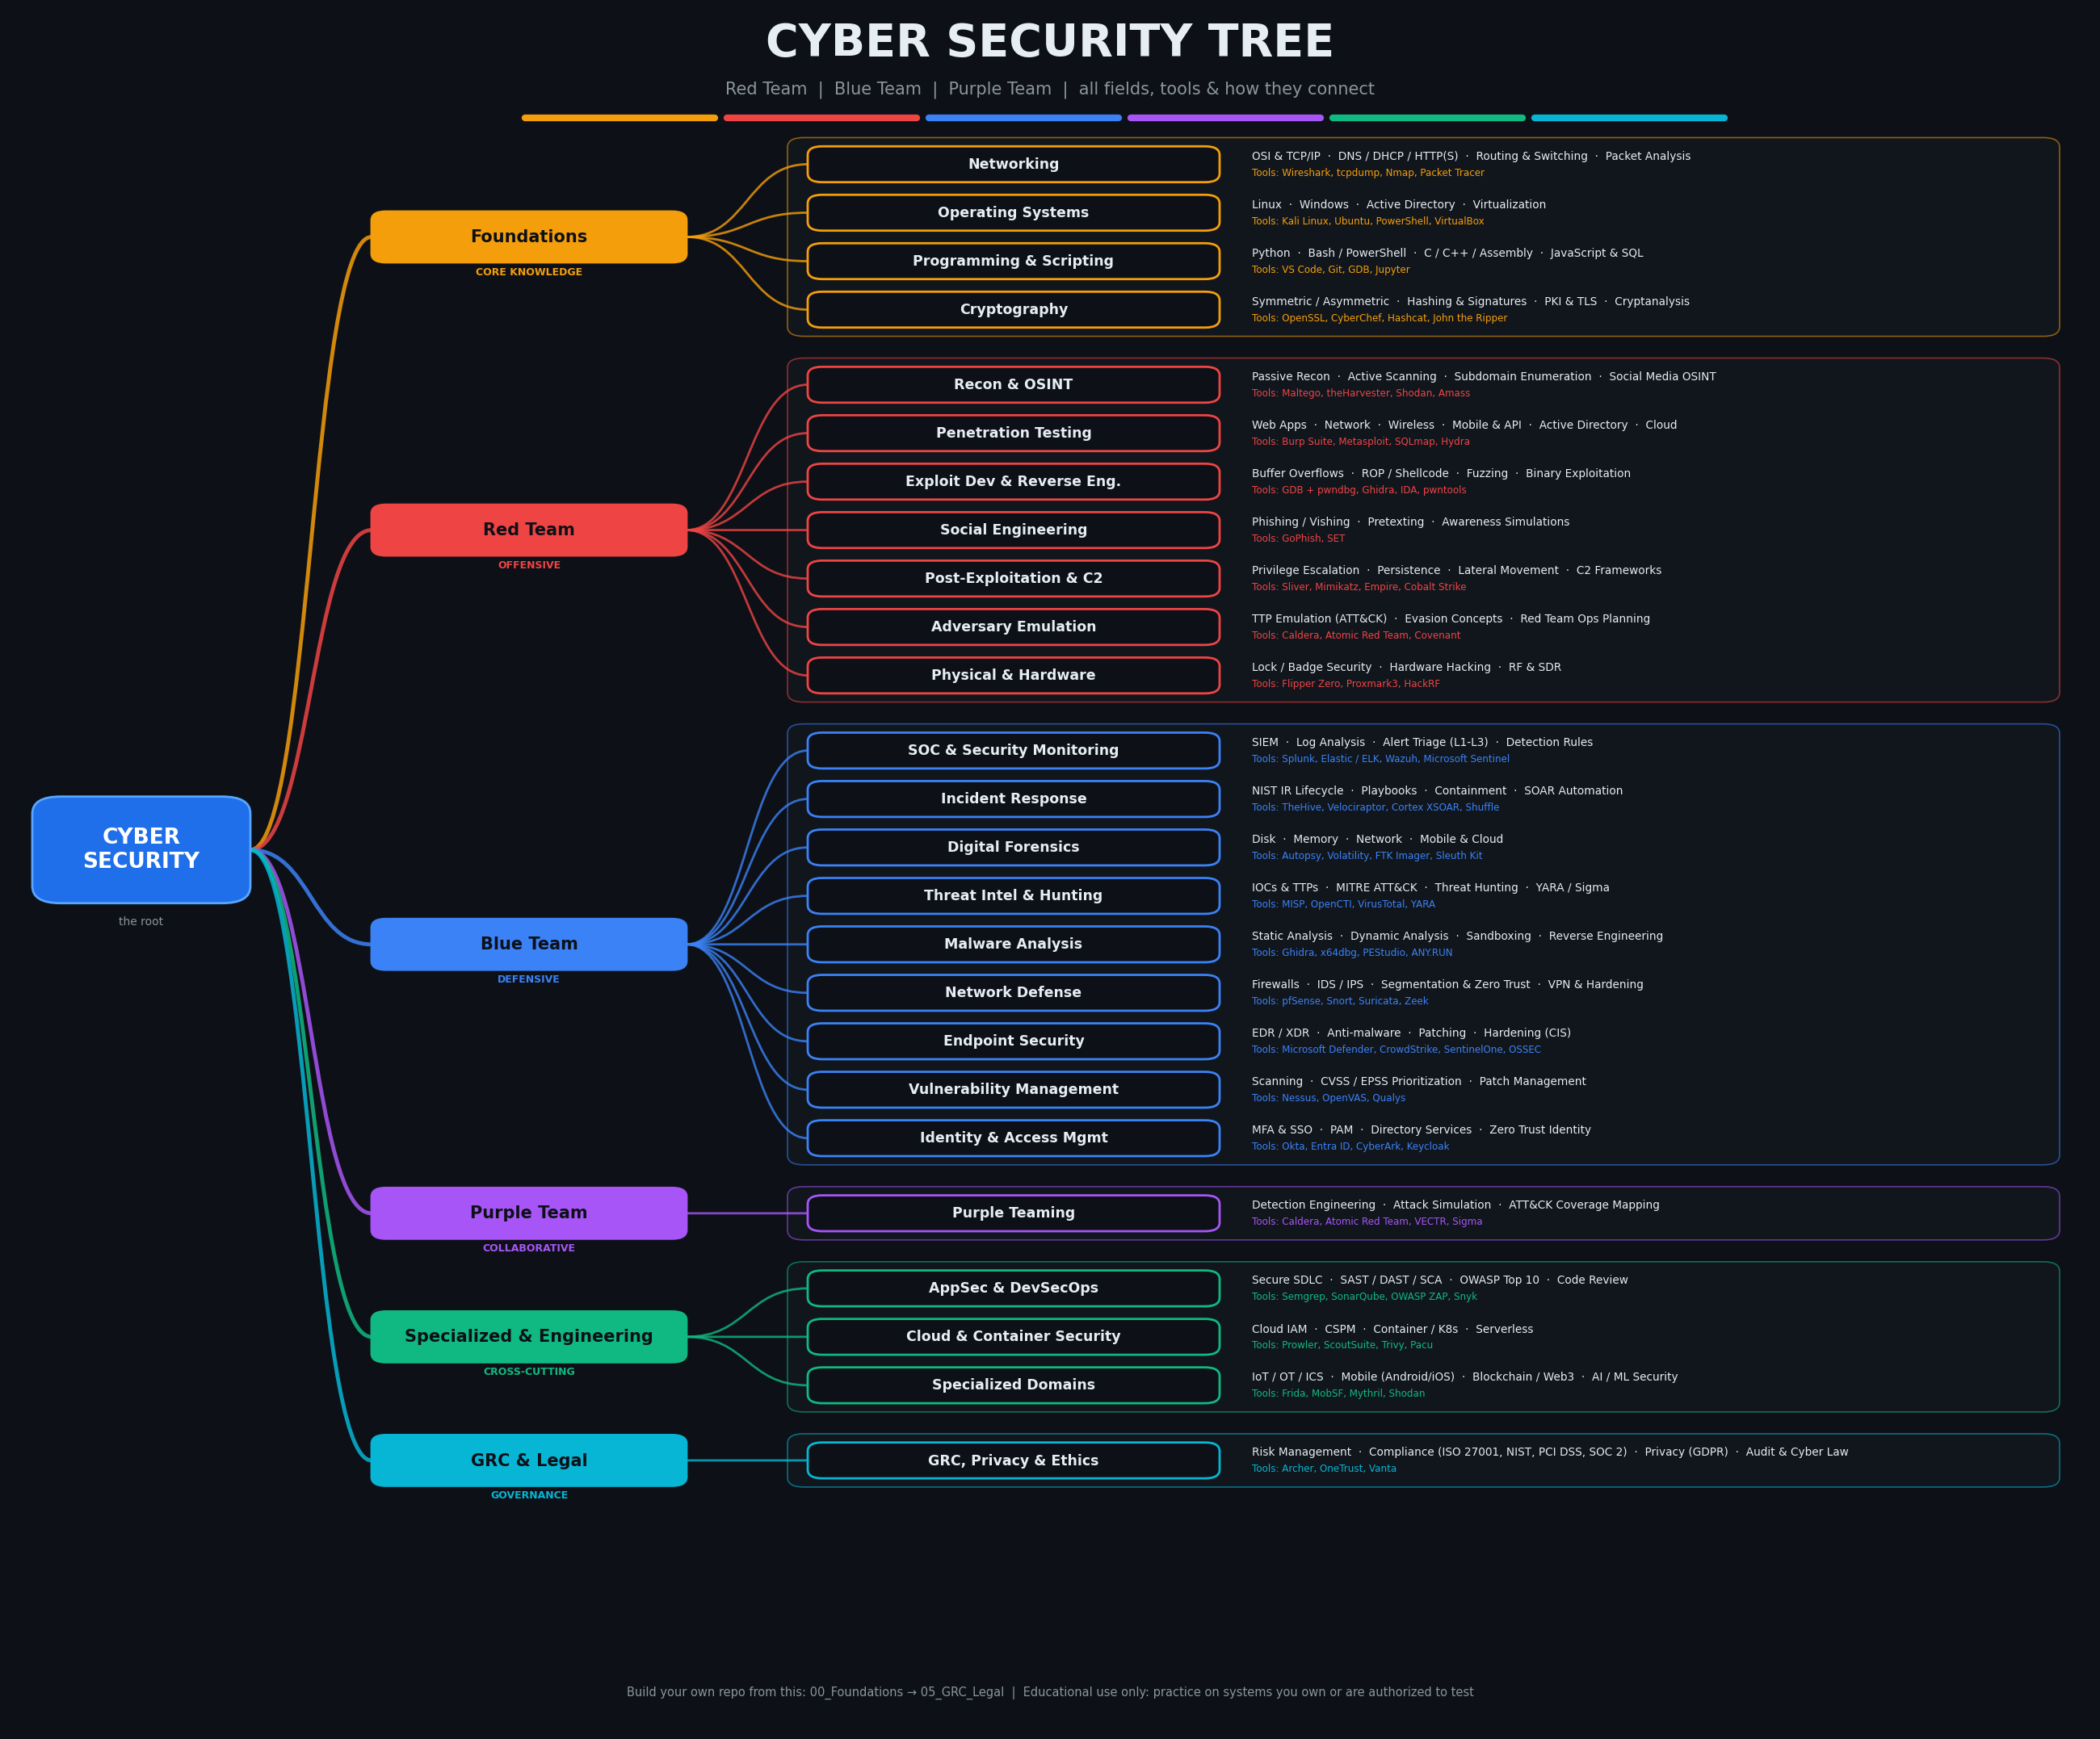
The Full Tree
Root
Cyber Security
Branches
6 teams / types
Fields
25 specialties
Leaves
sub-fields + tools
Full-size PNG included for GitHub and posters.

Slide 3
Six Branches, One Mission
CORE KNOWLEDGE
Foundations
The base every security role is built on
4 fields
OFFENSIVE
Red Team
Think like the attacker: break in, prove impact
7 fields
DEFENSIVE
Blue Team
Detect, respond, defend and recover
9 fields
COLLABORATIVE
Purple Team
Red and Blue working together to improve detection
1 field
CROSS-CUTTING
Specialized & Engineering
Secure-by-design fields that serve both sides
3 fields
GOVERNANCE
GRC & Legal
Policies, risk, compliance, audit and ethics
1 field

Slide 4
Foundations: Core Knowledge
Networking
OSI & TCP/IP · DNS / DHCP / HTTP(S) · Routing & Switching · Packet Analysis
Tools: Wireshark, tcpdump, Nmap, Packet Tracer
Certs: CCNA, Network+
Operating Systems
Linux · Windows · Active Directory · Virtualization
Tools: Kali Linux, Ubuntu, PowerShell, VirtualBox
Certs: Linux+, LPIC-1
Programming & Scripting
Python · Bash / PowerShell · C / C++ / Assembly · JavaScript & SQL
Tools: VS Code, Git, GDB, Jupyter
Certs: PCAP
Cryptography
Symmetric / Asymmetric · Hashing & Signatures · PKI & TLS · Cryptanalysis
Tools: OpenSSL, CyberChef, Hashcat, John the Ripper
Certs: Crypto I (Coursera)

Slide 5
Red Team: Offensive
Recon & OSINT
Passive Recon · Active Scanning · Subdomain Enumeration · Social Media OSINT
Tools: Maltego, theHarvester, Shodan, Amass
Certs: TCM OSINT
Penetration Testing
Web Apps · Network · Wireless · Mobile & API · Active Directory · Cloud
Tools: Burp Suite, Metasploit, SQLmap, Hydra
Certs: eJPT, PNPT, OSCP
Exploit Dev & Reverse Eng.
Buffer Overflows · ROP / Shellcode · Fuzzing · Binary Exploitation
Tools: GDB + pwndbg, Ghidra, IDA, pwntools
Certs: OSED, OSEE
Social Engineering
Phishing / Vishing · Pretexting · Awareness Simulations
Tools: GoPhish, SET
Certs: SEPP
Post-Exploitation & C2
Privilege Escalation · Persistence · Lateral Movement · C2 Frameworks
Tools: Sliver, Mimikatz, Empire, Cobalt Strike
Certs: CRTO, CRTP
Adversary Emulation
TTP Emulation (ATT&CK) · Evasion Concepts · Red Team Ops Planning
Tools: Caldera, Atomic Red Team, Covenant
Certs: CRTO, CRTL
Physical & Hardware
Lock / Badge Security · Hardware Hacking · RF & SDR
Tools: Flipper Zero, Proxmark3, HackRF
Certs: TCM Physical
Authorized testing only. Break it to fix it.

Slide 6
Blue Team: Defensive
SOC & Security Monitoring
SIEM · Log Analysis · Alert Triage (L1-L3) · Detection Rules
Tools: Splunk, Elastic / ELK, Wazuh, Microsoft Sentinel
Certs: Security+, BTL1, SC-200
Incident Response
NIST IR Lifecycle · Playbooks · Containment · SOAR Automation
Tools: TheHive, Velociraptor, Cortex XSOAR, Shuffle
Certs: GCIH, ECIH
Digital Forensics
Disk · Memory · Network · Mobile & Cloud
Tools: Autopsy, Volatility, FTK Imager, Sleuth Kit
Certs: GCFE, GCFA, CHFI
Threat Intel & Hunting
IOCs & TTPs · MITRE ATT&CK · Threat Hunting · YARA / Sigma
Tools: MISP, OpenCTI, VirusTotal, YARA
Certs: GCTI, CTIA
Malware Analysis
Static Analysis · Dynamic Analysis · Sandboxing · Reverse Engineering
Tools: Ghidra, x64dbg, PEStudio, ANY.RUN
Certs: GREM, eCMAP
Network Defense
Firewalls · IDS / IPS · Segmentation & Zero Trust · VPN & Hardening
Tools: pfSense, Snort, Suricata, Zeek
Certs: CCNA Security, NSE 4
Endpoint Security
EDR / XDR · Anti-malware · Patching · Hardening (CIS)
Tools: Microsoft Defender, CrowdStrike, SentinelOne, OSSEC
Certs: CySA+
Vulnerability Management
Scanning · CVSS / EPSS Prioritization · Patch Management
Tools: Nessus, OpenVAS, Qualys
Certs: CySA+
Identity & Access Mgmt
MFA & SSO · PAM · Directory Services · Zero Trust Identity
Tools: Okta, Entra ID, CyberArk, Keycloak
Certs: SC-300, CISSP (IAM)

Slide 7
Purple, Engineering & GRC
PURPLE TEAM
Purple Teaming
Detection Engineering · Attack Simulation · ATT&CK Coverage Mapping
Tools: Caldera, Atomic Red Team, VECTR, Sigma
Certs: SANS SEC599
SPECIALIZED & ENGINEERING
AppSec & DevSecOps
Secure SDLC · SAST / DAST / SCA · OWASP Top 10 · Code Review
Tools: Semgrep, SonarQube, OWASP ZAP, Snyk
Certs: CSSLP, OSWE
SPECIALIZED & ENGINEERING
Cloud & Container Security
Cloud IAM · CSPM · Container / K8s · Serverless
Tools: Prowler, ScoutSuite, Trivy, Pacu
Certs: AZ-500, CCSP, AWS Security
SPECIALIZED & ENGINEERING
Specialized Domains
IoT / OT / ICS · Mobile (Android/iOS) · Blockchain / Web3 · AI / ML Security
Tools: Frida, MobSF, Mythril, Shodan
Certs: GICSP, OSMR
GRC & LEGAL
GRC, Privacy & Ethics
Risk Management · Compliance (ISO 27001, NIST, PCI DSS, SOC 2) · Privacy (GDPR) · Audit & Cyber Law
Tools: Archer, OneTrust, Vanta
Certs: CISM, CISA, CISSP, ISO 27001 LA
HOW TO READ THIS
Purple = Red + Blue together
Green = built into products & cloud
Cyan = policy, risk and law

Slide 8
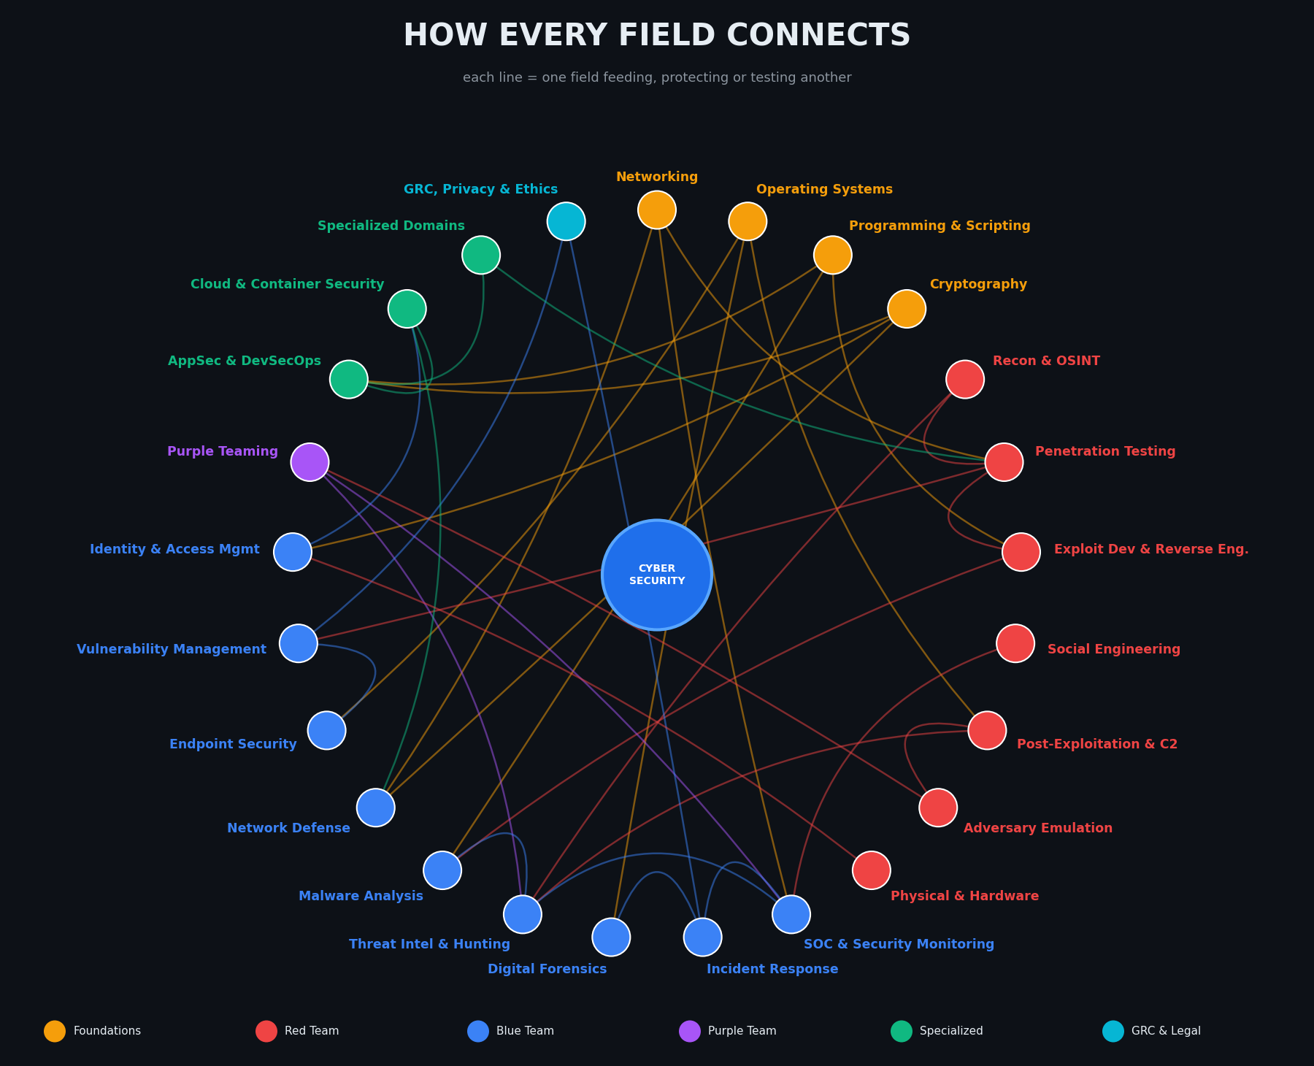
How Every Field Connects
Recon -> Pentest
targets & attack surface
Pentest -> Vuln Mgmt
findings become fixes
Emulation -> Purple -> SOC
attacks become detections
SOC -> IR -> DFIR
alert, response, evidence
Malware -> Threat Intel
YARA rules & IOCs
Crypto -> IAM / Network / AppSec
trust everywhere

Slide 9
Red vs Blue: The Kill Chain
Phase | Red Team does | Blue Team answers
1. Reconnaissance | OSINT, scanning, enumeration | Threat intel, honeypots, minimize exposure
2. Weaponization | Craft payloads & exploits | Malware analysis, YARA, sandboxing
3. Delivery | Phishing, drive-by, USB | Email gateway, awareness training, web filtering
4. Exploitation | Abuse a vulnerability | Patching, IPS, hardening, vuln management
5. Installation | Persistence, backdoors | EDR, app allow-listing, integrity monitoring
6. Command & Control | Beacon to C2 server | DNS sinkhole, egress filtering, NDR
7. Actions on Objectives | Exfiltration, ransomware | DLP, backups, incident response, forensics

Slide 10
Folder Structure for Your Study Repo
Cybersecurity/
├── 00_Foundations/ [Core Knowledge]
│ ├── Networking/
│ ├── Operating_Systems/
│ ├── Programming_Scripting/
│ └── Cryptography/
├── 01_Red_Team/ [Offensive]
│ ├── Recon_OSINT/
│ ├── Penetration_Testing/
│ ├── Exploit_Development/
│ ├── Social_Engineering/
│ ├── Post_Exploitation_C2/
│ ├── Adversary_Emulation/
│ └── Physical_Hardware/
├── 02_Blue_Team/ [Defensive]
│ ├── SOC_Monitoring/
│ ├── Incident_Response/
│ ├── Digital_Forensics/
│ ├── Threat_Intel_Hunting/
│ ├── Malware_Analysis/
│ ├── Network_Defense/
│ ├── Endpoint_Security/
│ ├── Vulnerability_Management/
│ └── Identity_Access/
├── 03_Purple_Team/ [Collaborative]
│ └── Purple_Teaming/
├── 04_Specialized_Engineering/ [Cross-cutting]
│ ├── AppSec_DevSecOps/
│ ├── Cloud_Security/
│ └── Specialized_Domains/
├── 05_GRC_Legal/ [Governance]
│ └── GRC_Privacy_Ethics/
├── 06_Certs_Roadmap/
├── 07_Labs_CTF/
├── 08_Tools/
└── 09_Resources/

Slide 11
Learning & Certification Roadmap
Beginner
Security+, CEH, eJPT, CC (ISC2), Google Cybersecurity
Red Path
PNPT, OSCP, CRTO, OSWE, OSED
Blue Path
BTL1, CySA+, GCIH, GCFA, SC-200
Management
CISSP, CISM, CISA, CCSP
1
2
3
4
5
Foundations
Network, Linux, Python, Crypto
Pick a side
Red or Blue, then cross-train
Practice
THM, HTB, CTFs, home lab
Specialize
Cloud, AppSec, DFIR, Intel
Credential
Exam for your track

Slide 12
Learn it. Practice it. Protect it.
Educational reference. Only test systems you own or have written permission to test.
github.com/Syed-Muhammad-Tayyab

