Slide 1
Dictionary
A Python data type.
Able to store data values in key : value pairs to express detailed information.
User information
id | 1
name | "Leanne Graham"
username | "Bret"
email | "Sincere@april.biz"
{ "id": 1,
"name": "Leanne Graham",
"username": "Bret",
"email": "Sincere@april.biz" }

Slide 2
Nested Dictionary
Able to store a dictionary in a dictionary to express more detailed information.
User information
{ "id": 1,
"name": "Leanne Graham",
"username": "Bret",
"email": “Sincere@april.biz”,
“address”: {
"street": "Kulas Light",
"suite": "Apt. 556",
"city": "Gwenborough“,
"zipcode": "92998-3874“
}
}
id | 1
name | "Leanne Graham"
username | "Bret"
email | "Sincere@april.biz"
address | { … }
Address information
street | "Kulas Light"
suite | "Apt. 556"
city | "Gwenborough“
zipcode | "92998-3874“

Slide 3
Class
A template that specifies data and functions (methods).
self: Class instance itself. Able to access data and functions.
Class User:
__init__(self, username, password):
self.username = username
self.password = password
update_username(self, new_username):
self.username = new_username
update_password(self, new_password):
self.password = new_password
User
username password
__init__(username, password) update_username(new_name) update_password(new_password)

Slide 4

Class Instance
A live entity (instance) made from a template (class).
User Instance 1
for
User
username password
__init__(username, password) update_username(new_name) update_password(new_password)
User1
User Instance 2
for
User2
User Instance 3
for
User3

Slide 5
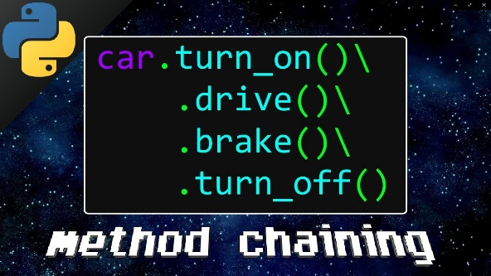
Python Method Chaining
Method chaining is a style of programming in which invoking multiple method calls occurs sequentially. It removes the pain of assigning variables at each intermediate step as each call performs action on same object and then returns the object to next call.
Method chaining has two useful benefits
It can reduce the length of the overall code as countless variables do not have to be created.
It can increase the readability of the code since methods are invoked sequentially.

Slide 6
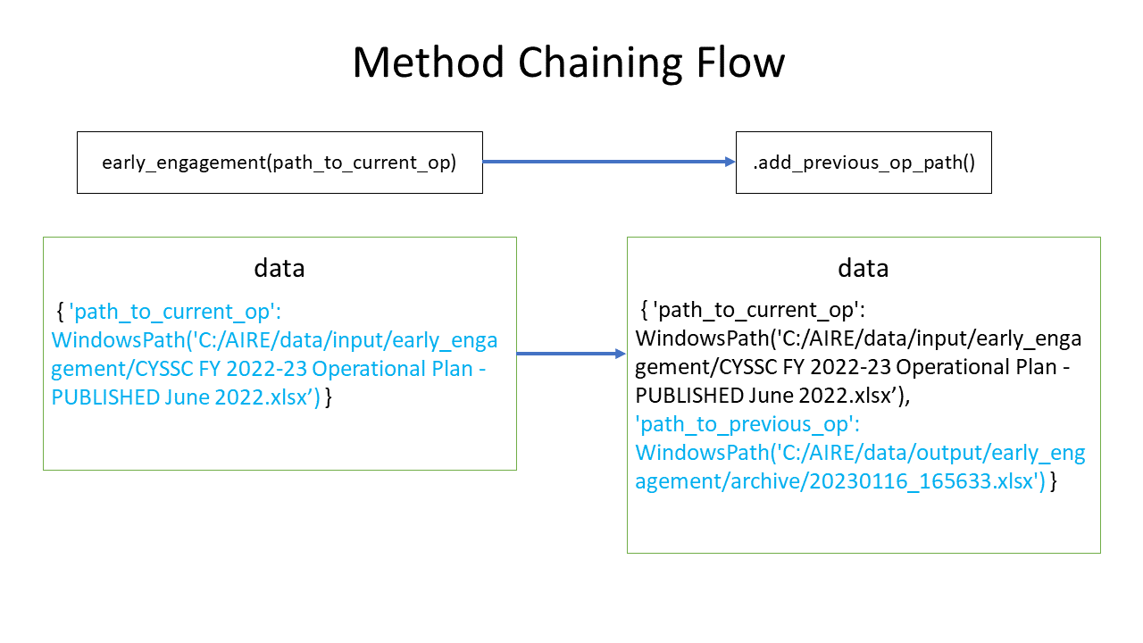

Slide 7
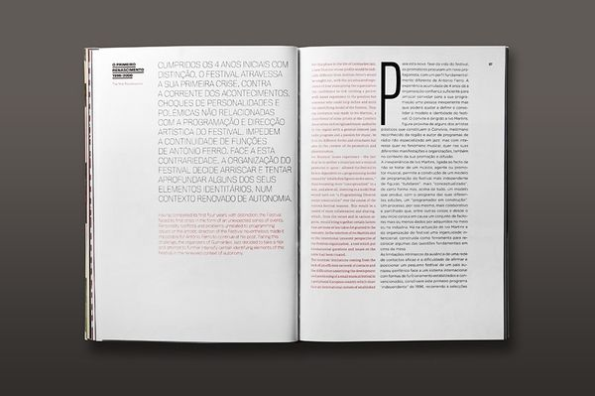

Clean Code
Making code readable so that even a 5-year-old child can understand.
To reduce the time to understand the code for teammates and future me.

Slide 8
Clean Code Technique
Abstraction: Hiding complex code and showing only what it does. Others can understand what the code does intuitively.
def main():
…
…
…
…
…
…
…
…
…
…
def main():
users = get_data_from(“user_list.xlsx”)
british_users = filter_british_users(users)
save_data(british_users, “british_user_list.xlsx”)
def get_data_from(file):
…
…

Slide 9
Clean Code Technique
Comments: explains what each methods do, complex code, or caution about bugs or issues

Slide 10
Code Review
A software quality assurance activity in which one or several people check a program mainly by viewing and reading parts of its source code
Share knowledge and teach each other to upgrade skills
Clean Code: check readability
Possible Optimizations: check if there’s any duplicated code or bugs
Keep in track with the requirements

