Slide 1
Dictionary
A Python data type.
Able to store data values in key : value pairs to express detailed information.
User information
id | 1
name | "Leanne Graham"
username | "Bret"
email | "Sincere@april.biz"
{ "id": 1,
"name": "Leanne Graham",
"username": "Bret",
"email": "Sincere@april.biz" }

Slide 2
Nested Dictionary
Able to store a dictionary in a dictionary to express more detailed information.
User information
{ "id": 1,
"name": "Leanne Graham",
"username": "Bret",
"email": “Sincere@april.biz”,
“address”: {
"street": "Kulas Light",
"suite": "Apt. 556",
"city": "Gwenborough“,
"zipcode": "92998-3874“
}
}
id | 1
name | "Leanne Graham"
username | "Bret"
email | "Sincere@april.biz"
address | { … }
Address information
street | "Kulas Light"
suite | "Apt. 556"
city | "Gwenborough“
zipcode | "92998-3874“

Slide 3
Class
A template that specifies data and functions (methods).
self: Class instance itself. Able to access data and functions.
Class User:
__init__(self, username, password):
self.username = username
self.password = password
update_username(self, new_username):
self.username = new_username
update_password(self, new_password):
self.password = new_password
User
username password
__init__(username, password) update_username(new_name) update_password(new_password)

Slide 4

Class Instance
A live entity (instance) made from a template (class).
User Instance 1
for
User
username password
__init__(username, password) update_username(new_name) update_password(new_password)
User1
User Instance 2
for
User2
User Instance 3
for
User3

Slide 5
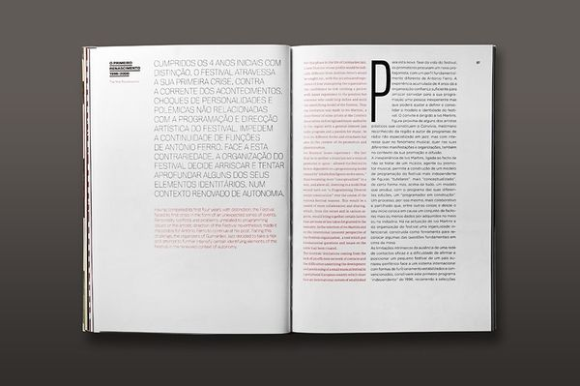
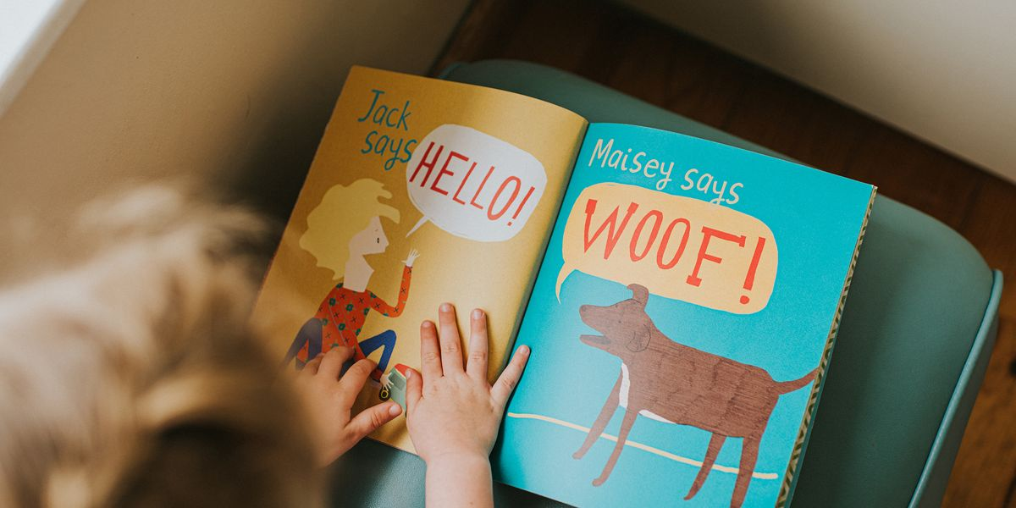
Clean Code
Making code readable so that even a 5-year-old child can understand.
To reduce the time to understand the code for teammates and future me.

Slide 6
Clean Code Technique
Abstraction: Hiding complex code and showing only what it does. Others can understand what the code does intuitively.
def main():
…
…
…
…
…
…
…
…
…
…
def main():
users = get_data_from(“user_list.xlsx”)
british_users = filter_british_users(users)
save_data(british_users, “british_user_list.xlsx”)
def get_data_from(file):
…
…

Slide 7
Clean Code Technique
Comments: explains what each methods do, complex code, or caution about bugs or issues

Slide 8
Code Review
A software quality assurance activity in which one or several people check a program mainly by viewing and reading parts of its source code
Share knowledge and teach each other to upgrade skills
Clean Code: check readability
Possible Optimizations: check if there’s any duplicated code or bugs
Keep in track with the requirements

