Slide 1
Online Retail Analysis
Presented to the CEO & CMO
By Data Analytics Team

Slide 2
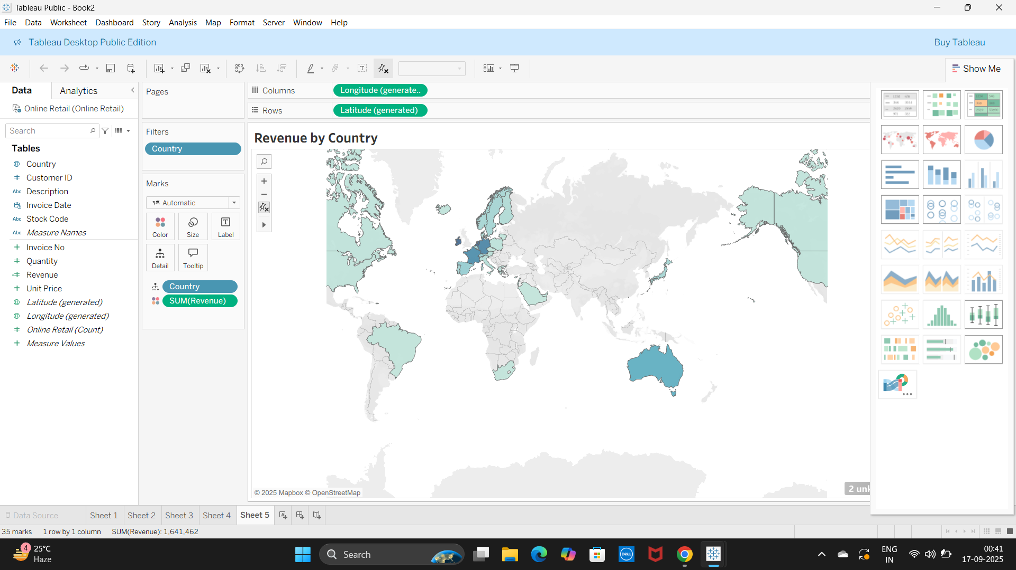
Revenue by Country
This map shows the distribution of revenue across different countries, highlighting our strongest markets.

Slide 3
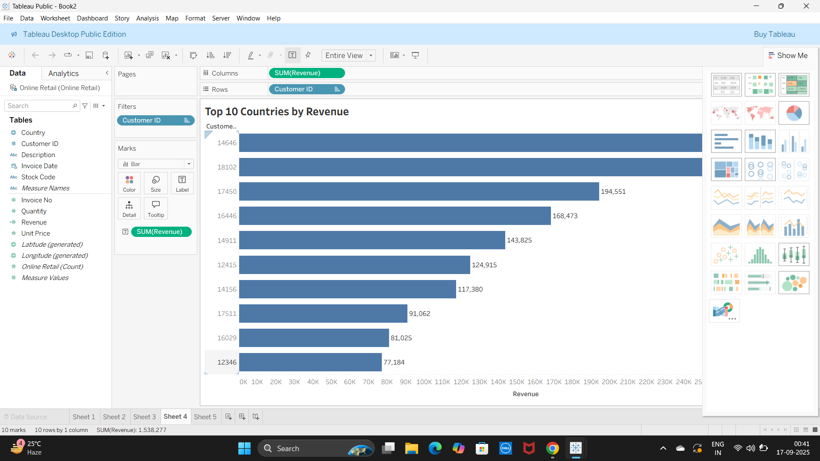
Top 10 Countries by Revenue
This bar chart highlights the top 10 countries contributing the most revenue.

Slide 4
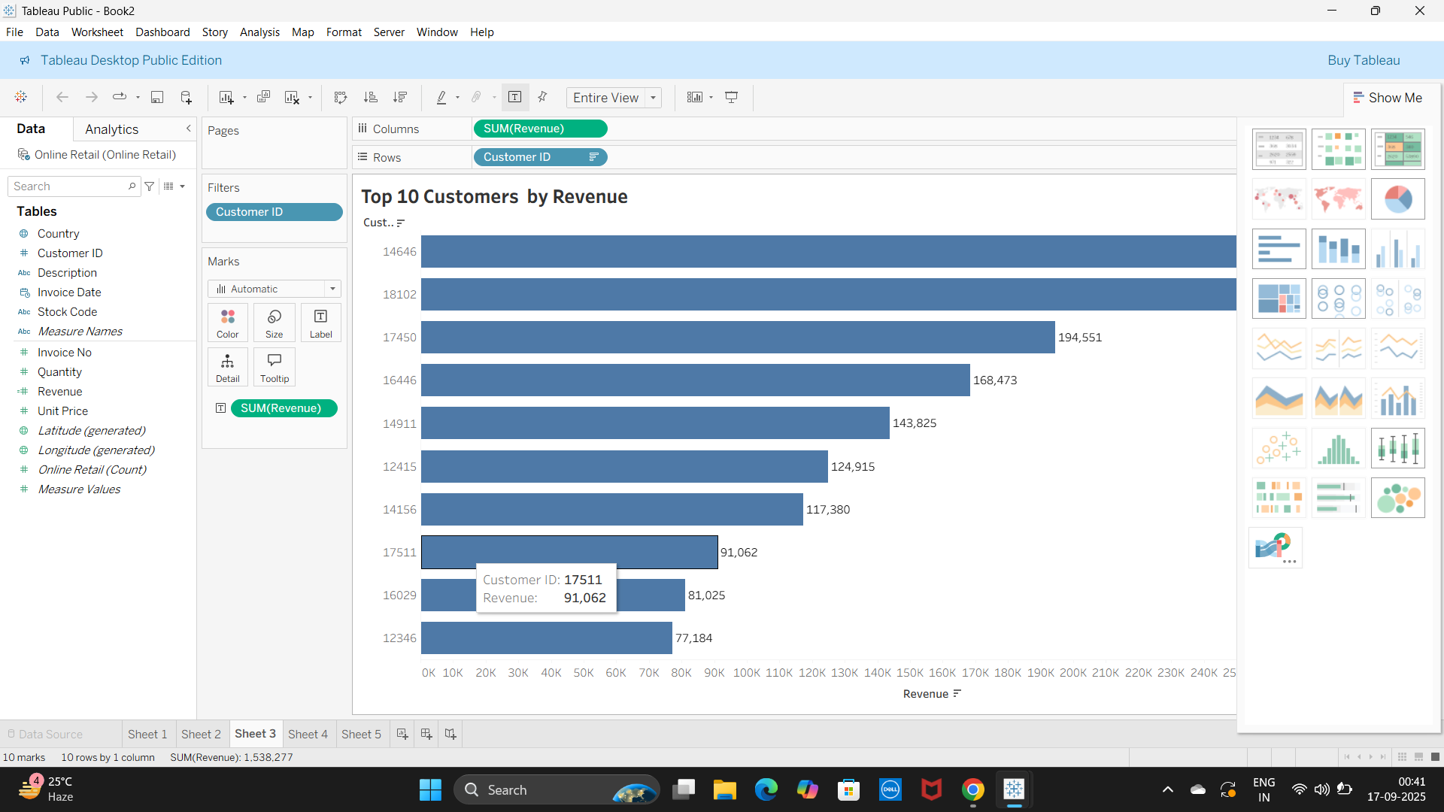
Top 10 Customers by Revenue
Here we see the top 10 customers who are driving significant revenue for our business.

Slide 5
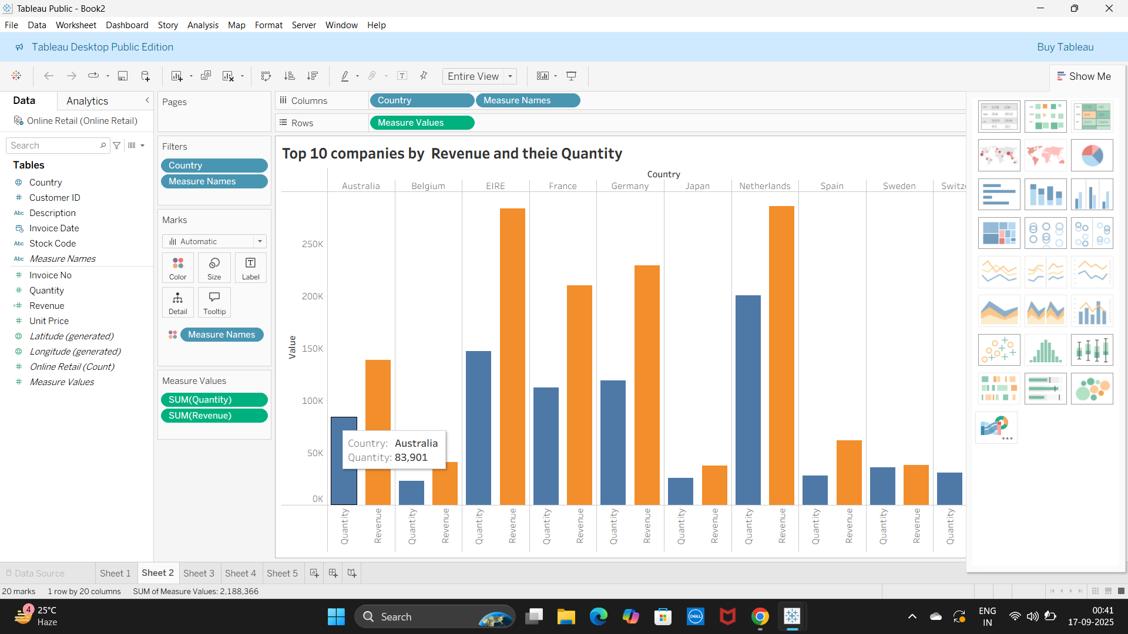
Top 10 Companies by Revenue and Quantity
This chart compares revenue and quantity sold across the top 10 countries, showing both demand and value.

Slide 6
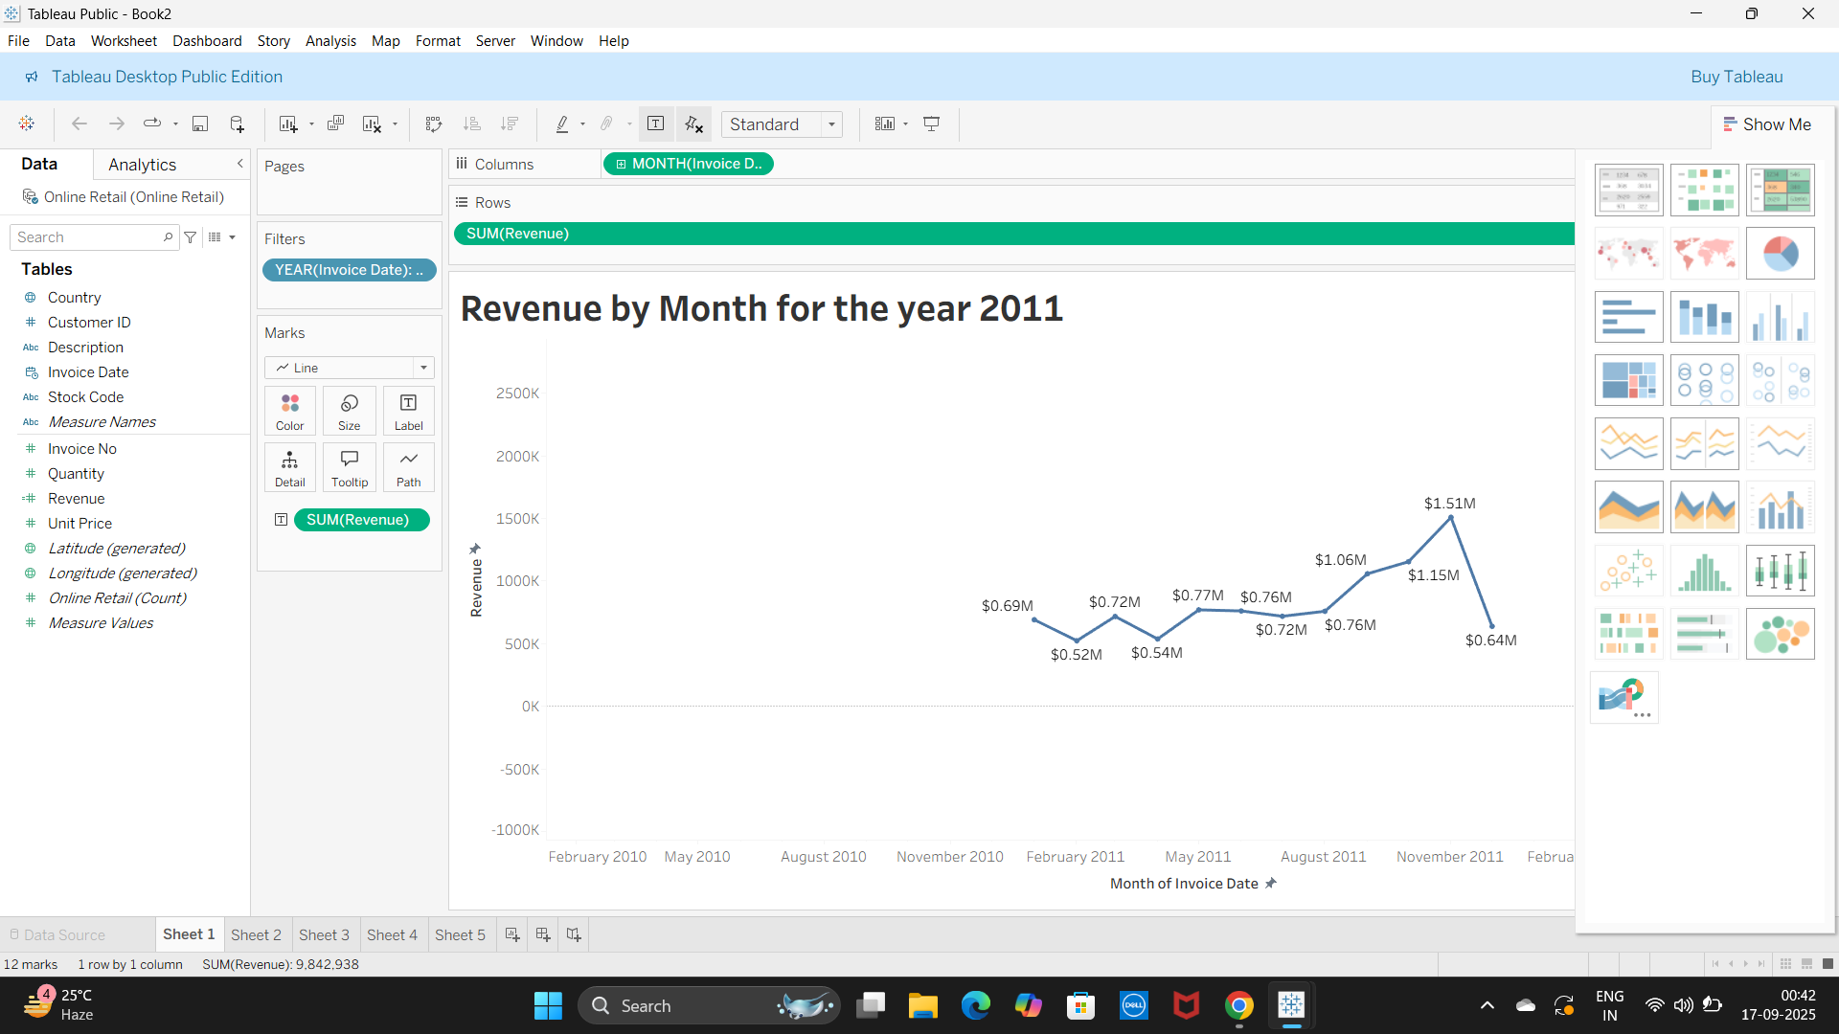
Revenue by Month for 2011
This line chart illustrates monthly revenue trends for 2011, highlighting seasonal sales patterns.

