Slide 1


Case Study #2
SPOTIFY ANALYSIS
www.Kaggle.com/datasets/spotify-top-hit-list
SQL
Data Exploration Project
- Syed Sarfaraz Ahmed / Data Analyst

Slide 2
INTRODUCTION
Imagine you're a data Analyst embarking on a captivating journey into the world of music. Your mission: to understand the evolution of songs on Spotify from 2010 to 2022. Armed with a treasure trove of data, you're determined to uncover the musical trends, hidden gems, and curious anomalies that have defined this era.
As you delve into this harmonious dataset, you discover that songs are not just an auditory experience but also a reflection of the cultural zeitgeist. From the rise of streaming platforms to the decline of physical sales, the music industry has undergone seismic shifts. Your task is to untangle the web of influences that have shaped the songs we've been grooving to over these years.

Slide 3
PROBLEM STATEMENT
Given the vast and intricate dataset encompassing Spotify's music library, user interactions, and artist performances over the past twelve years, we seek to extract meaningful insights and trends that shed light on the evolving landscape of music consumption and production. Our primary objectives include:
Top songs based on popularity
Top songs for each year (2000-2022)
Importance of Energy, Danceability, Loudness, Speechiness and Acousticness on Songs.

Slide 4
DATASET
Top songs in the world for year 2010-2022 in Spotify. This dataset has 23 descriptive variables about the songs. Dataset description
Popularity - The higher the value the more popular the song is.
Danceability - The higher the value, the easier it is to dance to this song.
Energy - The energy of a song - the higher the value, the more energetic song.
Key - the key the track is in. Integers map to pitches using standard Pitch Class notation. E.g. 0 = C, 1 = C♯/D♭, 2 = D, and so on. If no key was detected, the value is -1 (range: -1; 11) Loudness (dB) - The higher the value, the louder the song.
Mode - indicates the modality (major or minor) of a track, the type of scale from which its melodic content is derived. Major is represented by 1 and minor is 0.
Speechiness - The higher the value the more spoken word the song contains.

Slide 5
Acousticness - The higher the value the more acoustic the song is.
Instrumentalness - the number of vocals in a song. The closer the value to 1.0, the more instrumental the song is.
Liveness - The higher the value, the more likely the song is a live recording.
Valence - The higher the value, the more positive mood for the song.
Tempo - the overall estimated tempo of a track in beats per minute (BPM) Duration - duration of the song in ms.
Time signature - an estimated time signature. The time signature (meter) is a notational convention to specify how many beats are in each bar (or measure). The time signature ranges from 3 to 7 indicating time signatures of "3/4", to "7/4"

Slide 6
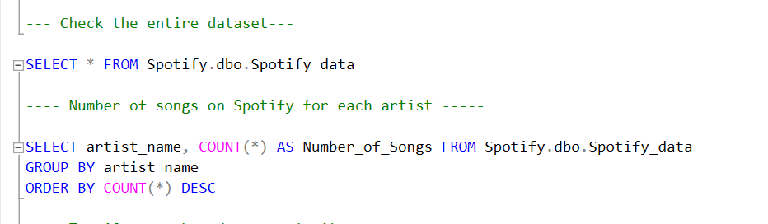
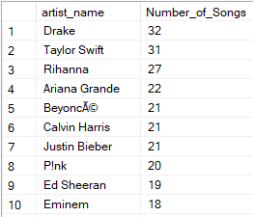

Slide 7
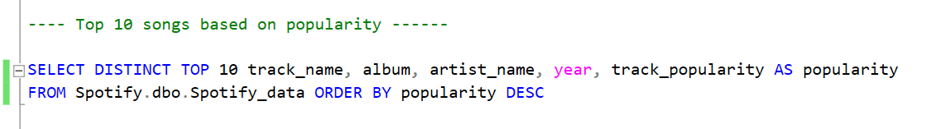
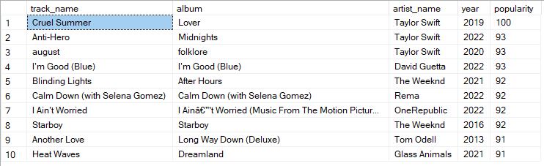

Slide 8
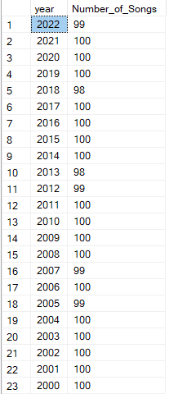
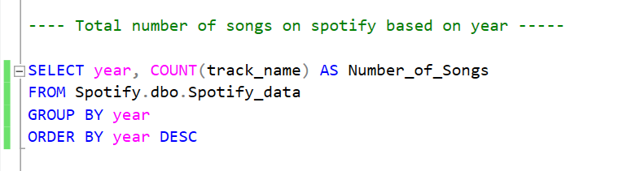

Slide 9
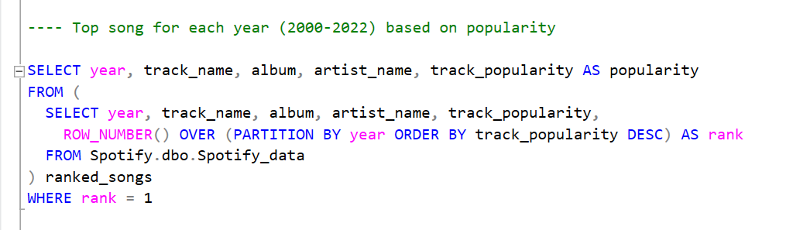
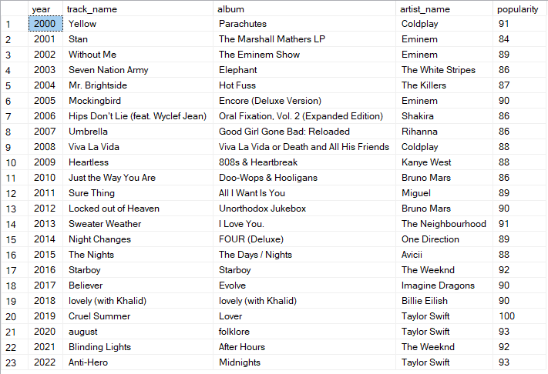

Slide 10
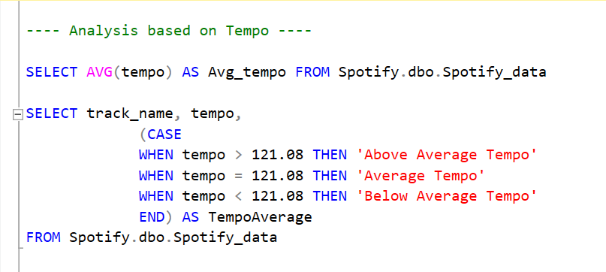
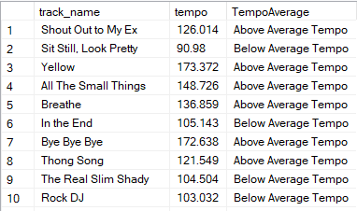

Slide 11
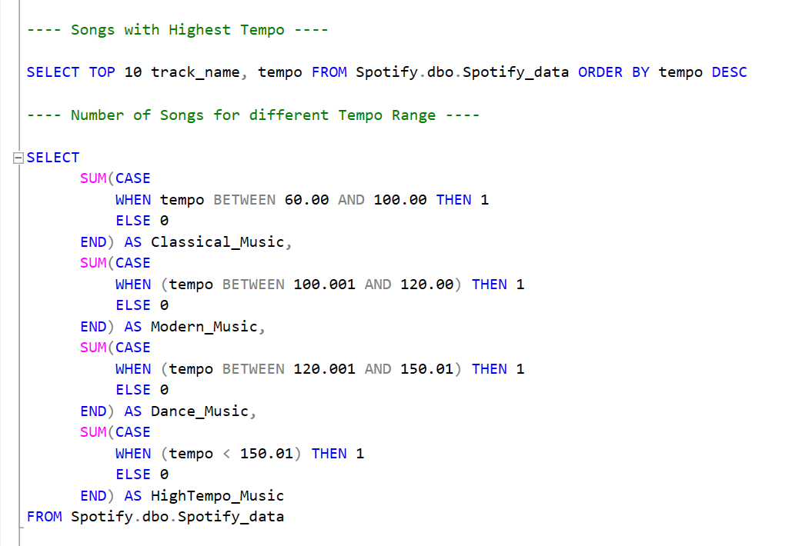
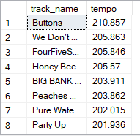


Slide 12
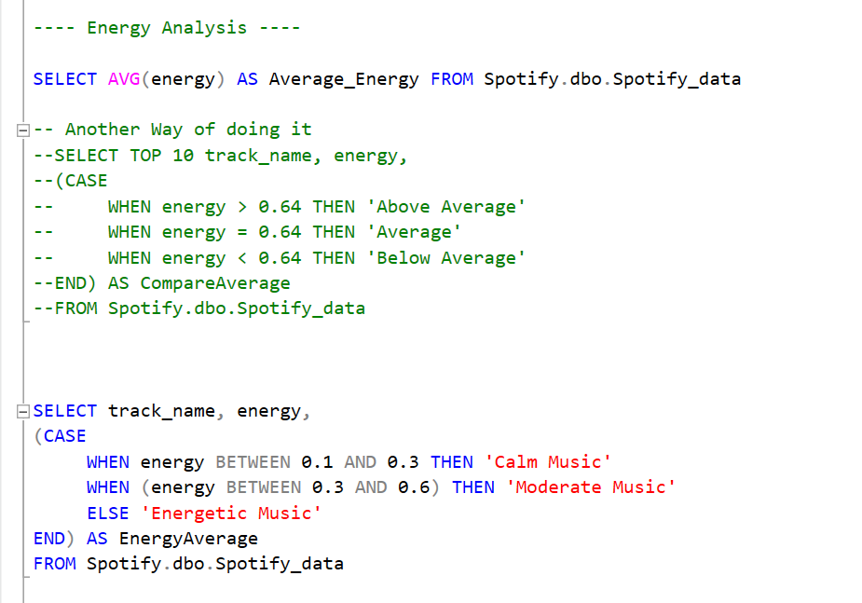

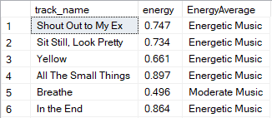

Slide 13
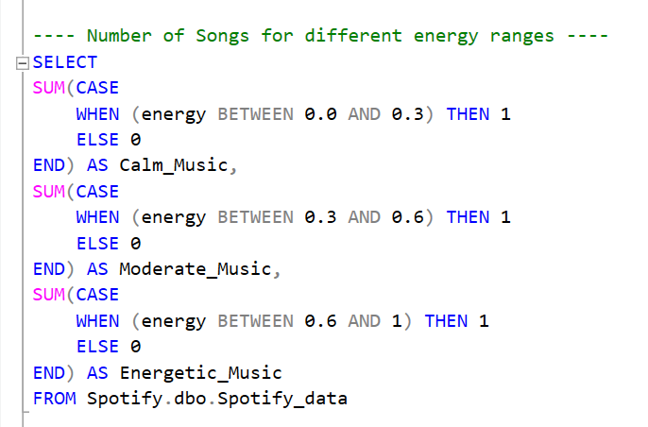


Slide 14
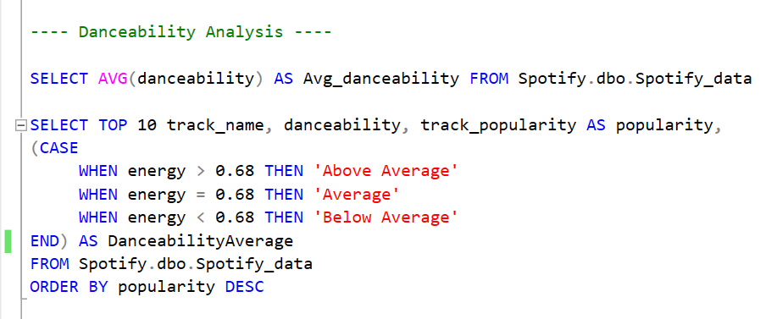
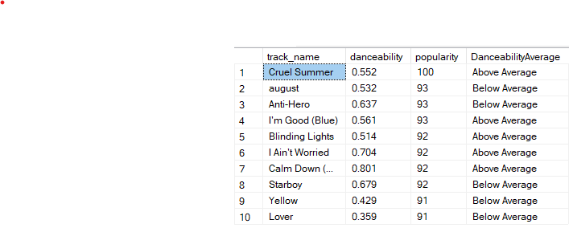

Slide 15
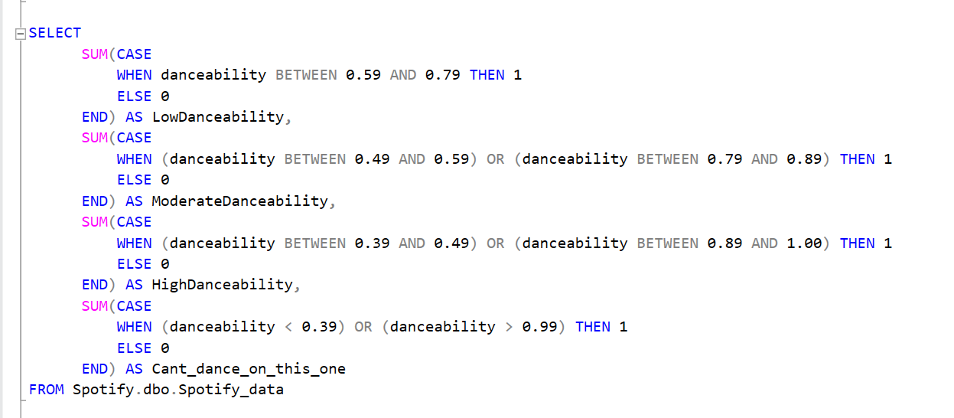

Slide 16
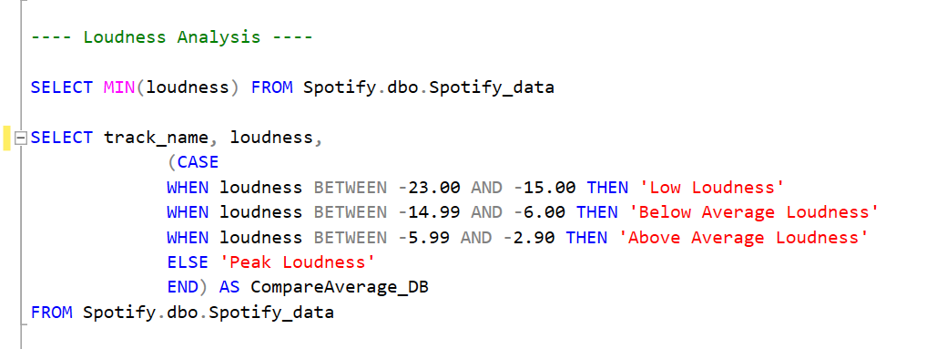
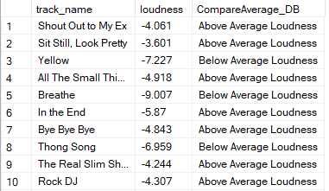

Slide 17
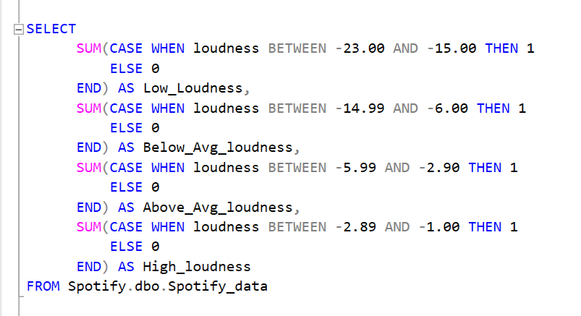

Slide 18
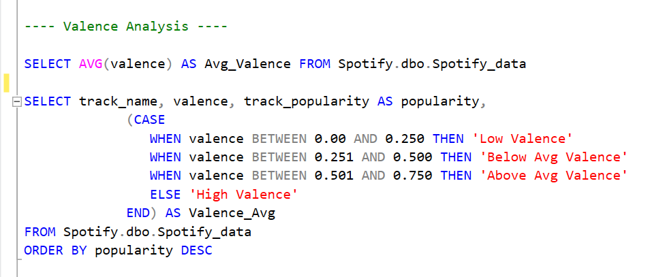
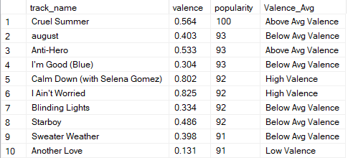

Slide 19
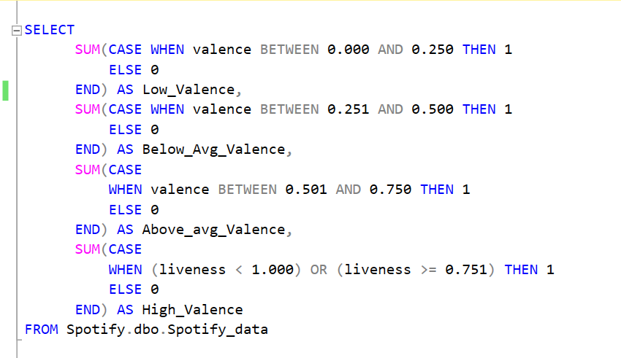

Slide 20
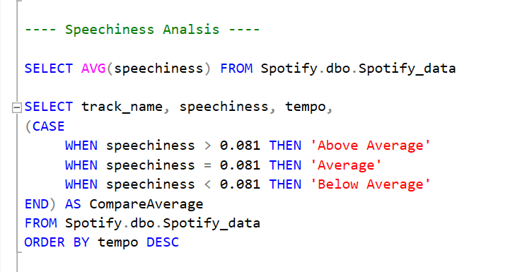
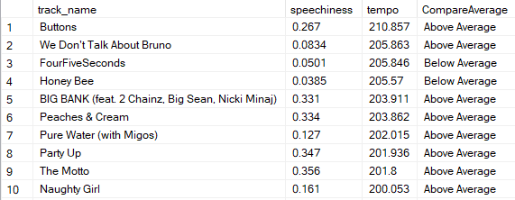

Slide 21
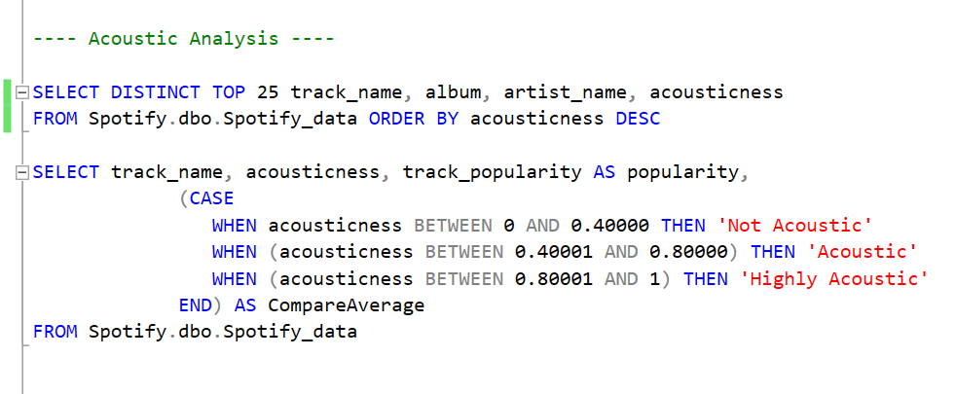
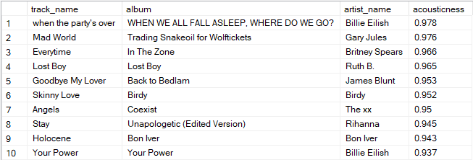
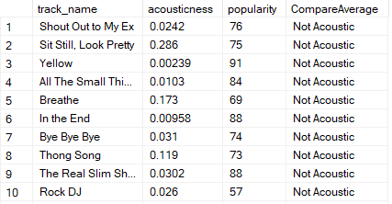

Slide 22
INSIGHTS
From the above analysis, It is observed that Drake had released the most number of songs on Spotify between 2010-2022.
Cruel Song from the album Lover by Taylor Swift was the most popular song on Spotify between 2010-2022.
Taylor Swift is probably the most popular singer as she had 3 songs among the top 10 songs in Spotify.
Majority of songs on Spotify have high tempo that means those songs have more energy and Speechiness.
Majority of songs on Spotify aren’t danceable.

Slide 23
RECOMMENDATIONS
In Recent times, there is a rise in calm and slowed songs and Spotify needs to add such songs to be with the trend.
Spotify needs to balance the valence songs.
Spotify needs to add more songs with less/below average loudness as they are starting to get in trend.
There is great rise in the number of people going for Dancing and Spotify needs to add more songs which are danceable.
Spotify needs to add more rap/high speechiness songs, as there is decline in number of rap songs over the years.

Slide 24
THANK YOU!

