Slide 1
“Graphs”
Terminal Exam Presentation
Department: Electrical Computer Engineering
Student name: S.M.Shahir.Ul.Haq
Course: Data Structures & Algorithms
Subject Teacher: Dr.Ali Mustafa & Sir Qasim Javed

Slide 2
Contents
The contents of presentation are as follows:
Introduction to graph theory
Components of graphs
Types of graphs
Real life examples
Representation of graphs
Introduction to STL
Code implementation
Conclusion

Slide 3
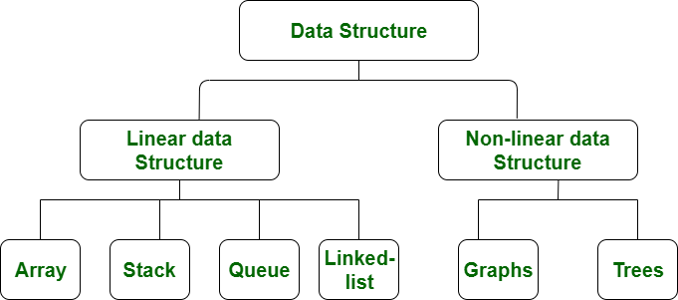
Introduction
Graphs:
“A Graph is a non-linear data structure consisting of vertices and edges.”
Non linear data structure:
“It is a form of data structure where the data elements don't stay arranged linearly or sequentially”

Slide 4
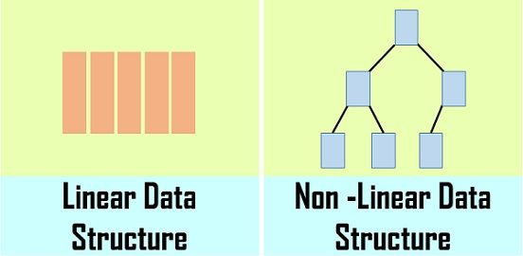
Introduction
Non linear data structure:
Non linear data structure may have several levels

Slide 5
Components Of Graph
Nodes:
Nodes are the fundamental units of graph
These are also called vertices
Edges:
The edges are lines or arcs that connect any two nodes in the graph
More formally a Graph is composed of a set of vertices( V ) and a set of edges( E )
The graph is denoted by G(E, V)

Slide 6
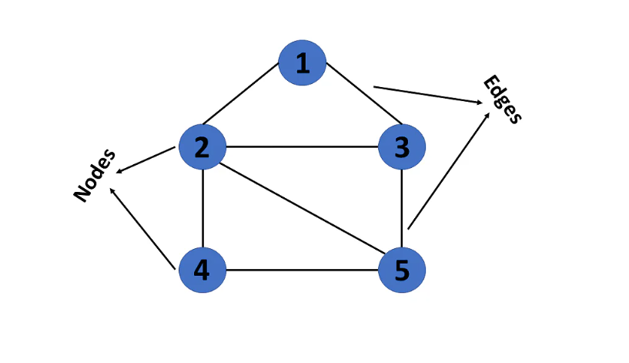
Graph
This picture illustrates the components of Graph:

Slide 7
Types Of Graphs
There are two types of graphs with respect to direction of edges
Directed Graphs
Undirected Graphs
Directed Graphs:
One vertex is directed towards another vertex through an edge between them
Undirected or Bi directed Graphs:
One vertex is connected with another vertex through an edge between them but no direction is specified

Slide 8
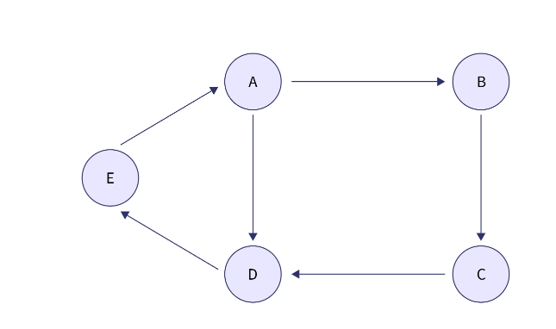
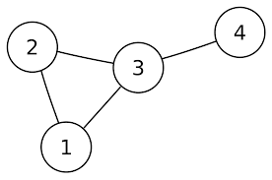
Directed & Undirected Graphs
Directed Graph Undirected Graph

Slide 9
Types Of Graphs
Furthermore the directed and undirected graphs can be weighted and unweighted graphs.
Weighted Graphs:
These are the graph data structures in which the edges are given some weight or value based on the type of graph we are representing.
Unweighted Graphs:
Unweighted graphs are the graph data structure which are not associated with any weight or value.

Slide 10
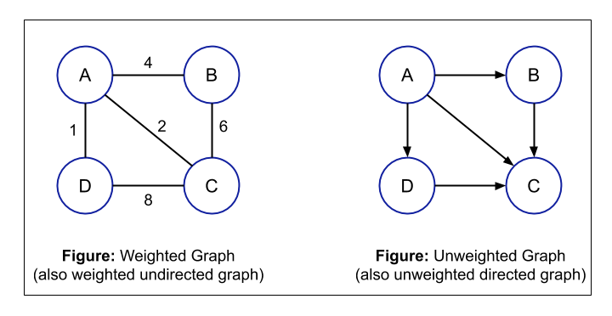
Weighted & Unweighted Graphs

Slide 11
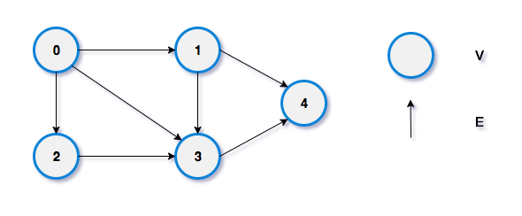
Degree
Degree shows the number of edges connected to each node
In directed graphs degree is divided into two terminologies
In degree & out degree
In degree means entering edges
Out degree means out going edges

Slide 12
Path
In graph theory the path is any route along the edges of a graph
A path may follow a single edge directly between two vertices
It may follow multiple edges through multiple vertices
Paths from 0 to 4{0->1->4,0->3->4,0->2->3->4}
Node cant be repeated

Slide 13
Real Life Example
Graph has many useful applications in real life
Few of them discusses here to give an idea about how a graph can be used ?
Maps:
Google maps uses graph data structure
Places are nodes 1km
Roads are edges
Route is path 2km 2km
5km
3km 1km
A
B
D
E
C

Slide 14
Real Life Example
Friend and Follow example:
Directed and undirected graph can be explained with the help of facebook friend and follow algorithm
friends followers
celeb
P1
P1
P2
P3
P2
P3

Slide 15
Representation
Now the question rises that how actually we can represent graph in programming?
It can be represented in two ways
Adjacency Matrix
Adjacency List
Adjacency Matrix:
Adjacency Matrix is a 2D array of size V x V where V is the number of vertices in a graph
Adjacency List:
An array of lists is used. The size of the array is equal to the number of vertices
//undirected n(n-1)/2
//directed n*(n-1)

Slide 16
Representation
Graph : Adjacency Matrix:

Slide 17
Representation
Adjacency List:

Slide 18
Introduction To STL
C++ STL (standard template library) is a software library for the C++ language
It provides a collection of templates representing containers, iterators, algorithms, and function objects
These can be very handful to implement data structures like linked list, arrays, stacks etc
These can also be handful to apply sorting and searching algorithms
Few example are as follows
List<data type>size; {for creating link list}
Stack<data type>size; {for creating stack}
Map<key data type, value for key>size; {for creating map}
For(auto i:m) {traverse map }
Further different commands are used to perform different operations like insert, delete and print etc

Slide 19
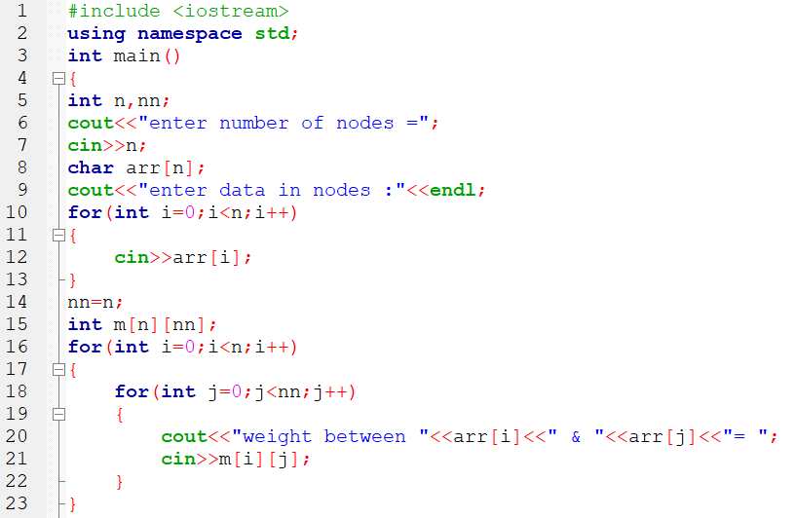
Code for Adjacency Matrix

Slide 20
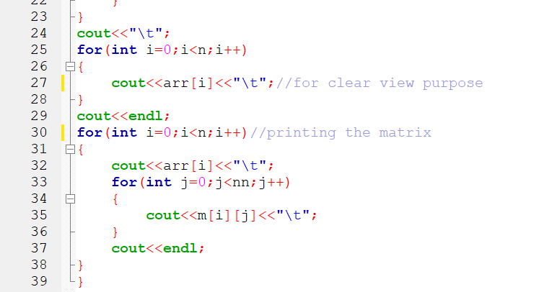
Code For Adjacency Matrix

Slide 21
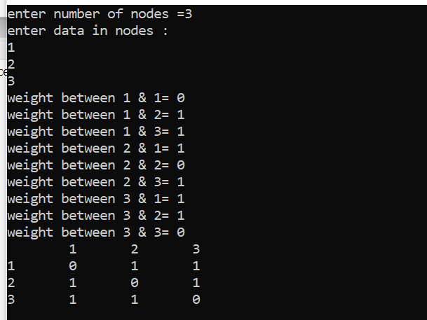
Output
Graph:
1
2
3

Slide 22
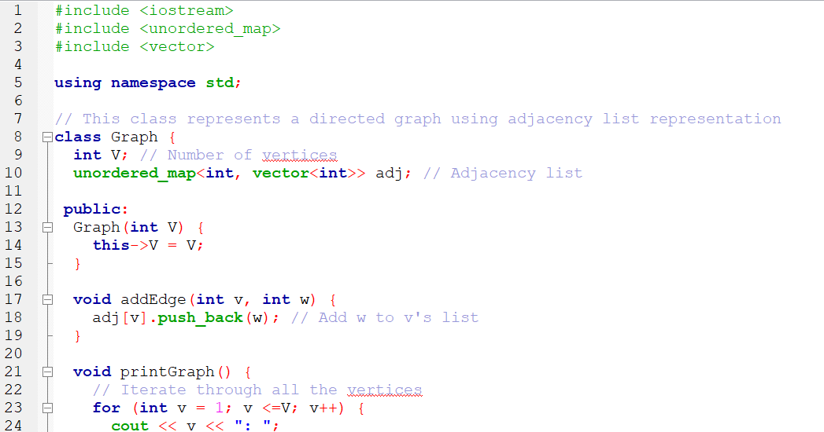
Code For Adjacency List

Slide 23
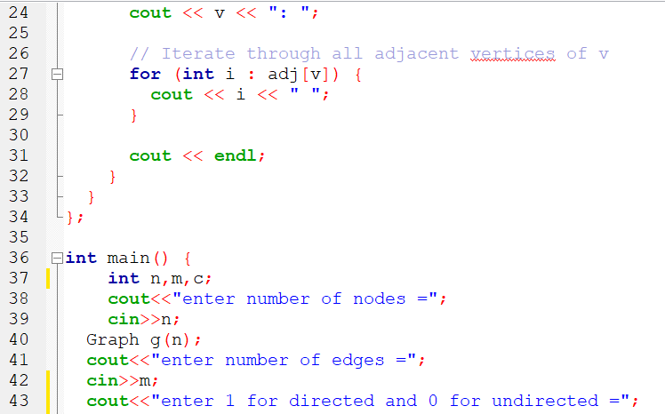
Code For Adjacency List

Slide 24
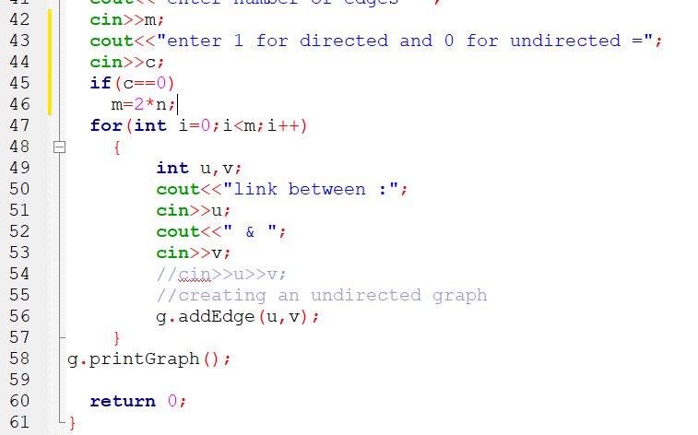
Code For Adjacency List

Slide 25
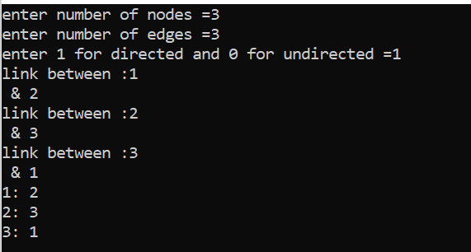
Output
Graph:
1
2
3

Slide 26
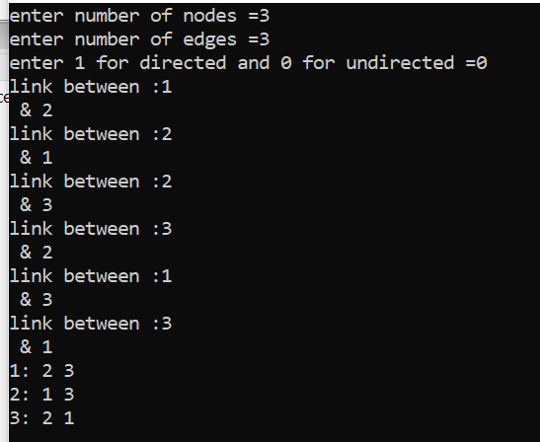
Output
Graph:
1
2
3

Slide 27
Conclusion
Graph is a non linear data structure
It is the combination of nodes and edges
It can be directed and undirected
The edges can be weighted and un weighted
Graph are very useful in making networks, maps and social media platforms
Graphs can be represented by two methods
Adjacency matrix and Adjacency list
STL(standard template library) is very handful library of containers and algorithms

Slide 28
Thanks!!!

