Slide 1
FETAL HEALTH CLASSIFICATION USING ML

Slide 2
Abstract:
Health complications during the gestation period have evolved as a global issue. These complications sometimes result in the mortality of the fetus, which is more prevalent in developing and underdeveloped countries. The genesis of machine learning (ML) algorithms in the healthcare domain have brought remarkable progress in disease diagnosis, treatment, and prognosis. Around 800 women die every day due to pregnancy and childbirth-related issues. Maternal health and fetal health are closely associated with each other because every year approximately 3 million newborn babies die. So there is a need for proper care including the prediction of risk levels before, during and after the delivery for the safety of both mother and child. Data mining is a commonly used technique for processing enormous data. Researchers apply several data mining and machine learning techniques to analyse huge complex data, helping health care professionals to predict fetal health. Different algorithms are compared and the best model is used for predicting the fetal health.

Slide 3
Existing System:
Fetal development relies on a complex circulatory network. Accurate assessment of flow distribution is important for understanding pathologies and potential therapies. In this paper, we demonstrate a method for volumetric imaging of fetal flow with magnetic resonance imaging (MRI). Fetal MRI faces challenges: small vascular structures, unpredictable motion, and inadequate traditional cardiac gating methods. Here, orthogonal multislice stacks are acquired with accelerated multidimensional radial phase contrast (PC) MRI. we have developed an approach for dynamic volumetric fetal flow imaging using highly accelerated multidimensional radial PCMRI. The method makes use of real-time reconstructions for intra-slice motion correction and derivation of fetal heart rate to provide flow sensitive CINEs. They are then combined with inter-slice spatiotemporal registration and volumetric update to create 4D flow reconstructions in human fetuses.

Slide 4
Disadvantages:
Machine learning is not implemented.
Fetal flow image is developed.
Fetal condition is not predicted.

Slide 5
Proposed System:
The aim of the proposed method is to predict whether the gestation fetal is normal or not. This can be predicted by a machine learning method. The process starts from collecting the data’s. After collecting the dataset, it is pre-processed for removing the unwanted data’s from the dataset. Machine learning method is now used and mostly used in all the departments where it reduces the mistake. Many algorithms are used and the best one is used for predicting the fetal health.

Slide 6
Advantages:
Fetal health condition will be predicted.
Machine learning is implemented.
More algorithms are compared.

Slide 7
Environmental Requirements:
1. Software Requirements:
Operating System : Windows
Tool : Anaconda with Jupyter Notebook
2. Hardware requirements:
Processor : Intel core i3
Hard disk : minimum 300 GB
RAM : minimum 4 GB

Slide 8
INTRODUCTION
Domain overview
Data science is an interdisciplinary field that uses scientific methods, processes, algorithms and systems to extract knowledge and insights from structured and unstructured data, and apply knowledge and actionable insights from data across a broad range of application domains.
The term "datascience " has been traced back to 1974, when Peter Naur proposed it as an alternative name for computer science. In 1996, the International Federation of Classification Societies became the first conference to specifically feature data science as a topic. However, the definition was still in flux.

Slide 9
MACHINE LEARNING:
Machine learning is to predict the future from past data. Machine learning (ML) is a type of artificial intelligence (AI) that provides computers with the ability to learn without being explicitly programmed. Machine learning focuses on the development of Computer Programs that can change when exposed to new data and the basics of Machine Learning, implementation of a simple machine learning algorithm using python. Process of training and prediction involves use of specialized algorithms. It feed the training data to an algorithm, and the algorithm uses this training data to give predictions on a new test data. Machine learning can be roughly separated in to three categories. There are supervised learning, unsupervised learning and reinforcement learning. Supervised learning program is both given the input data and the corresponding labeling to learn data has to be labeled by a human being beforehand. Unsupervised learning is no labels. It provided to the learning algorithm. This algorithm has to figure out the clustering of the input data. Finally, Reinforcement learning dynamically interacts with its environment and it receives positive or negative feedback to improve its performance.

Slide 10
Preparing the Dataset :
This dataset contains 2000 records of features extracted, which were then used to find the fetal health condition.

Slide 11
Literature survey:
General
A literature review is a body of text that aims to review the critical points of current knowledge on and/or methodological approaches to a particular topic.
It is secondary sources and discuss published information in a particular subject area and sometimes information in a particular subject area within a certain time period.
Its ultimate goal is to bring the reader up to date with current literature on a topic and forms the basis for another goal, such as future research that may be needed in the area and precedes a research proposal and may be just a simple summary of sources. Usually, it has an organizational pattern and combines both summary and synthesis.

Slide 12
Title : Comparison of machine learning algorithms to classify fetal health using cardiotocogram data
Author: Nabillah Rahmayanti, Humaira Pradani
Year : 2021
Cardiotocogram (CTG) is one of the monitoring tools to estimate the fetus health in womb. CTG mainly yields two results fetal health rate (FHR) and uterine contractions (UC). In total, there are 21 attributes in the measurement of FHR and UC on CTG. These attributes can help obstreticians to clasify whether the fetus health is normal, suspected, or pathological..

Slide 13
Title : Cardiotocographic Diagnosis of Fetal Health based on Multiclass Morphologic Pattern Predictions using Deep Learning Classification
Author: Julia H. Miao1 , Kathleen H. Miao1, 2
Year : 2018
Medical complications of pregnancy and pregnancy-related deaths continue to remain a major global challenge today. Internationally, about 830 maternal deaths occur every day due to pregnancy-related or childbirth-related complications. In fact, almost 99% of all maternal deaths occur in developing countries. In this research, an alternative and enhanced artificial intelligence approach is proposed for cardiotocographic diagnosis of fetal assessment based on multiclass morphologic pattern predictions, including 10 target classes with imbalanced samples, using deep learning classification models..
.

Slide 14
Objectives:
The goal is to develop a machine learning model for fetal health Prediction, to potentially replace the updatable supervised machine learning classification models by predicting results in the form of best accuracy by comparing supervised algorithm.

Slide 15
Project Goals:
Exploration data analysis of variable identification
Loading the given dataset
Import required libraries packages
Analyze the general properties
Find duplicate and missing values
Checking unique and count values
Exploration data analysis of bi-variate and multi-variate
Plot diagram of pairplot, heatmap, bar chart and Histogram
Comparing algorithm to predict the result
Based on the best accuracy

Slide 16
Scope of the Project:
Here the scope of the project is that integration of fetal health with computer-based prediction could reduce errors and improve prediction outcome. This suggestion is promising as data modeling and analysis tools, e.g., data mining, have the potential to generate a knowledge-rich environment which can help to significantly improve the quality of fetal health prediction.

Slide 17
Feasibility study:
Data Wrangling
In this section of the report will load in the data, check for cleanliness, and then trim and clean given dataset for analysis.
Make sure that the document steps carefully and justify for cleaning decisions.

Slide 18
List of Modules:
Data Pre-processing
Data Analysis of Visualization
Comparing Algorithm with prediction in the form of best accuracy result
Deployment

Slide 19
PYTHON:
Introduction:
Python is an interpreted high-level general-purpose programming language. Its design philosophy emphasizes code readability with its use of significant indentation. Its language constructs as well as its object-oriented approach aim to help programmers write clear, logical code for small and large-scale projects.

Slide 20
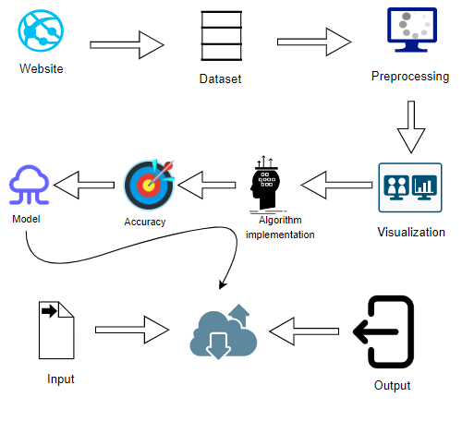
System Architecture :

Slide 21
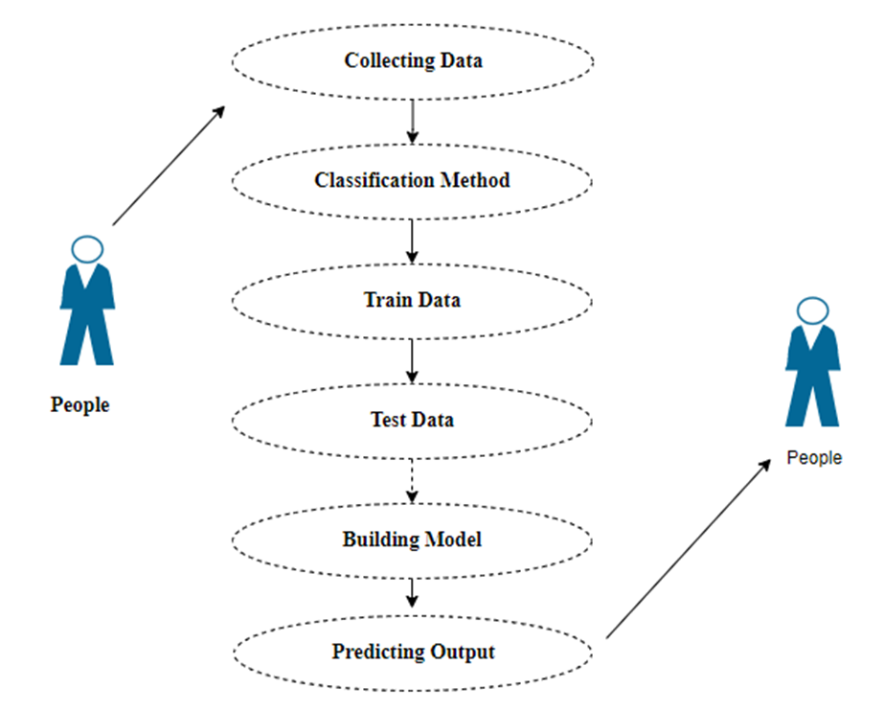
Use Case Diagram:

Slide 22
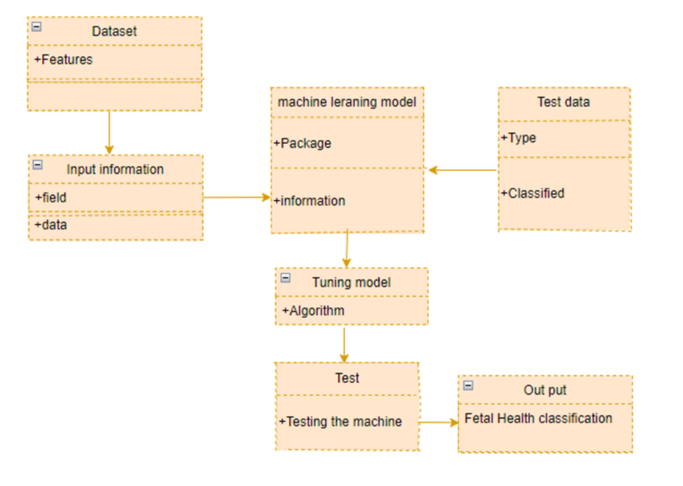
Class Diagram :

Slide 23
Module description:
Data Pre-processing
Validation techniques in machine learning are used to get the error rate of the Machine Learning (ML) model, which can be considered as close to the true error rate of the dataset.
If the data volume is large enough to be representative of the population, you may not need the validation techniques. However, in real-world scenarios, to work with samples of data that may not be a true representative of the population of given dataset. To finding the missing value, duplicate value and description of data type whether it is float variable or integer.
The sample of data used to provide an unbiased evaluation of a model fit on the training dataset while tuning model hyper parameters.

Slide 24
Data Validation/ Cleaning/Preparing Process:
Importing the library packages with loading given dataset. To analyzing the variable identification by data shape, data type and evaluating the missing values, duplicate values.
A validation dataset is a sample of data held back from training your model that is used to give an estimate of model skill while tuning model's and procedures that you can use to make the best use of validation and test datasets when evaluating your models.
Data cleaning / preparing by rename the given dataset and drop the column etc

Slide 25
Exploration data analysis of visualization
Data visualization is an important skill in applied statistics and machine learning.
Statistics does indeed focus on quantitative descriptions and estimations of data.
Data visualization provides an important suite of tools for gaining a qualitative understanding.
This can be helpful when exploring and getting to know a dataset and can help with identifying patterns, corrupt data, outliers, and much more.

Slide 26
Comparing Algorithm with prediction in the form of best accuracy result:
It is important to compare the performance of multiple different machine learning algorithms consistently and it will discover to create a test harness to compare multiple different machine learning algorithms in Python with scikit-learn.
It can use this test harness as a template on your own machine learning problems and add more and different algorithms to compare.
Each model will have different performance characteristics. Using resampling methods like cross validation, you can get an estimate for how accurate each model may be on unseen data.

Slide 27
Algorithm Explanation:
In machine learning and statistics, classification is a supervised learning approach in which the computer program learns from the data input given to it and then uses this learning to classify new observation.
This data set may simply be bi-class (like identifying whether the person is male or female or that the mail is spam or non-spam) or it may be multi-class too.
Some examples of classification problems are: speech recognition, handwriting recognition, bio metric identification, document classification etc

Slide 28
Django:
Django is a micro web framework written in Python.
It is classified as a micro-framework because it does not require particular tools or libraries.
It has no database abstraction layer, form validation, or any other components where pre-existing third-party libraries provide common functions.
However, Django supports extensions that can add application features as if they were implemented in Django itself.
Extensions exist for object-relational mappers, form validation, upload handling, various open authentication technologies and several common framework related tools.

Slide 29
Conclusion:
The analytical process started from data cleaning and processing, missing value, exploratory analysis and finally model building and evaluation. The best accuracy on public test set of higher accuracy score algorithm will be find out. The founded one is used in the application which can help to find the health of the fetal.

Slide 30
Future Work:
Deploying the project in the cloud.
To optimize the work to implement in the IOT system.

