Slide 1
COURSE NAME: COURSE CODE:
ARTIFICIAL INTELLIGENCE
CIS 412
SYED TANGIM PASHA
LECTURER,
DEPARTMENT OF COMPUTING AND INFORMATION SYSTEM (CIS)
DAFFODIL INTERNATIONAL UNIVERSITY (DIU)
DHAKA,BANGLADESH

Slide 2
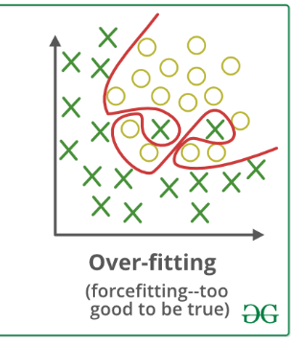
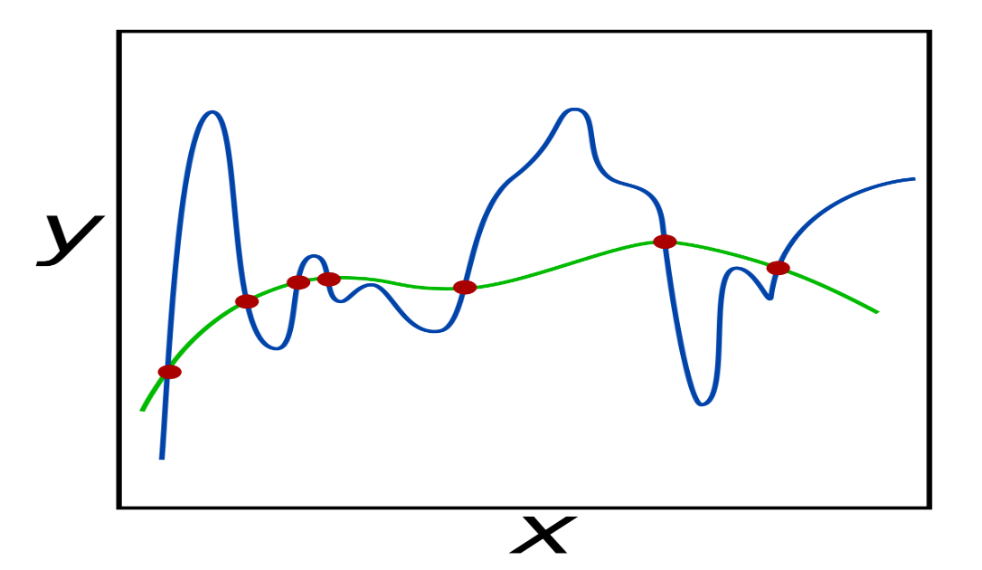
REGULARIZATION
Overfitting: Overfitting is a phenomenon that occurs when a Machine Learning model is constraint to training set and not able to perform well on unseen data.
Regularization: Regularization is a technique used to reduce the errors by fitting the function appropriately on the given training set and avoid overfitting.
OVERFITTING PROBLEM
REGULARIZATION

Slide 3
REGULARIZATION PARAMETER-LAMBDA (λ)
LAMBDA: The lambda parameter controls the amount of regularization applied to the model.
If λ is too large, it causes Underfitting.
If λ is 0 or too small, it causes Overfitting.
λ is a hyperparameter.

Slide 4
REGULARIZATION (TYPES)
L1 Regularization
L2 Regularization
Dropout Regularization

Slide 5

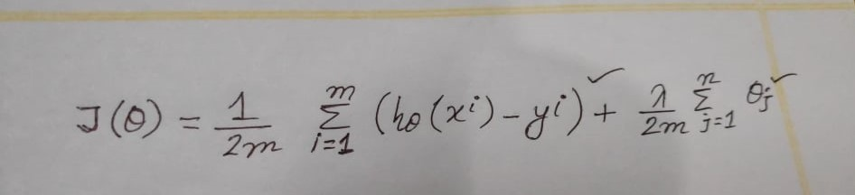
L1 REGULARIZATION
L1 Regularization: L1 regularization, also known as L1 norm or Lasso regression, combats overfitting by shrinking the parameters towards 0.
LINEAR REGRESSION COST FUNCTION AFTER ADDING L1 REGULARIZATION

Slide 6


L2 REGULARIZATION
L2 Regularization: l2 regularization, or L2 norm, or Ridge regression combats overfitting by forcing weights to be small, but not making the exactly 0.
LINEAR REGRESSION COST FUNCTION AFTER ADDING L2 REGULARIZATION

Slide 7
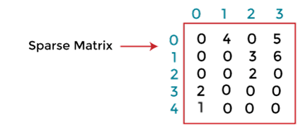
SPARSE MATRIX & SPARSITY
Sparsity: In AI and Machine Learning, sparsity refers to a matrix of numbers that includes many zeros or values that will not significantly impact a calculation.
Sparse Matrix: Sparse matrices are those matrices that have the majority of their elements equal to zero. In other words, the sparse matrix can be defined as the matrix that has a greater number of zero elements than the non-zero elements. Sparse matrix benefits:
(1)Storage: We know that a sparse matrix contains lesser non-zero elements than zero. So less memory can be used to store elements. It evaluates only the non-zero elements.
(2) Computing Time: In the case of searching sparse matrix, we need to traverse only the non-zero elements rather than traversing all the sparse matrix elements. It saves computing time by logically designing a data structure traversing non-zero elements.

Slide 8
L1 vs L2 REGULARIZATION
L1 REGULARIZATION | L2 REGULARIZATION
(1) Penalizes the sum of absolute value of weights. | (1) Penalizes the sum of square weights.
(2) It has a sparse solution. | (2) It has a non-sparse solution.
(3) Constructed in feature selection. | (3) No feature selection.
(4) Robust to outliers. | (4) Not robust to outliers.

