Slide 1
COURSE NAME: COURSE CODE:
ARTIFICIAL INTELLIGENCE
CIS 412
SYED TANGIM PASHA
LECTURER,
DEPARTMENT OF COMPUTING AND INFORMATION SYSTEM (CIS)
DAFFODIL INTERNATIONAL UNIVERSITY (DIU)
DHAKA,BANGLADESH

Slide 2
KNN
KNN: The abbreviation KNN stands for “K-Nearest Neighbor”. It is a supervised machine learning algorithm. The algorithm can be used to solve both classification and regression problems.
KNN algorithm stores all the available data and classifies a new data point based on the similarity. This means when new data appears then it can be easily classified into a well category by using KNN algorithm.
KNN is a non-parametric algorithm, which means it does not make any assumption on underlying data.
It is also called a lazy learner algorithm, because it does not learn from the training set immediately instead it stores the dataset and at the time of classification, it performs an action on the dataset.
KNN algorithm at the training phase just stores the dataset and when It gets new data, then it classifies that data into a category that is much similar to the new data.

Slide 3
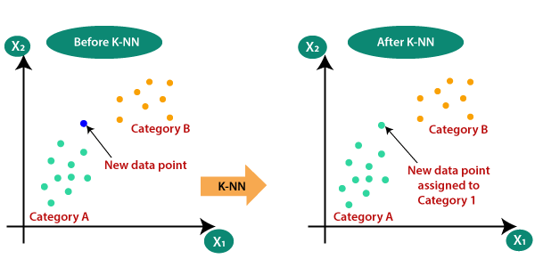
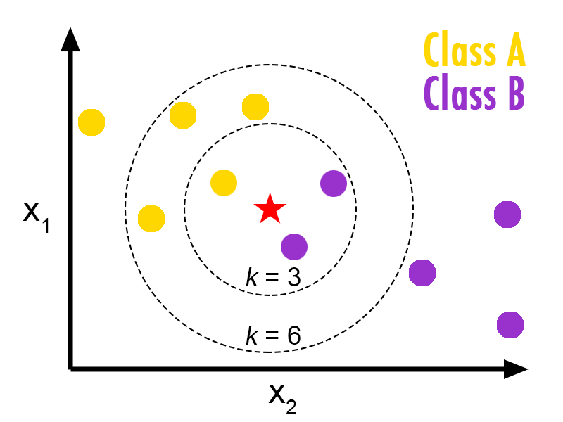
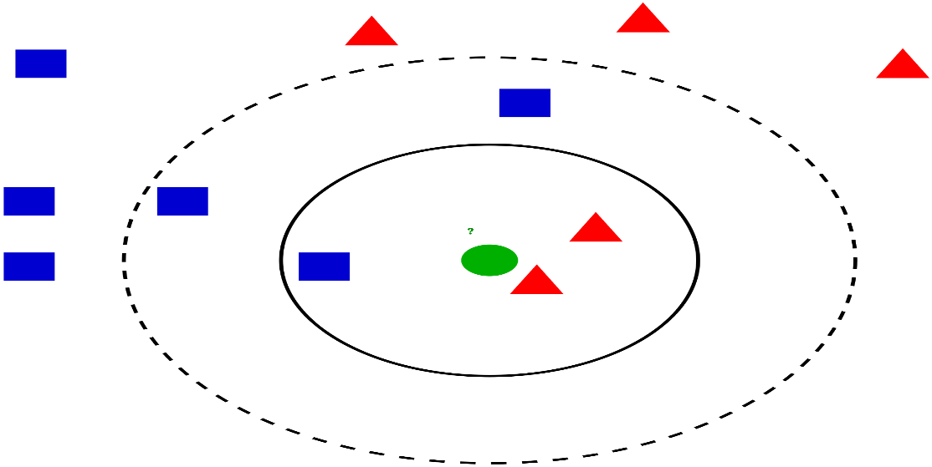
KNN

Slide 4
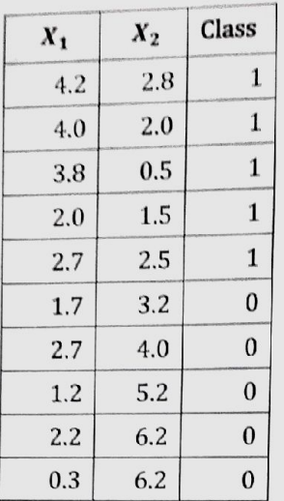

KNN
EUCLIDIEAN DISTANCE

Slide 5
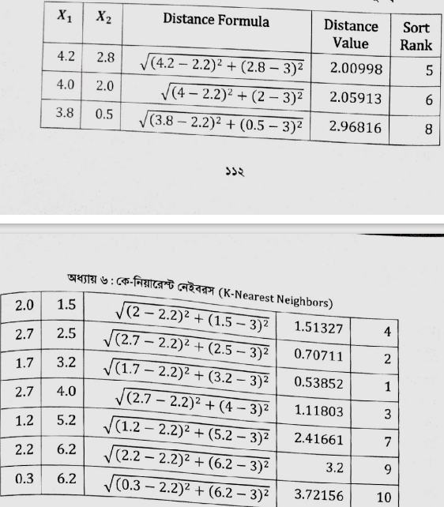
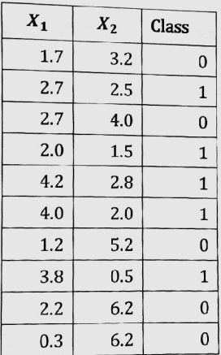
KNN

Slide 6
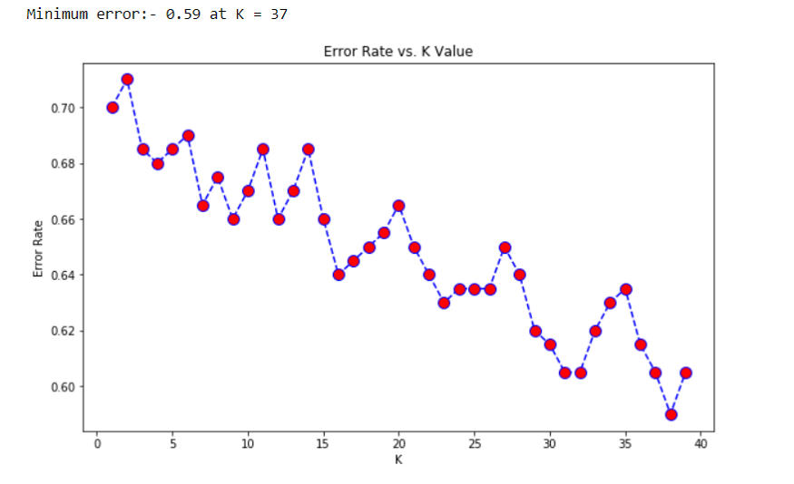
CHOOSE K VALUE
For binary classification, it is helpful to choose K to be an odd number as this avoid ties votes.
Derive a plot between error rate and K denoting values in a defined range. Then choose the K value as having a minimum error rate.
Took the square root value of the dataset. Ex: if n=150, then K = √150 ~= 12.28~=13 ( because it’s better to choose odd value for K)

