Slide 1
COURSE NAME: COURSE CODE:
ARTIFICIAL INTELLIGENCE
CIS 412
SYED TANGIM PASHA
LECTURER,
DEPARTMENT OF COMPUTING AND INFORMATION SYSTEM (CIS)
DAFFODIL INTERNATIONAL UNIVERSITY (DIU)
DHAKA,BANGLADESH

Slide 2
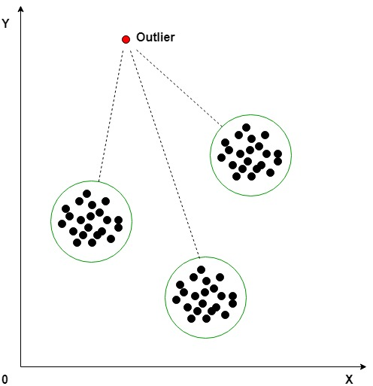
OUTLIERS
Outlier: An outlier is an observation in a given dataset that lies far from the rest of the observations. That means an outlier is vastly larger or smaller than the remaining values in the set.
Detecting Outliers:
(1) Boxplots
(2) Z-score
(3) Inter Quantile Range (IQR)

Slide 3
OUTLIERS
Handling Outliers:
Remove Outliers: In this technique, we remove the outliers from the dataset. Although it is not a good practice to follow.
Cap your outliers data: Another way to handle true outliers is to cap them. For example, if you’re using income, you might find that people above a certain income level behave in the same way as those with a lower income. In this case, you can cap the income value at a level that keep that intact.

Slide 4
OUTLIERS
Handling Outliers:
(3) Assign a new value: If an outlier seems to be due to a mistake in your data, try imputing a new value. Common imputation methods include using the mean of a variable or utilizing a regression model to predict the missing value.
(4) Mean/Median imputation: As the mean value is highly influenced by the outliers, it is advised to replace the outliers with the median value.

Slide 5
PARAMETER
Parameter: A model parameter is a configuration variable that is internal to the model and whose value can be estimated from data.
Characteristics of Parameter:
(1) They are required by the model when making predictions.
(2) They are estimated or learned from data.
(3) They are often not set manually by the practitioner.
Example: weights or coefficients of Linear or Logistic Regression models.

Slide 6
HYPERPARAMETER
Hyperparameter: Hyperparameters are parameters whose values control the learning process and determine the values of model parameters that a learning algorithm ends up learning.
Characteristics of Parameter:
(1) They are often used in processes to help estimate model parameters.
(2) They are often specified by the practitioner.
(3) They are often tuned for a given predictive modeling problem

Slide 7
HYPERPARAMETER
Example:
Learning rate (α) in Gradient Descent optimization algorithm.
Choice of Activation Function in Neural Network layers (Sigmoid, ReLU, Tanh, etc).
Number of hidden layers in a Neural Network
Number of activation units in each layer in Neural Network.
The drop out rate in Neural Network.
Number of iterations (epochs) in a training a Neural Network.

Slide 8
HYPERPARAMETER OPTIMIZATION
Hyperparameter Optimization: In machine learning, hyperparameter optimization or tuning is the problem of choosing a set of optimal hyperparameters for a learning algorithm.
GridSearchCV: It is the process of performing hyperparameter tuning in order to determine the optimal values for a given model. GridSearchCV is a function that comes in Scikit-learn’s (Sk-learn) model_selection package.

