Slide 1
COURSE NAME: COURSE CODE:
ARTIFICIAL INTELLIGENCE
CIS 412
SYED TANGIM PASHA
LECTURER,
DEPARTMENT OF COMPUTING AND INFORMATION SYSTEM (CIS)
DAFFODIL INTERNATIONAL UNIVERSITY (DIU)
DHAKA,BANGLADESH

Slide 2
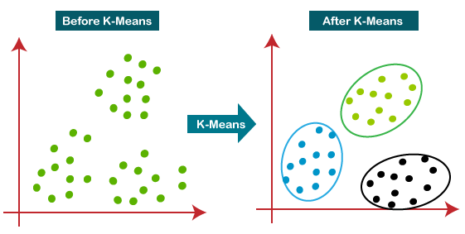
K-MEANS
K-Means: K-Means clustering is an unsupervised learning algorithm, which group the unlabeled dataset into different clusters.
Here, K defines the number of pre-defined clusters that need to be created in the process, as if K=2 there will be two clusters, and for K=3 there will be three clusters and so on.
It is a centroid-based algorithm, where each cluster is associated with a centroid. The main aim of this algorithm is to minimize the sum of distances between the data point and their corresponding clusters.

Slide 3
K-MEANS
The algorithm takes the unlabeled dataset as input, divides the dataset into K-number of clusters, and repeats the process until it does not find the best clusters.

Slide 4
K-MEANS ALGORITHM WORKING PROCEDURE
Step1: Select the number k to decide the number of clusters.
Step2: Select random K points or centroids.
Step3: Assign each data point to their closest centroid, which will form the predefined K clusters.
Step4: Calculate the variance and place a new centroid of each cluster.
Step5: Repeat the third steps, which means reassign each data point to the new closest centroid of each cluster.
Step6: If any reassignment occurs, then go to step-4 else go to finish.
Step7: The model is ready.

Slide 5
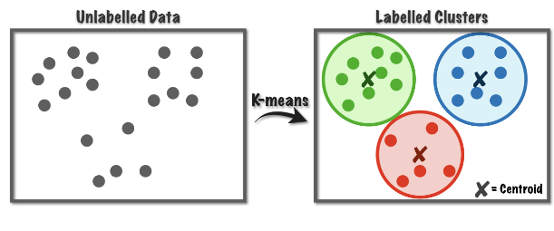
CENTROID
Centroid: A centroid is the imaginary or real location representing the center of the cluster.

Slide 6
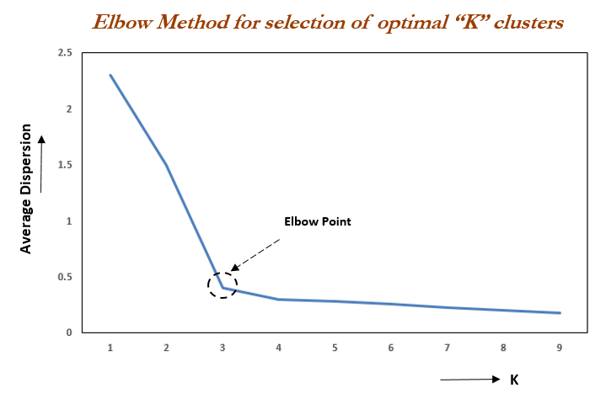
ELBOW METHOD
Elbow Method: Elbow is one of the most famous methods by which you can select the right value of K and boost your model performance. We also perform the hyperparamteter tuning to choose the best value of K.
The elbow method is used to determine the optimal number of clusters in K-means clustering. The elbow method plots the value of the cost function produced by different values of K. As you know, if K increases, average distortion will decrease, each cluster will have fewer constituent instances, and the instances will be closer to their respective centroids. However, the improvements in average distortion will decline as K increases. The value of K at which improvements in distortion declines the most is called the elbow, at which we should stop dividing the data into further clusters.

Slide 7
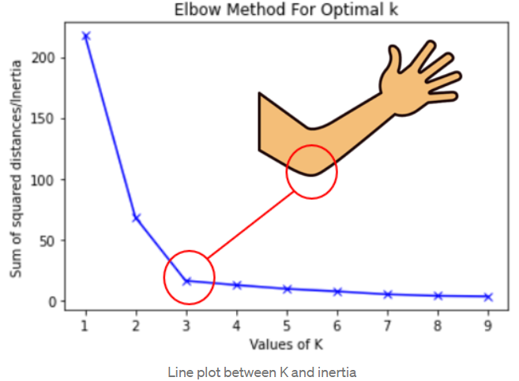
ELBOW METHOD

