Slide 1
FYP
FINAL YEAR PROJECT
DevDialogue AI
A Requirement-Aware AI Code Generation System
Syed Wafa Abbas Naqvi (37249)
Shehryar Mobashar (37189)
Shehryar Khan (37045)
Supervisor: Sumaira Aslam
Department of Computing & Technology · Iqra University, H-9 Islamabad · Batch 2022–2026
Notes:
Good morning. This is DevDialogue AI, our final year project — a requirement-aware AI code generation system. I am [name], presenting with my team members.

Slide 2
OVERVIEW
What We Will Cover
1
The Problem
2
Our Solution
Why single-prompt AI coding tools fall short
DevDialogue AI and its two generation modes
3
Literature & Gap
4
Requirements
How existing tools compare, and the gap we fill
Functional & non-functional specification (SRS)
5
System Design
6
Status & Future
Architecture, data model, and design models (SDS)
What works today and the road ahead
DevDialogue AI
2
Notes:
Here is our roadmap: the problem, our solution, how it compares to existing tools, the requirements, the design, and finally where the project stands and where it is going.

Slide 3
THE PROBLEM
The Trial-and-Error Loop
AI code tools answer whatever prompt they are given — with no step that checks whether the request is even complete.
1
2
3
4
5
▶
▶
▶
▶
Prompt
Output
Inspect
Re-prompt
Repeat
Developer writes a brief description
Receives partially-correct code
Finds the missing pieces
Re-describes what was missed
…again, and again
Wasted time
Cognitive load
Lost trust
iterative correction, not building
tracking what the tool misunderstood
adoption stalls for serious work
The core gap: no structured, dialogue-driven mechanism collects complete requirements before code is generated.
DevDialogue AI
3
Notes:
The problem is the trial-and-error loop. A developer prompts, gets partial code, inspects, re-prompts, and repeats. The cost is wasted time, cognitive load, and lost trust. The root cause: there is no structured step that gathers complete requirements before generation.

Slide 4
THE SOLUTION
DevDialogue AI: Ask First, Generate Second
A web platform that runs a structured requirement interview before writing any code — turning a reactive guess into a proactive, requirement-aware process.
1
2
3
4
▶
▶
▶
Describe
Interview
Confirm
Generate
Developer states the project idea
Engine asks targeted questions
Requirements summary is reviewed
Files appear in a code workspace
Built as a real product, not a demo
Secure email-OTP accounts · persistent chat-style sessions · ChatGPT-style code workspace · dark / light themes · subscription tiers
DevDialogue AI
4
Notes:
Our solution inverts the order: describe, interview, confirm, then generate. And it is delivered as a complete product — with secure OTP accounts, persistent sessions, and a polished code workspace, not just a proof of concept.

Slide 5
HOW IT WORKS
Two Generation Modes
Mode 1
Mode 2
Dialogue-Driven
Incremental
Full interview first, then the entire codebase at once
Best for smaller, well-defined tasks
One confirmation → complete set of files
Generates one module at a time
Pauses for approval after each file
Request changes → module is regenerated
Best for larger, multi-part projects
“Answer everything, get everything.”
“Build step-by-step, stay in control.”
DevDialogue AI
5
Notes:
There are two modes. Mode 1 runs the full interview then generates everything at once — good for small tasks. Mode 2 generates module by module, pausing for approval after each — good for larger projects where you want control at each step.

Slide 6
LITERATURE REVIEW
How Existing Tools Compare
Tool
Strength
The shared blind spot
GitHub Copilot
Deep IDE integration
No pre-generation requirement gathering
ChatGPT
Strong conversational context
No structured elicitation
Gemini
Powerful reasoning
No project-level requirement planning
DeepSeek Coder
High accuracy, low cost
Needs already-complete prompts
Cursor IDE
Codebase-aware edits
No upfront requirement interview
The gap: none of them ask structured questions before generating, and none offer an incremental, approval-driven build mode.
DevDialogue AI
6
Notes:
We surveyed the leading tools. Each is powerful in its own way, but they share one blind spot: none gathers requirements before generating, and none offers an incremental approval-driven mode. That gap is exactly what DevDialogue AI targets.

Slide 7
REQUIREMENTS (SRS)
Specified to IEEE 830
The system was specified with a full IEEE-830 SRS covering scope, users, interfaces, and detailed requirements.
17
7
3
4
Functional requirements
Non-functional requirements
User classes
Requirement dimensions
The interview covers four dimensions most often left unstated:
1
Tech stack
2
Core modules
3
Authentication
4
Constraints
languages, frameworks, database
the main features to include
user roles & login mechanisms
external APIs & edge cases
DevDialogue AI
7
Notes:
We wrote a full IEEE-830 specification: 17 functional and 7 non-functional requirements, three user classes. The heart of it is the interview — four dimensions that single prompts usually miss: stack, modules, authentication, and constraints.

Slide 8
REQUIREMENTS (SRS)
What the System Must Do
Functional — selected
Non-functional — qualities
Register with email + custom password policy
Verify account via 6-digit OTP (2-min expiry)
Run the structured requirement dialogue
Confirm summary before any generation
Mode 1 full / Mode 2 incremental generation
View, copy & download generated files
Persist, rename, search & delete sessions
Security
OTP expiry, strong password policy, CSRF
Usability
familiar chat UI, dark / light themes
Reliability
sessions persisted & resumable
Maintainability
generation isolated in one component
Portability
ORM abstracts the database
Scalability
stateless views scale horizontally
DevDialogue AI
8
Notes:
On the left, the key functional requirements — from OTP registration through the dialogue to multi-mode generation. On the right, the quality attributes: security, usability, reliability, maintainability, portability, and scalability.

Slide 9
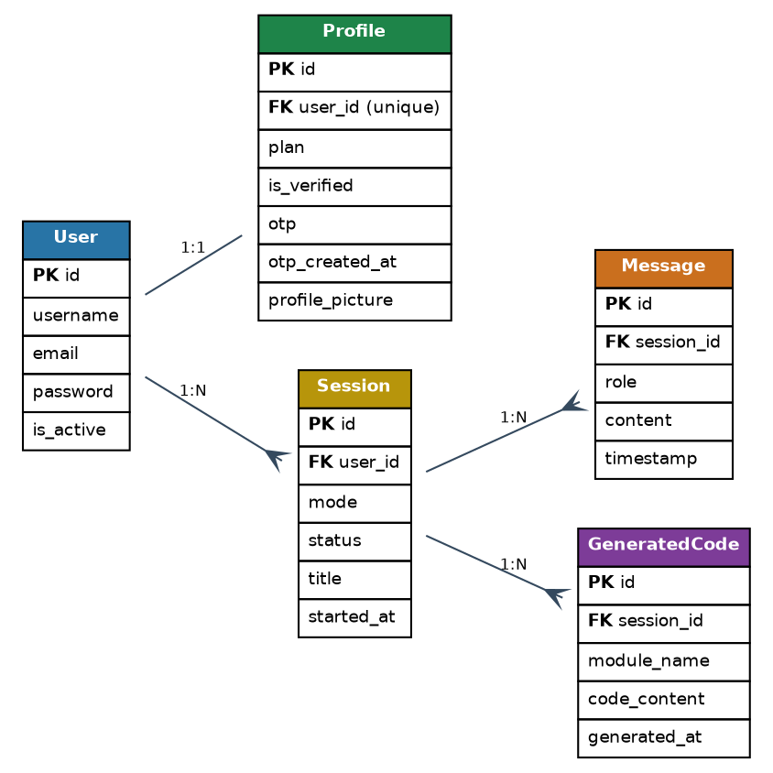
SYSTEM DESIGN (SDS)
The Data Model
Four entities
User + Profile
account, plan, OTP, verification
Session
mode, status, title, history
Message
user / assistant, ordered
GeneratedCode
module name & contents
Cascading deletes keep data consistent — removing a session removes its messages and files.
DevDialogue AI
10
Notes:
Four entities back the system: User and its Profile, Session, Message, and GeneratedCode. Relationships use cascading deletes, so removing a session cleanly removes its messages and generated files.

Slide 10
SYSTEM DESIGN (SDS)
The Dialogue Engine
The core component: it drives the questions, builds the summary, and produces the files — all behind one replaceable interface.
1
Ask
poses the next requirement question in order
2
Track
counts answers, saves each message
3
Summarise
builds a reviewable requirements summary
4
Confirm
waits for the user to approve
5
Generate
Mode 1 full · Mode 2 per-module loop
DevDialogue AI
11
Notes:
The dialogue engine is the heart of the system. It asks questions in order, tracks answers, builds the summary, waits for confirmation, and then generates — either all at once or module by module. The activity diagram on the right shows the full flow including Mode 2 approval loop.

Slide 11
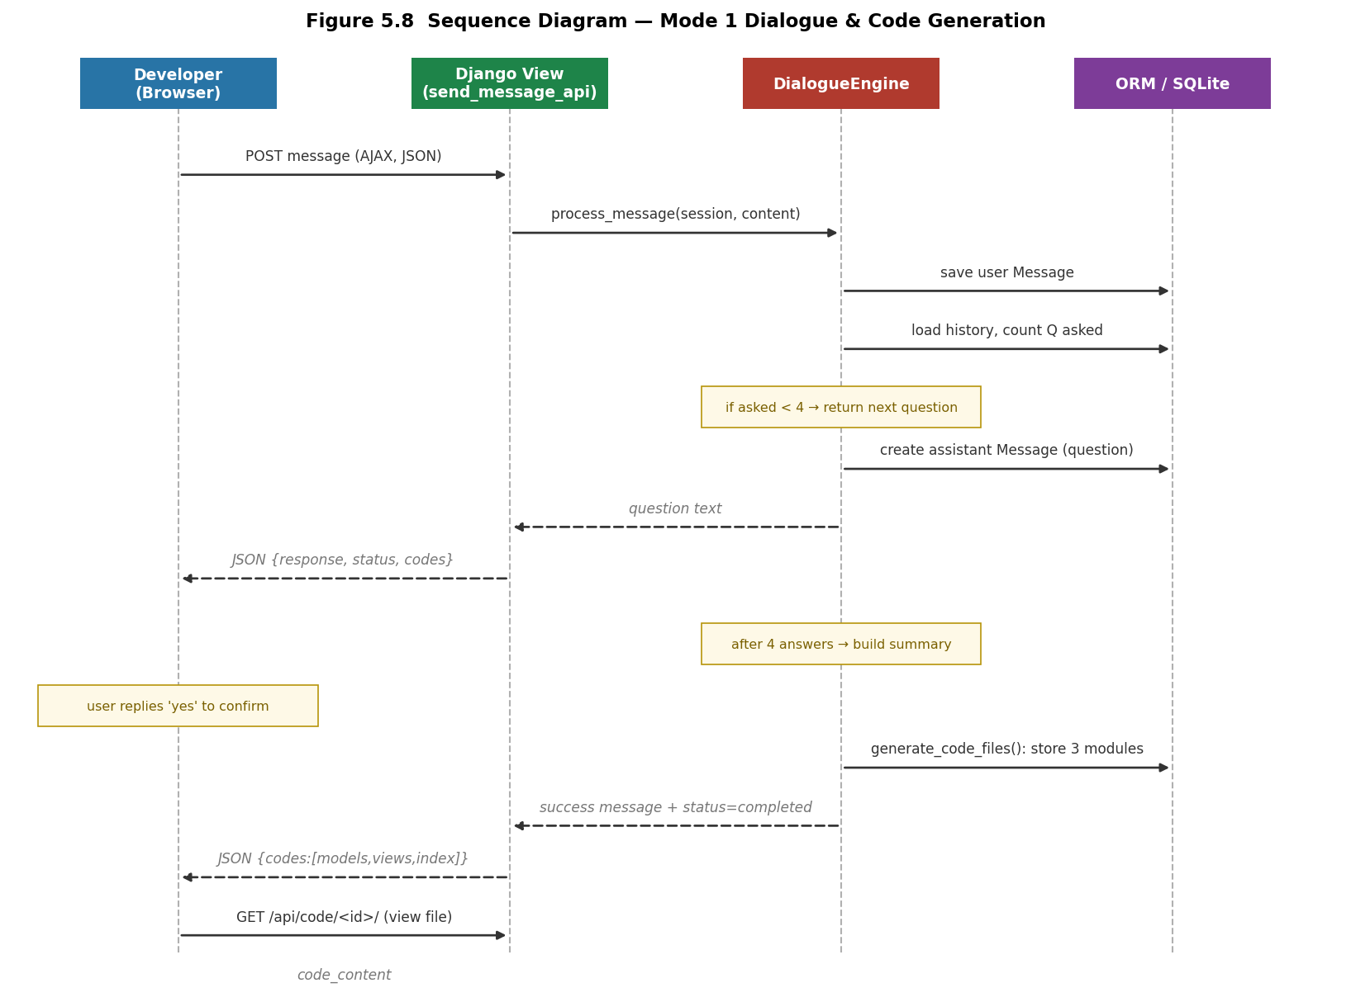
SYSTEM DESIGN (SDS)
A Request, End to End
Thin views, one engine
Browser posts the message (AJAX + CSRF)
View authenticates & delegates to the engine
Engine saves, decides, and responds
Files returned, then loaded into the panel
Views hold no state between requests — which is what makes the web tier easy to scale.
DevDialogue AI
12
Notes:
This sequence diagram traces a real Mode 1 request. The browser posts a message; the view authenticates and delegates to the engine; the engine saves, decides the next step, and responds; the files are then loaded into the workspace. Views are stateless, so the tier scales easily.

Slide 12
SYSTEM DESIGN (SDS)
Security by Design
Because the platform manages real accounts, four mechanisms work together.
🛡
Account verification
⏱
OTP integrity
New accounts stay inactive until a 6-digit OTP proves email ownership.
Random 6-digit codes expire after 2 minutes, with a resend path.
🔑
Password policy
🔒
Access control
Custom validator: length, capital first, lower-case, digit & symbol.
A verification decorator guards every view; CSRF on all writes.
DevDialogue AI
13
Notes:
Security was built in, not bolted on. Accounts must be verified by OTP; OTP codes expire in two minutes; passwords must pass a custom strength policy; and every view is guarded with CSRF protection on all state-changing requests.

Slide 13
IMPLEMENTATION
Technology Stack
Backend
Frontend
Database
Django 6.0 · Python 3
HTML5 · CSS3 · JS
SQLite via ORM
MVT pattern, function views
Vanilla JS, Lucide icons, AJAX
Portable to PostgreSQL
Auth & Mail
Testing
Tooling
Django auth · SMTP
Django TestCase
Git · GitHub · VS Code
OTP verification & reset
OTP, validator, dialogue flow
Version control & IDE
Dependencies: Django · python-docx · python-pptx · pypdf · python-dotenv
DevDialogue AI
14
Notes:
The stack is Django 6.0 on Python 3 with the MVT pattern, a vanilla-JS frontend, SQLite through the ORM, Django auth with SMTP for OTP, a real test suite, and standard Git tooling.

Slide 14
PROJECT STATUS
What Works Today
✓ Fully working
⟳ Designed for next
Secure OTP registration, login & password reset
Structured 4-question requirement dialogue
Requirements summary + confirmation step
Mode 1 and Mode 2 generation flows
Persistent sessions, history, rename & search
Code workspace: view, copy, download
Dark / light themes & subscription tiers
Live LLM backend for real code generation
Optional N8N workflow orchestration
ML-based stop condition for the interview
PostgreSQL for concurrent production use
Generation currently returns structured templates through the engine — the interface is ready for a model to drop in.
DevDialogue AI
15
Notes:
Being transparent about status: the elicitation dialogue, both modes, the full account system, sessions, and the workspace all work today. Generation currently returns structured templates through the engine — and because that engine is isolated behind one interface, a live LLM can drop straight in. That is our main future work.

Slide 15
LOOKING AHEAD
The Road to a Live Model
1
2
3
4
Integrate LLM
Orchestrate
Learn the stop point
Scale & extend
Replace the template method with a DeepSeek/LLM call behind the same interface
Add N8N workflows to manage prompts and multi-step generation
Train the interview to end when enough context is gathered
PostgreSQL, an IDE extension, and broader language support
DevDialogue AI
16
Notes:
The roadmap is straightforward because of how we built it: first drop a live model into the engine, then add workflow orchestration, then teach the interview when to stop, and finally scale the database and extend to an IDE and more languages.

Slide 16
IMPACT
Sustainable Development Goals
SDG
Quality Education
SDG
Decent Work & Growth
04
08
Teaches structured requirements thinking to new developers
Cuts time wasted in iterative coding, raising productivity
SDG
Industry & Innovation
SDG
Partnerships
09
17
Innovates in AI-assisted software tooling
Integrates open technologies and third-party AI services
DevDialogue AI
17
Notes:
The project maps to four SDGs: quality education, decent work and growth, industry and innovation, and partnerships — through open technology and third-party AI integration.

Slide 17
IN SUMMARY
Requirements first,
code second.
A working dialogue that makes requirements explicit before generation
Two first-class modes — full and incremental — in one session model
A complete, secure, production-shaped web application
An architecture ready for a live LLM to drop straight in
✓
Thank you · Questions?
DevDialogue AI
18
Notes:
To summarise: DevDialogue AI demonstrates that asking for requirements first improves AI-assisted coding. We delivered a working dialogue, two generation modes, a complete secure application, and an architecture ready for a live model. Thank you — we are happy to take questions.

