Slide 1
Learning resource manager
By:
Syed Wahidi
Steven Norfleet

Slide 2
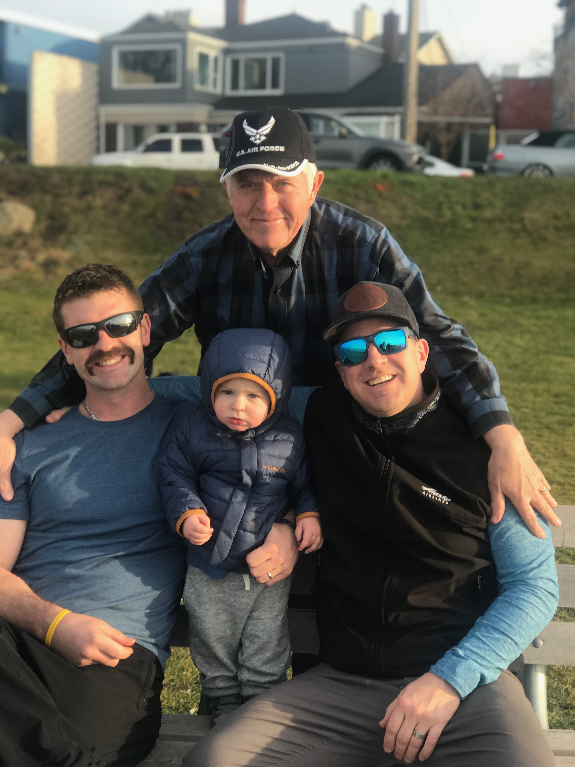
Client
Mr. Roger Cox
Air Force / Instructor
Instructor in multiple institution (SMU included; Boeing career employee)
Hoping to attend conference (virtually for the demo).

Slide 3
Clients-request
The System(s) should be able to:
a. Upload, Download, Delete, and Search for files or URL references.
b. Ease of use across major platforms (windows, Apple, Android, etc).
c. Functional with little to no install on the users end

Slide 4
What is nextcloud?
Open-Source proprietary services developed by Frank Karlitschek.
An open-source server software for both mobile and desktop applications geared purposely for all major platforms.
File hosting storage with open architecture so users will have full control of data input and regulatory status.
Syncs local clients and permits monitoring capabilities, search functions, group password authentications, as well as audio/video conferencing.

Slide 5
Nextcloud Continue…..
File hosting service for that is friendly for multiplatform OS.
Free and open Source.
Features include: Capabilities to connect to Dropbox/google drive, calendars customizations, contacts to which users can have password protected access and group admin.

Slide 6
Our web server
Domain Name: stmartinlrmp.com
Cloud server: nextcloud.stmartinlrmp.com
Our server Is functional. It has instructions on how to sign up and use the pre-built configured cloud server for resource management.
The Word-press and Nextcloud environment is implemented within a c-panel web-server.
The cloud environment is reached through the hosting services through web protocols (pre-built apps are available for mobile app/play store).

Slide 7
Demo of configured servers

Slide 8
What we have learned
Platform configurations can change when the OS system updates (accessibility and credentials will need to be re-entered)
Multi-platform based apps have major performance challenges (optimum performance may be affect between web and app depending OS).
Limited usability: different screen layout can prevent user to take total advantage of features offered and available.

Slide 9
Questions, comments, concerns?

Slide 10
Thank you!

