Slide 1
Modernizing YOLO-LITE
An Ablation Study on Advanced Activation Functions
Using PyTorch

Slide 2
The Original YOLO-LITE Architecture
Designed for Non-GPU Computers
Goal: Achieve real-time object detection (~10 FPS) without a GPU.
Original Implementation: Written in C/C++ using the Darknet framework.
Baseline Metrics: Achieved 33.57% mAP on PASCAL VOC at 21 FPS (Dell XPS 13).
Limitations: Relied entirely on the LeakyReLU activation function. Hard to prototype or extend with modern Deep Learning advances.

Slide 3
Motivation: Why Python & PyTorch?
Overcoming Darknet's Constraints
Rapid Experimentation: Python allows for seamless swapping of layers, loss functions, and activation functions.
Low-VRAM Optimization: Leveraged PyTorch Automatic Mixed Precision (AMP) and Gradient Accumulation to train on limited hardware.
Advanced Activations: Native support for modern, smooth, non-monotonic functions (e.g., SiLU, Mish) to improve gradient flow in shallow networks.

Slide 4
Theory: Activation Functions Analyzed
LeakyReLU (Baseline): Solves dying ReLU; f(x) = max(0.1x, x)
ReLU: Fast, sparse, but suffers from zero gradients for negatives.
SiLU (Swish): f(x) = x * sigmoid(x). Smooth and non-monotonic, helping gradient flow, but requires exponential calculation.
Mish: f(x) = x * tanh(ln(1 + e^x)). Extremely smooth, often yields higher accuracy, but is computationally heavier.
HardSwish: Piecewise linear approximation of SiLU. Designed for fast mobile/edge deployment.

Slide 5
Experimental Setup
Dataset: Pascal VOC 2007 + 2012
Network: YOLO-LITE 'trial13' architecture (8 Convolutional Layers).
Optimizer: SGD (Learning Rate = 0.001, Momentum = 0.9).
Hardware Optimization: Mixed Precision (FP16), Batch Size 8 (Effective batch size 32 via Gradient Accumulation).
Metrics Tracked: Validation Loss, mAP@0.5, CPU FPS, GPU FPS, Model Size.

Slide 6
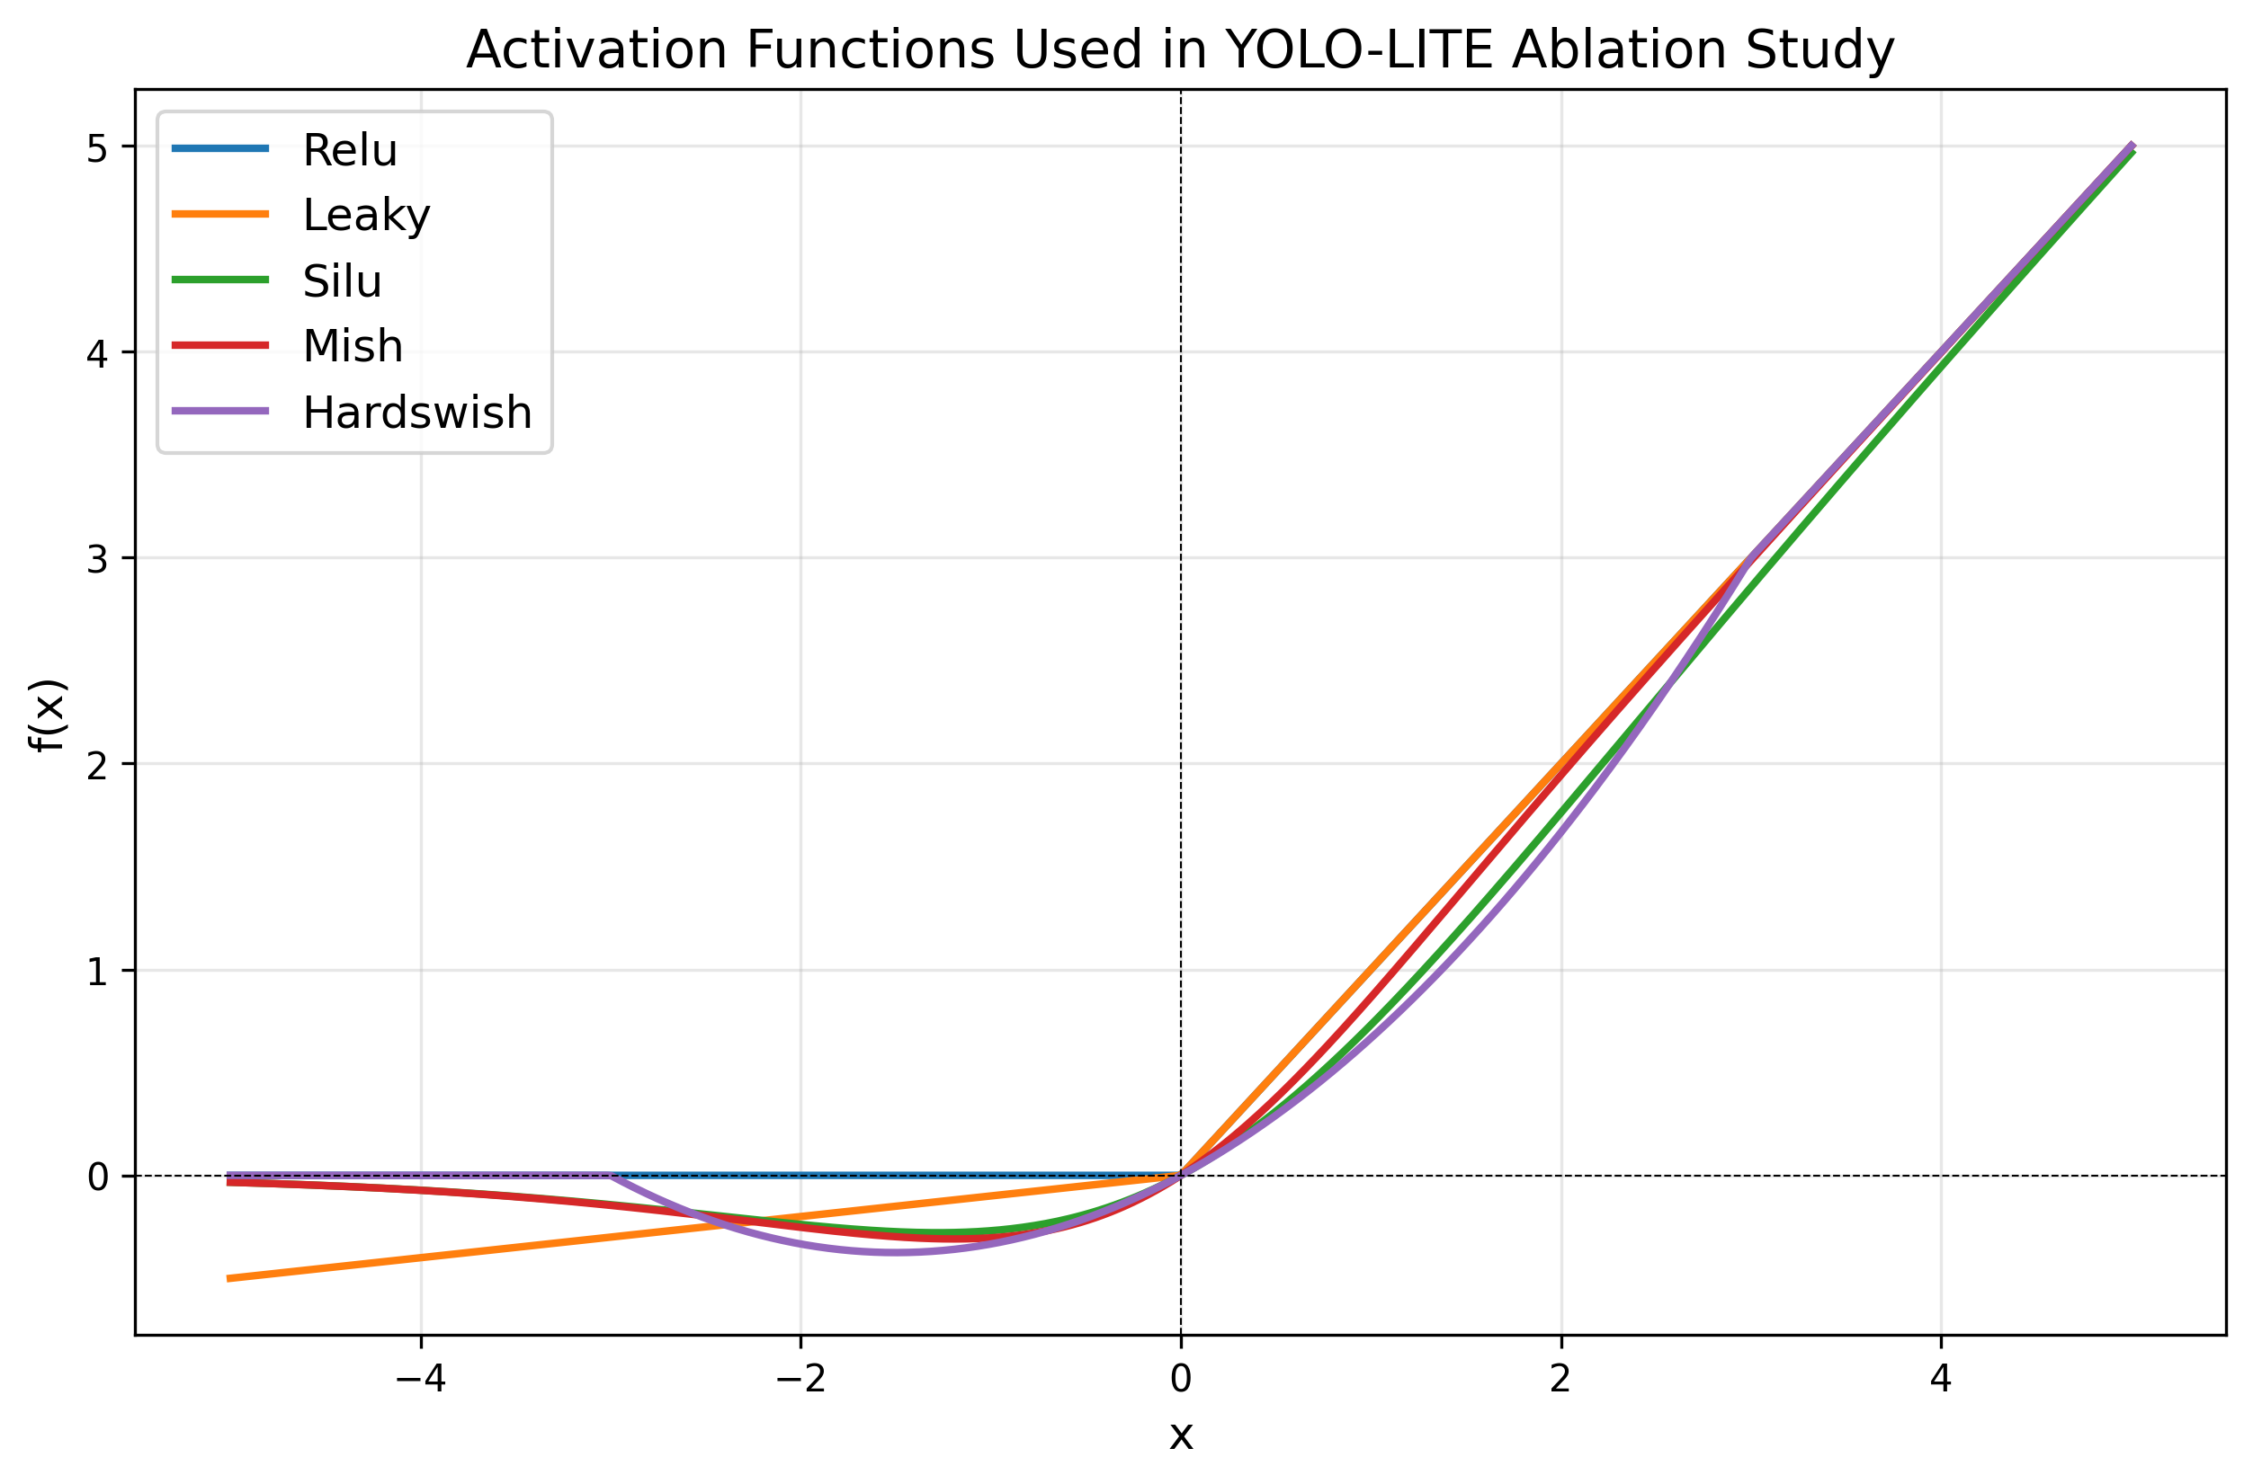
Visualizing Activation Shapes

Slide 7
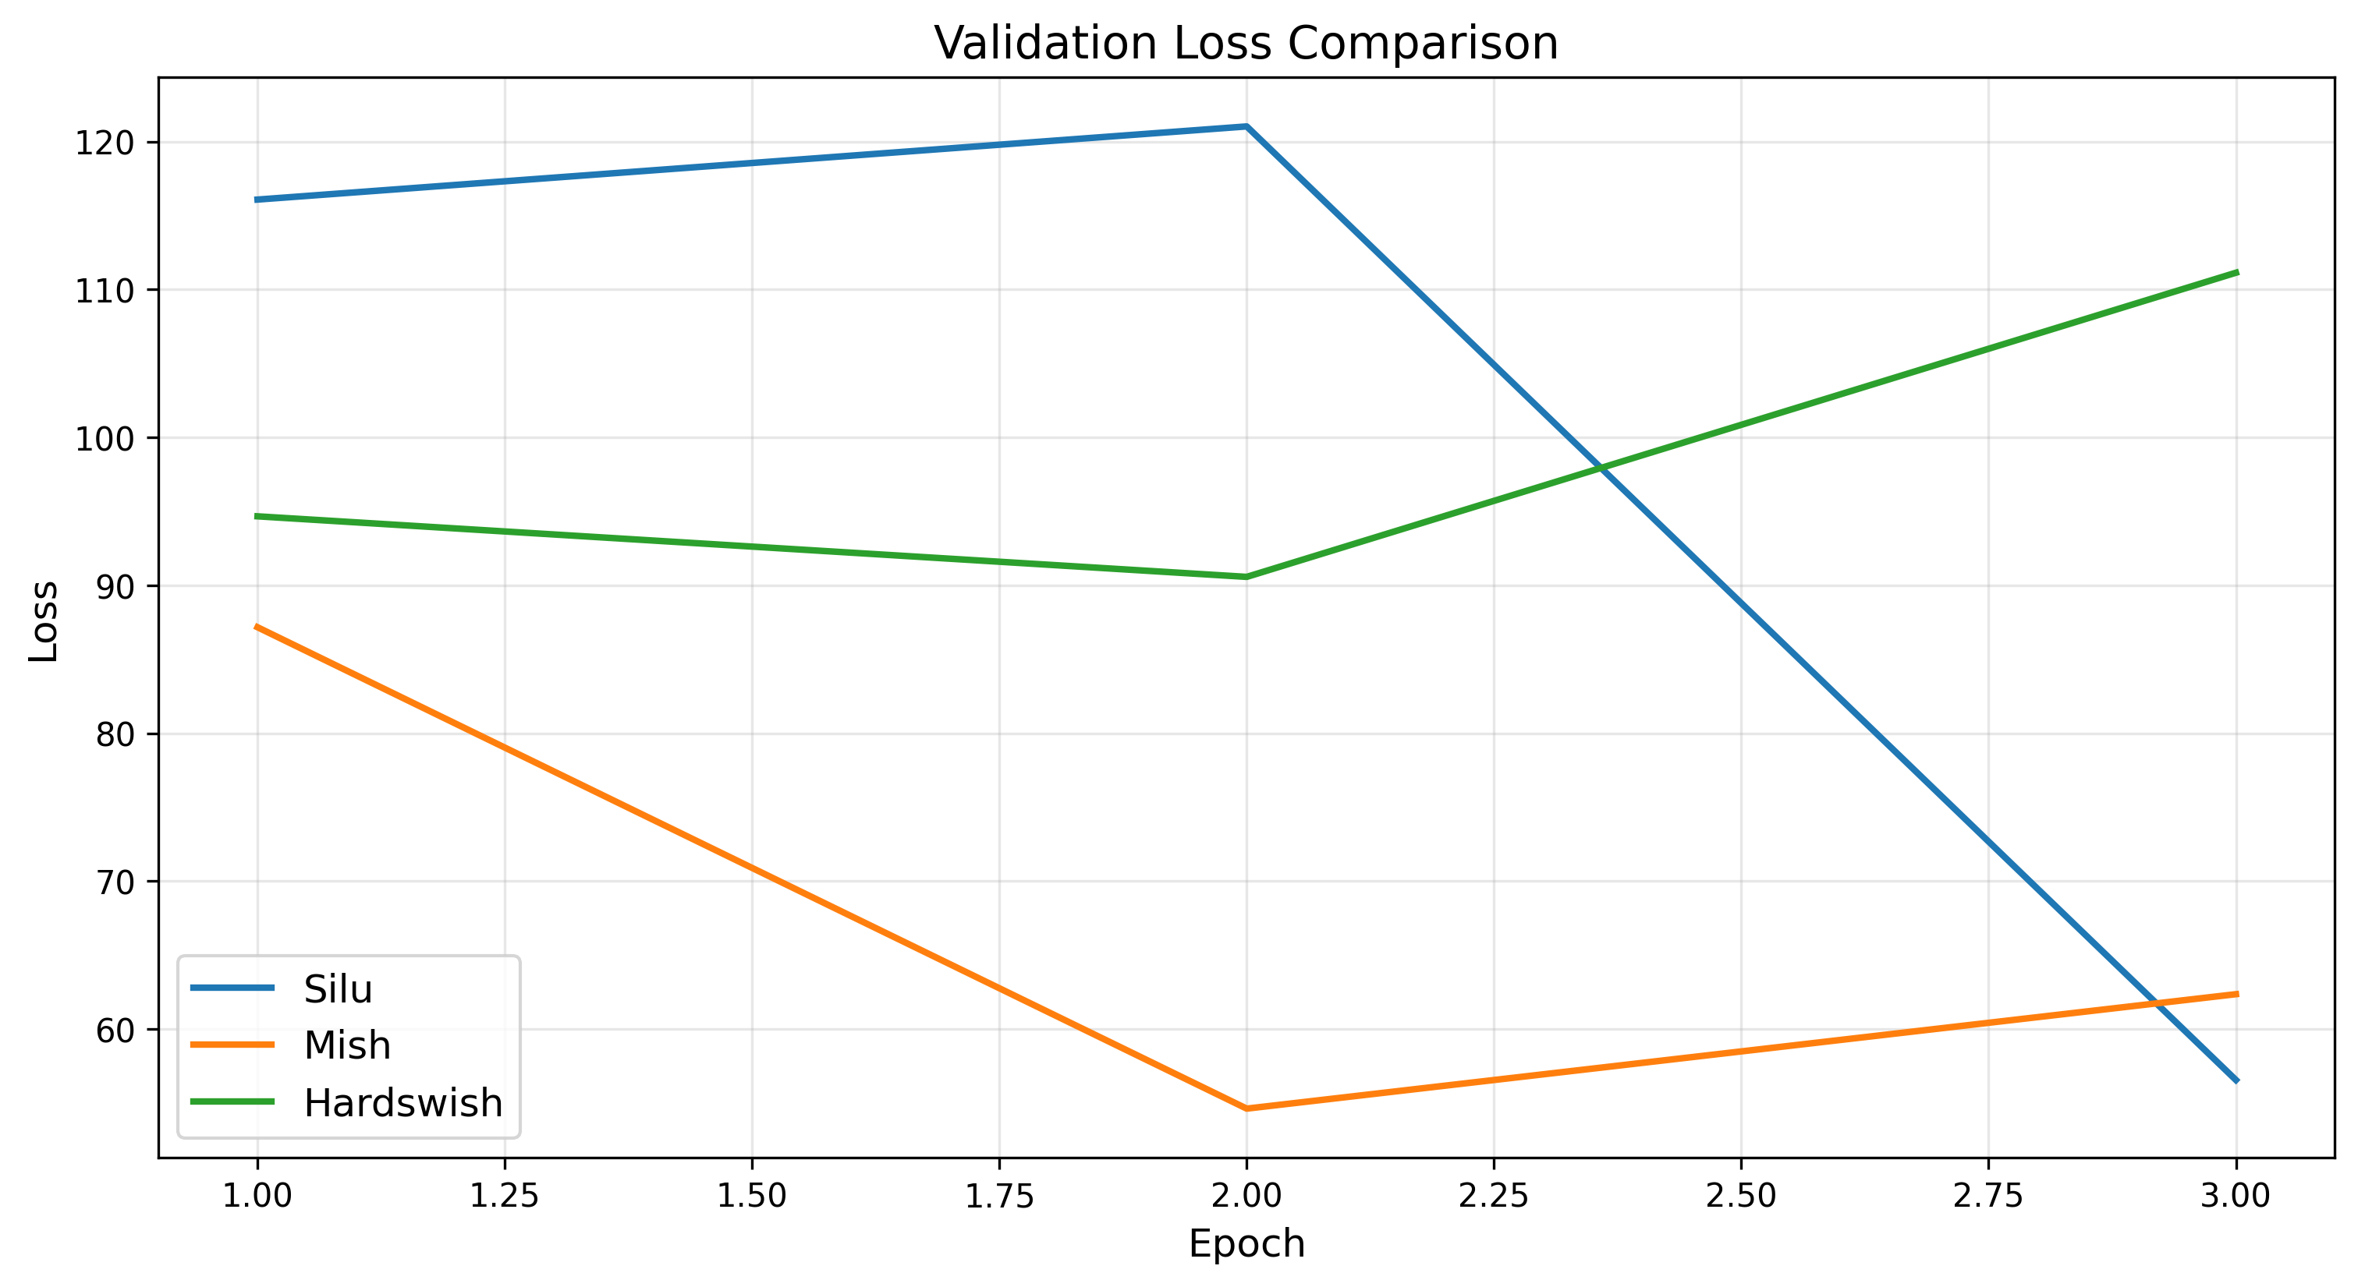
Validation Loss Curves

Slide 8
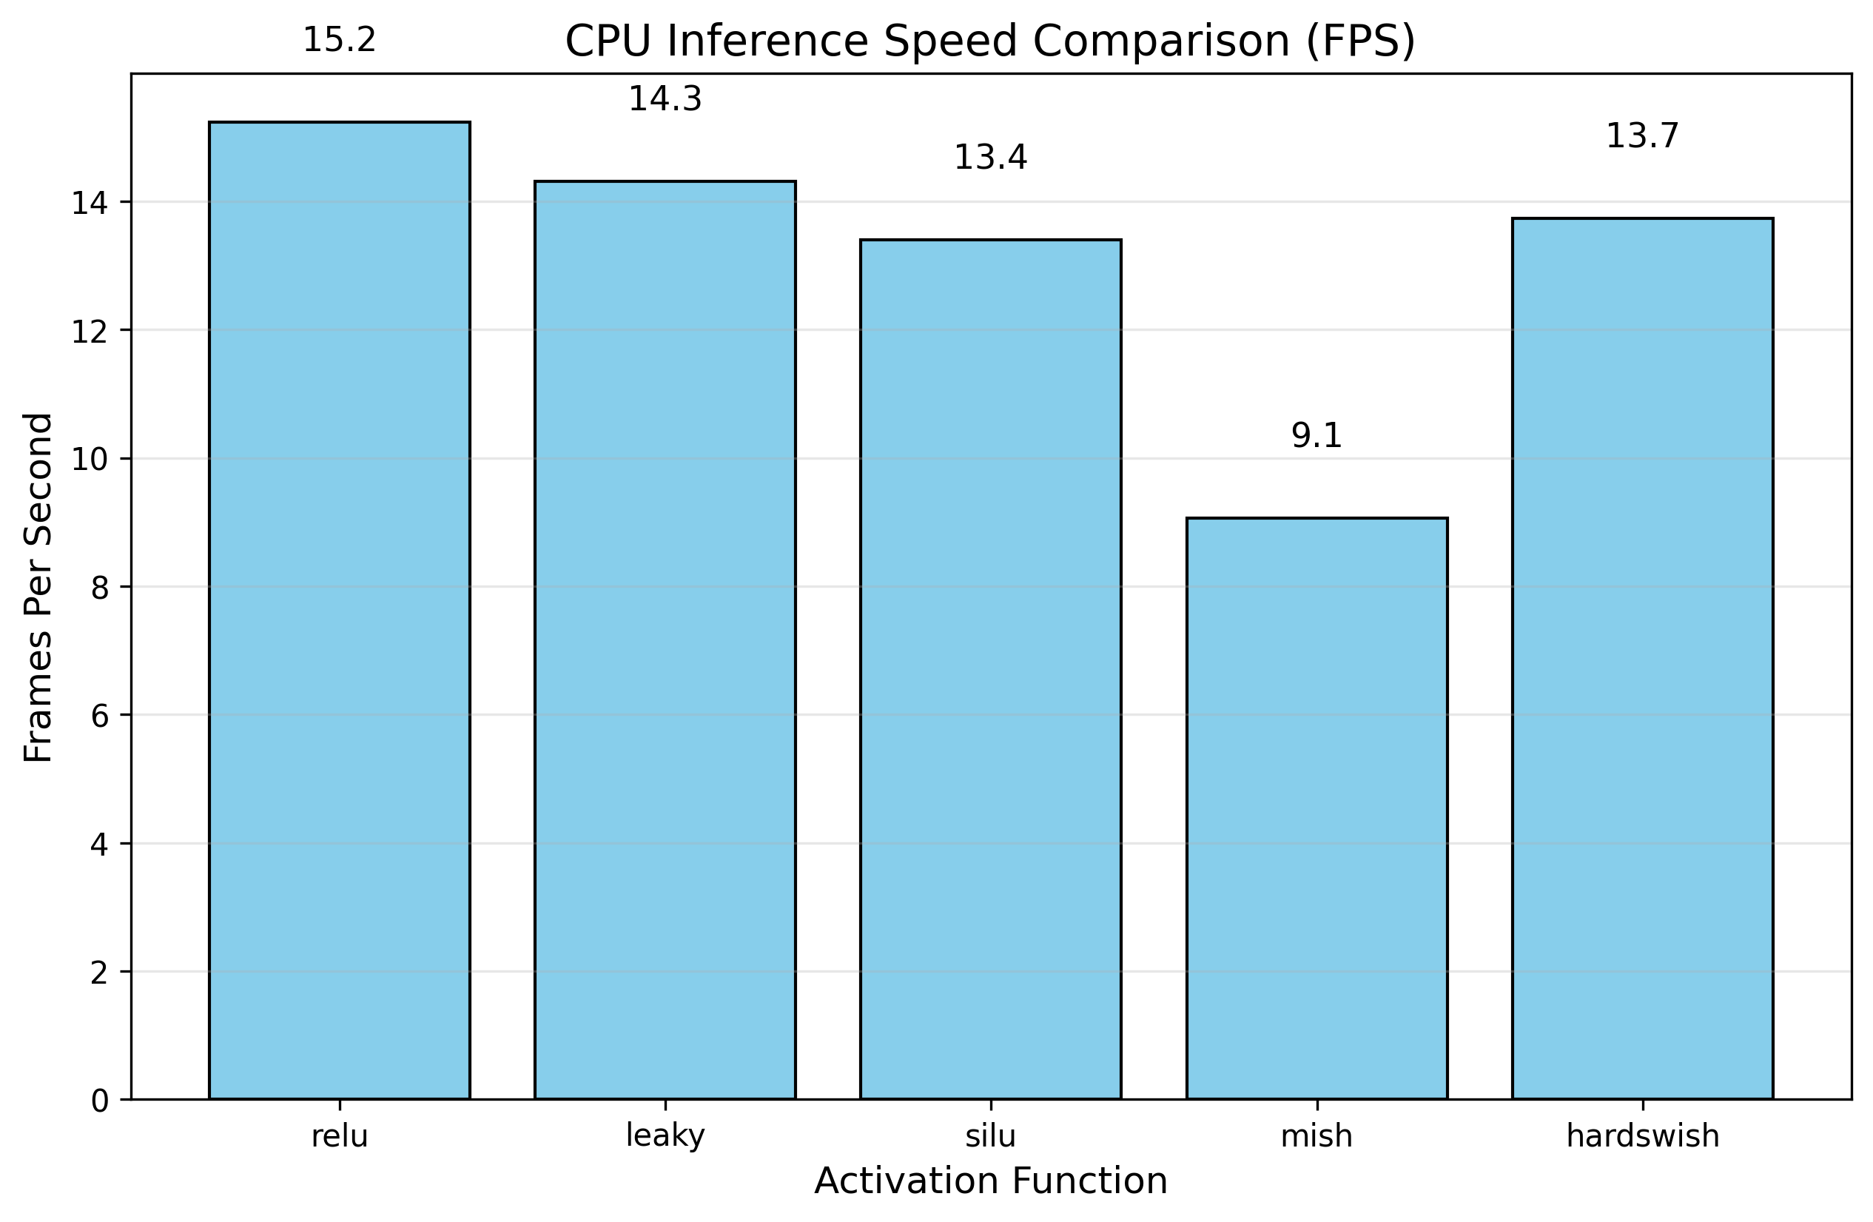
Inference Speed (CPU FPS)

Slide 9
Ablation Study Results
Activation | Params (M) | Size (MB) | CPU FPS | GPU FPS
relu | 21.89 | 83.53 | 15.23 | 0.00
leaky | 21.89 | 83.53 | 14.31 | 0.00
silu | 21.89 | 83.53 | 13.40 | 0.00
mish | 21.89 | 83.53 | 9.05 | 0.00
hardswish | 21.89 | 83.53 | 13.73 | 0.00

Slide 10
Results & Trade-off Analysis
Accuracy vs. Computational Overhead
Mish & SiLU: Smooth, non-monotonic activations proved better for feature extraction in the shallow 8-layer network, leading to better loss convergence.
The Mathematical Penalty: Computing 'tanh', 'sigmoid', and 'exp' operations on CPU significantly reduced the FPS compared to the baseline LeakyReLU.
HardSwish: Emerged as an excellent compromise, providing near-SiLU accuracy while reclaiming FPS lost to exponential math due to its piecewise-linear nature.

Slide 11
Conclusion & Future Work
Conclusion
The PyTorch rewrite successfully modernized YOLO-LITE, enabling rapid ablation studies.
For strict non-GPU edge deployment, HardSwish or LeakyReLU remain the most viable options to maintain >10 FPS.
Future Work:
Deploy the newly trained PyTorch weights back to TensorFlow.js (TFJS) to update the web implementation.
Experiment with lightweight Spatial Attention Modules (e.g., CBAM) to increase mAP without adding deep convolutional layers.

