Slide 1

Organizational Structure & Operations Management
Insights from Alphaventure Softwares
Presented by: Yasir, Yousha, Taha
Interviewee: Yousuf – Team Lead, Engineering

Slide 2
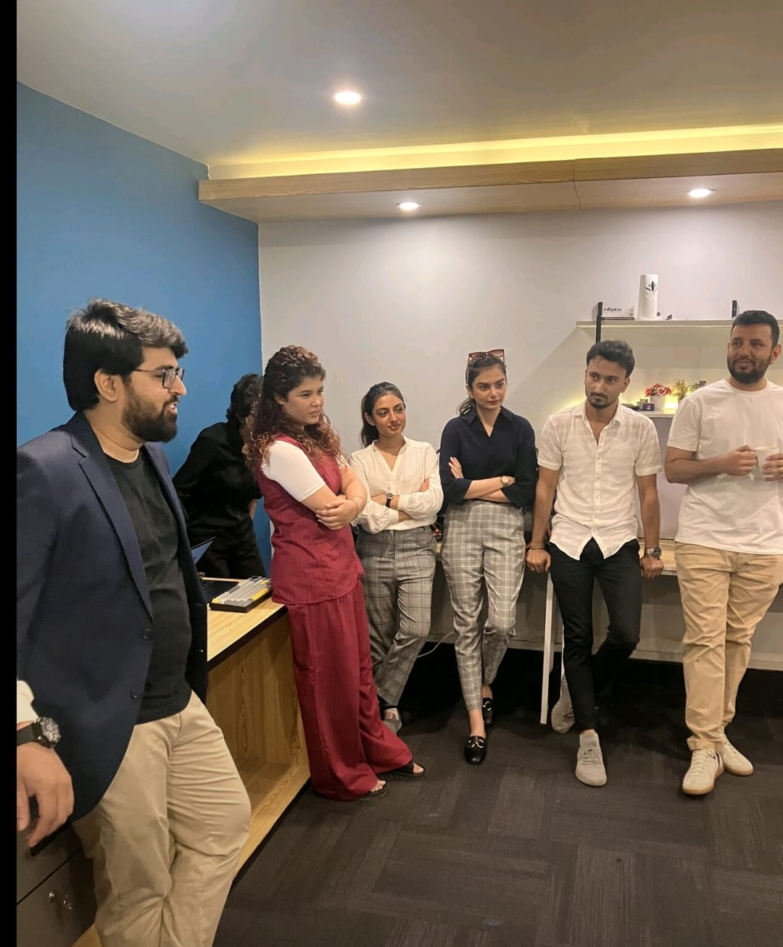
Slide 2 — About the Company & Interviewee
Alphaventure Softwares
Team Lead Engineering interviewed (5+ years experience)
Semi-hierarchical, collaborative culture

Slide 3
Slide 3 — Organizational Structure Overview
Semi-hierarchical
Clear internal roles
Leads/managers + open communication
Defined responsibilities within teams.
Cross-team clarity
Example
Still improving, leading to occasional overlaps.
Design → Dev → QA sometimes overlap

Slide 4




Slide 4 — Communication Flow
Direct Communication
Leads Bridge
Across teams
Team ↔ management
Weekly Alignment
Challenge
Cross-department meetings
Dependency delays in tight timelines
Analogy: “Think of it like traffic: each team is its own lane, but the moment one slows, the entire flow gets stuck.”

Slide 5
Slide 5 — Challenges in Current Structure
Overlapping Responsibilities
Cross-team Dependencies
Causing delays
Leads Juggling
QA Bottlenecks
Management + development work
When multiple projects hit testing

Slide 6
Slide 6 — Suggested Structural Improvements
01
02
Cross-functional Squads
Clearer Ownership
Move toward (Agile-inspired)
Between Design, Dev, QA
03
04
Structured Communication
Faster, Cleaner Handoffs
From leadership
Example: A “mini-team” for each product instead of passing the work like a relay race.

Slide 7

Slide 7 — Project Management Methodology
Hybrid model: Agile + Scrum + Kanban
Choose methodology based on project type
Tools: Notion for PM, documentation, sprints

Slide 8

Slide 8 — Task Assignment & Monitoring
1
2
Task Assignment
Sprint Boards & Standups
By skill + workload
Weekly reviews
3
4
Bi-weekly Planning
Blockers Resolution
For delivery
Frequent + priority shifts

Slide 9

Slide 9 — Operational Challenges
Scope creep
Client feedback delays
Technical blockers
Developers switching projects
QA overload

Slide 10
Slide 10 — Recommendations & Conclusion
Improve Sprint Estimation
And buffer times
Reduce Priority Shifts
Last-minute changes
Automate Testing
Strengthen Cross-team Processes
Move Toward Squad-based Model
Ending line: “Alphaventure is already strong operationally, but with better cross-team structure and planning, the workflow can become even smoother and more scalable.”

