Slide 1
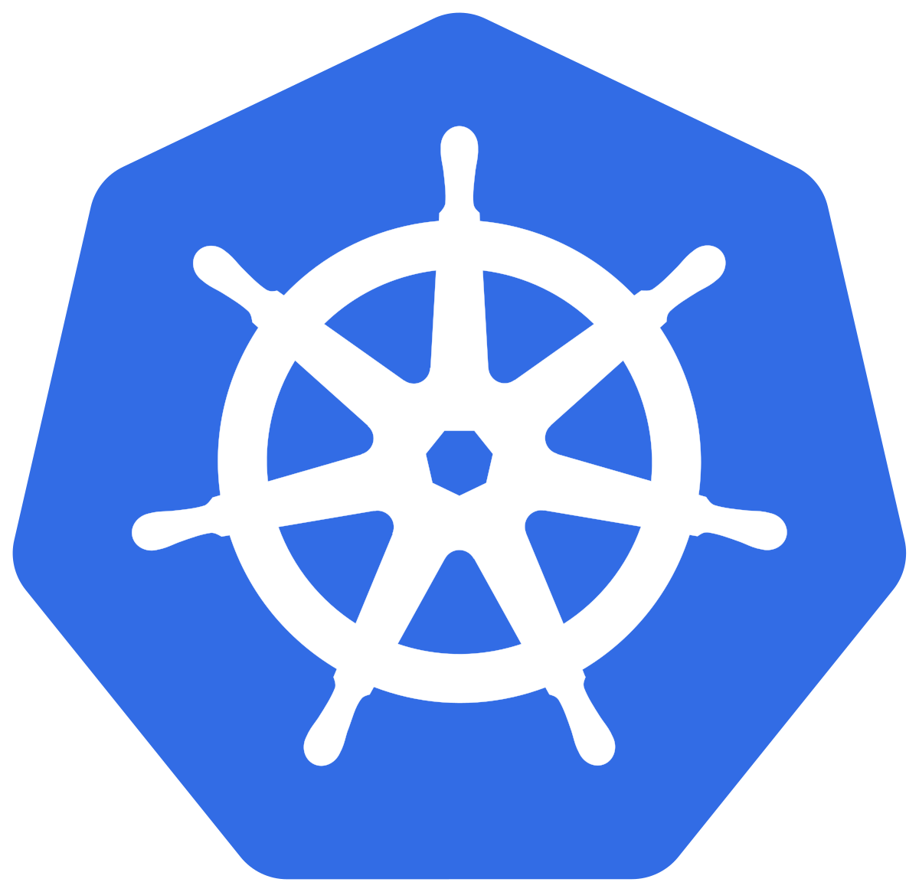
KUBERNETES
Alina Khan

Slide 2
Kubernetes
Architecture

Slide 3
Kubernetes - Architecture
Master
Worker Node
Kube Controller Manager
Cloud Controller Manager
Kubelet
Kube-Proxy
Container Runtime (Docker)
kube-apiserver
Worker Node
etcd
kube-scheduler
Kubelet
Kube-Proxy
Container Runtime (Docker)
Container Runtime (Docker)

Slide 4
Kubernetes Architecture - Master
Master
kube-apiserver
It acts as front end for the Kubernetes control plane. It exposes the Kubernetes API
Command line tools (like kubectl), Users and even Master components (scheduler, controller manager, etcd) and Worker node components like (Kubelet) everything talk with API Server.
etcd
Consistent and highly-available key value store used as Kubernetes’ backing store for all cluster data.
It stores all the masters and worker node information.
kube-scheduler
Scheduler is responsible for distributing containers across multiple nodes.
It watches for newly created Pods with no assigned node, and selects a node for them to run on.
Kube Controller Manager
Cloud Controller Manager
kube-apiserver
etcd
kube-scheduler
Container Runtime (Docker)

Slide 5
Kubernetes Architecture - Master
Master
kube-controller-manager
Controllers are responsible for noticing and responding when nodes, containers or endpoints go down. They make decisions to bring up new containers in such cases.
Node Controller: Responsible for noticing and responding when nodes go down.
Replication Controller: Responsible for maintaining the correct number of pods for every replication controller object in the system.
Endpoints Controller: Populates the Endpoints object (that is, joins Services & Pods)
Service Account & Token Controller: Creates default accounts and API Access for new namespaces.
Kube Controller Manager
Cloud Controller Manager
kube-apiserver
etcd
kube-scheduler
Container Runtime (Docker)

Slide 6
Kubernetes Architecture - Master
Master
cloud-controller-manager
A Kubernetes control plane component that embeds cloud-specific control logic.
It only runs controllers that are specific to your cloud provider.
On-Premise Kubernetes clusters will not have this component.
Node controller: For checking the cloud provider to determine if a node has been deleted in the cloud after it stops responding
Route controller: For setting up routes in the underlying cloud infrastructure
Service controller: For creating, updating and deleting cloud provider load balancer
Kube Controller Manager
Cloud Controller Manager
kube-apiserver
etcd
kube-scheduler
Container Runtime (Docker)

Slide 7
Kubernetes Architecture – Worker Nodes
Worker Node
Kubelet
Kubelet is the agent that runs on every node in the cluster
This agent is responsible for making sure that containers are running in a Pod on a node.
Kube-Proxy
It is a network proxy that runs on each node in your cluster.
It maintains network rules on nodes
In short, these network rules allow network communication to your Pods from network sessions inside or outside of your cluster.
Kubelet
Kube-Proxy
Container Runtime (Docker)
Container Runtime
Container Runtime is the underlying software where we run all these Kubernetes components.
We are using Docker, but we have other runtime options like rkt, container-d etc.

Slide 8
Kubernetes
Fundamentals
Pod, ReplicaSet, Deployment & Service

Slide 9
Kubernetes - Fundamentals
Pod
A POD is a single instance of an Application.
A POD is the smallest object, that you can create in Kubernetes.
ReplicaSet
A ReplicaSet will maintain a stable set of replica Pods running at any given time.
In short, it is often used to guarantee the availability of a specified number of identical Pods
k8s Fundamentals
Deployment
A Deployment runs multiple replicas of your application and automatically replaces any instances that fail or become unresponsive.
Rollout & rollback changes to applications. Deployments are well-suited for stateless applications.
Service
A service is an abstraction for pods, providing a stable, so called virtual IP (VIP) address.
In simple terms, service sits Infront of a POD and acts as a load balancer.

Slide 10
Kubernetes on AWS Cloud
Kubernetes Fundamentals
Imperative
Declarative
kubectl
YAML & kubectl
YAML K8S Live Template writing
Pod
Pod
ReplicaSet
ReplicaSet
Deployment
Deployment
Service
Service
AWS EKS Cluster

Slide 11
Kubernetes
POD

Slide 12
Kubernetes - POD
With Kubernetes our core goal will be to deploy our applications in the form of containers on worker nodes in a k8s cluster.
Kubernetes does not deploy containers directly on the worker nodes.
Container is encapsulated in to a Kubernetes Object named POD.
A POD is a single instance of an application.
A POD is the smallest object that we can create in Kubernetes.
N
Nginx Container
Image
N
N
POD
POD
Worker Node
Worker Node
Node
Worker Node
Kubernetes Cluster

Slide 13

Kubernetes - POD
PODs generally have one to one relationship with containers.
To scale up we create new POD and to scale down we delete the POD.
N
N
N
N
POD
POD
POD
POD
Worker Node - 1
Worker Node - 2
Kubernetes Cluster

Slide 14
Kubernetes – PODs
We cannot have multiple containers of same kind in a single POD.
Example: Two NGINX containers in single POD serving same purpose is not recommended.
N
N
N
N
N
POD
POD
POD
POD
Worker Node - 1
Worker Node - 2
Kubernetes Cluster

Slide 15
Kubernetes – Multi-Container Pods
We can have multiple containers in a single POD, provided they are not of same kind.
Helper Containers (Side-car)
Data Pullers: Pull data required by Main Container
Data pushers: Push data by collecting from main container (logs)
Proxies: Writes static data to html files using Helper container and Reads using Main Container.
Communication
The two containers can easily communicate with each other easily as they share same network space.
They can also easily share same storage space.
Multi-Container Pods is a rare use-case and we will try to focus on core fundamentals.
N
H
POD
Worker Node
Kubernetes Cluster
Helper
Containers
Node

Slide 16
Kubernetes
PODs
Demo

Slide 17
Kubernetes
Services - NodePort

Slide 18

Kubernetes – Service - NodePort
We can expose an application running on a set of PODs using different types of Services available in k8s.
ClusterIP
NodePort
LoadBalancer
NodePort Service
To access our application outside of k8s cluster, we can use NodePort service.
Exposes the Service on each Worker Node's IP at a static port (nothing but NodePort).
A ClusterIP Service, to which the NodePort Service routes, is automatically created.
Port Range 30000-32767
http://<Worker-Node-IP>:<NodePort>
NodePort: 3xxx
User
Worker NodePort
Port: 80
Service
ClusterIP Service Port
targetPort: 80
Container Port in a POD
Node
N
POD
Worker Node
Worker Node
Worker Node
Node
Kubernetes Cluster

Slide 19
Kubernetes
POD & NodePort Service
Demo

Slide 20
Kubernetes
ReplicaSets

Slide 21
Kubernetes - ReplicaSets
High Availability or Reliability
Scaling
ReplicaSets
Load Balancing
Labels & Selectors

Slide 22
Kubernetes – ReplicaSet
A ReplicaSet’s purpose is to maintain a stable set of replica Pods running at any given time.
If our application crashes (any pod dies), replicaset will recreate the pod immediately to ensure the configured number of pods running at any given time.
Reliability
Or
High Availability
N
N
N
POD
POD
POD
ReplicaSet
Worker Node
Kubernetes Cluster

Slide 23
Kubernetes – ReplicaSet
Load Balancing
To avoid overloading of traffic to single pod we can use load balancing.
Kubernetes provides pod load balancing out of the box using Services for the pods which are part of a ReplicaSet
Labels & Selectors are the key items which ties all 3 together (Pod, ReplicaSet & Service), we will know in detail when we are writing YAML manifests for these objects
Service
N
N
N
N
POD
POD
POD
POD
ReplicaSet
Worker Node
Worker Node
Kubernetes Cluster

Slide 24
Kubernetes – ReplicaSet
Scaling
When load become too much for the number of existing pods, Kubernetes enables us to easily scale up our application, adding additional pods as needed.
This is going to be seamless and super quick.
Service
N
N
N
N
POD
POD
POD
POD
ReplicaSet
Worker Node
Worker Node
Kubernetes Cluster

Slide 25
Kubernetes
ReplicaSets
Demo

Slide 26
Kubernetes
Deployments

Slide 27
Kubernetes – Deployments
Service
N
N
N
N
POD
POD
POD
POD
ReplicaSet
Deployment
Worker Node - 1
Worker Node - 2
Kubernetes Cluster

Slide 28
Kubernetes - Deployment
Create a Deployment to rollout a ReplicaSet
Updating the Deployment
Rolling Back a Deployment
Deployments
Scaling a Deployment
Pausing and Resuming a Deployment
Deployment Status
Clean up Policy
Canary Deployments

Slide 29
Kubernetes
Deployments
Demo

Slide 30
Kubernetes
Services

Slide 31
Kubernetes - Services
ClusterIP
Used for communication between applications inside k8s cluster (Example: Frontend application accessing backend application)
NodePort
Used for accessing applications outside of of k8s cluster using Worker Node Ports (Example: Accessing Frontend application on browser)
Services
LoadBalancer
Primarily for Cloud Providers to integrate with their Load Balancer services (Example: AWS Elastic Load Balancer)
Ingress
Ingress is an advanced load balancer which provides Context path based routing, SSL, SSL Redirect and many more (Example: AWS ALB)
externalName
To access externally hosted apps in k8s cluster (Example: Access AWS RDS Database endpoint by application present inside k8s cluster)

Slide 32


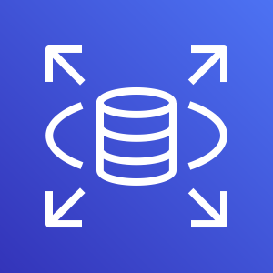
Kubernetes Cluster
Frontend App – NodePort or LoadBalancer or Ingress Service
Users
N
N
N
POD
POD
POD
ReplicaSet
Deployment (app=frontend)
Backend App - ClusterIP Service
AWS Cloud
B
B
B
DB – ExternalName Service
POD
POD
POD
AWS RDS Database
Services
ReplicaSet
Deployment (app=Backend)

Slide 33
Kubernetes
Services
Demo

Slide 34
Services Demo
Kubernetes Cluster
Frontend App – NodePort Service
Users
http://<workernode-public-ip>:<NodePort>/hello
N
POD
ReplicaSet
Deployment (app=frontend)
Backend App - ClusterIP Service
B
POD
ReplicaSet
Deployment (app=Backend)

Slide 35
Kubernetes
YAML Basics

Slide 36
YAML Basics
YAML is not a Markup Language
YAML is used to store information about different things
We can use YAML to define key, Value pairs like variables, lists and objects
YAML is very similar to JSON (Javascript Object Notation)
YAML primarily focuses on readability and user friendliness
YAML is designed to be clean and easy to read
We can define YAML files with two different extensions
abc.yml
abc.yaml

Slide 37
YAML Basics
YAML Comments
YAML Key Value Pairs
YAML Dictionary or Map
YAML Array / Lists
YAML Spaces
YAML Document Separator

Slide 38
THANK YOU

