Slide 1
KNOWLEDGE BASE AGENT
Codename: Gemini Neural Hub
Submitted for: Rooman AI Agent Development Challenge
Category: Business Operations

Slide 2
1. OVERVIEW OF THE AGENT
• An Intelligent 'Second Brain' for Business Operations.
• Solves the problem of information overload in technical manuals and HR policies.
• Uses RAG (Retrieval Augmented Generation) to understand full documents.
• Delivers instant, evidence-based answers with visual diagrams.
• Goal: Replace 'Ctrl+F' with 'Intelligent Reasoning'.

Slide 3
2. TECH STACK & APIS
• Frontend: Streamlit (Python) with Custom CSS/JS Injection.
• AI Core: Google Gemini API (v1beta).
• Models: Gemini 1.5 Flash (Speed) & 1.5 Pro (Reasoning).
• Logic: Custom 'GeminiBrain' class with Smart Switching.
• Data Processing: pypdf (Text Extraction).
• Visualization: Graphviz (Auto-Diagramming).

Slide 4
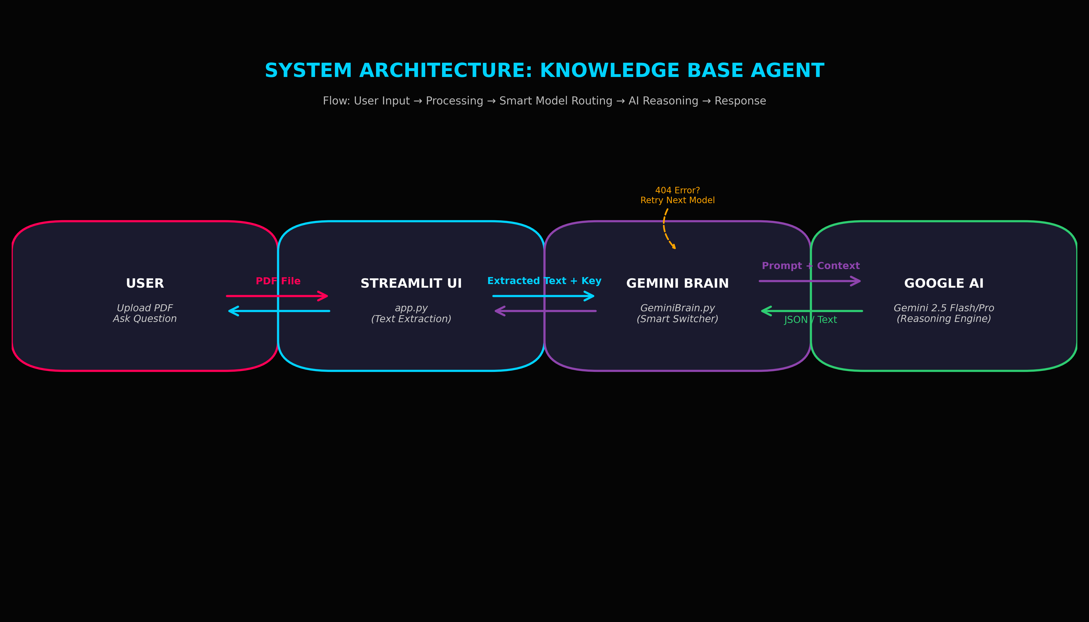
3. SYSTEM ARCHITECTURE
Flow: User Upload -> Text Extraction -> Context Injection -> Smart Routing -> AI Generation -> Response

Slide 5
4. KEY FEATURES
• 🧠 Smart Brain Engine: Auto-detects 404 errors and switches models (Flash -> Pro) instantly.
• 🎨 Cyberpunk HUD: Immersive dark mode UI with real-time telemetry.
• 🖼️ Auto-Diagramming: Detects 'process' questions and draws flowcharts automatically.
• 📊 Live Telemetry: Tracks page counts, character volume, and latency.
• 🛡️ Enterprise Security: Ephemeral in-memory processing (Zero Storage).

Slide 6
5. CURRENT LIMITATIONS
• Session Memory: Chat history clears on refresh (Security Feature).
• Single File Focus: Optimized for deep analysis of one document at a time.
• Text Only: Cannot yet interpret images or charts inside the PDF (OCR pending).

Slide 7
6. FUTURE ROADMAP
• 🎙️ Voice Integration: Speech-to-Text for hands-free field usage.
• 📂 Multi-Modal Support: Using Gemini Pro Vision to 'see' charts.
• 💾 Persistent Memory: Integrating ChromaDB for long-term document storage.
• 🔗 API Connectors: connecting to Slack or Teams.

Slide 8
THANK YOU

