Slide 1
What is Maven?
Maven is a project management tool that provides developers a complete build lifecycle framework. Development team can automate the project's build infrastructure.
Maven helps to manage
Builds
Documentation
Reporting
SCMs
Releases
Distribution
Build:
A build tool takes care of everything for building a process. It does follow:
Generates source code (if auto-generated code is used)
Generates documentation from source code
Compiles source code
Packages compiled code into JAR of ZIP file
Installs the packaged code in local repository, server repository, or central repository

Slide 2
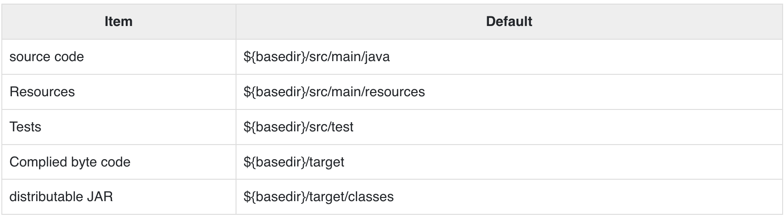

Slide 3
Install maven:
1) Check Java installation open command promt
java -version
2) environment variable
JAVA_HOME from your system java path
C:\Program Files\Java\jdk11.0.11
PATH C:\Program Files\Java\jdk11.0.11\bin
3)Download maven ZIP
https://dlcdn.apache.org/maven/maven-3/3.8.7/binaries/apache-maven-3.8.7-bin.zip
4)Extract & set environment variable
export M2_HOME=c:\Users\download\apache-maven/apache-maven-3.8.7
export M2=$M2_HOME\bin
5)verify maven
mvn --version

Slide 4
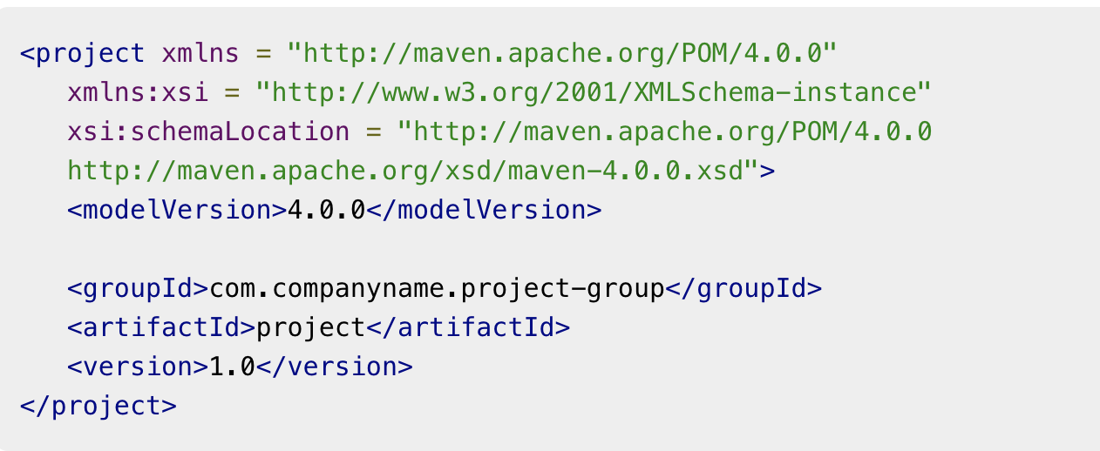
Maven - POM
POM stands for Project Object Model. It is fundamental unit of work in Maven. It is an XML file that resides in the base directory of the project as pom.xml
It should be noted that there should be a single POM file for each project.
The POM contains information about the project and various configuration detail used by Maven to build the project(s).
POM also contains the goals and plugins. While executing a task or goal, Maven looks for the POM in the current directory. It reads the POM, gets the needed configuration information, and then executes the goal. Some of the configuration that can be specified in the POM are following −
project dependencies
plugins
goals
build profiles
project version
developers

Slide 5
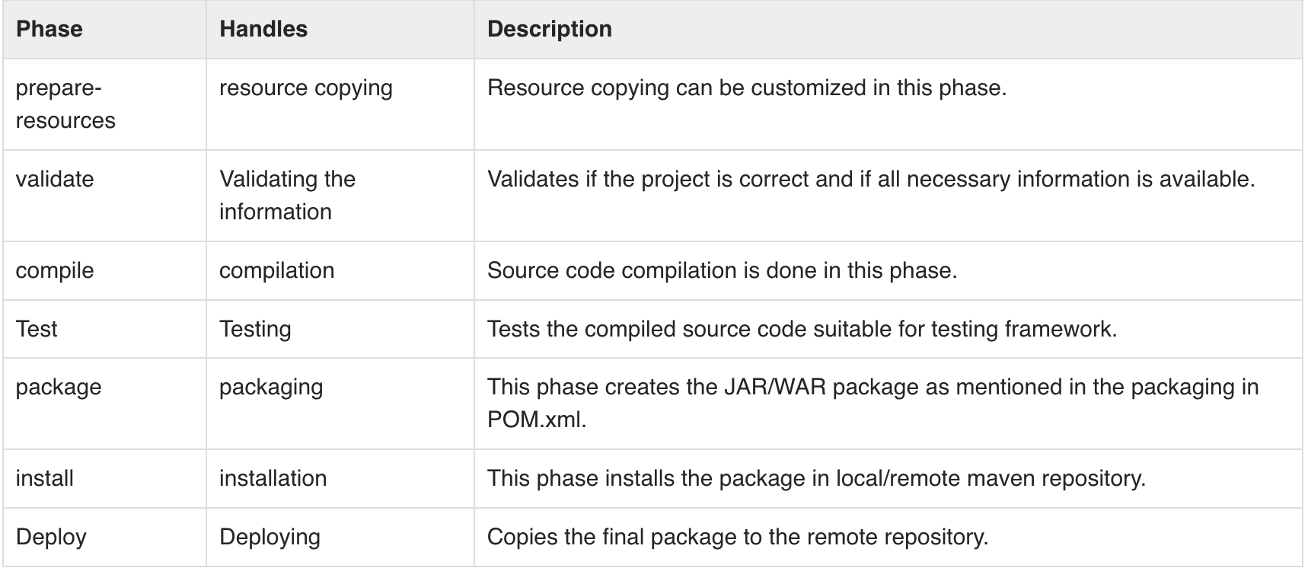
Super POM:
The Super POM is Maven’s default POM. All POMs inherit from a parent or default. This base POM is known as the Super POM, and contains values inherited by default
mvn help:effective-pom
What is Build Lifecycle?
A Build Lifecycle is a well-defined sequence of phases, which define the order in which the goals are to be executed.

Slide 6
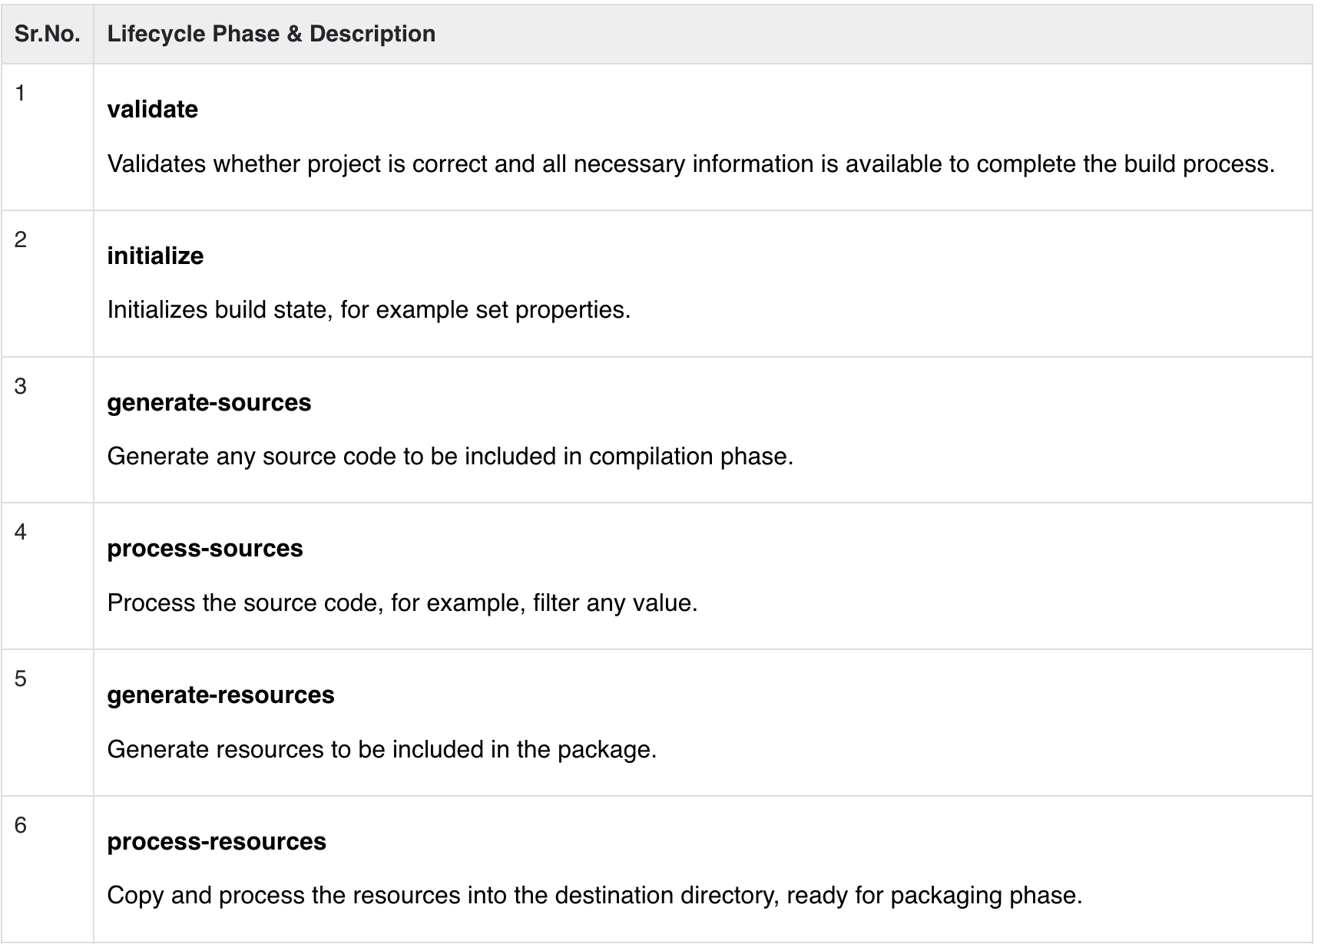
Default (or Build) Lifecycle
This is the primary life cycle of Maven and is used to build the application. It has the following 21 phases.

Slide 7
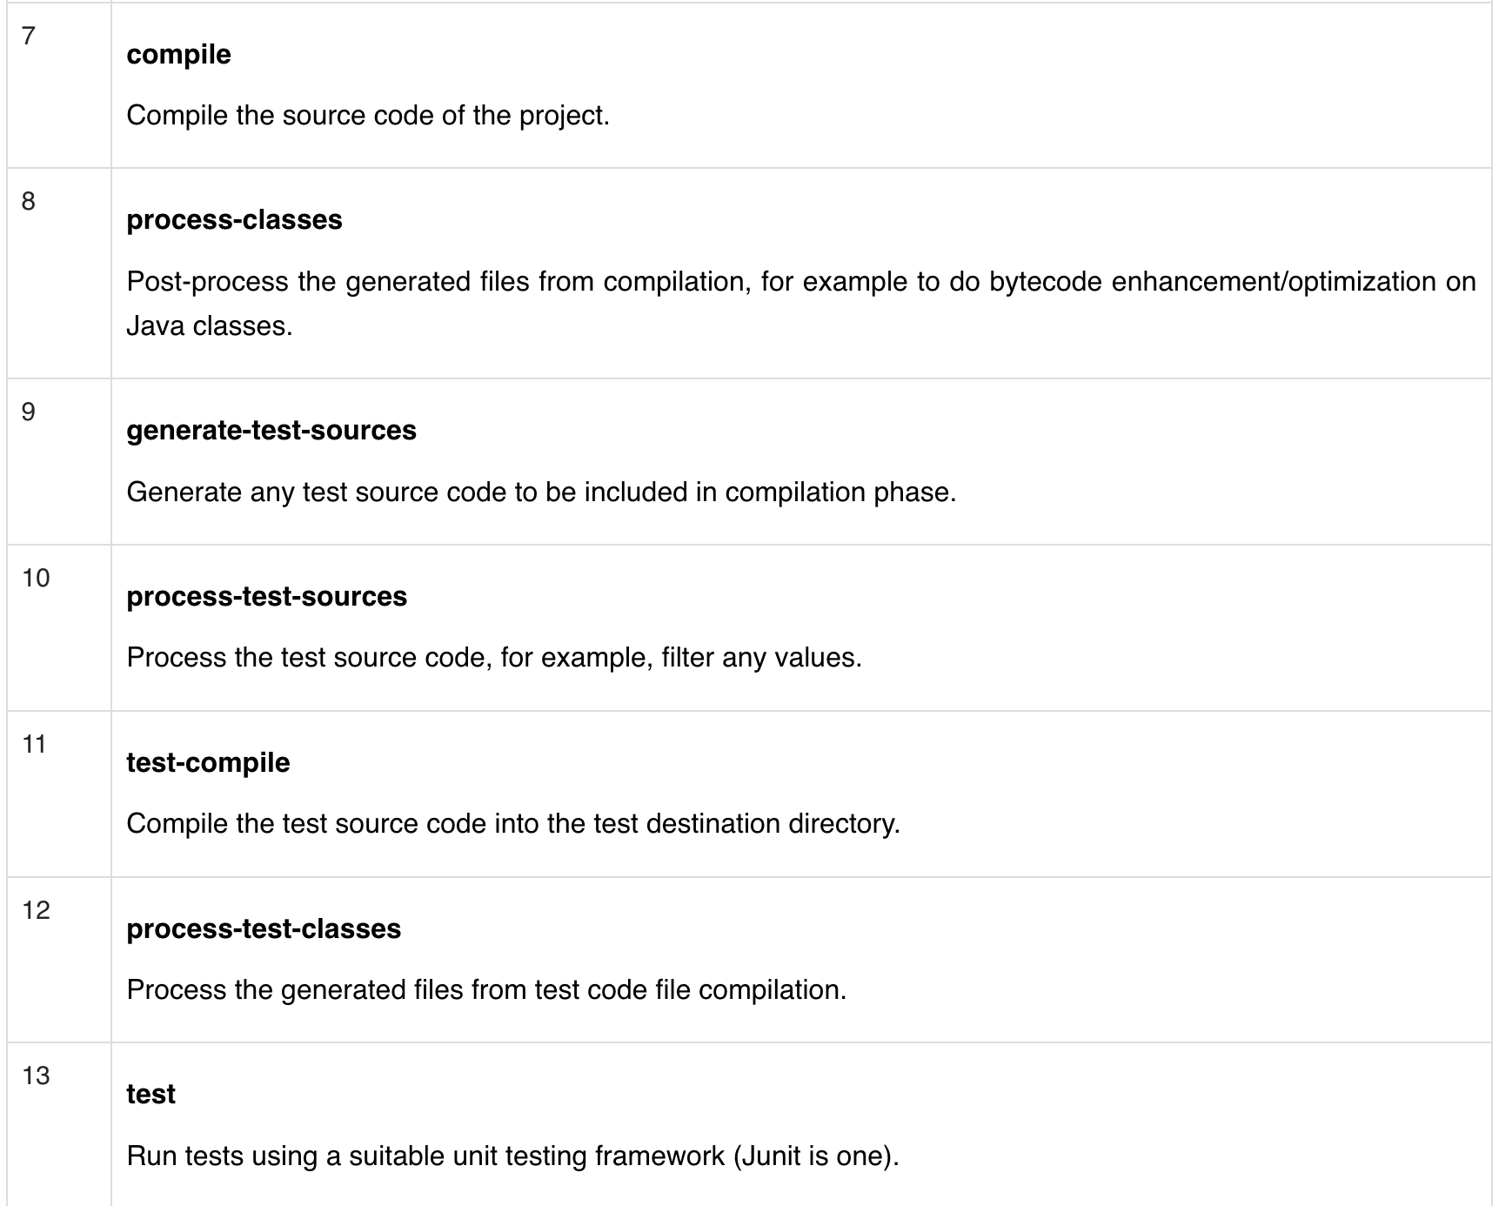

Slide 8
