Slide 1
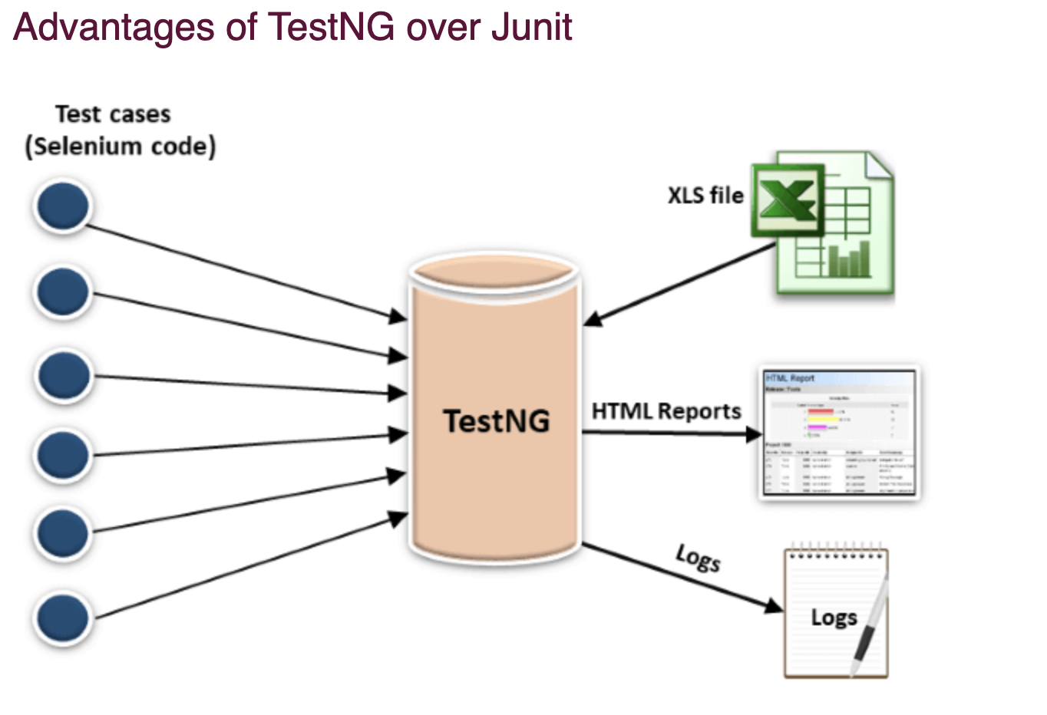
TestNG
What is TestNG
TestNG is a very important framework when you are actually developing the framework from scratch level.
TestNG provides you full control over the test cases and the execution of the test cases. Due to this reason, TestNG is also known as a testing framework.
If you want to run a test case A before that as a pre-requisite you need to run multiple test cases before you begin a test case A. You can set and map with the help of TestNG so that pre-request test cases run first and then only it will trigger a test case A. In such way, you can control the test cases.
TestNG framework came after Junit, and TestNG framework adds more powerful functionality and easier to use.
It is an open source automated TestNG framework. In TestNG, NG stands for "Next Generation".
TestNG framework eliminates the limitations of the older framework by providing more powerful and flexible test cases with help of easy annotations, grouping, sequencing and parametrizing.

Slide 2
Why Use TestNG with Selenium?
Generate the report in a proper format including a number of test cases runs, the number of test cases passed, the number of test cases failed, and the number of test cases skipped.
Multiple test cases can be grouped more easily by converting them into testng.xml file. In which you can make priorities which test case should be executed first.
The same test case can be executed multiple times without loops just by using keyword called ‘invocation count.’
Using testng, you can execute multiple test cases on multiple browsers, i.e., cross browser testing.
The TestNG framework can be easily integrated with tools like TestNG Maven, Jenkins, etc.
Annotations used in the testing are very easy to understand ex: @BeforeMethod, @AfterMethod, @BeforeTest, @AfterTest
WebDriver has no native mechanism for generating reports. TestNG can generate the report in a readable format like the one shown below.
TestNG simplifies the way the tests are coded. There is no more need for a static main method in our tests. The sequence of actions is regulated by easy-to-understand annotations that do not require methods to be static.
Uncaught exceptions are automatically handled by TestNG without terminating the test prematurely. These exceptions are reported as failed steps in the report.

Slide 3
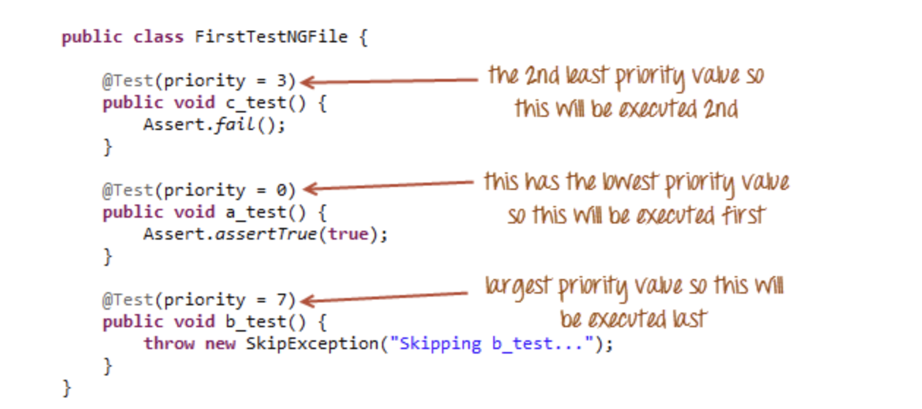
Parameters
If you want the methods to be executed in a different order, use the parameter “priority”. Parameters are keywords that modify the annotation’s function.
Parameters require you to assign a value to them. You do.this by placing a “=” next to them, and then followed by the value.
Parameters are enclosed in a pair of parentheses which are placed right after the annotation like the code snippet shown below.

Slide 4
@Test
TestNG code without Priority
TestNG code without Priority in Alphabetical Order
Methods with Same Priority
Combining both prioritized(having same priority) and non-prioritized methods

Slide 5
What is Annotation in TestNG?
Annotations in TestNG are lines of code that can control how the method below them will be executed. They are always preceded by the @ symbol.
The ability to run tests in parallel is available in TestNG but not in JUnit, so the TestNG framework is more preferred for testers using Selenium.
@BeforeTest and @AfterTest
@BeforeTest methods under this annotation will be executed prior to the first test case in the TestNG file.
@AfterTest methods under this annotation will be executed after all test cases in the TestNG file are executed.
@BeforeMethod and @AfterMethod
@BeforeMethod methods under this annotation will be executed prior to each method in each test case.
@AfterMethod methods under this annotation will be executed after each method in each test case.

Slide 6
Summary of TestNG Annotations
@BeforeSuite: The annotated method will be run before all tests in this suite have run.
@AfterSuite: The annotated method will be run after all tests in this suite have run.
@BeforeTest: The annotated method will be run before any test method belonging to the classes inside the tag is run.
@AfterTest: The annotated method will be run after all the test methods belonging to the classes inside the tag have run.
@BeforeGroups: The list of groups that this configuration method will run before. This method is guaranteed to run shortly before the first test method that belongs to any of these groups is invoked.
@AfterGroups: The list of groups that this configuration method will run after. This method is guaranteed to run shortly after the last test method that belongs to any of these groups is invoked.
@BeforeClass: The annotated method will be run before the first test method in the current class is invoked.
@AfterClass: The annotated method will be run after all the test methods in the current class have been run.
@BeforeMethod: The annotated method will be run before each test method.
@AfterMethod: The annotated method will be run after each test method.
@Test: The annotated method is a part of a test case

Slide 7
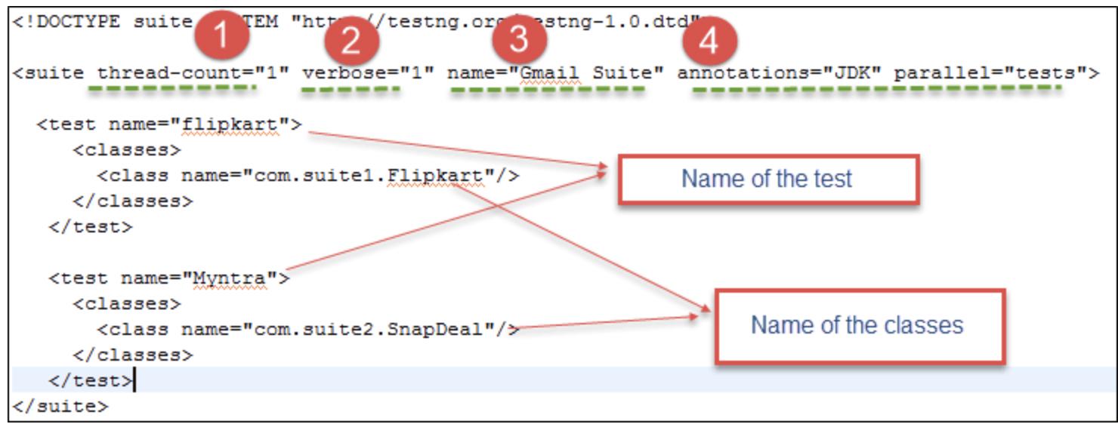
Parallel execution in TestNG
TestNG: Execute multiple Test Suites
1) thread-count: This is used for parallel execution, based on the number script. It will execute in parallel or sequential order.
2) verbose: It is used to log the execution details in the console. The value should be 1-10. The log details in the console window will get more detailed and clearer as you increase the value of the verbose attribute in the testng.xml configuration file.
3) name: Name of the suite. Here it is “Gmail Suite”
4) Parallel: To run scripts parallel, value can be tests/classes/methods/suites. Default value is none

Slide 8
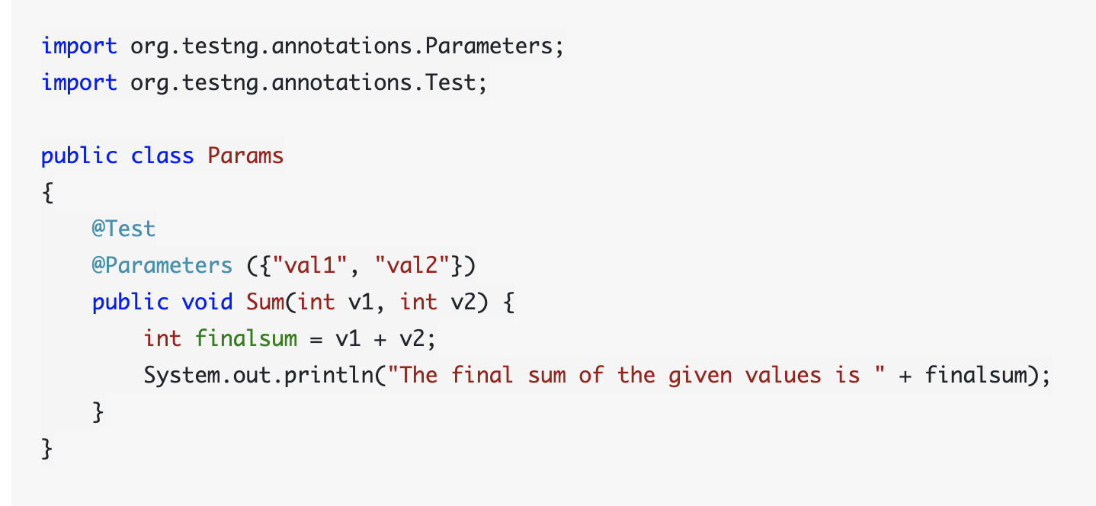
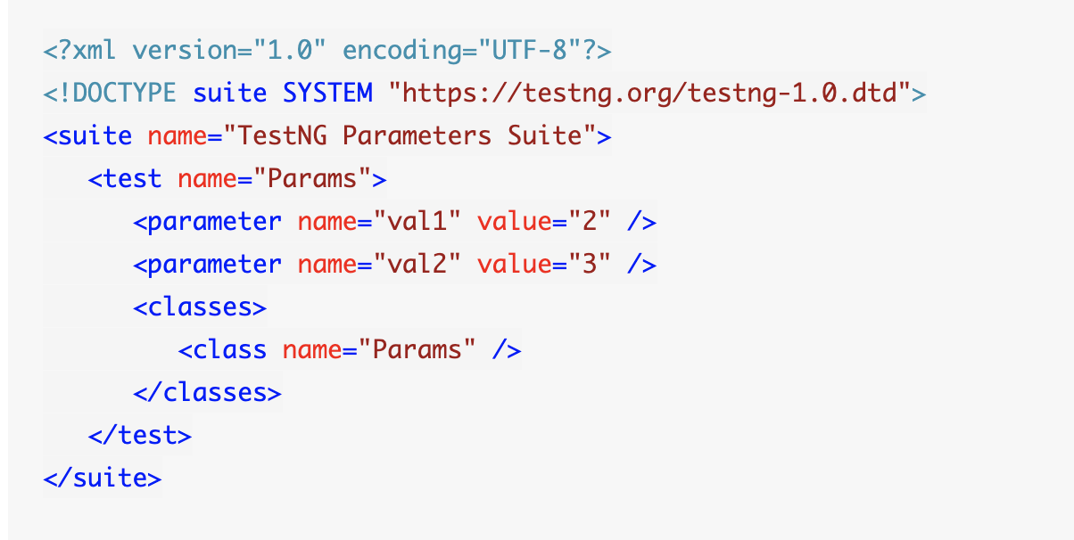
Parameters:
they are declared to pass some values onto the function. A simple reason to use parameters is that they let us run a function many times with different values or to run different functions with the same values. Parameters pass the values in the runtime.
Syntax:
@Parameters ({"a", "b"})

Slide 9
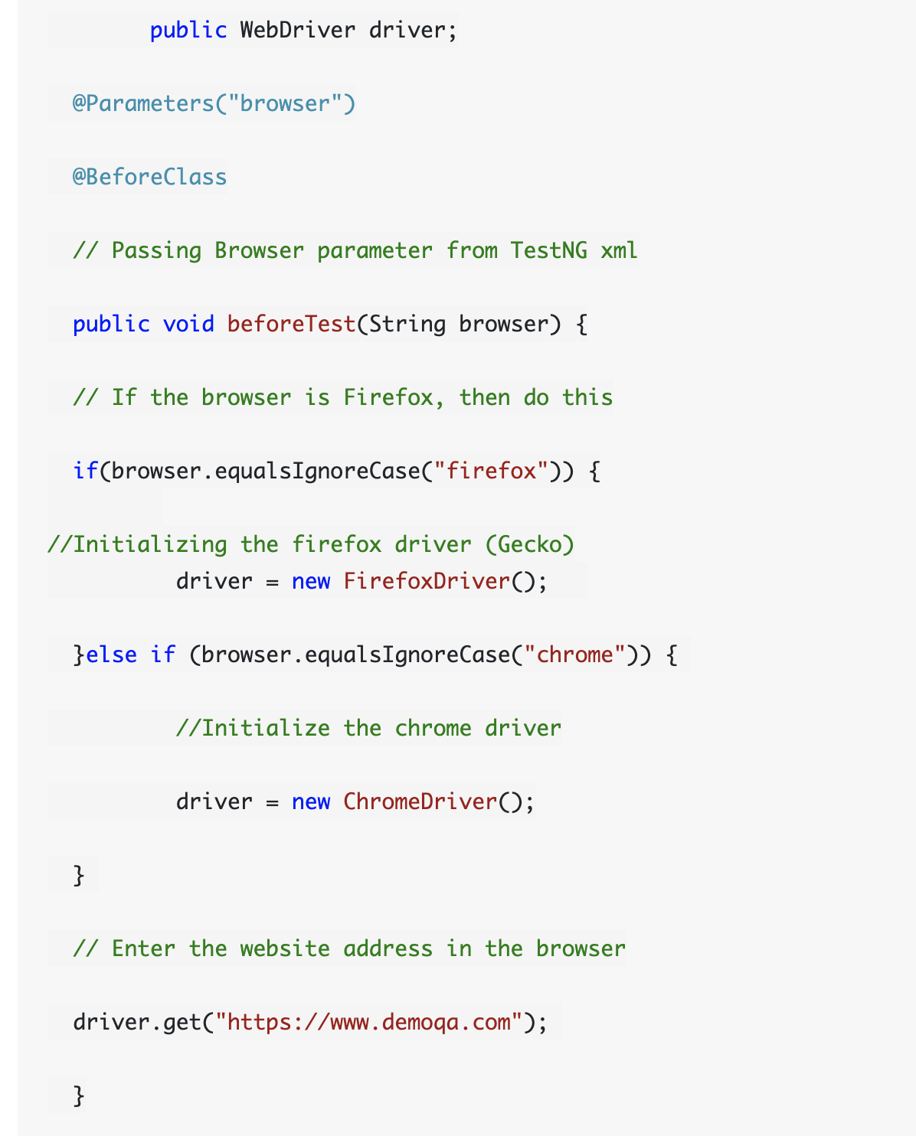
What is Cross-Browser Testing?
Cross-browser testing is the process of testing our website on different browsers and operating systems. With cross-browser testing, we make sure that the site is rendered the same in every browser.

Slide 10
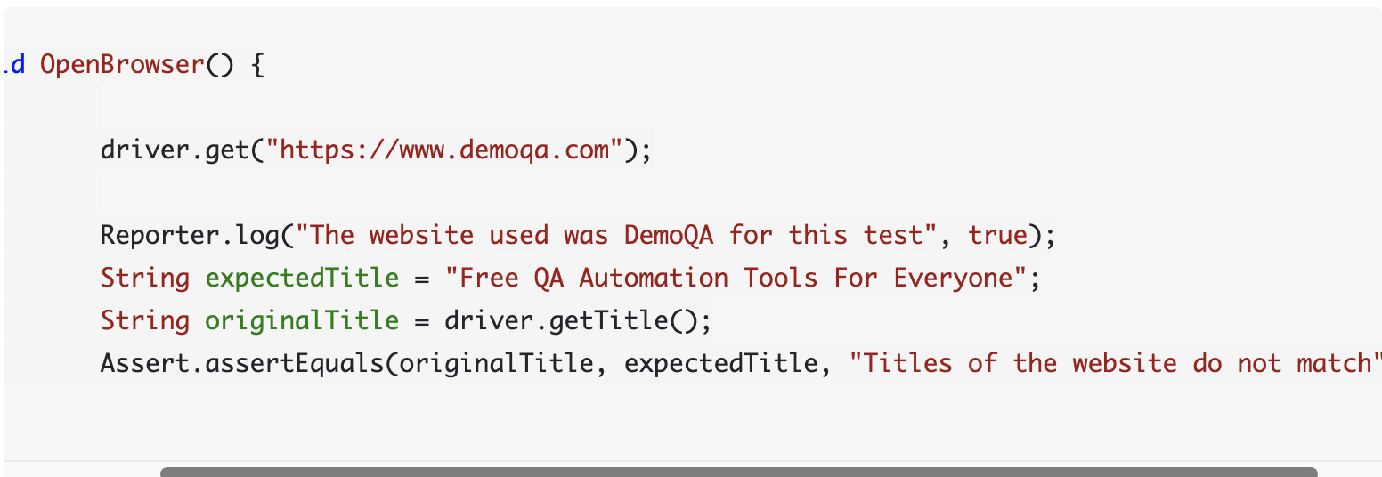
What are Assertions in TestNG?
Assertions in TestNG are a way to verify that the expected result and the actual result matched or not.
Syntax for TestNG Assertions:
Assert.Method(actual, expected)

Slide 11
Commonly used TestNG Assert Methods
All the TestNG Assert statements work in the same vein when we talk about the basic structure of its execution. But, like any other method, it can take different parameters and perform various types of validations in the test case methods.
Assert.assertEqual(String actual, String expected): Pass the actual string value and the expected string value as parameters. Validates if the actual and expected values are the same or not.
Assert.assertEqual(String actual, String expected, String message): Similar to the previous method just that when the assertion fails, the message displays along with the exception thrown.
Assert.assertEquals(boolean actual, boolean expected): Takes two boolean values as input and validates if they are equal or not.
Assert.assertTrue(condition): This method asserts if the condition is true or not. If not, then the exception error is thrown.
Assert.assertTrue(condition, message): Similar to the previous method with an addition of message, which is shown on the console when the assertion fails along with the exception.
Assert.assertFalse(condition): This method asserts if the condition is false or not. If not, then it throws an exception error.
Assert.assertFalse(condition, message): Similar to the previous method but with an addition of a message string which is shown on the console when the assertion fails, i.e., the condition is true*.
public static void assertEquals(Object actual, Object expected, String message): Asserts whether the two objects passed are equal or not. If not, the message and the exception error appears. The message parameter is optional.
public static void assertEquals(String actual, String expected, String message): Asserts whether two strings are equal or not. If not, the message along with the exception error displays. The message parameter is optional.

Slide 12
Listeners
https://www.guru99.com/listeners-selenium-webdriver.html

