Slide 1
Core Java
Introduction to Java
Sample Code(Hello World)
Comments
Variables
Data Types
Strings
Arrays
Casting
Constants
Operators(Arithmetic & Assignment)
Math class
Scanner class
Conditional statements
Loops
Break & Continue
Exception Handling

Slide 2
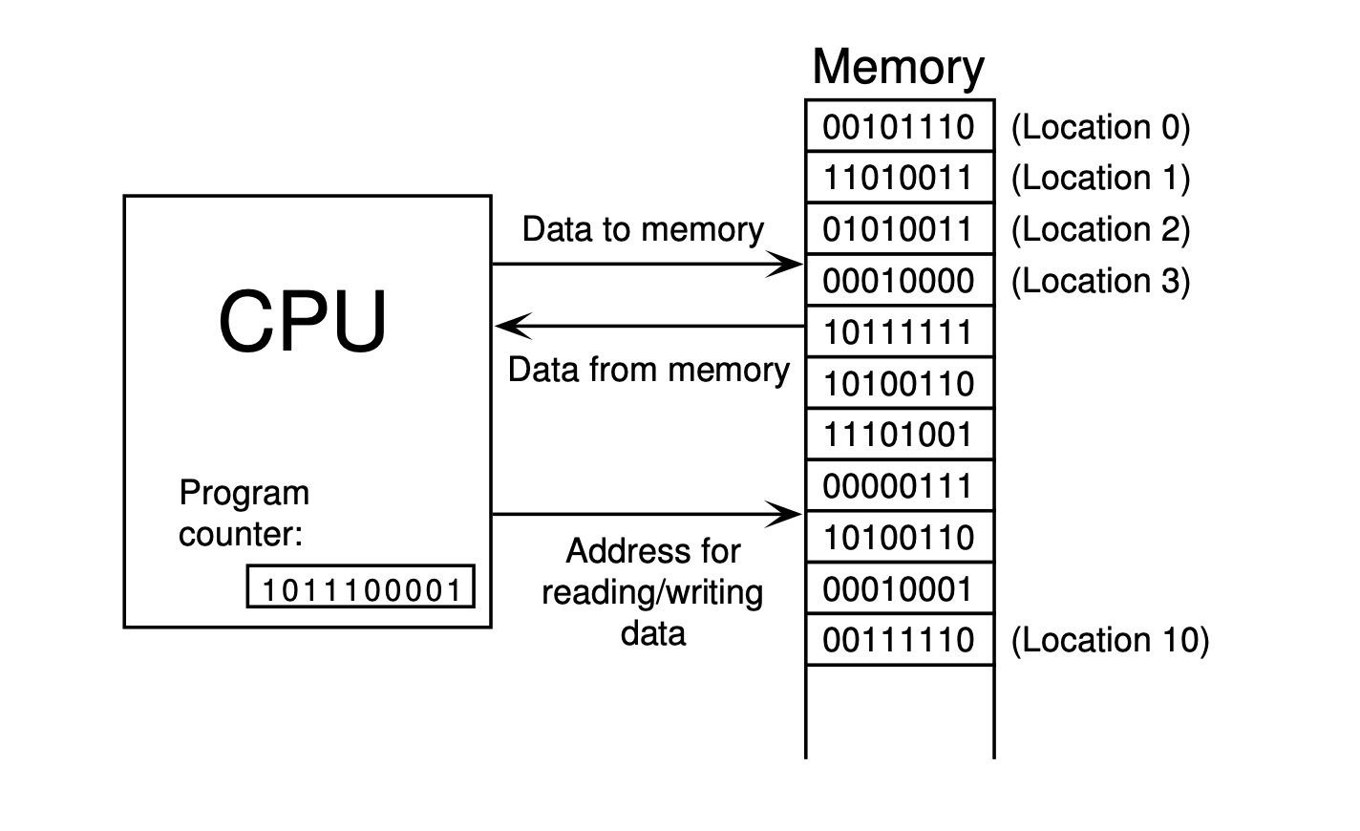
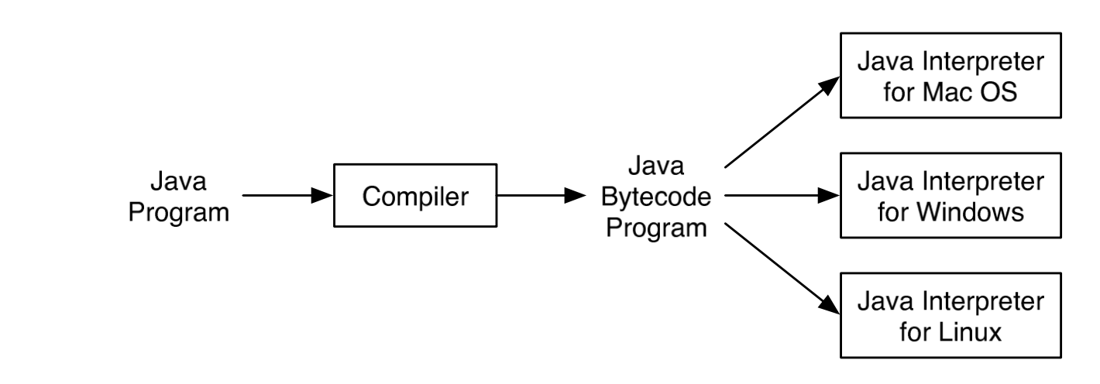
Introduction
Compiler:
A program written in a high-level language cannot be run directly on any computer. First, it must be translated into machine language. This translation can be done by a program called a compiler.
Java Virtual Machine(JVM) :
The designers of Java chose to use a combination of compilation and interpretation. Programs written in Java are compiled into machine language, This machine language compiled by java for a computer is called Java byte-code. This so-called “virtual” computer is known as the Java virtual machine.

Slide 3
Sample Code
Variables:
A variable is a container (storage area) used to hold data.
Each variable should be given a unique name (identifier).
package com.microcare;
public class Main {
public static void main(String[] args) {
// Variables
String name = "Aman";
int age = 30;
String neighbour = "Akku";
String friend = neighbour;
}
}
package com.microcare;
public class Main {
public static void main(String[] args) {
// Our 1st Program
System.out.println("Hello World");
}
}

Slide 4
Comments
We use comments to add notes to our code.
// This is a comment, and it won’t get executed.
/**
*This is also a comment
*
*/

Slide 5
Data Types
Data types are declarations for variables. This determines the type and size of data associated with variables which is essential to know since different data types occupy different sizes of memory.
There are 2 types of Data Types :
Primitive Data types : to store simple values
Non-Primitive Data types : to store complex values
Primitive Data Types
These are the data types of fixed size.
byte age = 30;
long viewsCount = 361238456L;
float price = 10.99F;
char letter = ‘A’;
boolean isEligible = true;
Data Type | Meaning | Size (in Bytes) | Range
byte | 2’s complement integer | 1 | -128 to 127
short | 2’s complement integer | 2 | -32K to 32K
int | Integer numbers | 4 | -2B to 2B
long | 2’s complement integer (larger values) | 8 | -9,223,372,036,854,775,808 to 9,223,372,036,854,775,807
float | Floating-point | 4 | Upto 7 decimal digits
double | Double Floating-point | 8 | Upto 16 decimal digits
char | Character | 2 | a, b, c .. A, B, C .. @, #, $ ..
bool | Boolean | 1 | True, false

Slide 6
Non-Primitive Data Types
These are of variable size & are usually declared with a ‘new’ keyword.
Eg : String, Arrays String name = new String("Aman");
int[] marks = new int[3];
marks[0] = 97;
marks[1] = 98;
marks[2] = 95;
syntax:
In Java, we terminate statements with a semicolon.
We enclose characters with single quotes and strings (series of characters) with
double quotes.
The default integer type in Java is int. To represent a long value, we should add L
to it as a postfix.
The default floating-point type in Java is double. To represent a float, we should append F to it as a postfix. Reference Types:
In Java we have 8 primitive types. All the other types are reference types. These types don’t store the actual objects in memory. They store the reference (or the address of) an object in memory. To use reference types, we need to allocate memory using the new operator. The memory gets automatically released when no longer used.
Date now = new Date();

Slide 7
String Class
Strings are non-primitive data types in Java.
This class in java has various important methods that can be used for Java objects. These include:
Concatenation
String name1 = new String("Aman");
String description = new String("is a good boy.");
String sentence = name1 + description;
System.out.println(sentence);
CharAt
String name = new String("Aman");
System.out.println(name.charAt(0));
Length
String name = new String("Aman");
System.out.println(name.length());
Replace
String name = new String("Aman");
System.out.println(name.replace('a', 'b'));
Substring
String name = new String("AmanAndAkku");
System.out.println(name.substring(0, 4));

Slide 8
• startsWith(“a”)
• endsWith(“a”)
• indexOf(“a”)
• toUpperCase()
• toLowerCase()
Arrays:
Arrays in Java are like a list of elements of the same type i.e., a list of integers, a list of Booleans etc.
Creating an Array (method 1) - with new keyword
int[] marks = new int[3];
marks[0] = 97;
marks[1] = 98;
marks[2] = 95;
Creating an Array (method 2)
int[] marks = {98, 97, 95};
Multi-dimensional Arrays
// Creating a 2x3 array (two rows, three columns)
int[2][3] matrix = new int[2][3];
matrix[0][0] = 10;
// Shortcut
int[2][3] matrix = { { 1, 2, 3 },{ 4, 5, 6 }};

Slide 9
Casting :
Casting in java is the assigning values of one type to another. The types being considered here are compatible i.e., we can only assign values of a number type to another type storing numbers (vice-versa is not allowed i.e., floating values cannot be assigned to boolean data types).
Casting in Java is of 2 types:
Implicit casting
This casting is done by java implicitly i.e., on its own. It is assigning smaller values to larger data types.
float price = 100.00F;
int gst = 18;
float finalPrice = price + gst;
Explicit casting
This casting is done by the programmer. It is assigning larger values to smaller data types.
int price = 100;
float gst = 18.06F;
int finalPrice = price + (int)gst;

Slide 10
Constants
A constant is a variable in Java which has a fixed value i.e., it cannot be assigned a different value once assigned.
package com.microcare;
public class Main {
public static void main(String[] args) {
// Constants
final float PI = 3.14F;
}
}
Order of Operations:
Multiplication and division operators have a higher order than addition and
subtraction. They get applied first. We can always change the order using
parentheses.
DMAS
int x = 10 + 3 * 2; // 16
int x = (10 + 3) * 2; // 26

Slide 11
Operators
There are 4 types of operators in Java :
Arithmetic Operators
Assignment Operators
Comparison/Relational Operators
Logical Operators
Arithmetic operators are just like operators we used in Math. These include:
‘+’ Add
int a = 30;
int b = 40;
int sum = a + b;
‘-’ Subtract
int a = 30;
int b = 40;
int diff = a - b;
‘*’ Multiply
int a = 30;
int b = 40;
int mul = a * b;

Slide 12
‘/’ Divide
int a = 30;
int b = 40;
int div = a / b;
‘%’ Modulo - Remainder of a/b
int a = 30;
int b = 40;
int modulo = a % b;
Unary Operators
int a = 30;
a++;
a--;
Pre-incrementer : It increments the value of the operand instantly.
Post-incrementer : It stores the current value of the operand temporarily and only after that statement is completed, the value of the operand is incremented.
Pre-decrementer : It decrements the value of the operand instantly.
Post-decrementer : It stores the current value of the operand temporarily and only after that statement is completed, the value of the operand is decremented.

Slide 13
Assignment Operators
Operator | Operation | Example
= | Assigns value of right operand to left operand | A=B will put value of B in A
+= | Adds right operand to the left operand and assigns the result to left operand. | A+=B means A = A+B
-= | Subtracts right operand from the left operand and assigns the result to left operand. | A-=B means A=A-B
*= | Multiplies the right operand with the left operand and assigns the result to the left operand. | A*=B means A=A*B
/= | Divides left operand with the right operand and assigns the result to left operand. | A/=B means A=A/B

Slide 14
Comparison/Relational Operators
Relational operators define the relation between 2 entities.
They give a Boolean value as result i.e., true or false.
Suppose : A=5 and B=10
Operator | Operation | Example
== | Gives true if two operands are equal | A==B is not true
!= | Gives true if two operands are not equal | A!=B is true
> | Gives true if left operand is more than right operand | A>B is not true
< | Gives true if left operand is less than right operand | A<B is true
>= | Gives true if left operand is more than right operand or equal to it | A>=B is not true
<= | Gives true if left operand is more than right operand or equal to it | A<=B is true

Slide 15
Logical Operators:
Logical operators are used to connect multiple expressions or conditions together.
We have 3 basic logical operators.
Suppose : A=0 and B=1
Operator | Operation | Example
&& | AND operator. Gives true if both operands are non zero | (A && B) is false
|| | OR operator. Gives true if atleast one of the two operands are non-zero. | (A || B) is true
! | NOT operator. Reverse the logical state of operand | !A is true

Slide 16
Math class
Math is an important class in Java that is extensively used and has a lot of interesting functions.
To import - import java.lang.Math;
Some functions include:
Max
int a = 10;
int b = 20;
Math.max(a, b);
Min
int a = 10;
int b = 20;
Math.min(a,b);
Random
int randomNumber = (int)(Math.random()*100);

Slide 17
Scanner Class:
We take input using the Scanner class and input various types of data using it.
To import the Scanner class –
import java.util.Scanner;
Example :
Scanner sc = new Scanner(System.in);
int n = sc.nextInt();
float a = sc.nextFloat();
String name = sc.next();
String line = sc.nextLine();

Slide 18
Conditional Statements ‘if-else’
The if block is used to specify the code to be executed if the condition specified in if is true, the else block is executed otherwise.
int age = 30;
if(age > 18) {
System.out.println("This is an adult");
} else {
System.out.println("This is not an adult");
}

Slide 19
Conditional Statements ‘switch’
Switch case statements are a substitute for long if statements that compare a variable to multiple values. After a match is found, it executes the
corresponding code of that value case.
int n = 1;
switch(n) {
case 1 :
System.out.println("Monday");
break;
case 2 :
System.out.println("Tuesday");
break;
case 3 :
System.out.println("Wednesday");
break;
case 4 :
System.out.println("Thursday");
break;
case 5:
System.out.println("Friday");
break;
case 6 :
System.out.println("Saturday");
break;
default :
System.out.println("Sunday");
}

Slide 20
Break & Continue
Jumps in loops are used to control the flow of loops. There are two statements used to implement jump in loops - Continue and Break. These statements are used when we need to change the flow of the loop when some specified condition is met.
Continue statement is used to skip to the next iteration of that loop. This means that it stops one iteration of the loop. All the statements present after the continue statement in that loop are not executed.
int i;
for (i=1; i<=20; i++) {
if (i%3==0) {
continue;
}
System.out.println(i);
}
In this for loop, whenever i is a number divisible by 3, it will not be printed as the loop will skip to the next iteration due to the continue statement. Hence, all the numbers except those which are divisible by 3 will be printed.

Slide 21
Break statement is used to terminate the current loop. As soon as the break statement is encountered in a loop, all further iterations of the loop are stopped and control is shifted to the first statement after the end of loop.
int i;
for (i=1; i<=20; i++) {
if (i == 11) {
break;
}
System.out.println(i);
}
In this loop, when i becomes equal to 11, the for loop terminates due to break statement, Hence, the program will print numbers from 1 to 10 only.

Slide 22
Loops
A loop is used for executing a block of statements repeatedly until a particular condition is satisfied. A loop consists of an initialization statement, a test condition and an increment statement.
For Loop
The syntax of the for loop is :
for (initialization; condition; update) {
// body of-loop
}
for (int i=1; i<=20; i++) {
System.out.println(i);
}

Slide 23
While Loop
The syntax for while loop is :
while(condition) {
// body of the loop
}
int i = 0;
while(i<=20) {
System.out.println(i);
i++;
}

Slide 24
Do-While Loop
The syntax for the do-while loop is :
do {
// body of loop;
}
while (condition);
int i = 0;
do {
System.out.println(i);
i++;
} while(i<=20);

Slide 25
Exception Handling (try-catch)
Exception Handling in Java is a mechanism to handle the runtime errors so that normal flow of the application can be maintained.
It is done using 2 keywords - ‘try’ and ‘catch’.
Additional keywords like finally, throw and throws can also be used if we dive deep into this concept.
int[] marks = {98, 97, 95};
try {
System.out.println(marks[4]);
} catch (Exception exception) {
System.out.println("An exception for caught while accessing an index the 'marks' array");
}
System.out.println("We tried to print marks & an exception must have occurred with index >=3");

