Slide 1
Random Forest Model Pipeline for GitHub Issue Classification
Exercise 3 - Principles of AI Engineering
Syed Muhammed Hassan Ali

Slide 2
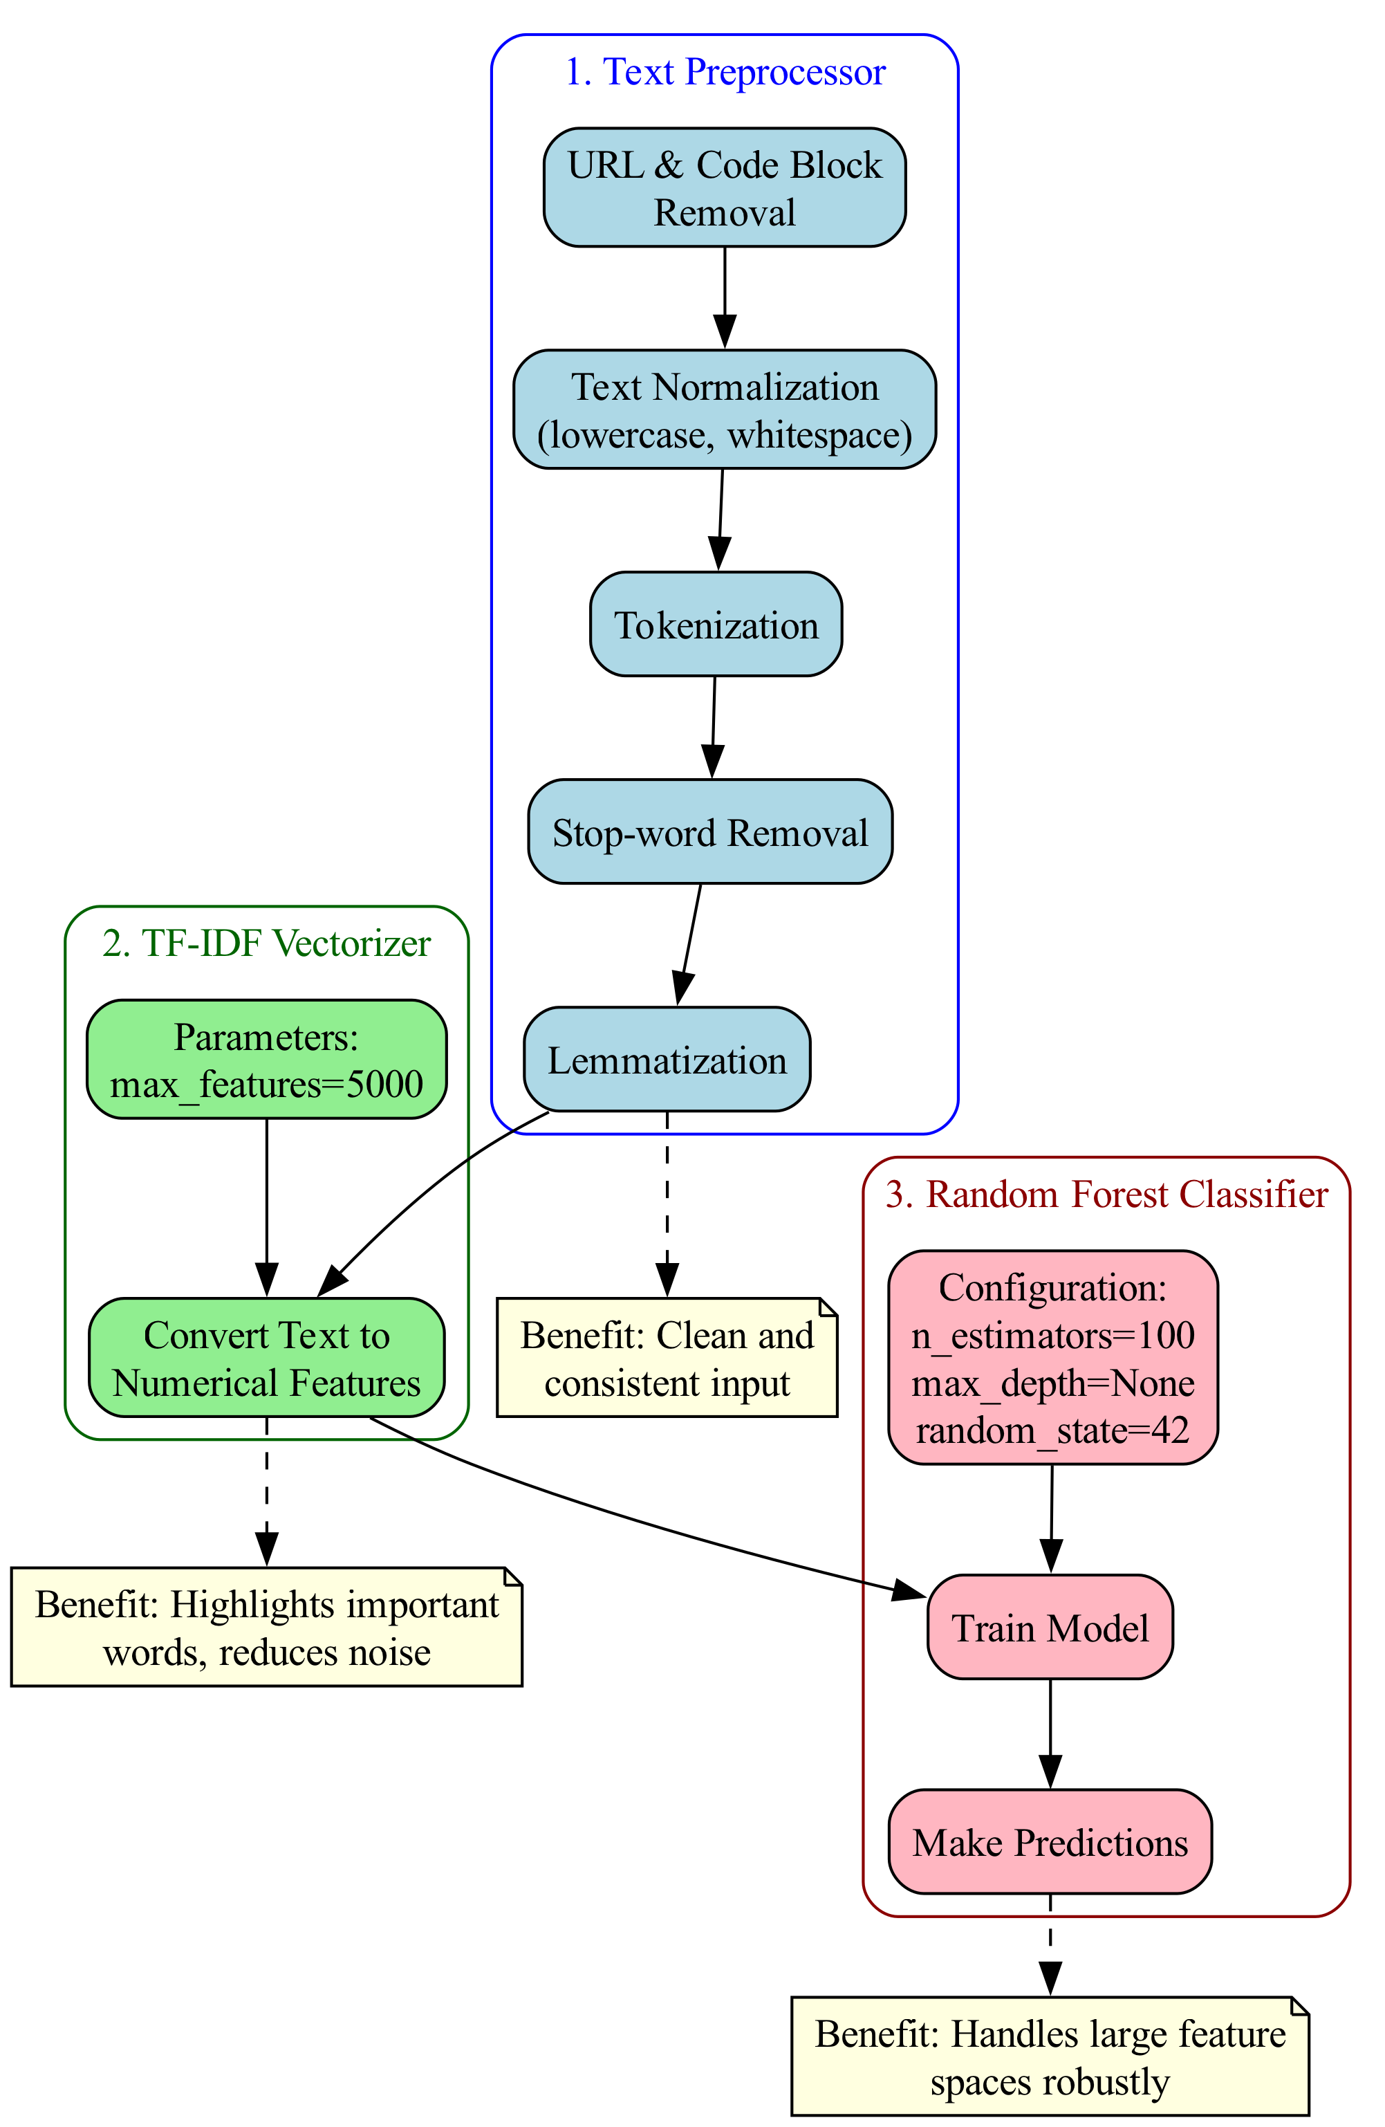
Model Pipeline Components
Text Processing Pipeline:
• URL & Code Block Removal
• Text Normalization
• Tokenization & Lemmatization
Feature Extraction:
• TF-IDF Vectorization
Model Training:
• Random Forest with Cross-Validation

Slide 3
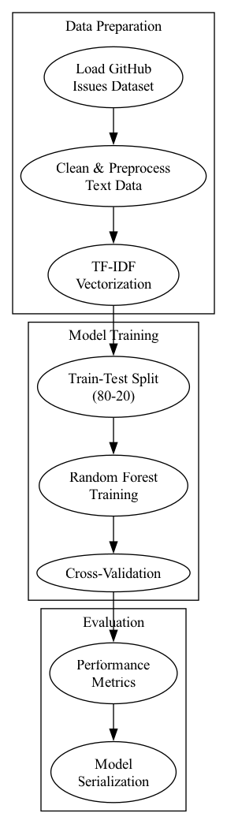
Training Process Flow
1. Data Preparation
• Load and clean GitHub issues
• Apply text preprocessing steps
2. Feature Engineering
• Convert text to TF-IDF features
3. Model Training
• Train Random Forest model
• Validate performance

Slide 4
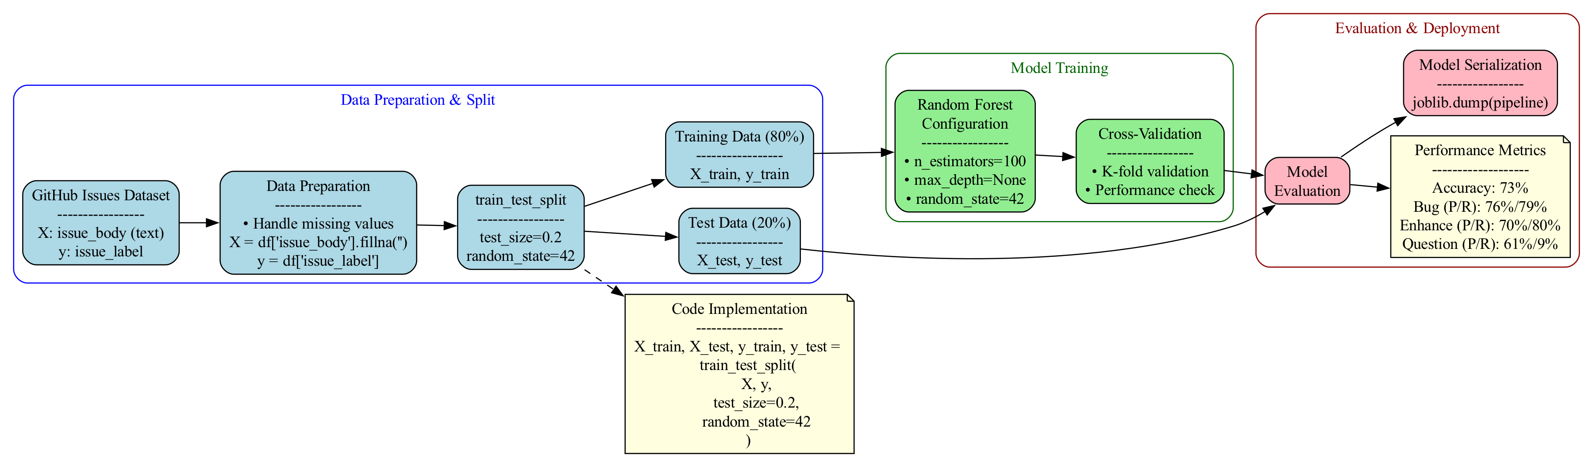
Training and Evaluation of the Model
Training Methodology:
• Used scikit-learn's RandomForestClassifier
• Applied cross-validation for reliable assessment
• Serialized model using joblib
Evaluation Metrics:
• Overall Accuracy: 73%
• Bug Classification:
- Precision: 76%, Recall: 79%
• Enhancement Classification:
- Precision: 70%, Recall: 80%
• Question Classification:
- Precision: 61%, Recall: 9%

Slide 5
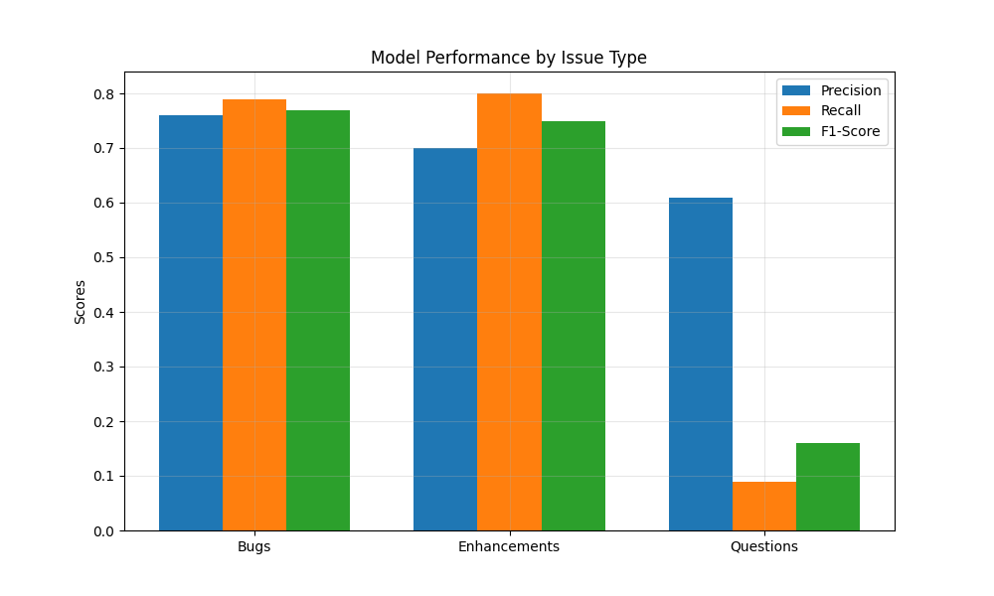
Model Performance Analysis
Performance by Issue Type:
• Strong performance on Bugs
• Good results for Enhancements
• Challenges with Questions
Key Insights:
• Class imbalance impact
• Need for balanced dataset

Slide 6
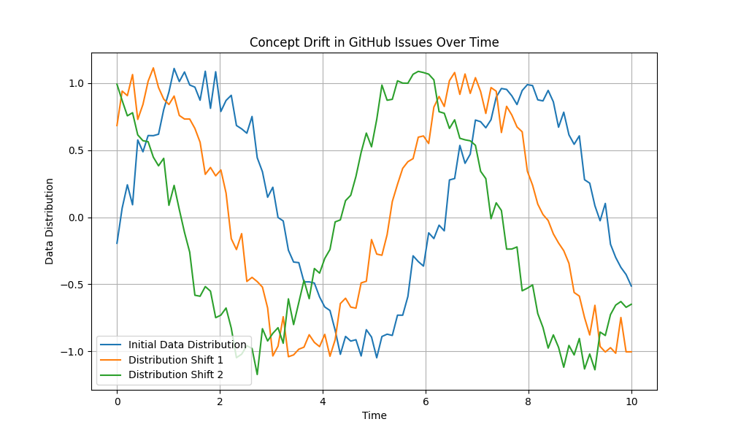
Impact of Concept Drift
Observed Changes:
• Shifting issue patterns
• Evolution of terminology
• New feature requests
Challenges:
• Static model limitations
• Need for adaptive learning

Slide 7
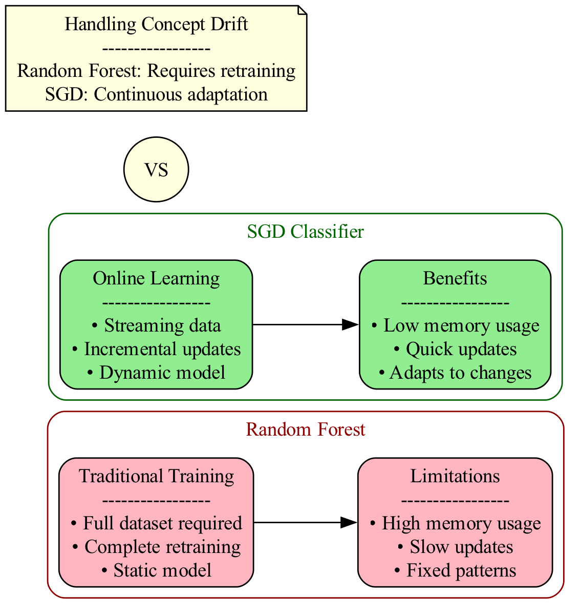
Alternative: SGD Classifier for Concept Drift
Advantages:
• Online Learning Capability
- Continuous model updates
- Adapts to new patterns
• Memory Efficient
- No stored trees
- Linear model complexity
• Scalable Solution
- Fast training and updates
- Handles streaming data

