Slide 1
VALLIAMMAL COLLEGE FOR WOMEN
COOKBOOK RECIPE APPLICATION
Team ID : SWTID1741250353149964
SYED ALI AASIN J(Team Leader) : syedaliaasinj22cs088@gmail.com
TEAM MEMBERS
SUNDARAKAMATCHI I : sundarakamatchi.i22cs083@gmail.com
SWETHA R : swetha.r22cs085@gmail.com
SWETHA S : swethas2cs086@gmail.com
SWETHA S : swetha22cs087@gmail.com

Slide 2
TEAM MEMBERS AND THEIR ROLES
SYED ALI AASIN J : DOCUMENTATION
SUNDARAKAMATCHI I : CONTENT FOR DOCUMENT
SWETHA R : PPT
SWETHA S : VIDEO MAKING
SWETHA S : CONTENT FOR DOCUMENTATION

Slide 3
INTRODUCTION
The CookBook project is a web-based application developed using React.js that allows users to explore, manage, and save their favorite recipes.
The platform serves as a digital cookbook where users can browse a rich collection of recipes, search for specific dishes or ingredients, and follow step-by-step cooking instructions.
The application is designed to be user-friendly, featuring an intuitive UI, authentication system, and personalized recipe recommendations.
The primary goal of CookBook is to simplify cooking and recipe management by providing users with an organized and accessible platform.
Instead of relying on scattered notes, printed cookbooks, or multiple online sources, CookBook consolidates recipes into a single, efficient digital solution.

Slide 4
MODULE SPECIFICATION
Authentication Module
Recipe Management Module
Search & Filter Module
Recipe Detail & Cooking Guide Module
User Profile & Personalization Module
Trending & Popular Recipes Module
UI & Navigation Module
Testing & Quality Assurance Module
API & Backend Integration Module

Slide 5
PROJECT OVERVIEW
PURPOSE
A Cookbook Recipe Application is a digital platform that allows users to explore, save, and manage various recipes.
FEATURES
Recipe Library.
Ingredient List.
User authentication.
Step by Step Cooking Instruction.
Detailed Procedure.

Slide 6
ARCHITECTURE
COMPONENT STRUCTURE
The application is built using React.js with a component-based architecture. Major components include:
Header: Contains the navigation bar and search bar.
Sidebar: Displays user playlists and navigation links.
Home Page: Most Popular Categories, and Trending dishes.
Search Page: Allows users to search for recipe, ingredient, and video.
STATE MANAGEMENT
The application uses Redux for global state management.
The Redux store manages user authentication, recipe, ingredients, and search results.
ROUTING
The application uses React Router for navigation. Routes include:
Home page
search: Search page
login: User login page

Slide 7
COMPONENTS
Hero Component – Provides an introduction and a button to explore more recipes.
Popular Categories – Displays different categories of recipes.
Trending Dishes – Showcases the most popular or trending recipes.
Newsletter Component – Allows users to subscribe for recipe updates.
Category Page – Displays dishes under a selected category.
Recipe Page – Shows recipe details, including images, ingredients, instructions, and a tutorial video

Slide 8
STATE MANAGEMENT
GLOBAL STATE
The Redux store manages the following global states
User: Current authenticated user.
Player: Current playing track, playback status (playing/paused), and volume.
Search Results: Results from the search functionality.
LOCAL STATE
Local state is managed using React's useState hook within components.
For example, the Search Page component manages the search query input locally.

Slide 9
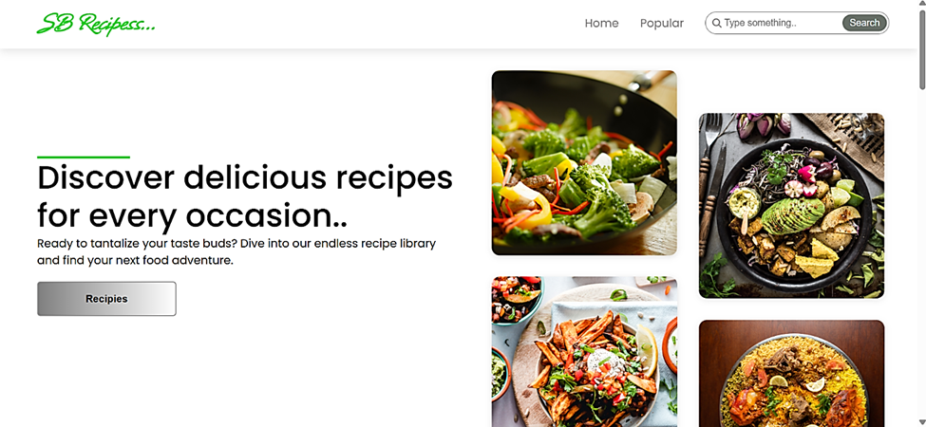
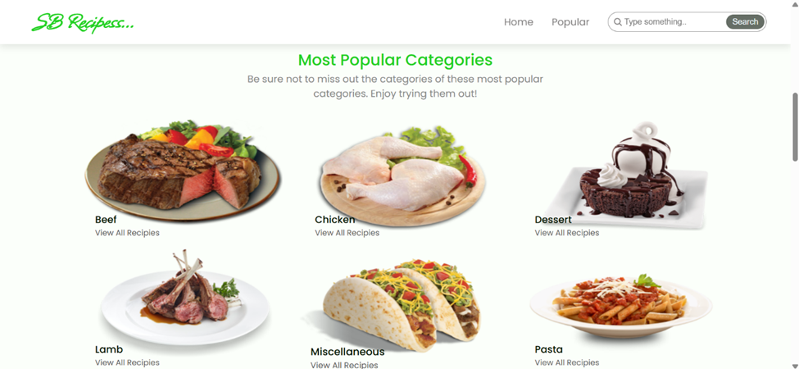
OUTPUT
HOME PAGE
MOST POPULAR CATEGORIES

Slide 10
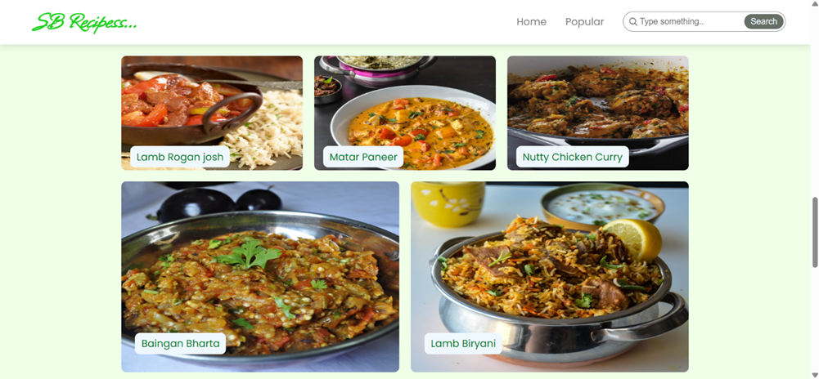
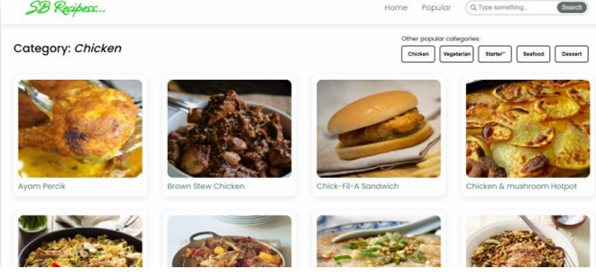
TRENDING DISHES
CATEGORY DISHES PAGE

Slide 11
CONCLUSION
The CookBook project successfully delivers a feature-rich and user-friendly recipe management system that simplifies the cooking experience for users.
Key Achievements:
User Authentication & Personalization – Secure login and recipe-saving features.
Recipe Management System – Organized and categorized recipe storage.
Search & Filtering – Advanced search based on ingredients, cuisine, and dietary preferences.
Step-by-Step Cooking Guide – Detailed instructions for an easy cooking experience.
Responsive UI – Seamless experience across mobile and desktop devices.

Slide 12
REFERENCE GITHUB LINK : https://github.com/Syed1284/CookBook_SyedAliAasin GOOGLE DRIVE LINK : https://drive.google.com/drive/folders/1vGGiA_lzhwOfl6IWK-e3QNSfVSslzmlY

