Slide 1
Introduction
With this presentation, I want to share my experience using kafka to create a pipeline and eventually steaming data into the pipeline

Slide 2
Why choose Airport/Flight data API
Big Data analytics can give airlines a huge advantage over their competitors.
It includes booking, check in, boarding, even during the flight. These airlines can learn a huge amount about their clients
In addition to loyalty programs, information gathered has valuable information that impacts operations, services and efficiency.

Slide 3
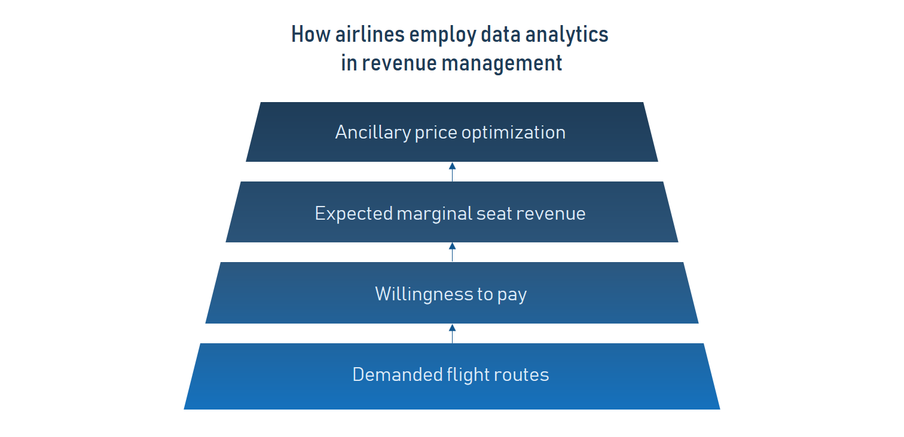
Regarding Data Ingested
Da

Slide 4
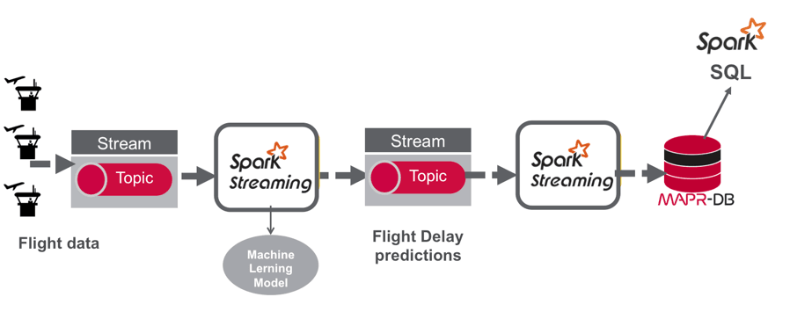
Usecases of API data

Slide 5
Usecases of API data cont.
In this usecase Airport information system gives information regarding flight delays, reason flight get delayed, time in different formats, souce and destination details including diverted routes to predict delays in flights
Modify airport operations according to recent data following Covid 19 pandemic.

Slide 6
Demonstration of Kafka Producer Consumer program
I tried to create topic to get data from kafka producer to consumer
Store the data from API into the hadoop file system

Slide 7

Questions

