Slide 1
EduPredict
Big Data + Predictive Analytics for Education
A complete data pipeline with ML predictions, R analytics, and interactive dashboard — all in Docker
eProject | Semester 6 | May 2026
Team: Nusrah Naeem · Bilal Farooqui · Kashif · Bilal A. · Shah Azzam · Ismail

Slide 2
The Problem
▸ 10-20% student dropout rates with NO early warning system
▸ Overcrowded or empty courses — no demand forecasting
▸ Massive data collected (grades, attendance, LMS) but never analyzed
▸ Reactive approach: problems found AFTER students fail
▸ No personalized insights for individual students
Goal: Transform raw educational data into actionable predictions

Slide 3
Our Solution — EduPredict
▸ Collect & generate educational data (500 students, 5 datasets)
▸ Process with Big Data tools (Hadoop, Spark, Kafka, MongoDB)
▸ Predict using 4 Machine Learning models (scikit-learn)
▸ Analyze with R statistical computing (Plumber API + visualizations)
▸ Display on interactive web dashboard (Tailwind + Chart.js)
▸ Deploy with ONE command: docker compose up (10 services)

Slide 4
Technology Stack
Storage
Streaming
Processing
ML
MongoDB 7 + Hadoop HDFS
Apache Kafka + Zookeeper
Apache Spark 3.5.3
scikit-learn (Python)
Statistics
Backend
Frontend
Deploy
R 4.3 + Plumber API
FastAPI (Python)
HTML + Tailwind + Chart.js
Docker Compose (10 containers)

Slide 5
System Architecture
Web Dashboard (Nginx:3001) → FastAPI Backend (:8000) → ML Models (Python) ↕ ↕ R Analytics (:8787) Spark Processing (:8080) ↕ ↕ MongoDB (:27017) Kafka (:9092) + HDFS (:9870)
10 Docker Containers — All orchestrated with docker compose up
MongoDB • Zookeeper • Kafka • HDFS NameNode • HDFS DataNode • Spark Master • Spark Worker • FastAPI • R Service • Nginx Web

Slide 6
Data Pipeline
1
2
3
4
5
6
Generate Data
Ingest to MongoDB
Kafka Streaming
Spark Processing
ML Model Training
API + Dashboard
→
→
→
→
→
500 students 5 CSV files
5 collections batch load
Real-time events
Feature engineering
4 models trained
16 endpoints 9 sections

Slide 7
ML Model Results
R² = 0.965
88.0%
R² = 0.647
40 (8%)
Student Performance Random Forest Regressor
Dropout Risk Accuracy Gradient Boosting
Course Demand Random Forest Regressor
Anomalies Detected Isolation Forest
▸ Performance model predicts GPA with 96.5% accuracy (MAE = 0.11 GPA points)
▸ 54 students (10.8%) flagged as dropout risk — avg GPA 1.75 vs 2.87 for active
▸ Course demand growing across all departments — CS has highest enrollment
▸ Anomalous students show significantly different behavioral patterns

Slide 8
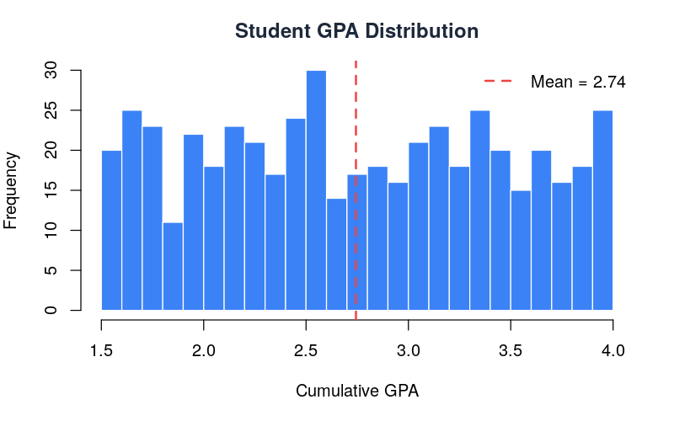
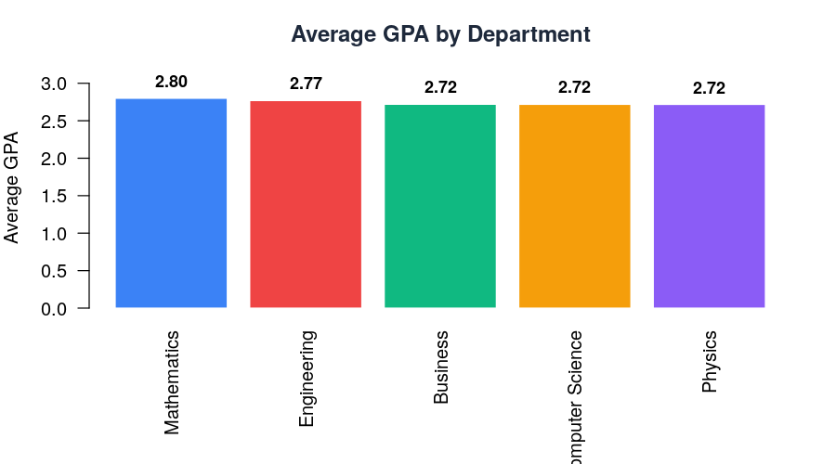
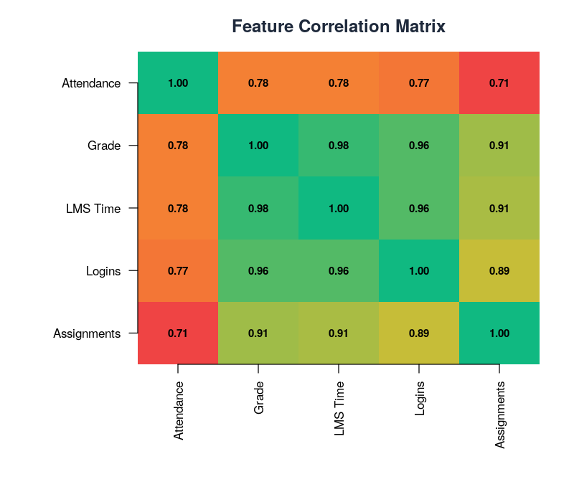
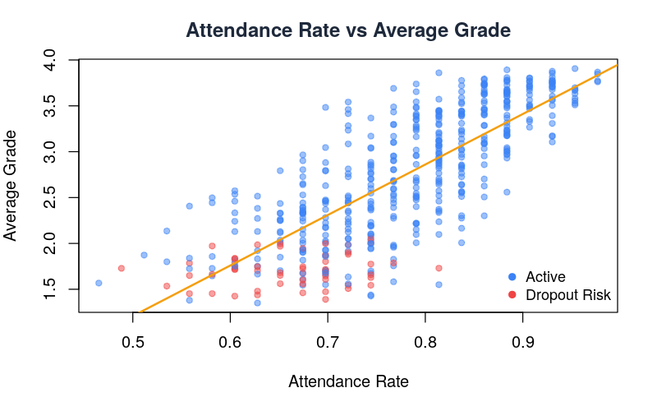
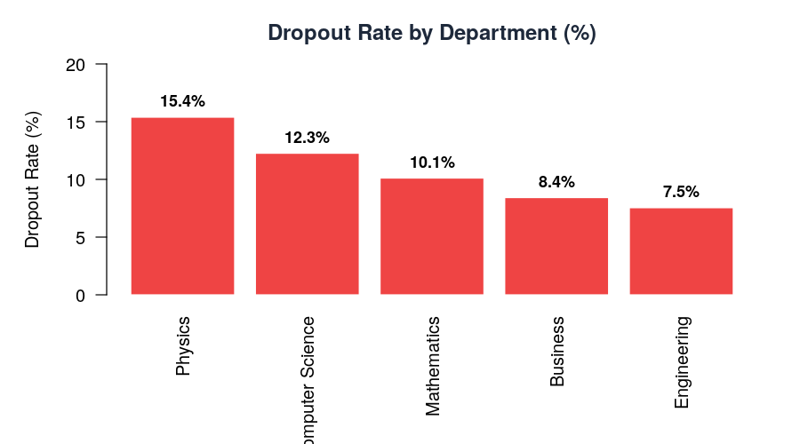
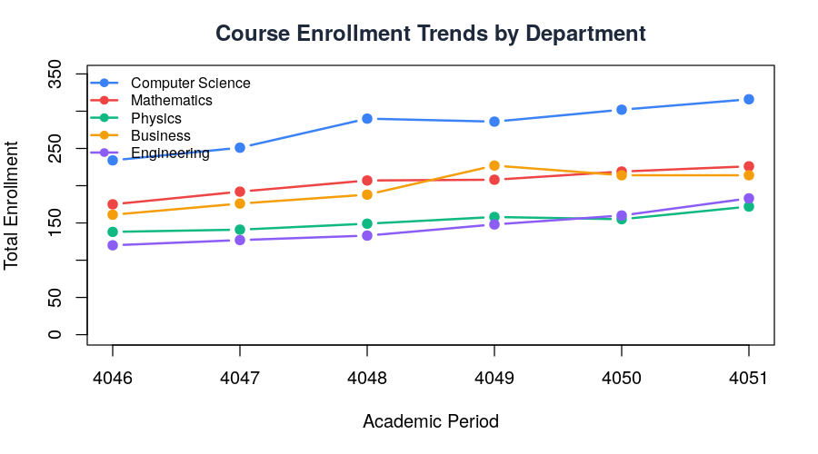
R Analytics — Visualizations

Slide 9
R Statistical Analysis Results
▸ Descriptive Statistics: 500 students, mean GPA = 2.74, mean attendance = 77.3%
▸ ANOVA (GPA ~ Department): F=0.254, p=0.907 — No significant difference across depts
▸ T-test (Dropout vs Active GPA): t=-29.8, p<0.001 — HIGHLY SIGNIFICANT
▸ Correlation: Attendance ↔ Grade r=0.782, LMS Time ↔ Grade r=0.977
▸ Shapiro-Wilk: GPA distribution is non-normal (p<0.001)
▸ Dropout students: GPA 1.75, Attendance 66% vs Active: GPA 2.87, Attendance 79%
Key Insight: LMS engagement time is the strongest predictor of academic success (r=0.977)

Slide 10
Docker Infrastructure
MongoDB
Kafka
Zookeeper
HDFS NameNode
HDFS DataNode
:27017
:9092
:2181
:9870
—
NoSQL Database
Event Streaming
Coordination
File Storage
Data Blocks
Spark Master
Spark Worker
FastAPI
R Service
Nginx Web
:8080
—
:8000
:8787
:3001
Processing
Compute Node
Backend API
R Analytics
Dashboard

Slide 11
Team Contribution
Nusrah Naeem
Bilal Farooqui
Kashif Akhtar
30% • Lead
30% • Lead
10% • Member
Data Pipeline + ML Models
API + Web + Docker
Database & Storage
Bilal Ahmed
Shah Azzam
Syed M. Ismail
10% • Member
10% • Member
10% • Buffer
Documentation
Testing & QA
Dashboards

Slide 12
Future Enhancements
▸ Real student data integration (replace synthetic with institutional data)
▸ JWT authentication with role-based access (admin, faculty, student)
▸ Cloud deployment on AWS/Azure with auto-scaling Spark clusters
▸ Deep Learning: LSTM models for time-series grade prediction
▸ Tableau dashboard integration for non-technical stakeholders
▸ Automated email alerts when dropout risk exceeds threshold

Slide 13
Live Demo
▸ 1. git clone <repository-url>
▸ 2. cd eProject---Big-Data---EduPredict
▸ 3. docker compose up -d
▸ 4. Open http://localhost:3001 (Web Dashboard)
▸ 5. Open http://localhost:8000/docs (API Swagger)
▸ 6. Open http://localhost:8080 (Spark UI)
That's it — everything runs with a single command!

Slide 14
Thank You!
Questions & Discussion
Dashboard: http://localhost:3001 API Docs: http://localhost:8000/docs R Service: http://localhost:8787

