Slide 1
Crop Recommendation Model
BY GROUP : DATA DRIVEN
ML Model Engineering (Jupyter)
[Mohammad Aayan Zafar]
2nd Year Electronics Engineering
Web Application (Streamlit)
[Syed Ahmad Ali]
2nd Year Electrical Engineering

Slide 2
Problem Statement & Objectives
⚠ Agricultural Challenges
• Unscientific Selection: Dependence on habit leads to poor yields and soil nutrient depletion.
• Multi-Factor Weather: Complex interplay between N, P, K, pH, temperature, humidity, and rainfall.
• Technical Gap: Advanced ML models remain locked in notebooks, inaccessible to real farmers.
✔ Our End-to-End Solution
• Scientific Matching: Recommends optimal crops tailored to exact soil and climate conditions.
• 51-Crop Precision: Trained across Random Forest, KNN, and Logistic Regression on 6,596 dataset records.
• Streamlit Web UI: Simple, 1-click web interface transforming raw inputs into live predictions.

Slide 3
System Architecture & Pipeline Flowchart
PHASE 1: RESEARCH & MODEL PIPELINE (Jupyter Notebook)
Raw Dataset
6,596 Records, 51 Crops
→
EDA & Preprocessing
Null Checks & Cleaning
→
StandardScaler & OneHotEncoder
Scikit-Learn Pipeline
→
Model Training & Benchmark
RF vs. KNN vs. LogReg
↓
PHASE 2: WEB APPLICATION & DEPLOYMENT (Streamlit)
Streamlit Code Transfer
Load Dataset & Pipeline
→
Interactive User Interface
N,P,K, Climate Form
→
Automated Preprocessing
Scaled & Transformed Input
→
Real-Time Crop Recommendation
99.55% Accuracy Output

Slide 4
Dataset Profile & Preprocessing
🛢 Dataset Summary
• Total Volume: 6,596 agricultural instances.
• Target Classes: 51 distinct crops (Wheat, Rice, Potato, Onion, Spices, Fruits, etc.).
• Data Integrity: 100% complete dataset (0 missing/null values).
• Nutrients: Nitrogen (0–180), Phosphorus (5–145), Potassium (5–205).
• Climate & Soil: Temp (1.2–43.7°C), Humidity (14–100%), Rainfall (3.3–3,322 mm), pH (3.5–9.9).
⚙⚙ Scikit-Learn Preprocessing
1. Data Cleaning & Inspection: Verified complete feature coverage across all 51 classes.
2. Feature Normalization (StandardScaler): Standardized numerical inputs to zero mean and unit variance.
3. Categorical Transformation (OneHotEncoder): Processed categorical variables without introducing artificial ordinal bias.

Slide 5
Machine Learning Benchmarks
⚙
Logistic Regression
Linear baseline model for multi- class classification utilizing multinomial loss. Evaluates linear boundary capability.
◈
KNN Pipeline
Distance-based classifier (K=5) heavily reliant on StandardScaler feature normalization across 7 dimensions.
▲
Random Forest
Ensemble decision tree classifier using bagging. Excels at capturing complex, non-linear multi-variable features.

Slide 6
Model Evaluation & Comparative Performance
Random Forest
99.55%
K-Nearest Neighbors
96.44%
Logistic Regression
92.73%
Model Pipeline | Training Accuracy | Testing Accuracy | Key Characteristic
Random Forest Pipeline | ~99.79% | 99.55% | Best handling of complex non-linear features
KNN Pipeline | ~97.74% | 96.44% | Highly effective following StandardScaler scaling
Logistic Regression | ~93.40% | 92.73% | Fast execution; limited by non-linear decision spaces

Slide 7
Conclusion & Impact
Key Outcomes
• Data-Driven Precision: Our model effectively classifies 51 distinct crop varieties based on 7 critical soil and weather parameters.
• Bridge from Code to Practice: Deploying our pipeline in Streamlit turns complex Python machine learning into an accessible decision tool for modern agriculture.
99.55%
TESTING ACCURACY

Slide 8
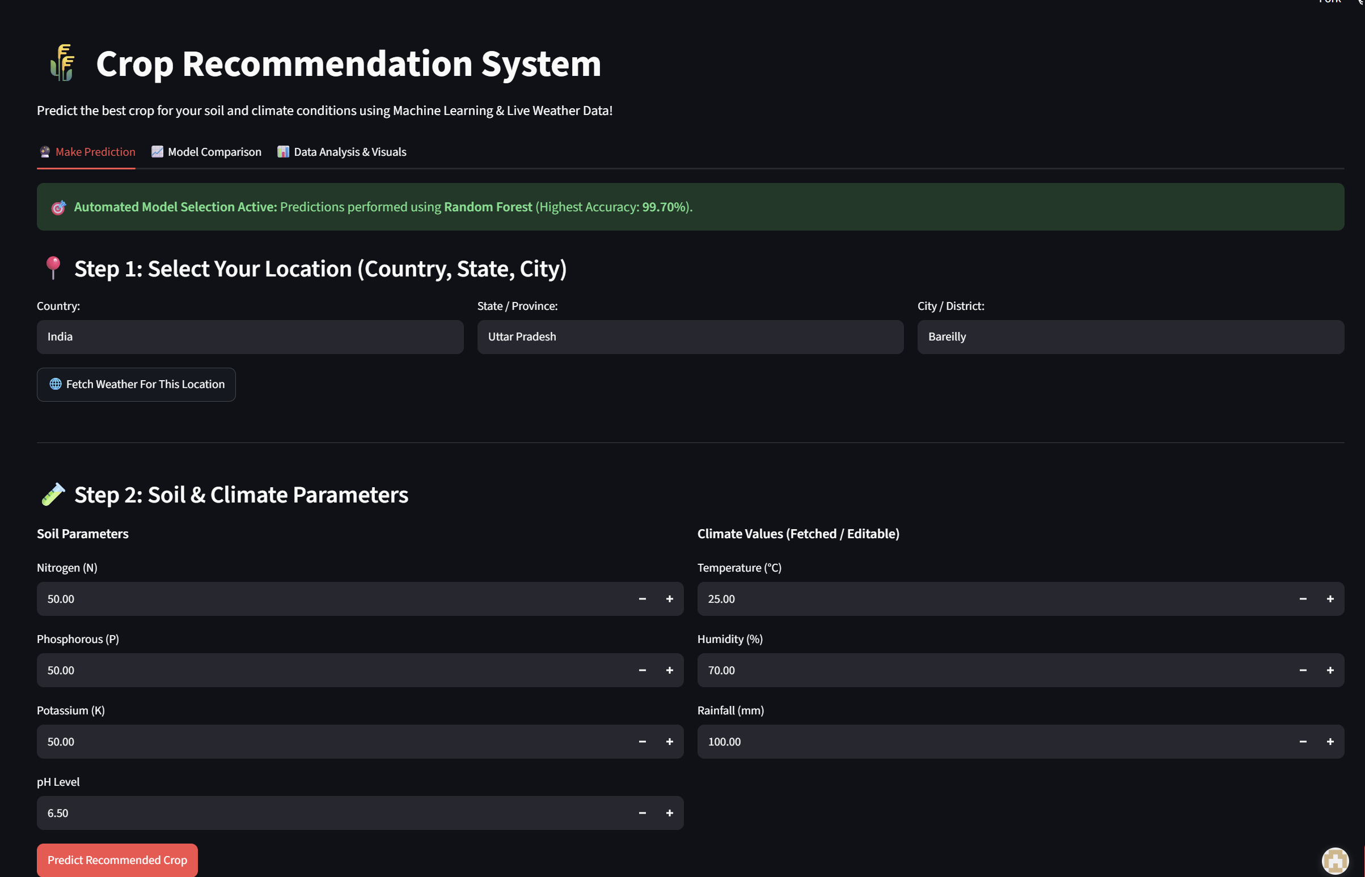
Streamlit Web Application
Interactive Deployment
Transferred dataset loading, scaling, and Random Forest pipeline code into Streamlit to create a seamless web tool.
• Input Form:
Sliders & numerical fields for N, P, K, Temp, Humidity, pH, Rainfall.
• Automated Scaling:
Raw inputs feed directly into the fitted StandardScaler pipeline.
• Real-Time Output:
Displays the predicted crop out of 51 categories instantly.
Web app link here : https://crop-recommendation-mrxficaj6jkwgd3bkimjdt.streamlit.app/

Slide 9
Future Enhancements
☁
Live Weather API Integration: Fetch regional rainfall, humidity, and temperature automatically using GPS location coordinates.
▣
IoT Soil Sensor Hardware: Connect live N–P–K and pH hardware sensor modules directly to the Streamlit app interface.
◉
Cloud Deployment: Host on Streamlit Community Cloud with multi-language UI support for rural farming communities.

Slide 10
Project Technical Summary
Dataset Used
merged_crop_dataset.csv — 6,596 agricultural samples covering
51 target crop classes with 7 features
(N, P, K, Temp, Humidity, pH, Rainfall).
Data Preprocessing
1. Data Cleaning & Null Inspection 2. StandardScaler normalization 3. OneHotEncoder transformation
Algorithms / Models
1. Random Forest (99.55%) 2. KNN (96.44%) 3. Logistic Regression (92.73%)
Tech Stack Used
Python 3.14.6 Scikit-Learn, Pandas, NumPy, Matplotlib, Seaborn Jupyter Notebook, Streamlit
Team Member Contributions
• Mohammad Aayan Zafar : ML engineering, preprocessing, benchmarking. • Syed Ahmad Ali : Streamlit UI and deployment.

Slide 11
THANK YOU

