Slide 1
Building Energy
Project
Syed Ali Raza (10758930)
Laith Omaran Hisham Al Gazali (10780691)

Slide 2
TABLE OF CONTENTS
01
03
02
04
Data Explanation
Data Analysation
Feature Engineering
Machine Learning Model

Slide 3

INTRODUCTION
In this project, we are asked to develop accurate models of metered building energy usage in the following areas: chilled water, electric, hot water, and steam meters. The data comes from over 1,000 buildings over a three-year timeframe. For our analysis we choose only the chilled water. In this project we need to build model based on historic usage rates and observed weather.

Slide 4
01
Data Explanation

Slide 5
ABOUT THE DATA
The data consits of 3 data files which represents the Weather data, Building data and the meter data. This data is for the year of 2016. Meter data has 4 columns and more than 20 million rows. Weather data has 9 columns and 139773 rows. Building data has 1449 rows and 6 columns.

Slide 6
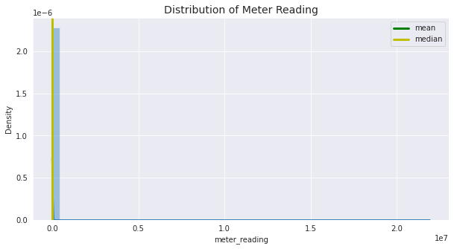
Data Explanation
As it can be seen from the graph that the distribution of meter reading is highly skewed. Moreover, the values are highly concentrated to 0. To avoid this skewness of data we have applied natural log (1 + meter_reading) using np.log1p, this will allow us to get better visualization of the data as it will change 0 to 1.
As the natural logarithm of zero is minus infinity (a real number to the power of some real number is never 0)

Slide 7
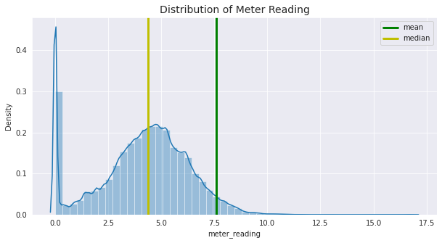
Data Explanation
from the graph above we can see that mean > median that means the distribution is right skewed. This skewness is caused by the significantly high number of 0 and 1 measurements in the meter reading. This high number of 0 meter reading values shows not only zero consumption but may indicate some missing data in the meter reading. If we visulaize it is impossible for any building to consume 0 at a given time because there will be atleast some appliances connected.

Slide 8
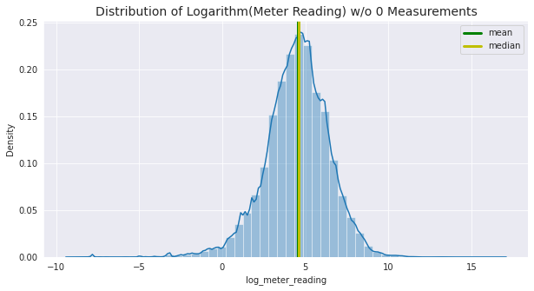
Data Explanation
Now, it is more evident that 0 observations represents missing values.
After dropping the zero values and taking the logarithm of the meter reading values, distribution shows a perfect normal distribution.
Data is centered around the mean. Mean and median values are equal to each other. Taking the logarithm helped to lower the variance.

Slide 9
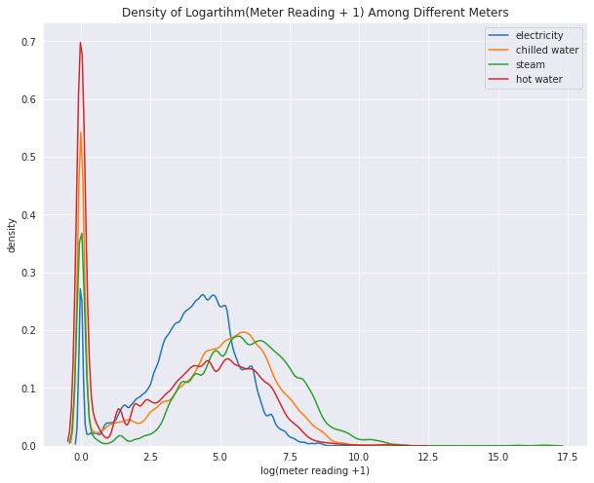
Data Explanation
For the better visualization we took log(x+1) of the meter reading. The readings of chilled water, steam and electricity are less skewed towards zero, meaning we have less missing values in the electricity usage. This picture shows that meter reading values shows different distribution in each meter category, especially electricity consumption is different than others. Thus, meter is a significant variable to determine the meter reading values. It is already included in the train and test dataset as a determinant factor.

Slide 10
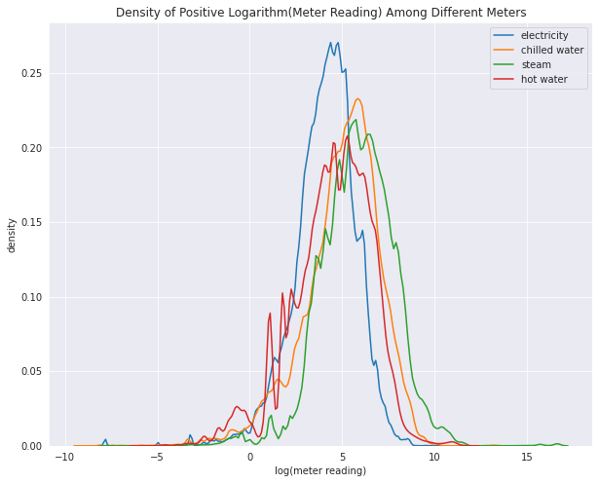
Data Explanation
Electricity shows a slightly different distribution than other categories.
Chilled water and steam meter reading shows similar distributions with close mean values.
Hot water has the least number of datapoints and has more spikes than the other categories.

Slide 11
02
Feature Engineering

Slide 12
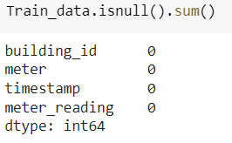
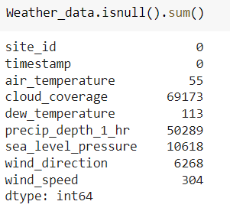
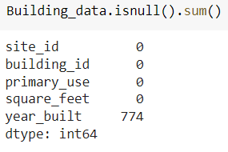
Null Values in the data set

Slide 13
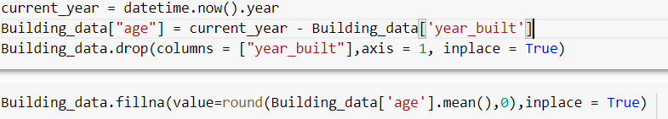
Taking Care of the null values
In the building data we take care of the null value by changing year built into the age. This is done by subtracting the year built with the current year. There were also so many missing values in floor count so we had dropped the floor count column.
In the weather data we used the predefined method given by the organizers to guess the missing values and it can be found on the following link, https://www.kaggle.com/aitude/ashrae-missing-weather-data-handling
The method use for this purpose is to group the data by the site id, month and day of the month and then taking the mean and replacing Nan value with the mean.

Slide 14
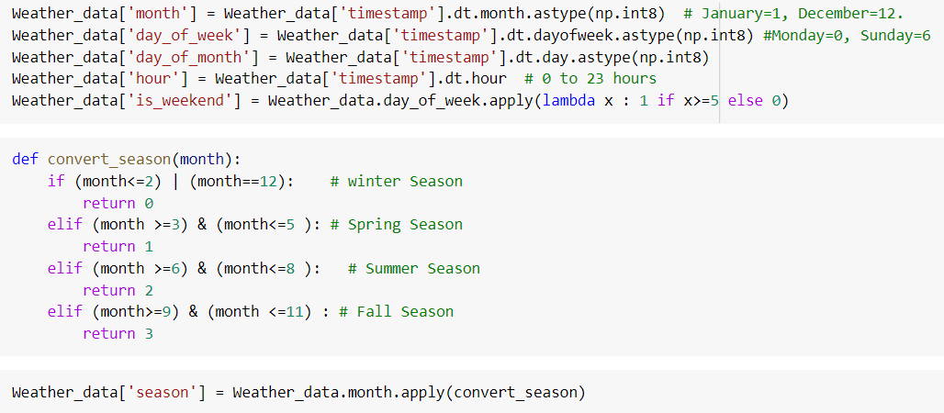

Feature Addition
In the weather data we have added the month, season, and day of the week to check the seasonality of our data.
After that I removed the other 3 meters and keep the meter of chilled water.

Slide 15
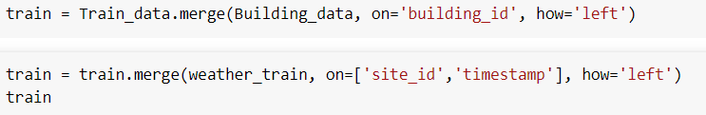
Merged Data
After that I merged my 3 data sets to make one data set with 20 columns and 4182440 rows.
After merging I got NaN values because number of rows of all the data sets were different.
Later I will explain what approach I used to mitigate them because no model can work properly with these type of data.

Slide 16
03
Data Analysis

Slide 17
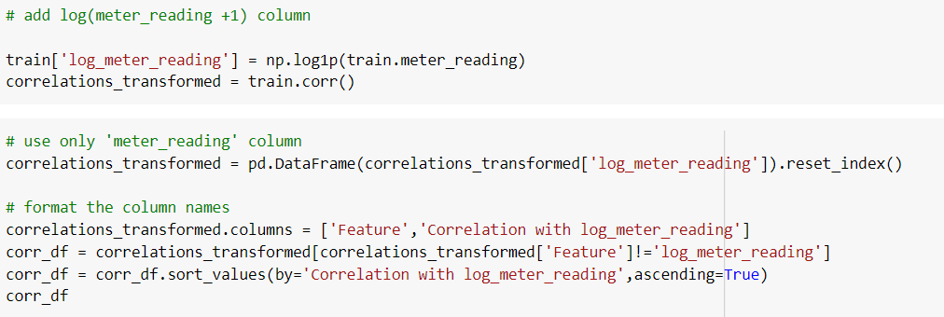
Corelation
We find the correlation among our dataset to the attended target which is meter reading using Pearson correlation.
First, we find the correlation with the meter reading but we didn’t get strong correlation, the maximum we got were -0.028 for the age of the building and 0.049 for dew temperature.
So, we improved the correlation of our dataset by taking correlation with the log of the meter reading, by doing this we improved the correlation by the factor of 10 (almost).

Slide 18
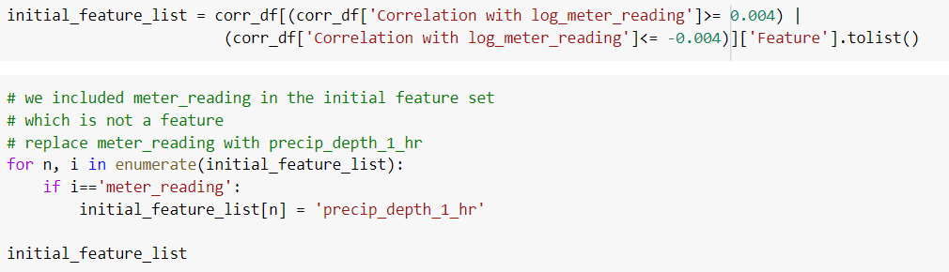
Feature List
We define the feature list based on the result we obtained from correlation, such as we keep the features which have a correlation of >=0.004 or <=-0.004 with the log of meter reading.

Slide 19

Train and Validation Sets
We divide the features and targets into 2 sets say X and Y, where X contains a set of 18 features and Y contains log meter reading which is our target.
As I said earlier that in the feature set we have a lot of missing values so we choose the method method='ffill': Ffill or forward-fill which propagates the last observed non-null value forward until another non-null value is encountered.

Slide 20
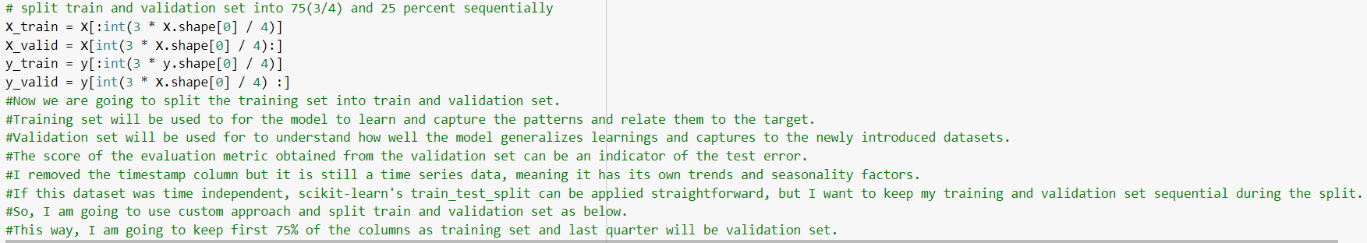
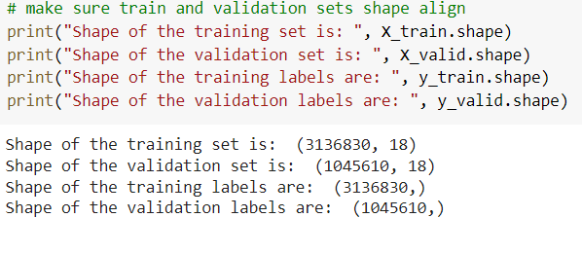
Train and Validation Sets
After that we split our data set into training and validation data sets in a ratio ¾.

Slide 21
04
Machine Learning Models

Slide 22

Baseline Model (1)
Before going into deep in the machine learning model we decided to first develop a commonsense baseline, which can be dummy or simple algorithm based on few lines.
Baseline metrics can be different in regression and classification problems. For a regression problem it can be a central tendency measure as the result for all predictions, such as the mean or the median.
Baseline metrics are important in a way that, if a ML model cannot beat the simple and intuitive prediction of a person's or an algorithm's guess, the original problem needs reconsideration or training data needs reframing.
I have already applied log1p transformation to the target so throughout the project I am going to use RMSE (root mean squared error) as the single evaluation metric, which is:

Slide 23
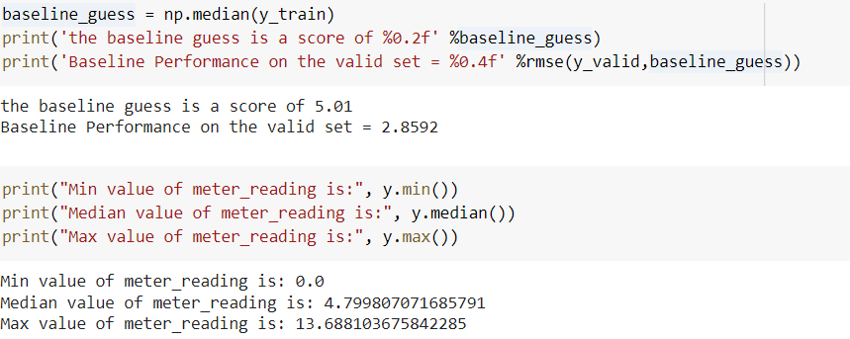
Baseline Model (2)
I already decreased the variance in the target by applying log1p, and I expect a machine learning model to generate predictions within the same ranges as log1p of target. By measuring it with RMSE and predicting log1p of the target, I can get closer results to measuring with RMSLE and target.
We get the RMSE of baseline model using the previous defined function such as,

Slide 24
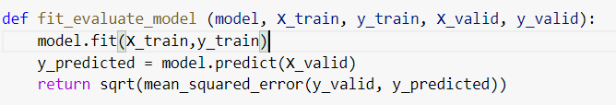
Function for Evaluation
For the evaluation we develop the following function,
This function is very straight forward we define the model, and train and validation set we develop above, then we let the model to learn from the train data, then it will predict using the feature of validation data, this will return us with square root of mean square error in which we put the prediction and validation set.

Slide 25
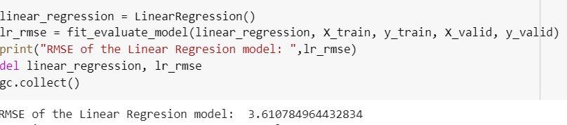
Linear Regression
We calculate the RMSE using the linear regression model,

Slide 26
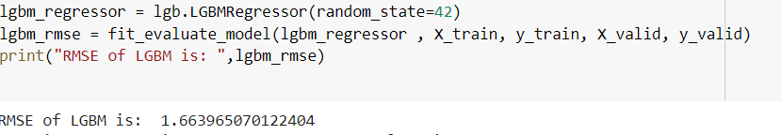
Light GBM (1)
We calculate the RMSE using the Light GBM model,
Light GBM outperformed linear regression, let's set some initial parameters for the algorithm.

Slide 27
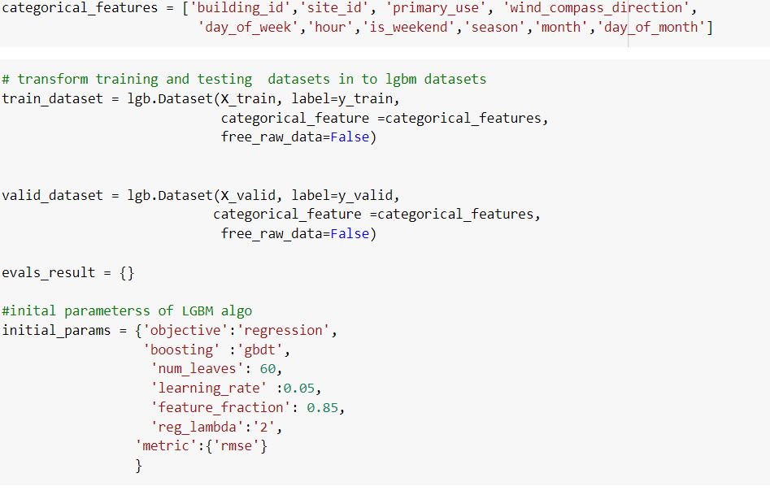
Light GBM (2)
As Light GBM outperformed the linear Regression Model, I will develop Light GBM dataset and perform the analysis,

Slide 28
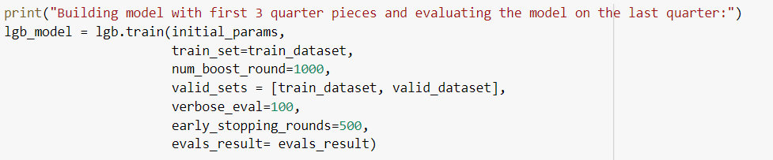
Light GBM (3)
Based on the previous function, we develop a Light GBM model as,

Slide 29
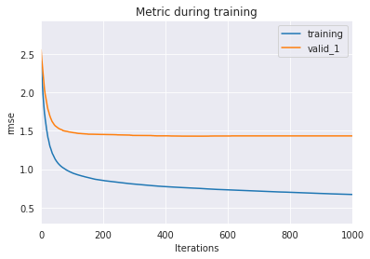
Light GBM - Results
Thanks to this model, we started with 0.95 RMSE for training set and 1.48 RMSE for validation set and improved it to 0.66 RMSE and 1.43 RMSE respectively.
Training error decreases more rapidly as compared
to validation error, which shows, model learns quickly
from the training set and this is the consequence of
model trained with the same set of training set in
iteration.
Both training and validation errors decreased, so if
I set the num_boost rounds to a higher number, I
would probably achieve less RMSE in the cost of higher runtimes.
Gap between training and validation error increased, so this is a sign of we are overfitting, to eliminate the possibility of overfitting I will introduce cross-validation into the model rather than hyperparameter tuning.

Slide 30
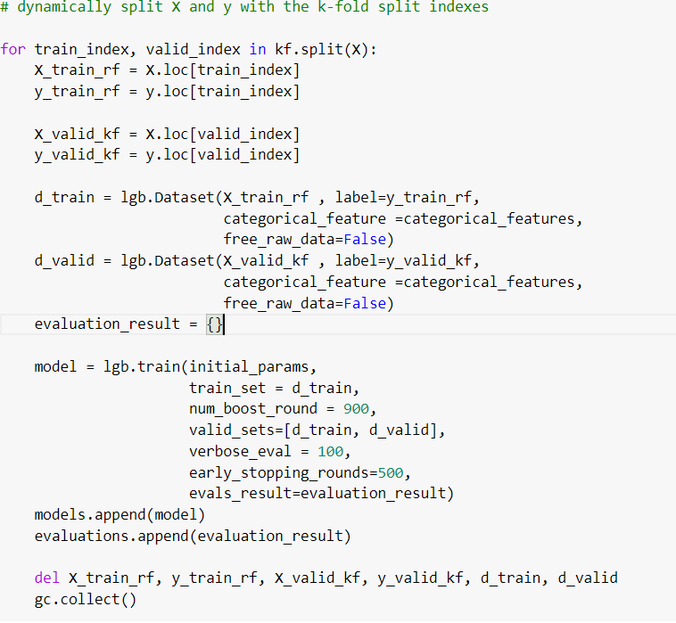
Cross Validation - Kfold
Now, I am going to iteratively run the model on the 75% of the training data and see if RMSE will improve.
I am going to use KFold, and split X to 4 pieces and run light GBM iteratively on each fold.

Slide 31
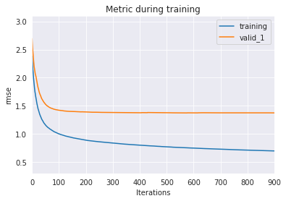
Kfold - Results
With Kfold the gap between the training and validation sets significantly decreases,

Slide 32
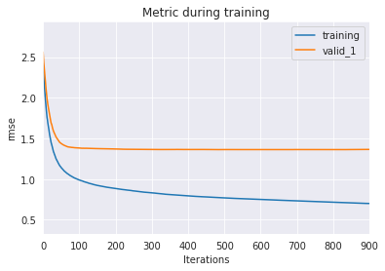
Cross Validation - TSCV
I used the same approach used by K-fold, and the gap between the training and validation set further reduced a bit,

Slide 33
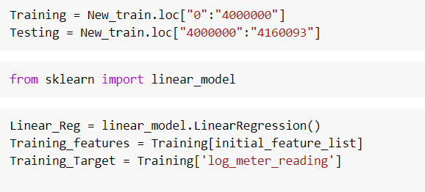
Prediction – LR
For making the prediction, I decided to drop the NaN values as they will not affect much our prediction because they are only 20 thousand out of 4.4 million.
For this I decided to make two sets, training and testing with 4 million and 0.16 million rows respectively.

Slide 34
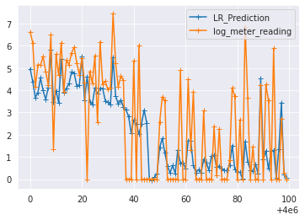
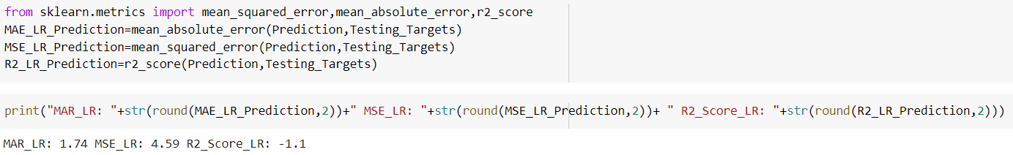
LR - Results
The results of this model was not so encouraging because they deviate much from the actual data,
We also find the mean_square_error, R2Score and
mean_absolute_error of this model. The results are shown
below,

Slide 35
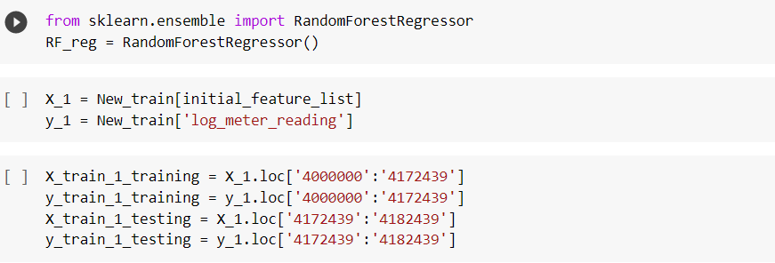
Prediction – RF
Same, what we do for the linear regression I decided to do with the random forest in a pursuit of better results,
For this model, I choose to train the model with 0.18 M rows of training data and predicted 10 K rows of testing data. (I tried to do with more data, but laptop didn’t keep up with me)

Slide 36
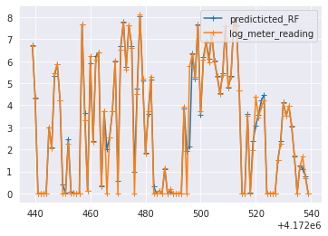
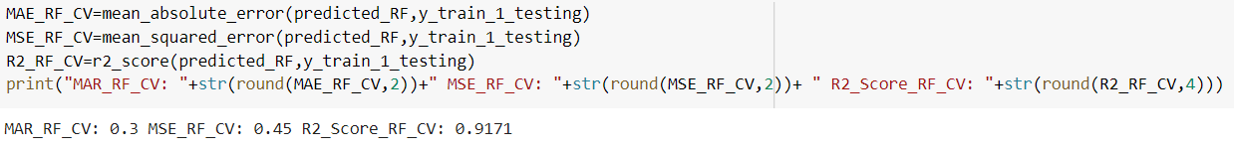
RF - Results
The Results obtained from this model were quite encouraging, I was able to precisely predict the testing targets.
We also find the mean_square_error, R2Score and
mean_absolute_error of this model. The results are shown
below,

Slide 37
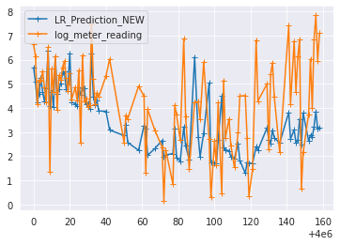
Prediction – LR (No 0)
As, I said earlier that 0 represents the missing value in the meter data, so I tried to do the same analysis but this time without O and for LR, the results didn’t change much.

Slide 38
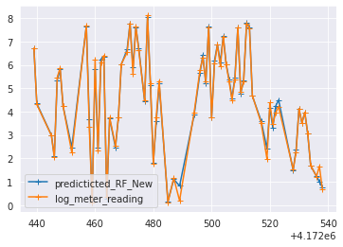
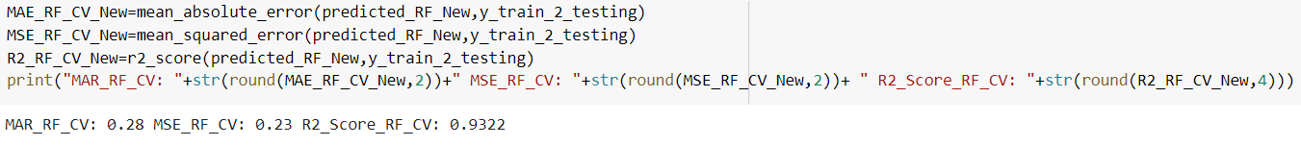
Prediction – RF (No 0)
As, I said earlier that 0 represents the missing value in the meter data, so I tried to do the same analysis but this time without O and for RF, the results improved,
We also find the mean_square_error, R2Score and
mean_absolute_error of this model. The results are shown
below,

