Slide 1

Sales Data Analysis Project
Advanced Techniques in Data Science

Slide 2
Presented by: Syed Ali Rehan 2024-MSDS-01 Presented to: Dr. Awais Hassan

Slide 3

OBJECTIVE
To analyze and derive actionable insights from sales data:
Evaluate branch, city, and product-level performance.
Identify trends and patterns influencing sales.
Support data-driven decision-making for business growth.

Slide 4

Dataset Overview(Kaggle)
Total Records: 1,000
Columns: 12
Key Features: Branch, City, Product, Total Price, Reward Points
Purpose: Analyze sales trends and customer behavior.

Slide 5

Exploratory Data Analysis (EDA)
Key focus on sales distribution across branches, cities, and products.
Visual exploration to highlight patterns and anomalies.
Metrics used: Total sales, tax, and reward points.

Slide 6
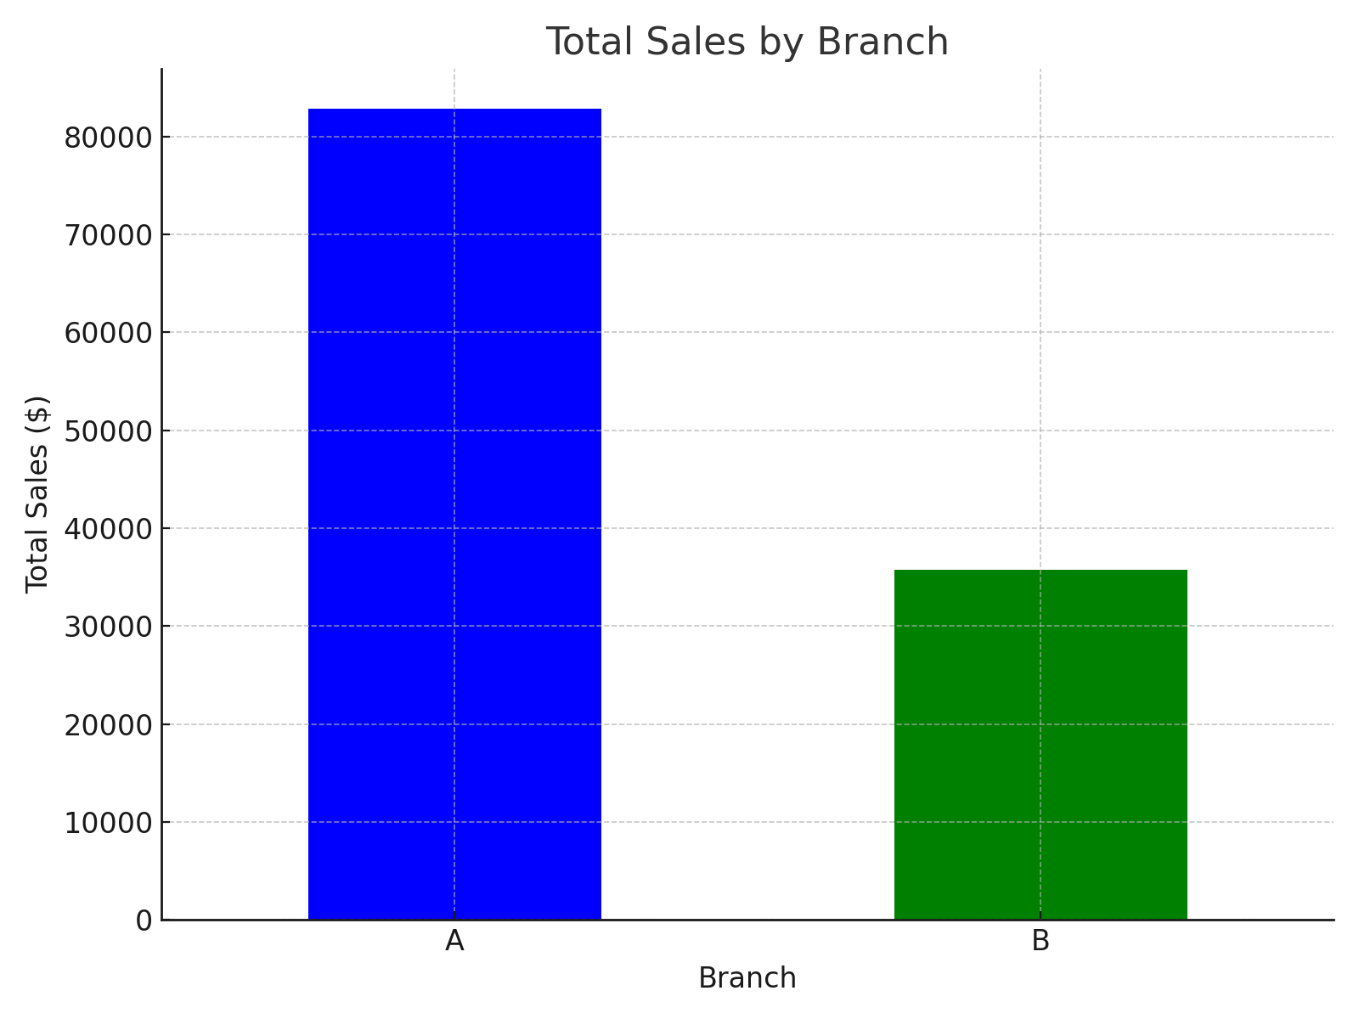
Total Sales by Branch

Slide 7
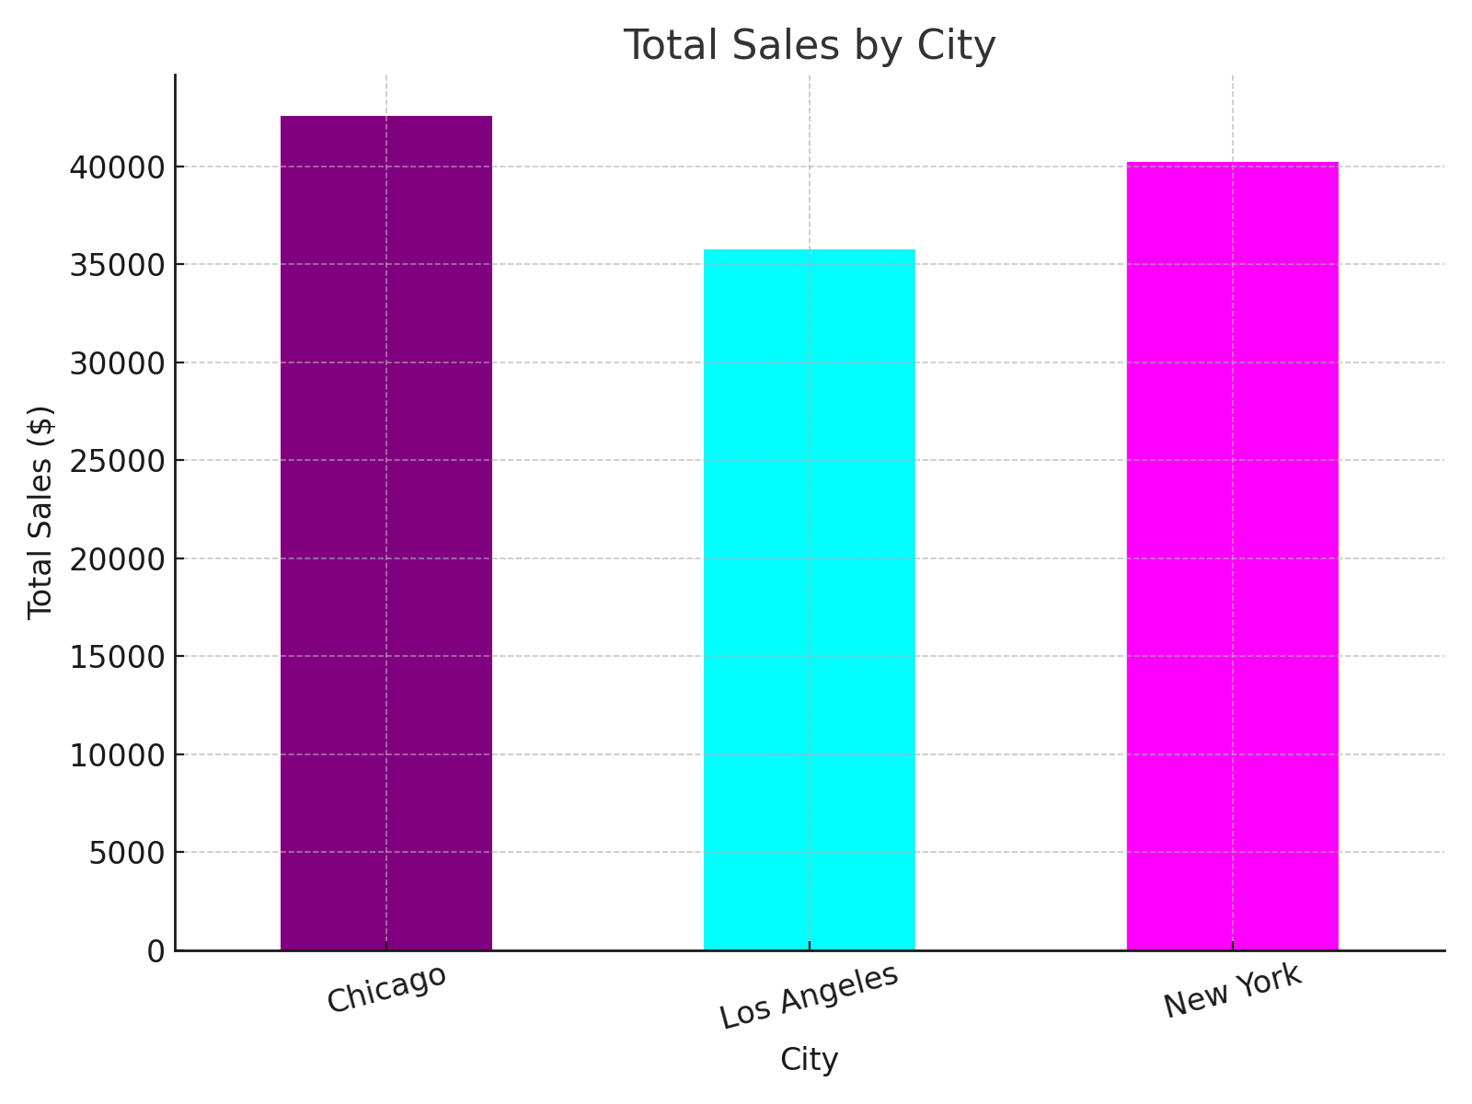
Total Sales by City

Slide 8
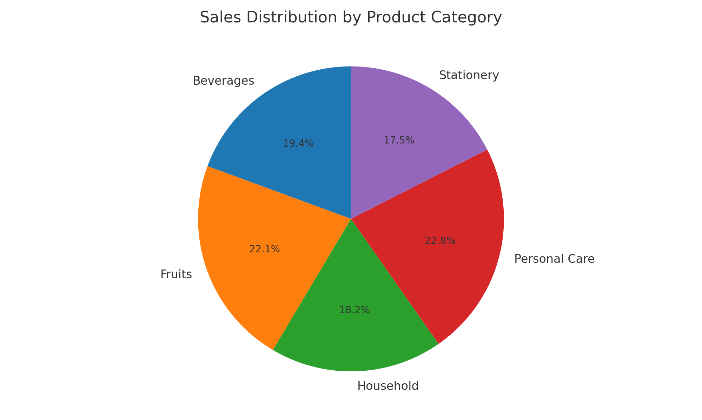
Sales Distribution by Product Category

Slide 9
Key Insights
Branch B achieved the highest total sales, indicating superior performance.
Chicago leads in city-level sales, showcasing strong demand.
Fruits and Personal Care categories contribute significantly to revenue.

Slide 10
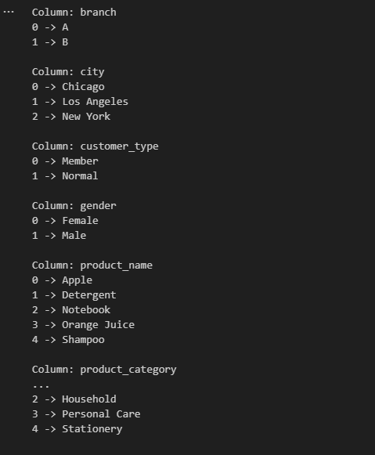
Data Wrangling (Encoding)

Slide 11
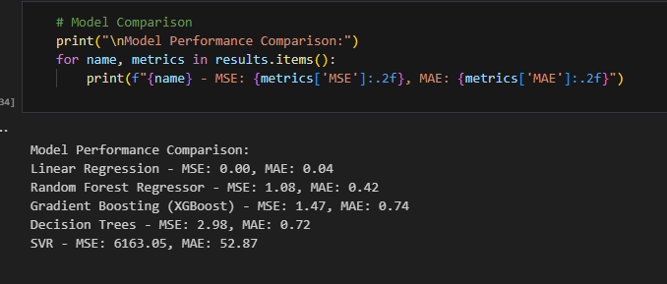
Models

Slide 12

Recommendations
Focus on expanding high-performing branches like Branch A.
1
Enhance inventory in New York to meet demand.
2
Promote popular categories like Beverages and Personal Care for growth.
3

Slide 13

Conclusion
The analysis provides actionable insights to optimize sales strategies.
Data-driven recommendations support better resource allocation.
Future scope: Deeper customer segmentation and predictive modeling.

