Slide 1
Hr Data Analytics
(using Best fit Model)
IMARTICUS PGDA BATCH_29
Capstone-ML-Project
Under Guidance of:
Dr. Vinod Steve
Presented by:
Syed Ammar Ahmed

Slide 2
Context
This dataset contains information about employees who worked in a company.
Content
This dataset contains columns: Satisfactory Level, Number of Project, Average Monthly Hours, Time Spend Company, Promotion Last 5 Years, Department, Salary ,Inspiration and Left(Target Variable)
Exploratory Data analysis to figure out which variables have a direct and clear impact on employee retention (i.e. whether they leave the company or continue to work)
Plot bar charts showing the impact of employee salaries on retention
Plot bar charts showing a correlation between department and employee retention
Now build a logistic regression model using variables that were narrowed down in step 1
Measure the accuracy of the models
Select the best model

Slide 3
Methodology
Cleaning Data by removing null values and replacing the null values with mode for categorical data and median/mean for continuous data
Reducing Continuous attribute by checking the correlation of each continuous variable with target variable and validating it with linear-regression plot
Analysing Categorical data with highest correlating continuous variable by grouping it with various levels of category
Cleaning Outliers by Plotting Box plot and replacing it with median
Randomly Selecting Attributes
Number of levels =2

Slide 4
Methodology
Number of levels =2
Yes
No
Independency Test
ANOVA
Test
Yes
P_Value> 0.05
No
Yes
P_Value> 0.05
No
Two levels are same, hence Drop the attribute
Two levels are different, hence we keep the attribute
Multi levels are same, hence we Drop the attribute
At Least one is different, hence we perform Tukey Test

Slide 5
Methodology
Reducing the Multi levels of each Category with the help of Tukey plot by seeing how close the mean values are with each other
At Least one is different, hence we perform Tukey Test
Multiple Models
Best Model to be selected

Slide 6
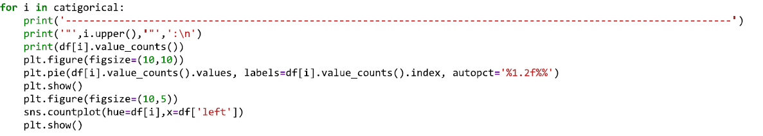
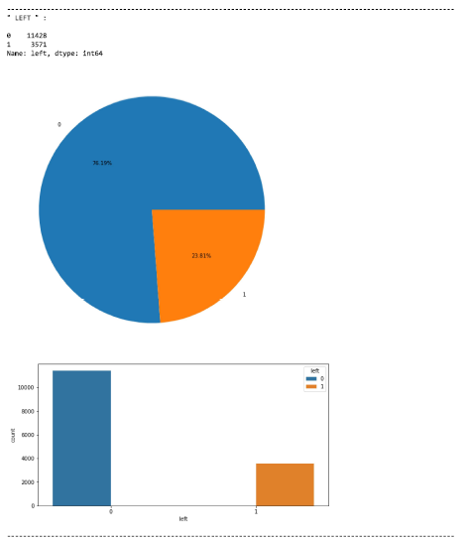

Slide 7

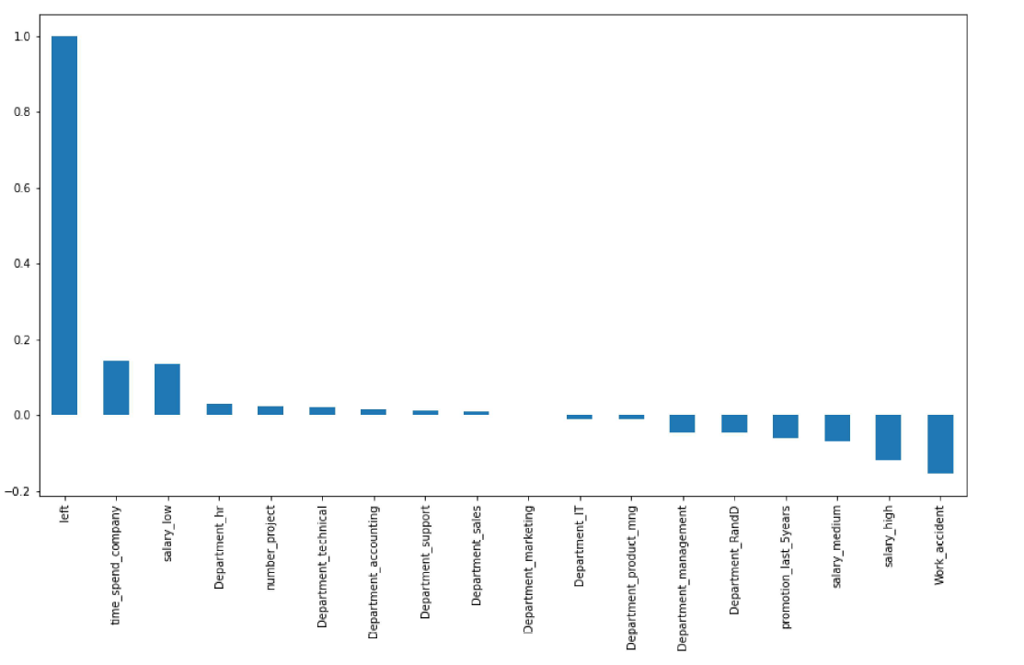

Slide 8
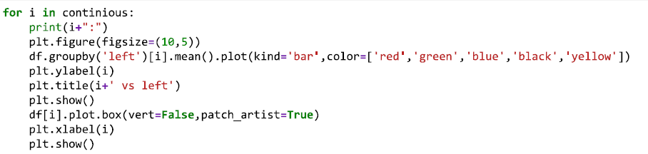
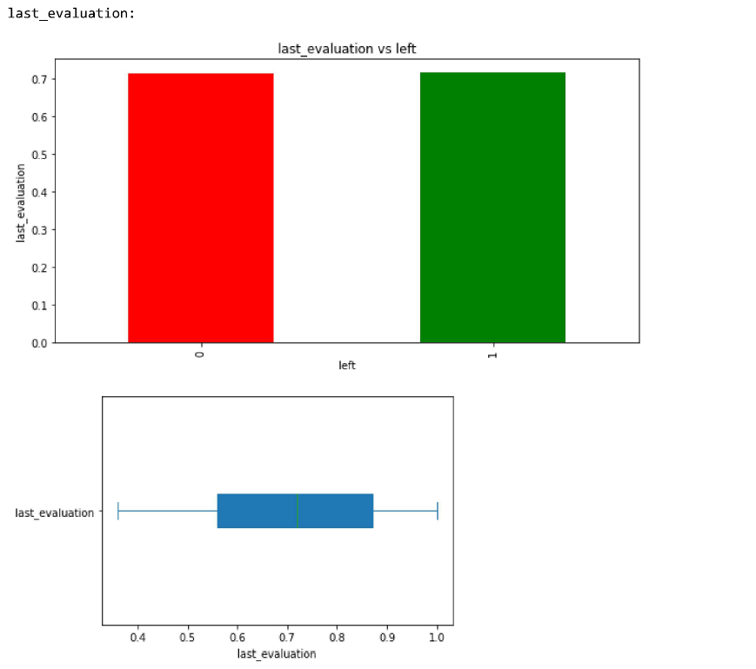

Slide 9
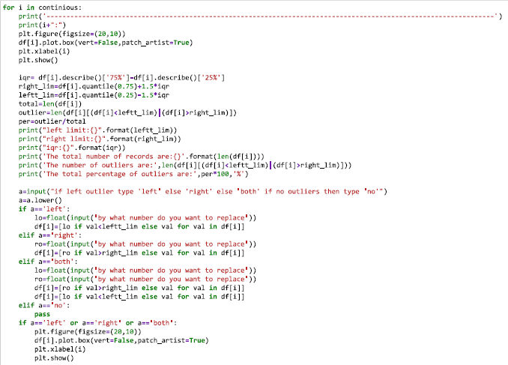
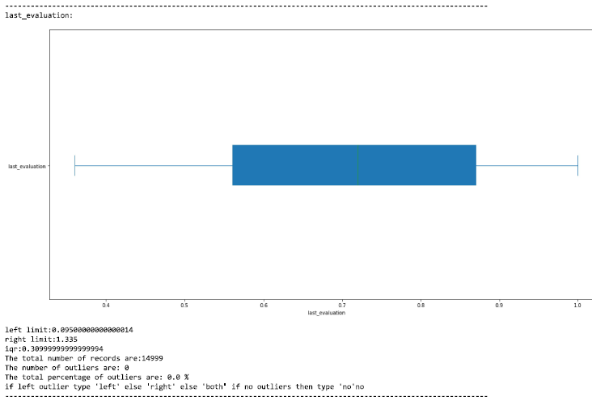

Slide 10
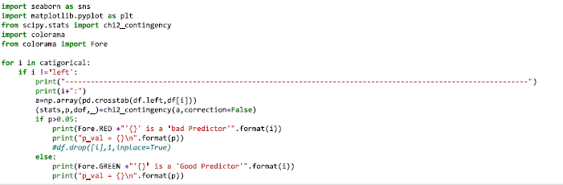
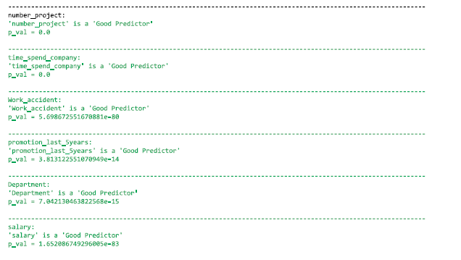

Slide 11
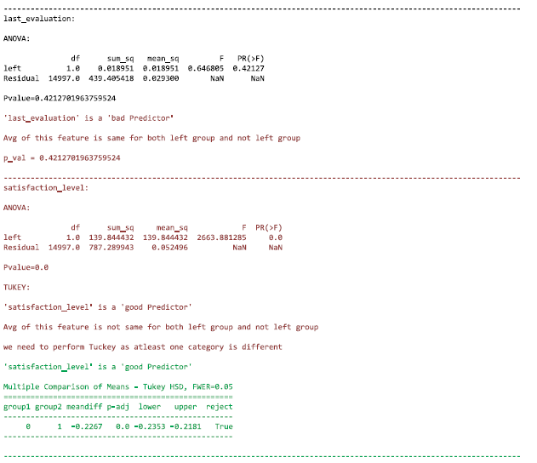
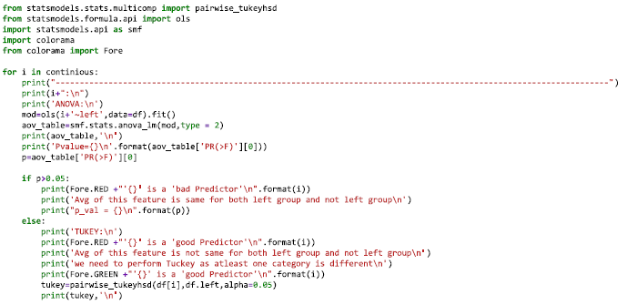

Slide 12
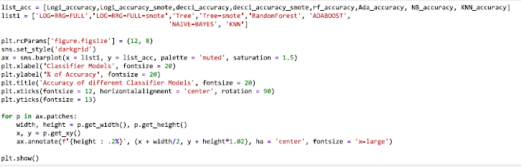
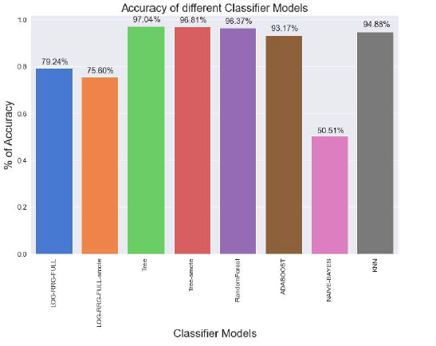

Slide 13
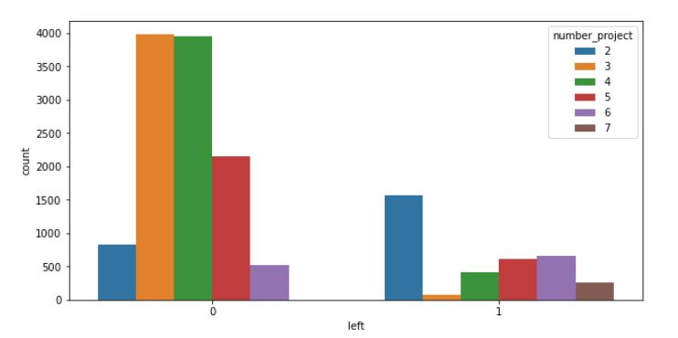
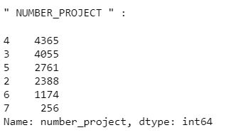
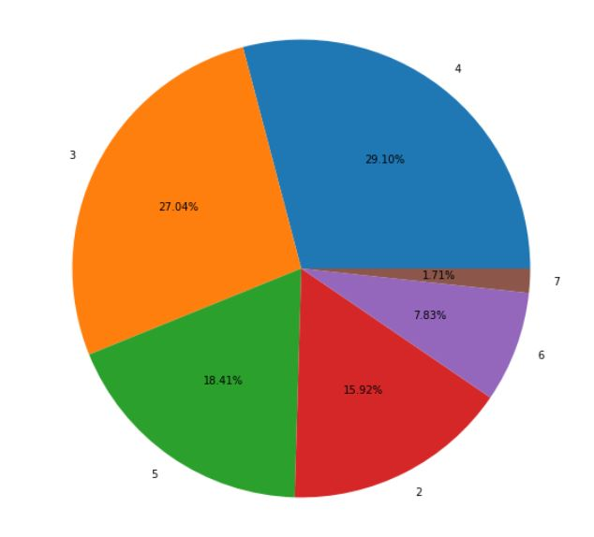
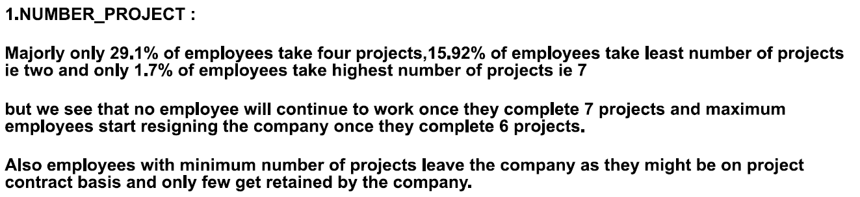


Slide 14
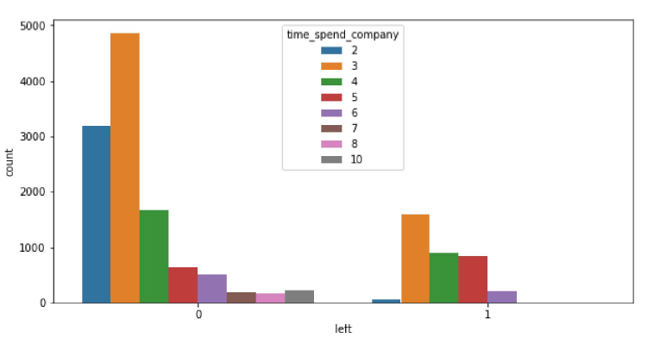
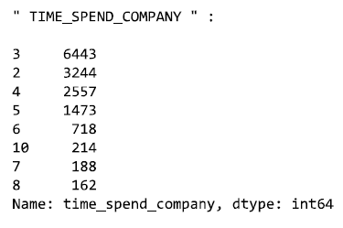
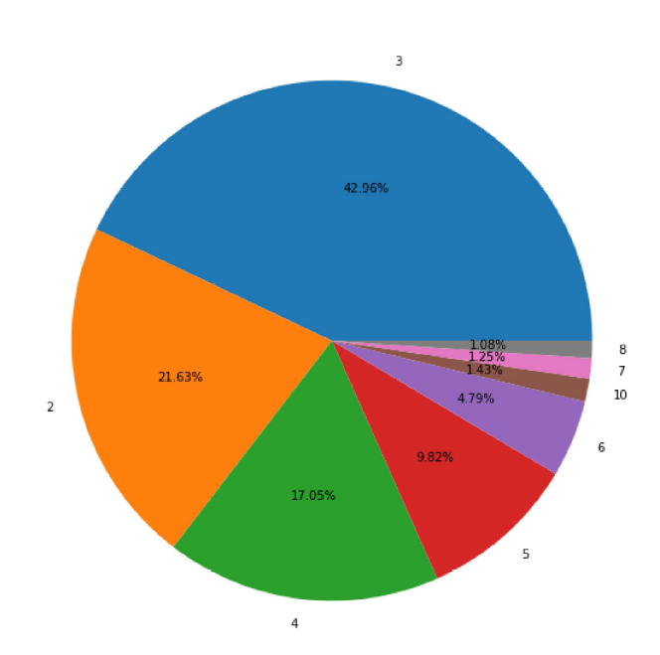
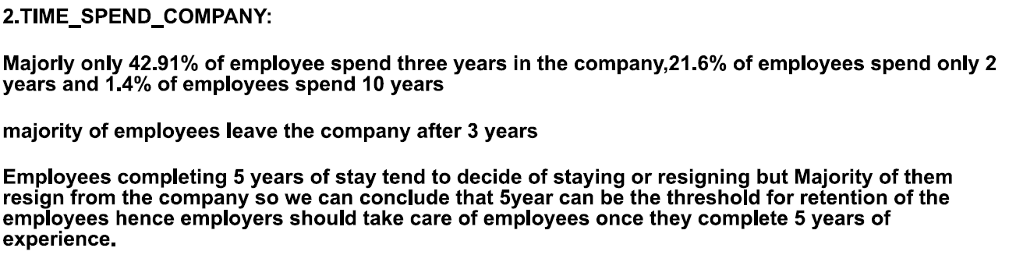


Slide 15
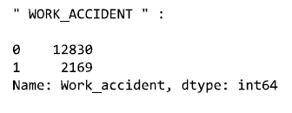
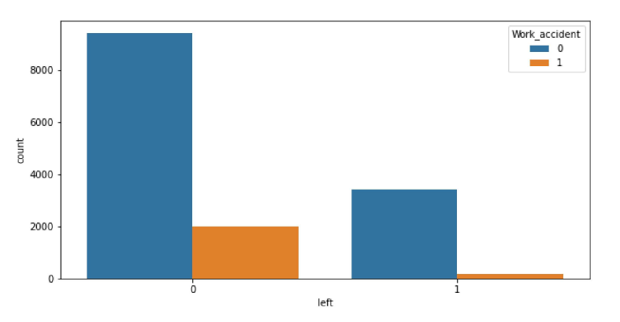
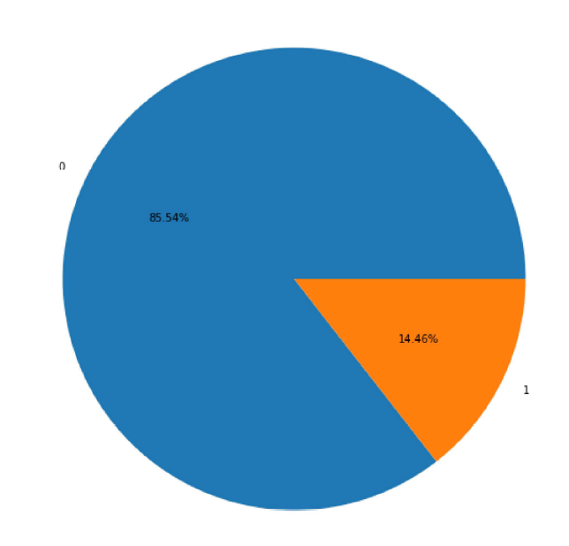
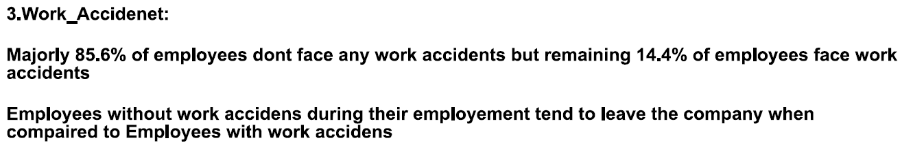


Slide 16
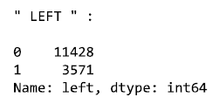
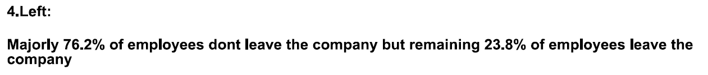

Slide 17
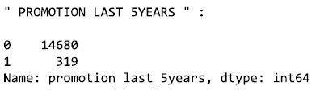
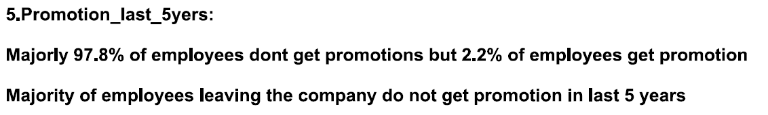


Slide 18
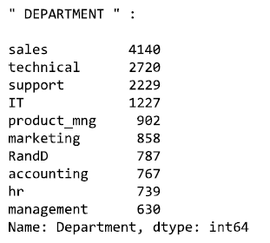
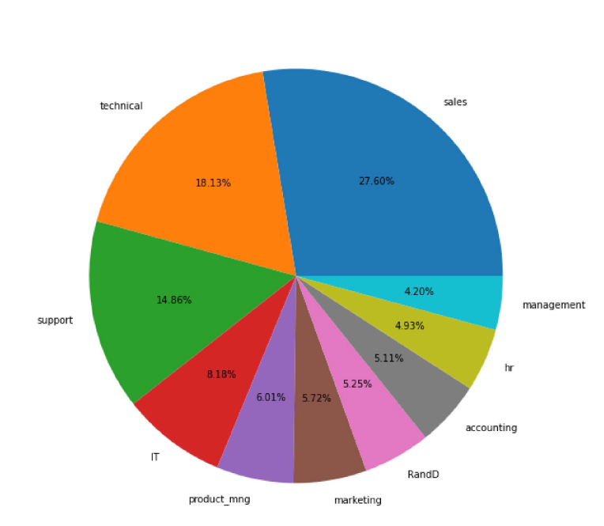
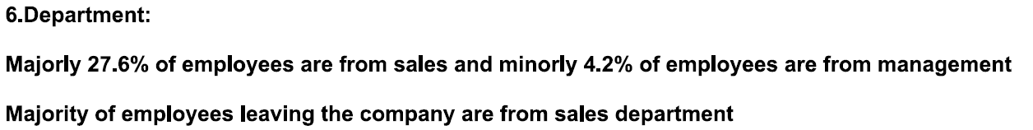


Slide 19
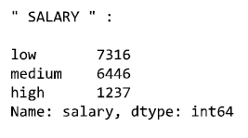
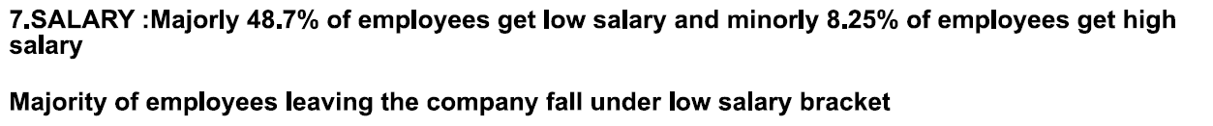


Slide 20
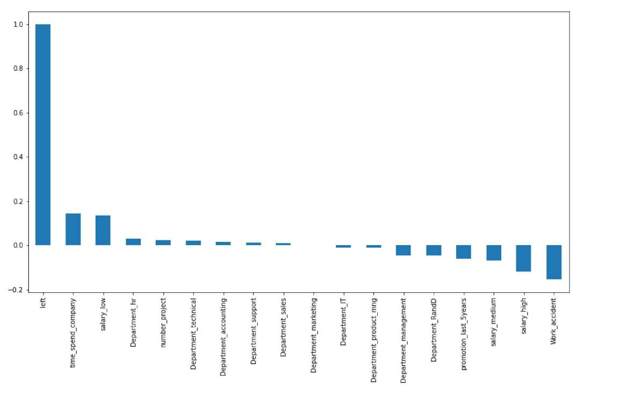
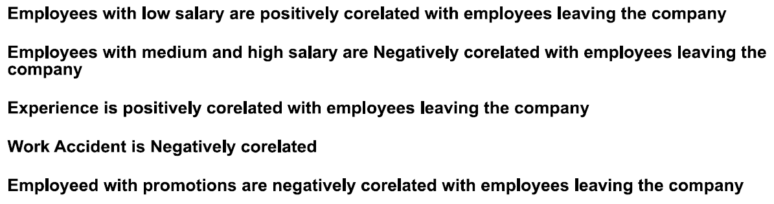

Slide 21
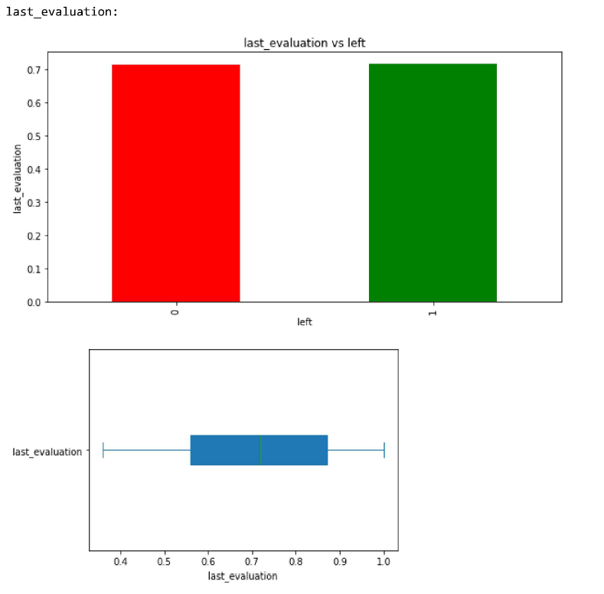
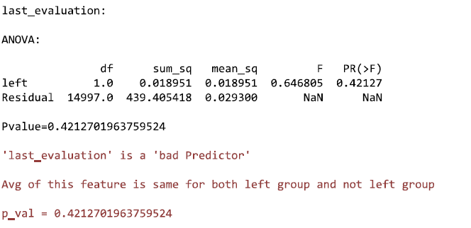


Slide 22
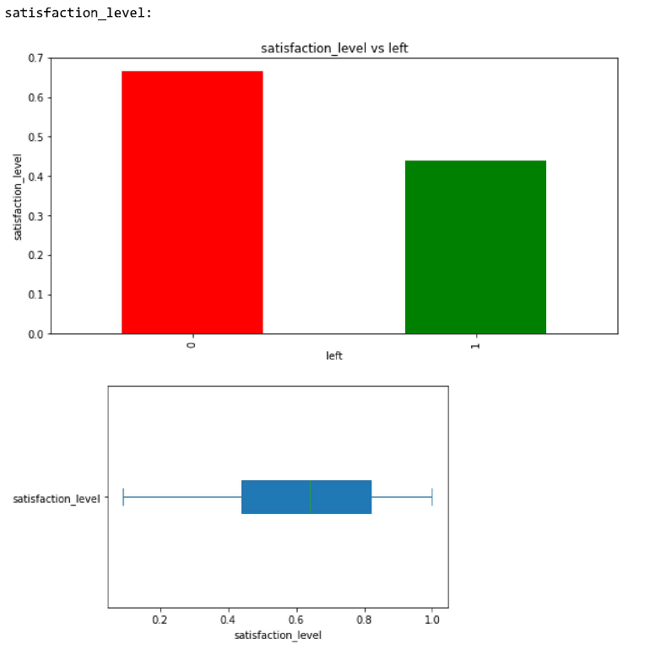
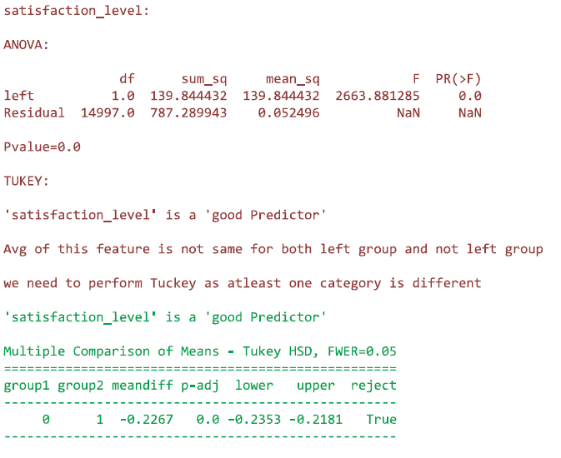

Slide 23

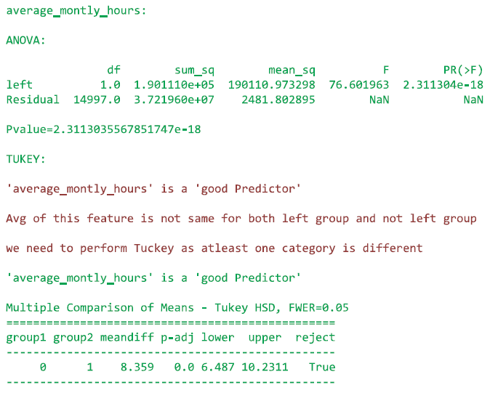
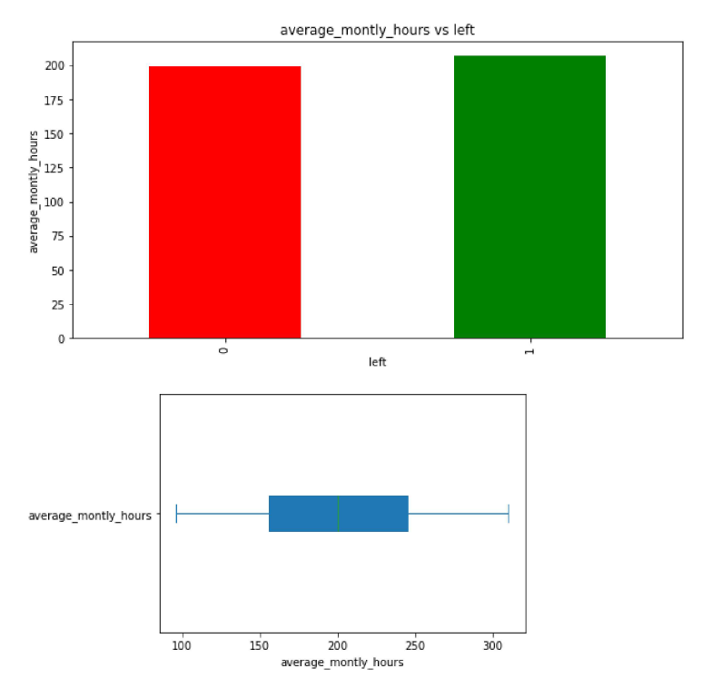

Slide 25
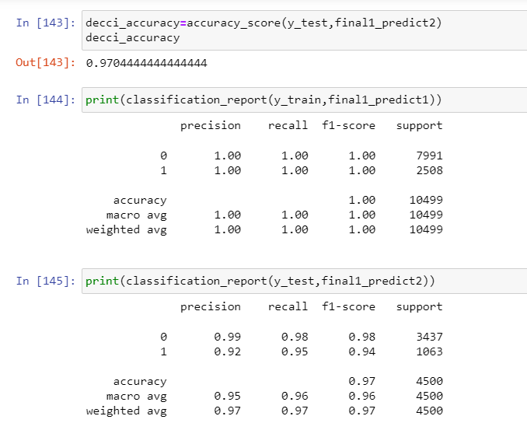
Conclusion:
We select Decision tree as our final Training model as the Accuracy is 97% for test data

Slide 26
Link:
https://www.kaggle.com/datasets/mfaisalqureshi/hr-analytics-and-job-prediction?select=HR_comma_sep.csv

Slide 27
THANK YOU

