Slide 1
Bottle Classifier APP
Using Artificial Intelligence

Slide 2
purpose
Artificial intelligence techniques are utilized in this bottle classifier app to identify flaws in the created bottles and classify them as either good or bad.
This Bottle Classifier application displays comprehensive analytics of bottle production quality
Images of the bottles are preserved and can be seen in the image gallery, with filter options available
The "Analytics" and "Image Gallery" Tabs are the primary ones.

Slide 3
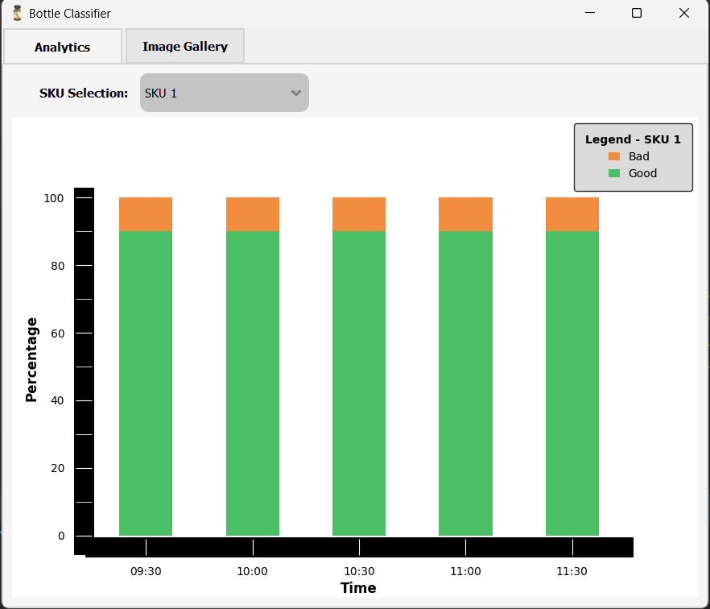
Analytics Tab
This page displays a bar chart with an analytics view of the Good and Bad
This Shows the percentage of Good Vs Bad for every 30 minutes
We can choose the appropriate SKU ID and look at its analytics
SKU ID is a special identifier for a specific type of unit

Slide 4
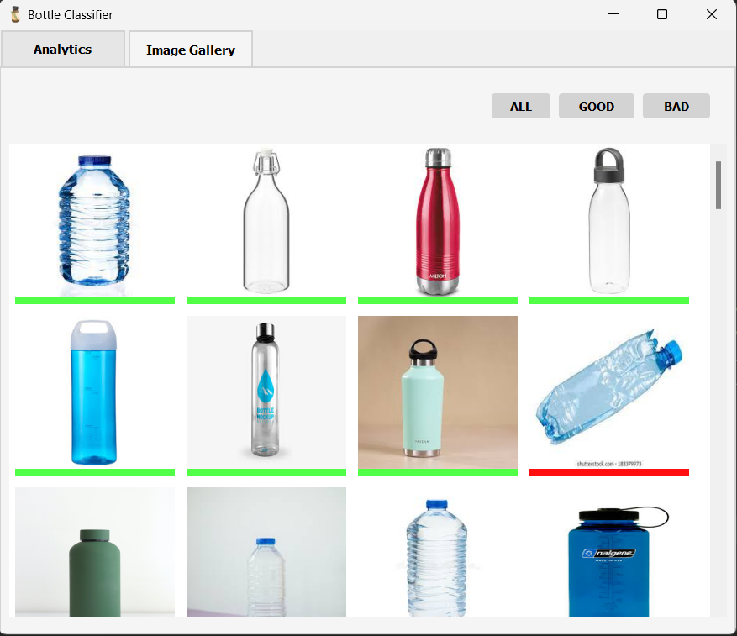
Image gallery tab
In Image Gallery tab we can view the Stored Images of the bottles which are processed in the assembly line
We can see the bottle images with a bottom line “Red” or “Green” which represents “Bad” or “Good”
There are three filters available to sort through the images in the list: "All," "Good," and "Bad."

Slide 5
Thank you

