Slide 1
AI-Powered PDF Assistant
Architecture, NLP Approach, Deployment & Usage

Slide 2
Introduction
An AI-powered chatbot that allows users to:
- Upload PDFs
- Ask context-based questions
- Get precise or creative answers
Built with FastAPI, Gradio, Hugging Face, FAISS, and GPU acceleration.

Slide 3
System Architecture
- PDF Loader: Extracts text from PDFs
- Text Splitter: Splits text into chunks
- Embeddings: SentenceTransformers
- Vector Store: FAISS for similarity search
- LLM: Hugging Face pipeline (Flan-T5)
- Interfaces: FastAPI + Gradio

Slide 4
Why This Approach?
- Combines classical NLP with modern LLMs
- Ensures accuracy with retrieval-augmented generation
- Lightweight models enable running on local machines
- Modular for deployment flexibility (Colab, Docker, Local)

Slide 5
Why GPU?
- NLP models are computationally heavy
- GPU accelerates embeddings & LLM inference
- 10x faster performance compared to CPU
- Enables near real-time Q&A responses

Slide 6
Why FAISS?
- FAISS = Facebook AI Similarity Search
- Efficient similarity search on embeddings
- Handles large text corpora
- Scales well for enterprise-level applications

Slide 7
NLP & Model Selection
- Embeddings: all-MiniLM-L6-v2 (lightweight, fast, accurate)
- LLM: Flan-T5-base for Q&A
- Hugging Face pipeline for generation
- Balance between efficiency and accuracy

Slide 8
Deployment Options
1. Google Colab (with GPU)
2. Local machine (CPU/GPU)
3. Docker container
4. Cloud platforms (AWS, GCP, Azure)

Slide 9
Usage Instructions
1. Upload PDF file
2. System processes and indexes text
3. Ask natural language questions
4. Receive context-aware answers
5. Use via Gradio UI or FastAPI endpoints

Slide 10
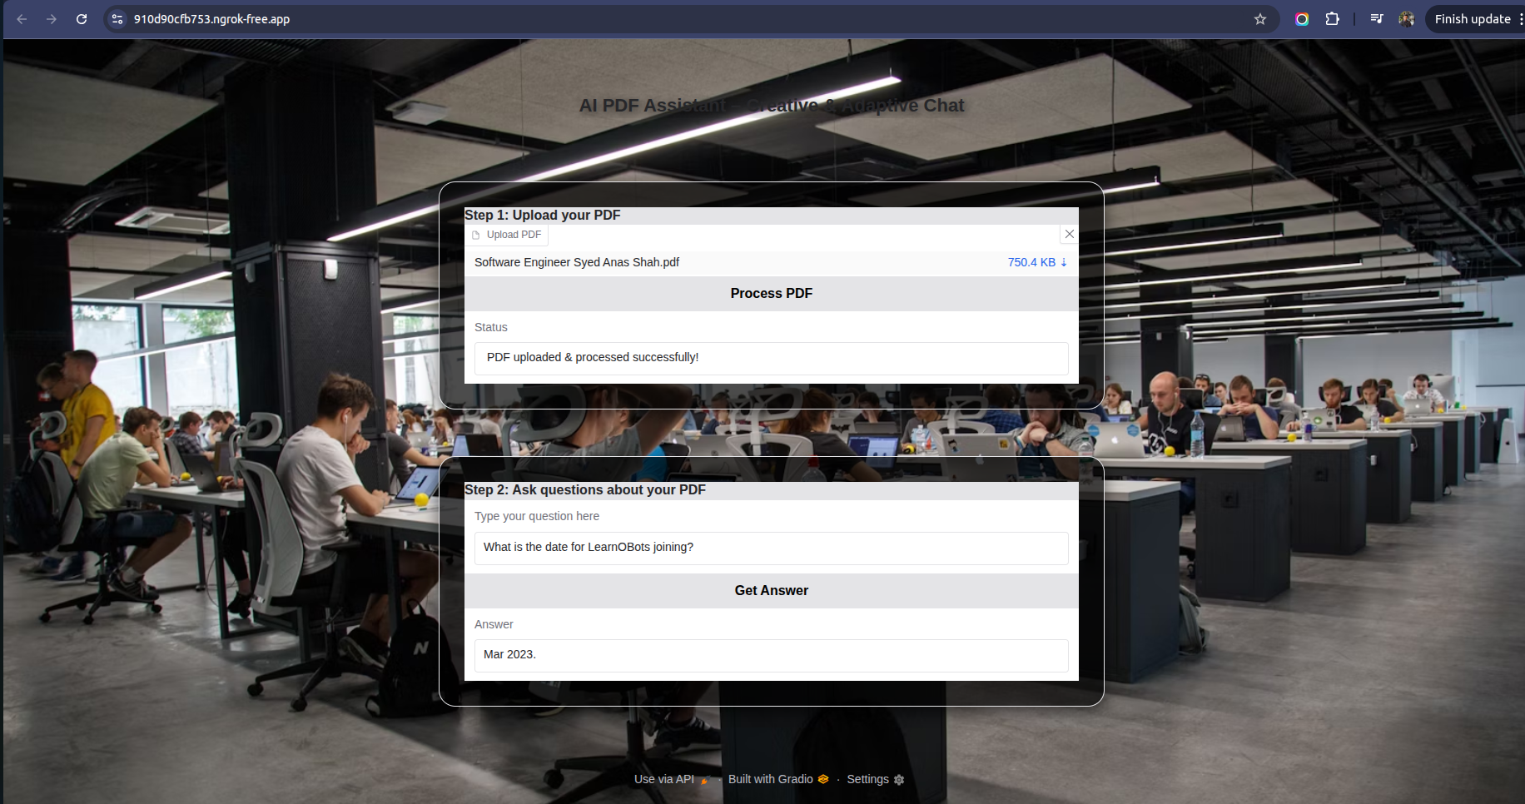
Gradio UI - PDF Upload

Slide 11
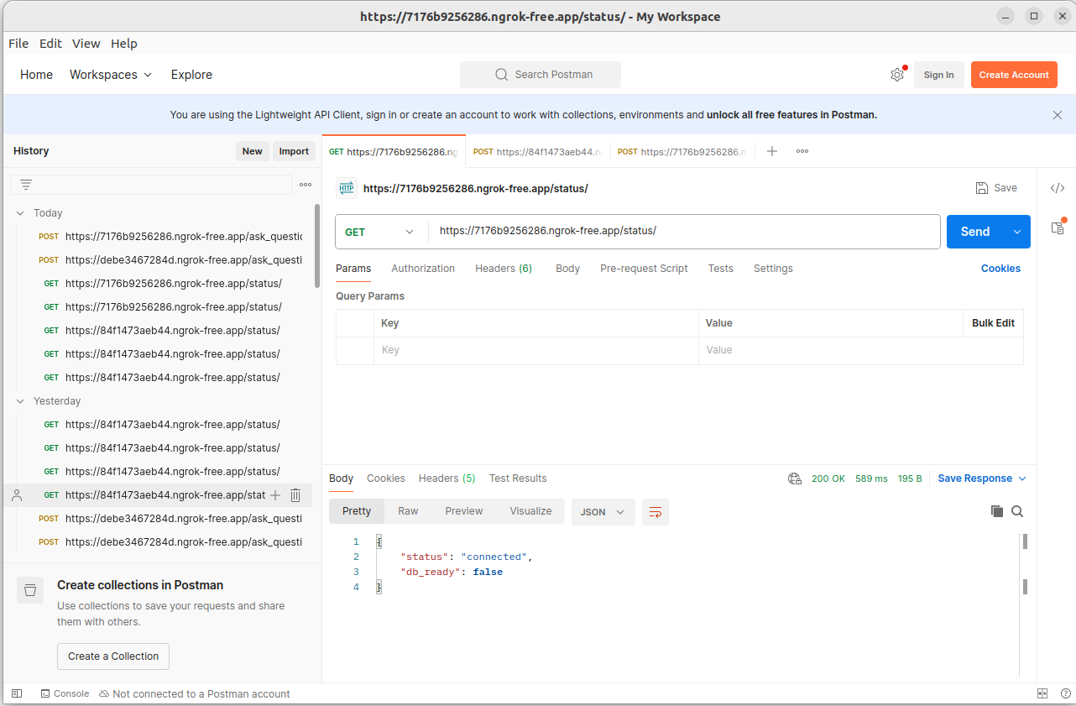
FastAPI Status Check

Slide 12
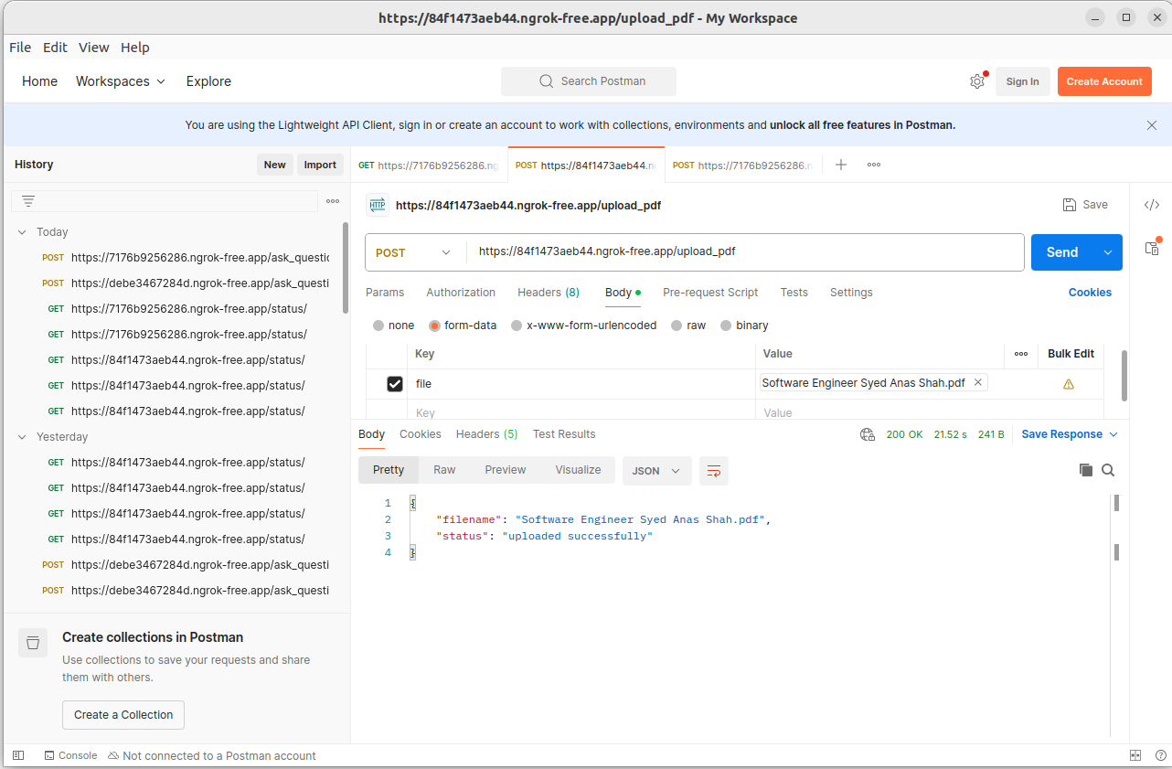
FastAPI PDF Upload

Slide 13
Key Features
- Adaptive answering (factual vs creative)
- Scalable architecture
- GPU acceleration supported
- Dual interface: Gradio UI & FastAPI API

Slide 14
Challenges Faced
- Extracting clean text from scanned PDFs
- Managing large documents efficiently
- Balancing accuracy vs speed
- Handling GPU/CPU deployment differences

Slide 15
Future Improvements
- Support scanned PDFs (OCR)
- Add multi-document support
- Integrate more powerful LLMs (LLaMA, GPT)
- Enhance UI with chat history & file management

Slide 16
Conclusion
This project demonstrates how to build an AI-powered PDF Assistant:
- Combines embeddings + LLM for accuracy
- Runs on GPU for speed
- Flexible deployment (Colab, Local, Docker)
- Practical real-world use cases (education, research, business)

Slide 17
Thank You!
Questions & Discussion

