Slide 1


Slide 2
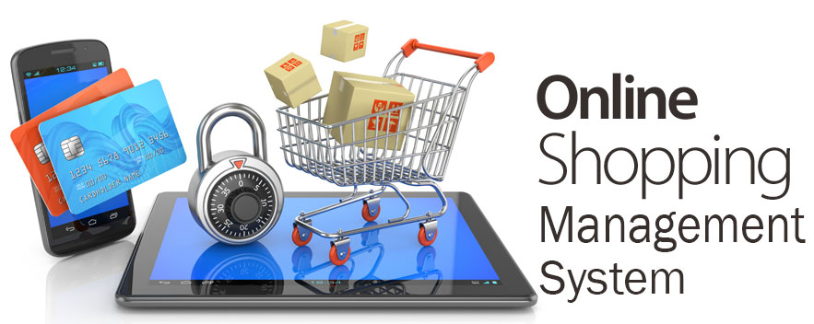

Slide 3
Project Developed By
Name | ID
Syed Ariful Islam Emon | P-201502302
Nirjhar Mazumder | P-201502305
Md. Masud Shikder | P-201502306

Slide 4
Project Supervised By
Md. Saiful Islam Shuvo Software Engineer LumexTech Solutions Ltd. Course Instructor Bangladesh Computer Council

Slide 5
Introduction
Can be controlled and accessed from anywhere by its respective users and administrators which will make the task of managing online shopping easier.
Another advantage of this system is that it does not require any installation and modification of system files to access.
Basically the target of this system is to given facilities to the customers so that they can shopping from home by ordering and paid by online.

Slide 6
Objectives
1. To enable administrator to access the system from anywhere. 2. To manipulate data precisely. 3. To abate data redundancy and pruning ambiguous data. 4. To secure the information and obstruct the access of unauthorized persons. 5. To enable customers to get an overview frequently about the products. 6. Reduce Human Work.

Slide 7
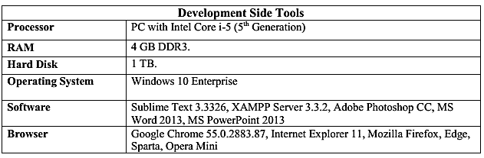
Development
The front end comprised with- HTML, CSS, Java Script, Bootstrap, jQuery (JavaScript Framework) In the back end we have a server which is designed and manipulated by- PHP OOP MYSQL

Slide 8
Challenges
To design UI
To Create User Login
To store data from UI
To show previous data
Report writing

Slide 9
Main Features
➢ Ordering and payments completed in real time ➢ Easy to administer ➢ Database driven ➢ Mass entry and updating of product and category information ➢ Easy to use for visitors and customers ➢ Complete product list including product prices and links to each product page ➢ Automatic calculation of shipping charges - customer can determine freight cost before commencing checkout process. ➢ Payment and invoicing completed in real time.
➢ Highly extensible.

Slide 10
Benefits
• It’s a web-enabled project.
• Increase the efficiency, accuracy and transparency.
• To Secure Information.
• Attractive and interesting
• Highly Automated
• Highly extensible - unlimited number of products
• Customers can choose and order products easily from this site only by registering.
• Customers can cancel orders within a limited time if any problem occurs.

Slide 11
Limitations
I. Cannot generate report yet.
II. Customer can’t pay in online. Pay pal (Credit/Debit card) system is not available. III. Quantity alert message to admin. IV. Discount for maximum sell. V. Best seller list, automatic updated. VI. 10% discount on next purchase. VII. Message will be sent automatically to customer email for upcoming product VIII. A message will be sent to admin about higher sells Products
XI. Unable to search product.

Slide 12
Future Enhancement of Our Project
I. Automatic notification of customer’s conduct to the administrator.
II. Our system privacy will be hard & more secure when we open a bank account & add PayPal system so that customer do not feel unsecure.
III. When our any product will become less than 5 then an alert message will automatically send to admin.
IV. Report either can be export in pdf or excel file or print directly by printer.
VI. To Develop UI & database.

Slide 13
Conclusion
The target of this system is to given facilities to the customers so that they can shopping from home by ordering and paid by online.
This website is not totally dynamic but it is extendable.
We have tried our best to build a website which is secure, dynamic, extendable and reusable.
There still have the opportunity to add other features that are not mentioned here.

Slide 14

Have Any Question

Slide 15


