Slide 1



Exploratory Data Analysis – Retail Author: Syed Arsalan Amin
View in Power BI
Main Objectives
● Perform ‘Exploratory Data Analysis’ on dataset ‘SampleSuperstore’
● As a business manager, try to find out the weak areas where you can
work to make more profit.
● What all business problems you can derive by exploring the data?

Slide 2
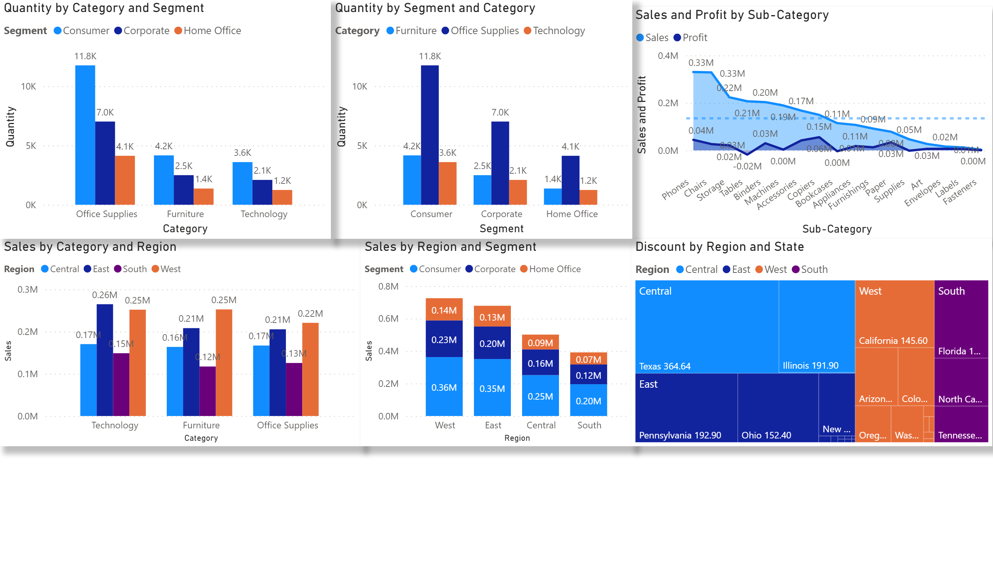
Page 1
Notes:
areaChart
No alt text provided.
columnChart
No alt text provided.
clusteredColumnChart
No alt text provided.
treemap
No alt text provided.
clusteredColumnChart
No alt text provided.
clusteredColumnChart
No alt text provided.

