Slide 1
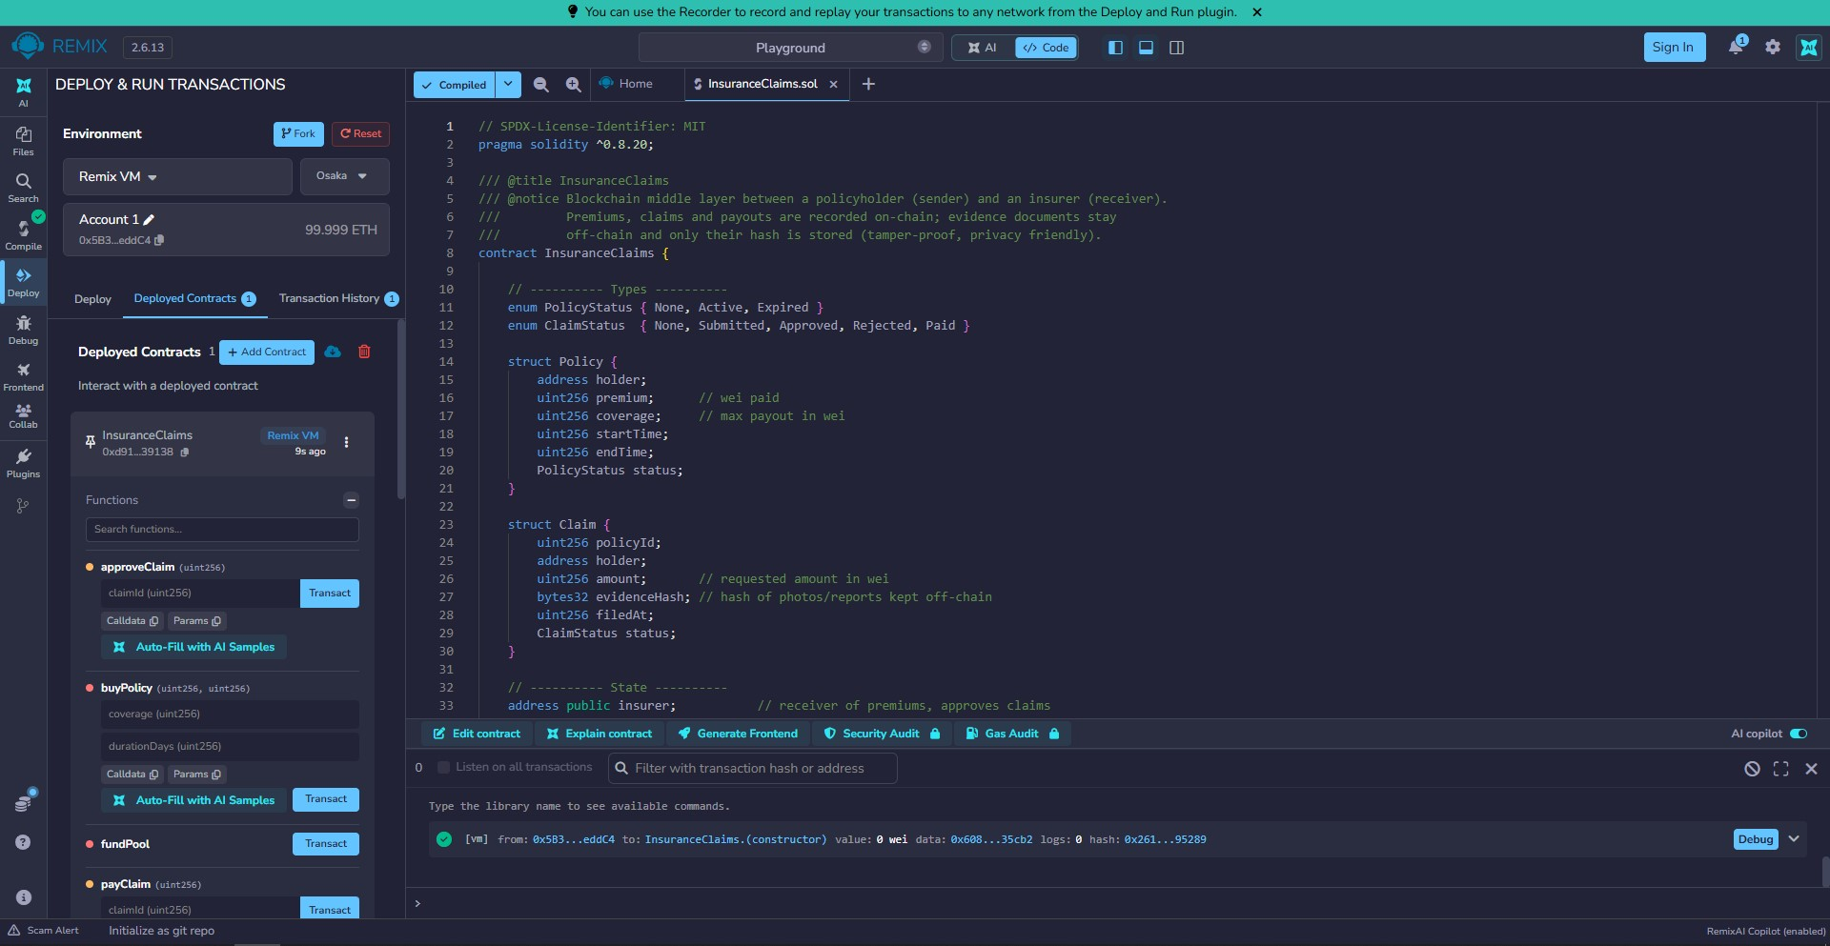
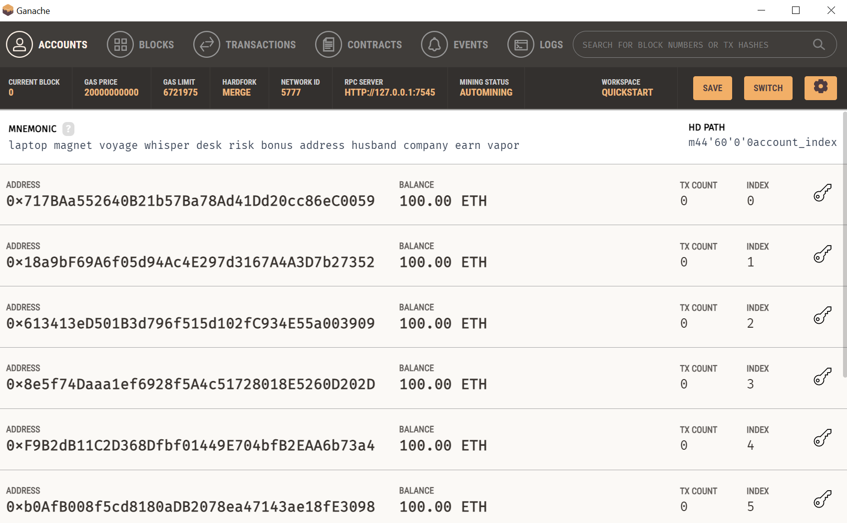
Blockchain-Based Insurance Claims
Name: Syed Arslan Haider | Student No. 2024409
CCT College Dublin | BSc (Hons) Computing & IT
GitHub: https://github.com/SyedArslan2024409/CA1-Distributed-Digital-Transactions
A smart contract as the trusted middle layer between policyholder and insurer
1
The Problem
4
Solution Architecture
6
Smart Contract Features
Many parties keep separate records
Claims take days or weeks
Fraud and disputes are hard to prove
Policyholder (sender)
buys policy, files claim
Insurer (receiver)
funds pool, pays claim
buyPolicy pay the premium
submitClaim file claim with hash
approveClaim assessor decides
payClaim automatic payout
verifyEvidence check a file hash
2
What Blockchain Changes
Smart Contract (middle layer)
rules + money + audit trail
 | Today | Blockchain
Records | Separate copies | One shared ledger
Payout | Manual, slow | Automatic
Evidence | Paper, editable | Hash on chain
Audit | Slow | Instant
7
Testing: Remix + Ganache
Assessor
approves or rejects the claim
Screenshot:
Deploy
5
Cryptography: SHA-256 + Signatures
A hash is a fingerprint of the evidence file; any change gives a new hash
Only the hash goes on-chain: private and cheap
ECDSA signatures prove who sent each transaction
Result: Submitted, Approved, Paid. Unauthorized calls are blocked.
3
Business Model
Insurer earns premiums and cuts admin and fraud costs
Small service fee per policy
Next step: oracles for parametric cover, such as flight delay
8
Benefits and Challenges
Benefits
Challenges
Transparent
Fast payout
Tamper-proof
Privacy and GDPR
Contract bugs
Regulation
Evidence file
SHA-256
Hash on chain

