Slide 1
Deepfakes
Jawwad A Shamsi

Slide 2


Slide 3
What is Deepfake
A synthetic Media
In which a person in an existing image or video is replaced with a fake image or a fake video

Slide 4
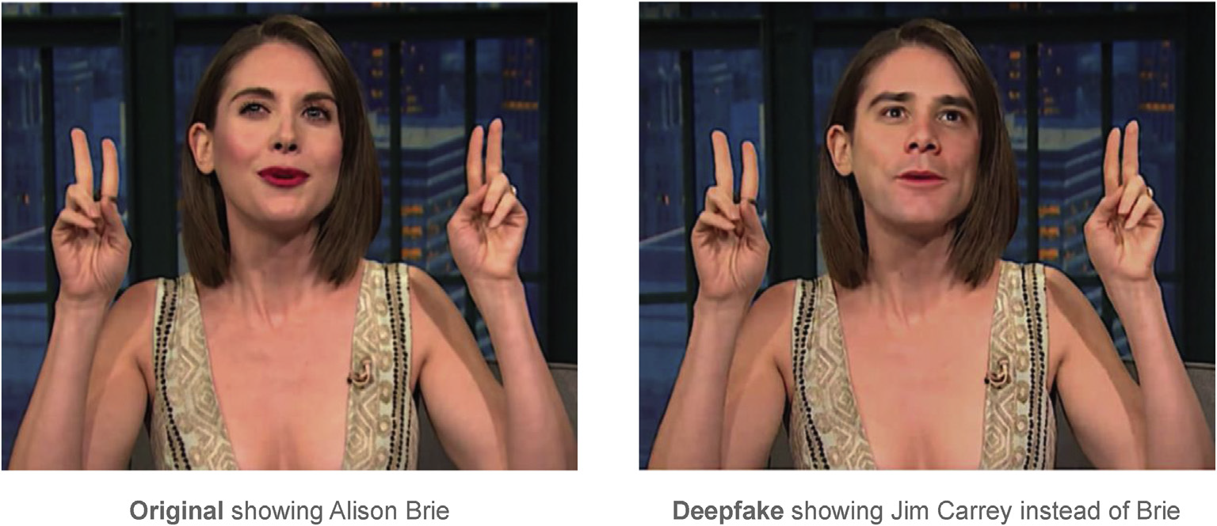

Slide 5
Deepfakes: Example
a screenshot
of Alison Brie from the original talk show
interview on the left,
and on the right is a frame
from the resulting deepfake video featuring Brie’s
body with Carrey’s face.

Slide 7
Three Steps
The region of the image showing Brie’s face was extracted from an original movie frame;
Using DNN, this image was then used to automatically generate a matching image showing Carrey instead (Step 2); and
This generated face was then inserted into the original reference image to create the deepfake.

Slide 8
Auto Encoder
Based on a given, large set of input images (e.g., all depicting Alison Brie), an autoencoder is trained to recognize key characteristics of a face and subsequently recreate input images as its output.

Slide 9
Three Steps
Encoder: Recognize a comparably small number of facial characteristics in the input
Latent Space:
Decoder: Generate real-looking faces as output

Slide 11
Encoder
It takes tens of thousands of pixels and compresses them into typically 300 measurements that relate to particular facial characteristics.
whether the eyes are open or closed,
the head pose, the emotional expression, the eye expressions,
ambient light, or skin colore

Slide 12
Latent Space
Information bottlenecks
Learn General facial Characteristics
For the autoencoder, this bottleneck is needed so that the network can learn more general facial characteristics rather than memorizing all input examples of specific people.

Slide 13
Decoder
the purpose of the decoder is to decompress 300 measurements in order to reconstruct an image as truthfully as
possible.

Slide 14
Problem
every point in the latent space corresponds to an image of a given person.
Which point in this vast space of nearly infinite possibilities will correspond to the image we desire.

Slide 15
The deepfake trick
The trick for creating deepfakes is to set up the structure of the autoencoder in a way that an image of another person can act as a guide to help find the specific combination of measurements that yields the desired image

Slide 16
The deepfake trick (2)
The trick to making this possible is using the same shared encoder for both people. In the encoding process, the DNN selects 300 measurements it deems meaningful based on the training images for each person. If images of two people are compressed on separate encoders different features would be seen as meaningful and we could not combine them in a valuable way

Slide 18
The deepfake trick(3)
The autoencoder trick is to train two autoencoders, each with a person-specific decoder, using the exact same encoder. This encoder will learn to use general features that the faces of both people have in common.

Slide 19
The deepfake trick(4)
This allows for similar pictures of two different people to be positioned in a similar location of the latent space. For example, pictures showing either a smiling Carrey or Brie will lead to very similar measurements, or unit activations, in the latent space

Slide 20
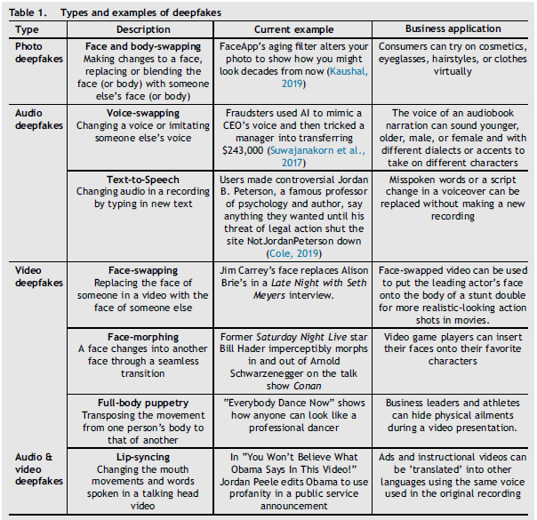

Slide 21
Positives: In movies
voice dubbing
fix misspoken lines or make script changes
without rerecording footage
create seamless dubs of actors speaking different languages.
Stunt doubles can be created
Actors can look older or younger with the use of deepfakes
instead of time-consuming make-up.

Slide 22
Negatives
the entire dubbing and re-voicing industry, which has long translated movies so that the new words match the original lip movement of the actor, is endangered and at risk of becoming extinct now that languages and lips can be changed.

Slide 23
Negatives (2)
anyone with deepfake technology can make a powerful politician an artificial intelligence (AI) puppet and make them say things, which they may have never said in real life.

Slide 24
Malicious usage
President Obama video for President Donald Trump
deepfake audio was used toscam a CEO of a UK-based energy firm and robbedC220,000
Real video of US speaker, believed to be appear as fake.

Slide 25
How to detect
Pay attention to the face. High-end DeepFake manipulations are almost always facial transformations.
· Pay attention to the cheeks and forehead. Does the skin appear too smooth or too wrinkly? Is the agedness of the skin similar to the agedness of the hair and eyes? DeepFakes are often incongruent on some dimensions.
· Pay attention to the eyes and eyebrows. Do shadows appear in places that you would expect? DeepFakes often fail to fully represent the natural physics of a scene.
· Pay attention to the glasses. Is there any glare? Is there too much glare? Does the angle of the glare change when the person moves? Once again, DeepFakes often fail to fully represent the natural physics of lighting.

Slide 26
How to detect(2)
· Pay attention to the facial hair or lack thereof. Does this facial hair look real? DeepFakes might add or remove a mustache, sideburns, or beard. But, DeepFakes often fail to make facial hair transformations fully natural.
· Pay attention to facial moles. Does the mole look real?
· Pay attention to blinking. Does the person blink enough or too much?
· Pay attention to the size and color of the lips. Does the size and color match the rest of the person's face?

Slide 27
Conclusion
Emerging topic
Lots of Challenges and Opportunities

Slide 28
References
Deepfakes : Trick or Treat
Youtube video
https://www.youtube.com/watch?v=l82PxsKHxYc
The Emergence of Deepfake Technology: A Review. MIT Technology Review
Deepfake Detection using Capsule Networks withLong Short-Term Memory Networks
Detect Deepfakes: Howto counteract. MIT Media
https://www.media.mit.edu/projects/detect-fakes/overview/

