Slide 1
GPT-3
Dr. Jawwad A Shamsi

Slide 2
Outline
What is GPT-3
GPT-3 Specifications
Models vs Parameters
Datasets for GPT-3
GPT-3 Accuracy
Applications of GPT-3

Slide 3
What is GPT-3
Generative Pre-Trained Transformer
A powerful third generation language model developed by OpenAI
Can easily understand and generate human-like text.
A pre-trained model

Slide 4
What is a Language Model
Given some text
It can predict what would be the next word
Example
Humans do not require large supervised datasets to learn more language tasks.
Generate Language in a probabilistic way

Slide 5
Specifications
175 billion parameters
45 TB text data
Wikipedia
Books
60% of data was taken from common crawl
Crawls website and provide dataset

Slide 6
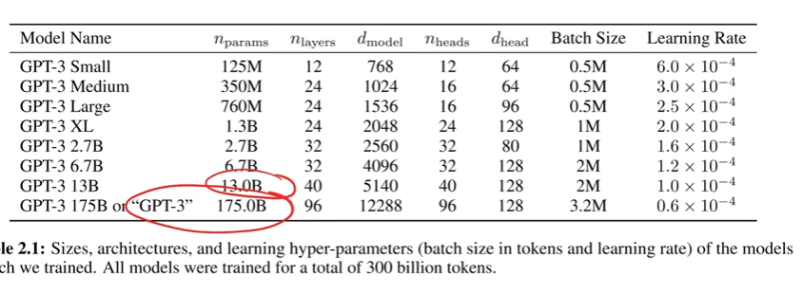

Slide 7
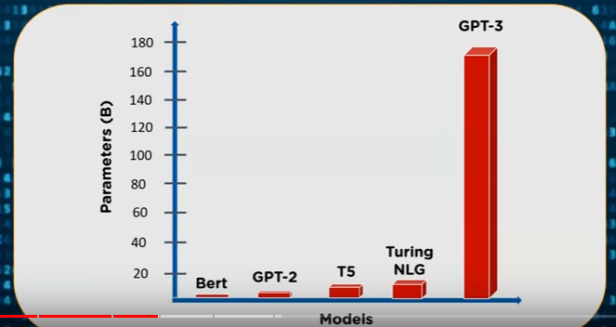
How it works
Statistical dependencies between words of dataset
It has 96 decoder layers and is built on a system with 285k cpu cores, 10K GPUs, and 400 GBPS for each GPU server.

Slide 8
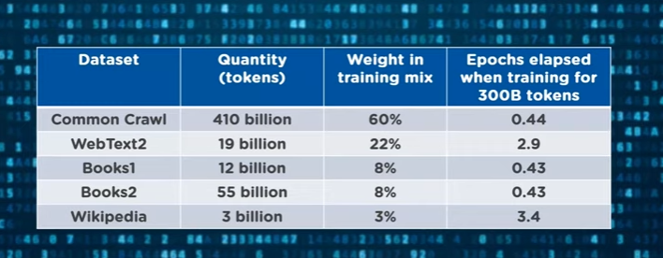
Datasets

Slide 9
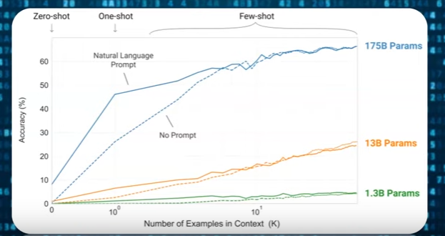
Accuracy vs no. of Parameters

Slide 10
Applications
Search Engine
Build ML mod
Create Resume
Writing SQL Queries

