Slide 1
Machine Learning
Syed Faizul Islam

Slide 2
Programming & Visualization Technologies
Cloud
Data Science
Data
ML Algorithm

Slide 3
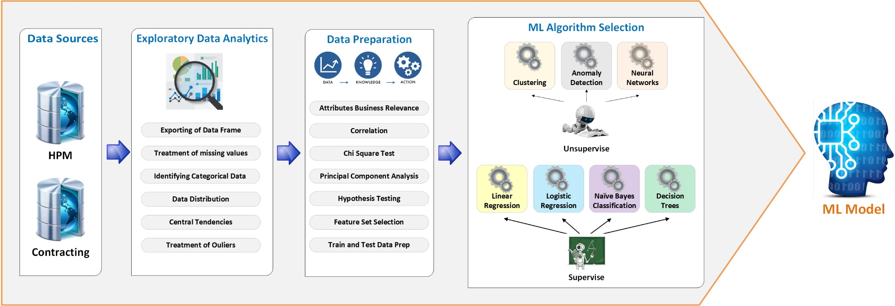

Slide 4
Data
EDA
Model
Api
Data Scientist: Handles EDA and Model training
Domain Expert: Helps Data Scientist in business understanding
ML Engineers: Essentially Full stack dev with decent understanding of Data science, Cloud and CI-CD

