Slide 1
QuantSight
FYP progress update
Syed
Supervisor meeting, 28 September 2026
1
Notes:
Opening (20 seconds): QuantSight is my FYP for predicting the direction of US stocks and ETFs over five trading sessions. This progress update focuses on the working application, the backtesting method, what the research actually shows and the remaining validation. The current system is a deployed prototype, with predictive performance still under evaluation.
Project evidence: SUPERVISOR_PROGRESS.md; PROJECT_CHEAT_SHEET.md. Status verified on 27 September 2026.

Slide 2
Project objective
Predict price direction over five trading sessions
Cover 44 US stocks and ETFs
Use price indicators and evaluate news sentiment
Support decisions with explanations and performance evidence
2
Notes:
Explain (30 seconds): The prediction target is whether the closing price will be higher after five trading sessions. Weekends and exchange holidays do not count as sessions. The application covers 44 instruments, including ETFs as well as individual stocks. An UP label means future close is greater than current close. The opposite class includes unchanged prices. The output is a directional probability, not an exact future price. The educational contribution includes explanations and honest performance evaluation.
Project evidence: PROJECT_CHEAT_SHEET.md sections 1 and 4; backend target and live prediction code.

Slide 3
Completed project improvements
Added backtesting, benchmarks and downloadable trade records
Clarified historical dates and improved the Dashboard
Compared VADER and FinBERT on matching observations
Configured five-session tracking and cloud deployment
3
Notes:
Explain (40 seconds): The current application includes Market and instrument detail views, an AI comparison page, the new Backtesting page, a model leaderboard and forward Track Record. Portfolio, learning Game, login/settings and chat features also exist, although account/game flows still need further user testing. Recent work added audited execution accounting, clarified historical data dates, introduced the controlled news study and aligned live forecasts to the five-session target. This is a progress summary, not a claim that the final model is already validated.
Project evidence: SUPERVISOR_PROGRESS.md section 2; docs/IMPROVEMENT_ROADMAP.md.

Slide 4
System and deployment
React + Vite on Vercel: interface and charts
Python + FastAPI on Render: API and inference
Supabase: accounts, PostgreSQL and live prediction log
GitHub: source code, automated checks and scheduling
Historical datasets and reports also live in backend files
4
Notes:
Explain (35 seconds): React with Vite builds the frontend and Vercel hosts it. The browser calls the Python FastAPI server on Render. Many historical datasets, models and reports are prepared files shipped with that server. Supabase provides PostgreSQL, authentication, account data and the forward-prediction log. GitHub stores the project and runs checks plus a scheduled prediction job. Render and Vercel follow GitHub deployments. Supabase SQL migrations remain a separate step. Local operation replaces Vercel/Render with two processes on the laptop.
Project evidence: PROJECT_CHEAT_SHEET.md sections 2 and 3; frontend/package.json; backend/main.py; .github/workflows/.

Slide 5
Models and techniques
Historical: XGBoost, LSTM, GRU, Random Forest, Logistic Regression and Transformer
12 variants plus a four-model ensemble
Live inference: finance-only XGBoost with calibration
Research: VADER and FinBERT news features
5
Notes:
Explain (45 seconds): Six historical model families have finance and finance-plus-sentiment variants, giving 12 variants. LSTM and GRU use attention pooling, while the Transformer Encoder uses self-attention. The four-model ensemble averages the two XGBoost and two LSTM probabilities. The current live model is only finance-only XGBoost with its saved feature list and calibration. Inputs include OHLCV, RSI, moving averages, MACD, volatility and volume measures. Sequence models use 10-session windows. VADER is a rule-based sentiment method. ProsusAI/finbert is a pretrained financial headline classifier. Their sentiment outputs become features in the separate controlled research classifiers. Calibration maps scores into probabilities using a separate calibration segment. Groq chat explains retrieved project data and is separate from numerical prediction.
Project evidence: PROJECT_CHEAT_SHEET.md sections 4-7; backend/train_xgboost.py; backend/train_lstm.py; backend/live_signals.py; docs/research/FINBERT_STUDY.md.

Slide 6
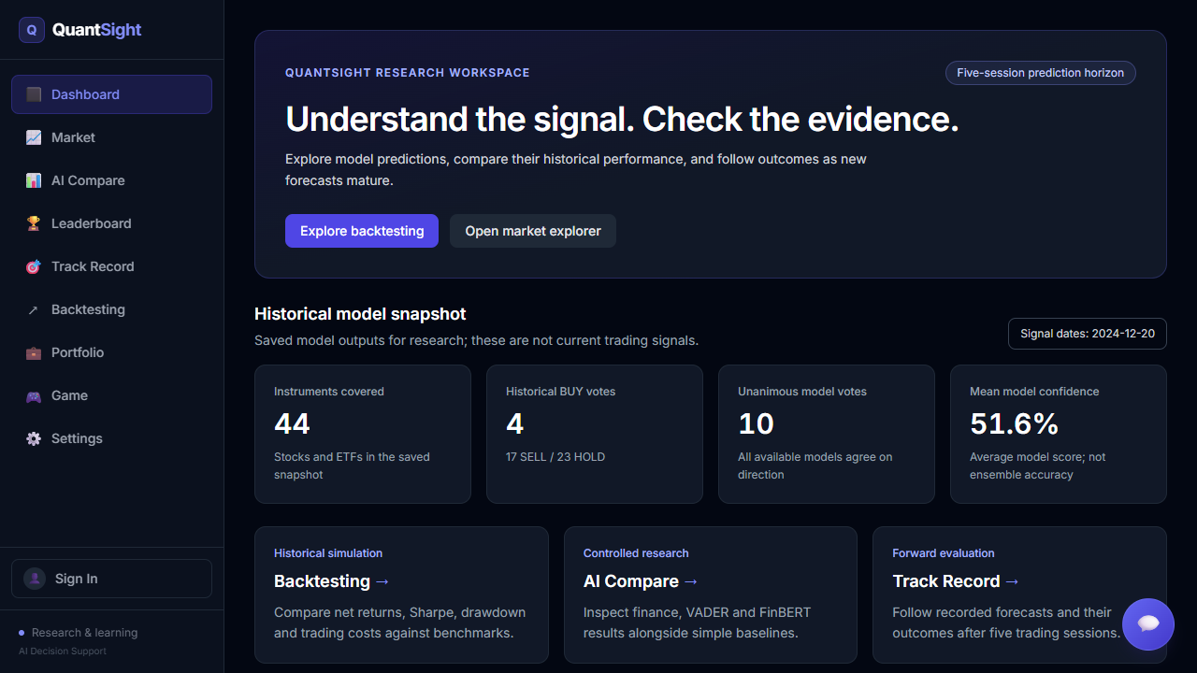
Interface improvements
Visible data dates
Clear research links
Mobile and error states
6
Notes:
Explain (30 seconds): This is an actual capture of the current Dashboard. The snapshot displays 20 December 2024 so it cannot be mistaken for current market predictions. The saved news archive has its own date, separate from the signals. Links lead to Backtesting, the controlled research comparison and forward tracking. The update also includes responsive layouts, metric explanations and independent retry states. Confidence values in the screenshot are model scores, not measured accuracy. The live demonstration can show the details at readable browser scale.
Project evidence: Actual local Dashboard screenshot, captured 28 September 2026: backend/data/research/supervisor_slides_20260928/dashboard.png. See docs/DASHBOARD_PROVENANCE.md.

Slide 7
Backtesting method
Previous-close signal, next-open execution
USD 100,000 start, weekly rebalance, five slots
0.15% trading cost per side, including slippage
15 portfolios with SPY and equal-weight benchmarks
Historical simulation: 22 February 2023 to 20 December 2024
7
Notes:
Explain (50 seconds): Start with USD 100,000 and use weekly rebalancing with five slots. The policy buys long positions or holds cash, with no leverage. Model target weights have a 25% cap and can drift between rebalances. The signal comes from the previous close and trading occurs at the next open. This avoids using the execution day information to choose that same trade. The simulator maintains fractional shares and cash across overnight gaps, charges costs on changed notional and charges final liquidation. Commission is 10 basis points plus 5 basis points of slippage per side, totalling 0.15% for each buy or sell. Cash/risk-free rate is assumed 0%. It compares 12 variants and an ensemble with SPY and equal weight, making 15 portfolios. Exported ledgers support independent replay.
Project evidence: docs/BACKTESTING.md; backtest run 20260926T102301904516Z; notebooks/15_backtesting.py.

Slide 8
Historical backtest results
22 Feb 2023 to 20 Dec 2024, after trading costs
Strategy | Net return | Sharpe | Max drawdown
Four-model ensemble | 61.98% | 1.444 | -17.80%
SPY | 51.69% | 1.888 | -9.97%
Equal weight | 42.89% | 1.524 | -11.48%
Ensemble: higher return, lower Sharpe, deeper drawdown
Exploratory results from a reused evaluation period
8
Notes:
Explain (60 seconds): These figures cover 462 trading sessions with trading costs included. The four-model ensemble has the highest return among these three rows, but SPY has a higher Sharpe ratio and shallower drawdown. The ensemble therefore does not dominate the benchmark. Maximum drawdown means the worst fall from a previous portfolio peak. The evaluation period has already influenced model development, so the figures are exploratory. At a higher cost assumption of 0.30% per side, the ensemble return falls to around 41.03%, below SPY under the same cost assumption. Independent replay reproduces all 15 portfolio equity series within USD 0.000001, which validates the accounting rather than removing research bias. Avoid presenting the best historical model as a confirmed future winner.
Project evidence: docs/SUPERVISOR_PROGRESS_2026-09-28.md; docs/BACKTEST_FIRST_RUN.md; published backtest run 20260926T102301904516Z.

Slide 9
How project success is measured
Accuracy and Brier loss: direction and probability quality
Sharpe ratio: return relative to volatility
Drawdown: worst loss from a previous peak
Net return, costs and reliability: practical usefulness
Compare with simple baselines and report uncertainty
9
Notes:
Explain (40 seconds): Accuracy measures correct UP/DOWN calls. Balanced accuracy gives both directions equal importance. Brier loss evaluates probability errors and lower is better. Calibration asks whether events assigned 70% probability occur approximately 70% of the time. Sharpe divides average excess daily return by daily volatility and annualizes it using the square root of 252, with a 0% risk-free assumption here. Maximum drawdown measures loss from a peak. Sortino focuses on downside variability, while Calmar compares annualized growth with drawdown. Net return includes costs. We also assess stability across periods, uncertainty, response time and user task completion. No single score proves project success, and final thresholds should be agreed before the final test.
Project evidence: PROJECT_CHEAT_SHEET.md sections 8, 10 and 14; docs/BACKTESTING.md metrics definitions.

Slide 10
Data audit found a timing mismatch
Original finance panel ends in December 2024
WSB posts end in 2021, saved Dashboard news is from 2026
Text inputs are zero in the shared 2023-2024 test sample
Legacy model differences cannot establish a sentiment benefit
10
Notes:
Explain (45 seconds): The original finance panel ends in December 2024. WSB posts end in August 2021, while the saved GDELT Dashboard news is from 2026. In the shared 2023-2024 historical evaluation sample, the text feature values are all zero. Therefore differences between the older finance and sentiment model variants cannot demonstrate a benefit from contemporary sentiment. This finding motivated acquiring a separate historical news archive, excluding future-price fields and aligning availability timestamps conservatively. Finding and disclosing this issue is an important methodological improvement.
Project evidence: docs/research/RESEARCH_RECOMMENDATIONS.md; docs/research/FINBERT_STUDY.md; SUPERVISOR_PROGRESS.md section 4.

Slide 11
The news study did not beat the baseline
2023 exploratory evaluation, logistic regression comparisons
Inputs / baseline | Accuracy | Brier loss
Constant training prior | 55.23% | 0.247623
Finance only | 47.43% | 0.255580
Finance + VADER | 47.49% | 0.255890
Finance + FinBERT | 47.33% | 0.256194
Lower Brier loss is better
No evidence to replace the live model
11
Notes:
Explain (60 seconds): The study uses a historical news archive with 70,974 source rows and coverage of 26 of the 44 instruments. Models fit on 2017-2021, calibrate on 2022 and evaluate on the same 10,780 observations in 2023, including 3,658 observations with news. Five-session labels crossing split boundaries are purged. The table shows the logistic regression family, comparing finance alone with finance plus news coverage and VADER or FinBERT. The constant baseline uses training-period UP frequency. Lower Brier loss is better. FinBERT accuracy is slightly lower than the other logistic variants and the simple baseline is better. A gradient-boosting follow-up has a small Brier improvement versus VADER but still fails to beat the constant baseline. No model was promoted to live service. 2023 was already examined, so this is exploratory research rather than an untouched final test.
Project evidence: docs/research/FINBERT_STUDY.md; saved research run 0024c8e43e438b37; SUPERVISOR_PROGRESS.md section 4.

Slide 12
New data and validation preparation
135,545 price rows across 50 instruments
Complete 2025 coverage for all 50 instruments
Three purged development folds prepared
2025 remains a candidate final test, with no new scores
Next requirement: confirm that the final period has never guided model choices
12
Notes:
Explain (40 seconds): The frozen price snapshot contains 135,545 instrument-session rows across the existing 44 instruments and six additional sector ETFs. Every instrument has all 250 NYSE sessions for 2025. Development files and the candidate 2025 holdout are separate and hashed. Three purged development folds for 2022, 2023 and 2024 are prepared. Purging removes observations whose future target crosses into the following split. The preparation step has not fitted new models or produced 2025 accuracy scores. We still need to confirm whether 2025 was used previously before treating it as an untouched final test. Fixed-universe and retrospectively adjusted vendor-price limitations remain.
Project evidence: docs/research/FRESH_VALIDATION.md; snapshot 20260927T141409402344Z; PROJECT_CHEAT_SHEET.md section 7.

Slide 13
Deployment and forward tracking
Live site and local backup both work
72 Python tests and 11 database checks passed
Supabase v2 tracker is configured
No resolved v2 forecasts at the latest verified check
Live accuracy requires genuine forecasts and five-session outcomes
13
Notes:
Explain (40 seconds): The live site and main APIs passed read checks on 27 September. The local Dashboard, Backtesting and AI Compare also passed browser checks, including a report download. Latest completed automated checks include 72 Python tests, 11 database migration checks and a frontend build. These checks assess software behavior, not model accuracy. The Supabase v2 migration is applied and preserves the old table. At the latest verified snapshot on 27 September, there were zero logged and zero resolved v2 forecasts. Actual scheduled writes and matured fifth-session outcomes remain to be observed. Each genuine forecast is recorded with its model version, original inputs and target date. The evaluator waits for the exact fifth subsequent NYSE session and leaves missing outcomes pending.
Project evidence: docs/DEMO_VERIFICATION_2026-09-27.md; docs/LIVE_ROLLOUT.md; SUPERVISOR_PROGRESS.md section 5. Counts reflect the 27 September check.

Slide 14
Next development priorities
Verify scheduled forecasts and their actual outcomes
Freeze an unused final evaluation period
Run walk-forward experiments, then backtest after costs
Complete user testing and remaining interface checks
14
Notes:
Explain (45 seconds): First observe scheduled forecast writes and later verify the fifth-session resolution. In parallel, confirm and freeze an unused final evaluation period. Run time-ordered development experiments with feature selection and preprocessing fitted only on training data. Keep all trial results, compare to simple baselines and examine calibration and regime stability before choosing more complex architectures. Then backtest eligible new predictions after costs and compare risk against SPY. Complete remaining account/game checks, explanation fidelity checks, user testing and responsiveness improvements. Discuss the FYP acceptance criteria with the supervisor before opening the final holdout.
Project evidence: SUPERVISOR_PROGRESS.md section 9; docs/IMPROVEMENT_ROADMAP.md; docs/research/FRESH_VALIDATION.md.

Slide 15
Demonstration and supervisor feedback
Demo order: Dashboard, Backtesting, AI Compare
Agree on the final evaluation period and success criteria
Live website
quantsight.vercel.app
Local backup
http://127.0.0.1:3000
15
Notes:
Demo (1-2 minutes if time allows): Open the Dashboard and explain the historical date. Go to Backtesting, compare ensemble with SPY, and download the trade ledger or report. Open AI Compare and explain the baseline and the negative sentiment result. Warm both the hosted site and localhost before the meeting because the first request can be slow. The progress Markdown contains the two-terminal startup commands. The core saved-data pages work locally, while live prices, cloud sign-in/account sync and Groq chat need internet. Ask the supervisor whether the primary contribution should emphasize prediction quality, decision support or their comparison, and agree on the final evaluation protocol and deadline.
Project evidence: SUPERVISOR_PROGRESS.md sections 6-9; PROJECT_CHEAT_SHEET.md; docs/DEMO_VERIFICATION_2026-09-27.md.

